Slide 1
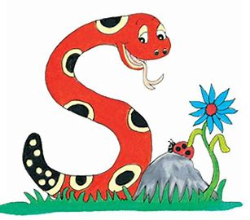
Jolly Grammar
4-31

Slide 2
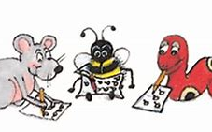
Spelling Test 31

Slide 3
prepare

Slide 4
prepare
prevent

Slide 5
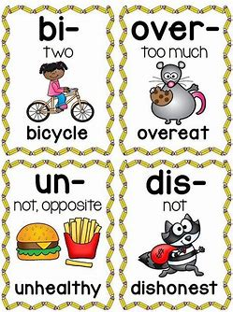
prepare
prevent
prefix

Slide 6
prepare
prevent
prefix

Slide 7
prepare
prevent
prefix
prevail
preview

Slide 8
prepare
prevent
prefix
prevail
preview
predict

Slide 9
prepare
prevent
prefix
prevail
preview
predict
7.precede

Slide 10
prepare
prevent
prefix
prevail
preview
predict
7.precede
8.premiere

Slide 11
prepare
prevent
prefix
prevail
preview
predict
7.precede
8.premiere
9.precedent

Slide 12
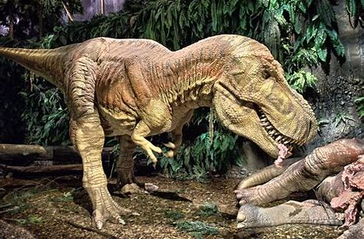
prepare
prevent
prefix
prevail
preview
predict
7.precede
8.premiere
9.precedent
10.prehistoric

Slide 13
prepare
prevent
prefix
prevail
preview
predict
7.precede
8.premiere
9.precedent
10.prehistoric
11.preference

Slide 14
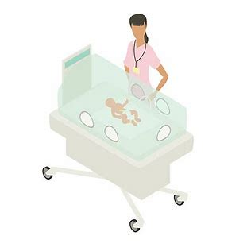
prepare
prevent
prefix
prevail
preview
predict
7.precede
8.premiere
9.precedent
10.prehistoric
11.preference
12.premature

Slide 15
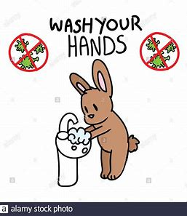
prepare
prevent
prefix
prevail
preview
predict
7.precede
8.premiere
9.precedent
10.prehistoric
11.preference
12.premature
13.previously

Slide 16
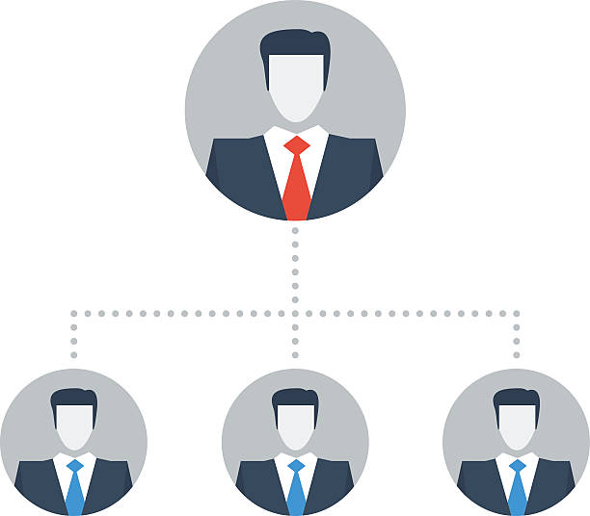
prepare
prevent
prefix
prevail
preview
predict
7.precede
8.premiere
9.precedent
10.prehistoric
11.preference
12.premature
13.previously
14.predecessor

Slide 17
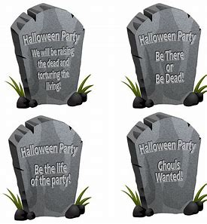
prepare
prevent
prefix
prevail
preview
predict
7.precede
8.premiere
9.precedent
10.prehistoric
11.preference
12.premature
13.previously
14.predecessor
15.prearrange

Slide 18
prepare
prevent
prefix
prevail
preview
predict
7.precede
8.premiere
9.precedent
10.prehistoric
11.preference
12.premature
13.previously
14.predecessor
15.prearrange
16.preliminary

Slide 19
prepare
prevent
prefix
prevail
preview
predict
7.precede
8.premiere
9.precedent
10.prehistoric
11.preference
12.premature
13.previously
14.predecessor
15.prearrange
16.preliminary
17.presumption

Slide 20
prepare
prevent
prefix
prevail
preview
predict
7.precede
8.premiere
9.precedent
10.prehistoric
11.preference
12.premature
13.previously
14.predecessor
15.prearrange
16.preliminary
17.presumption
18.precautionary

Slide 21
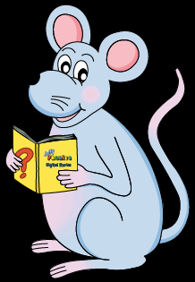
Let’s revise
Tenses.

Slide 22
I prepare dinner.
I shall be preparing dinner.
I prepared dinner.
He was walking the dog.
He will walk the dog.
He is walking the dog.

Slide 23
I prepare dinner. Simple present
I shall be preparing dinner.
I prepared dinner.
He was walking the dog.
He will walk the dog.
He is walking the dog.

Slide 24
I prepare dinner. Simple present
I shall be preparing dinner. Future continuous
I prepared dinner.
He was walking the dog.
He will walk the dog.
He is walking the dog.

Slide 25
I prepare dinner. Simple present
I shall be preparing dinner. Future continuous
I prepared dinner. Simple past
He was walking the dog.
He will walk the dog.
He is walking the dog.

Slide 26
I prepare dinner. Simple present
I shall be preparing dinner. Future continuous
I prepared dinner. Simple past
He was walking the dog. Past continuous
He will walk the dog.
He is walking the dog.

Slide 27
I prepare dinner. Simple present
I shall be preparing dinner. Future continuous
I prepared dinner. Simple past
He was walking the dog. Past continuous
He will walk the dog. Simple future
He is walking the dog.

Slide 28
I prepare dinner. Simple present
I shall be preparing dinner. Future continuous
I prepared dinner. Simple past
He was walking the dog. Past continuous
He will walk the dog. Simple future
He is walking the dog. Present continuous

Slide 29
Let’s learn
Infinitives.

Slide 30
Infinitives
to
to
to
to
cook
read
sing
dive
Jim decides to stay at home.

Slide 31
Infinitives
to
to
to
to
cook
read
sing
dive
Jim decides to stay at home.

Slide 32
Infinitives
to
to
to
to
cook
read
sing
dive
s
Jim decides to stay at home.

Slide 33
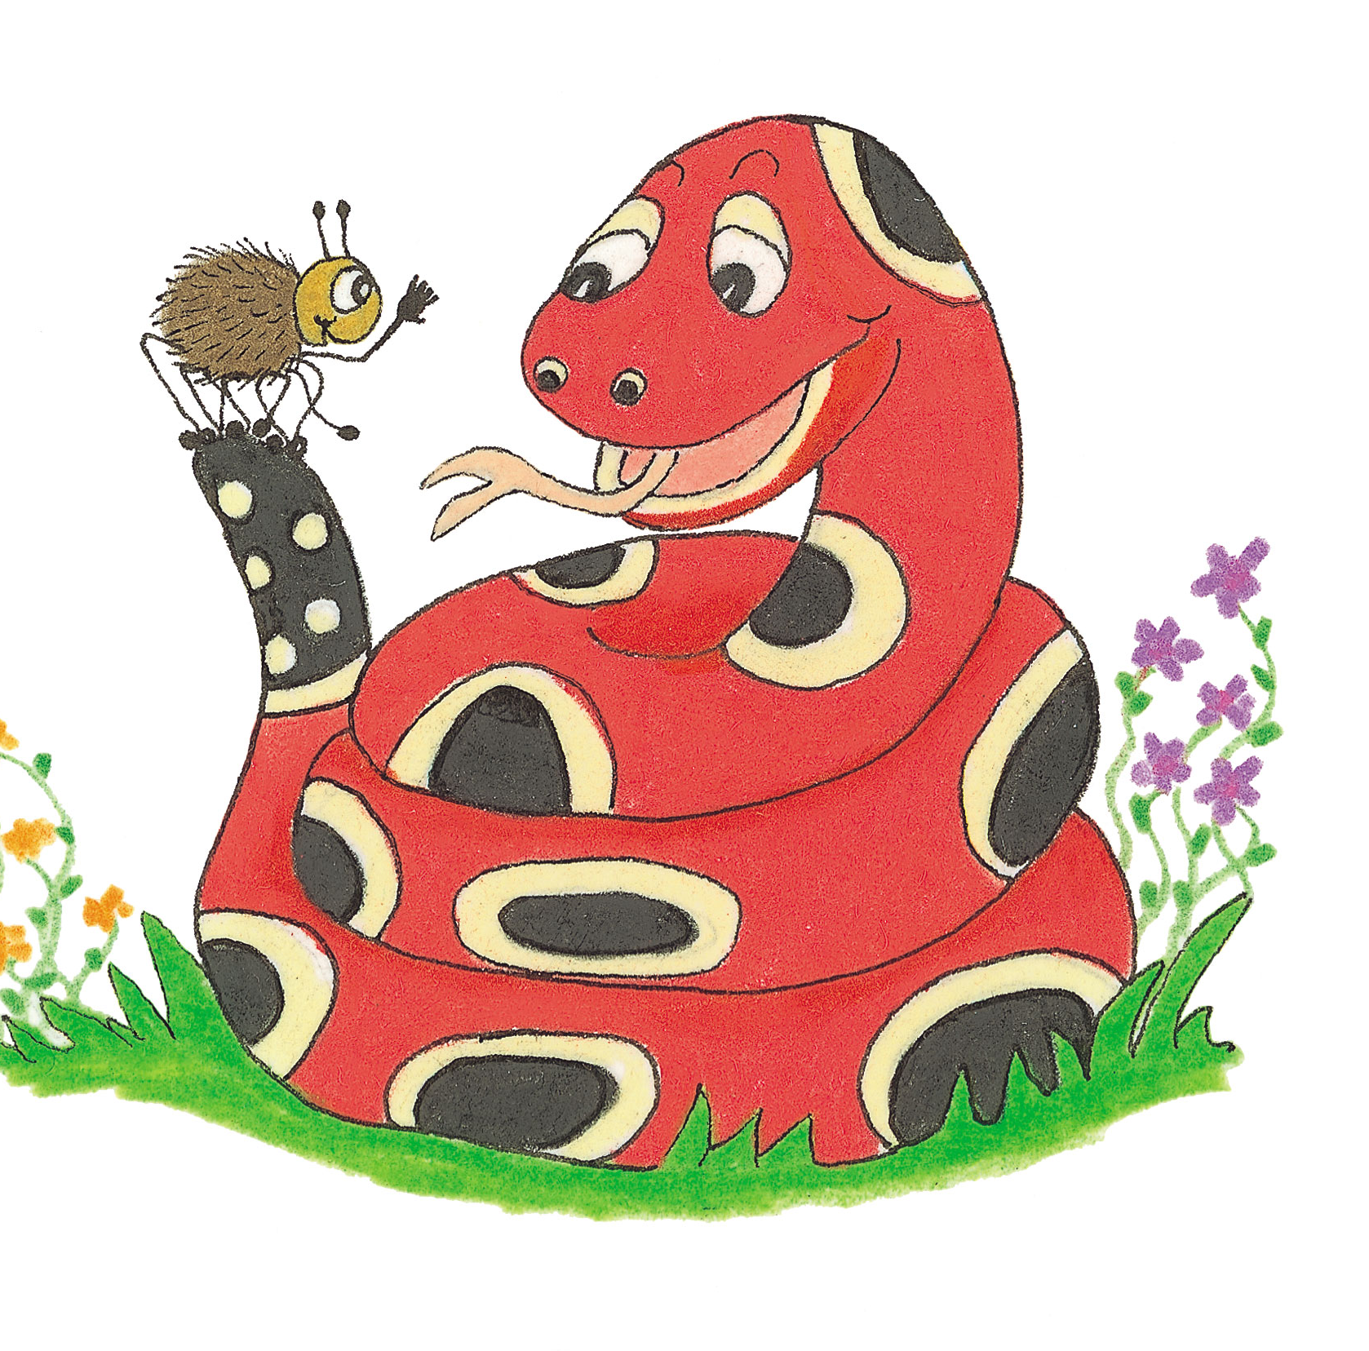
Activity Page
Grammar:
Infinitives

Slide 34
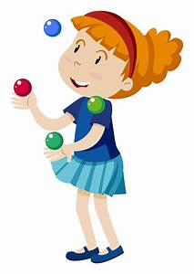
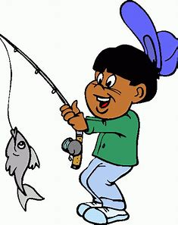
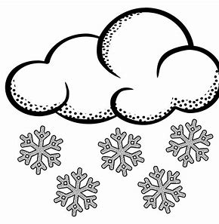
to fish to explode to snow to jungle

Slide 35
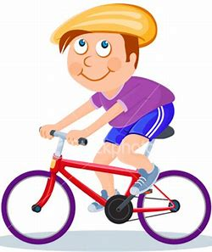
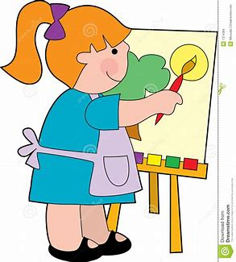
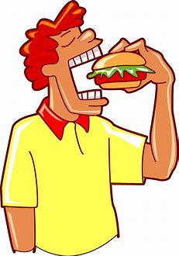
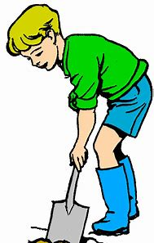
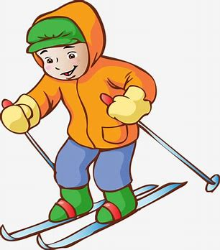
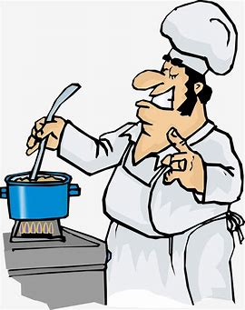
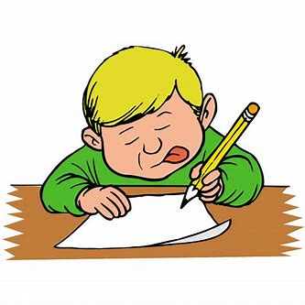
to cycle to paint to read to eat
to dig to write to ski to cook

Slide 36
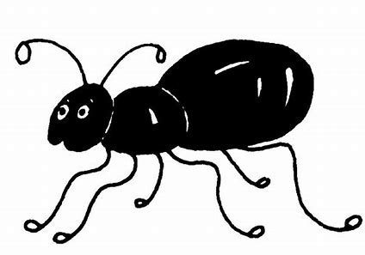
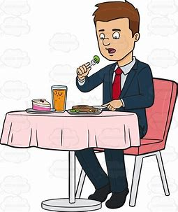
Identify the infinitive in each sentence and underline it in pencil. Then find the main verb and underline it in red. Put a box with a small <s> in the corner around the subject.
s
He preferred to eat at the new restaurant.

Slide 37
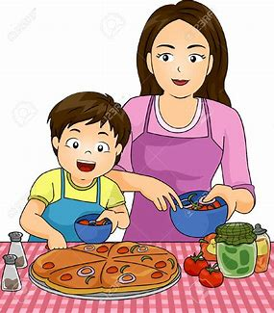
I will be helping to cook the dinner.

Slide 38
s
I will be helping to cook the dinner.

Slide 39
She demanded to speak to the manager.

Slide 40
s
She demanded to speak to the manager.

Slide 41
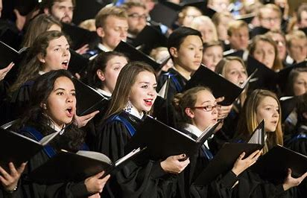
The student yearned to sing in the choir.

Slide 42
s
The student yearned to sing in the choir.

Slide 43
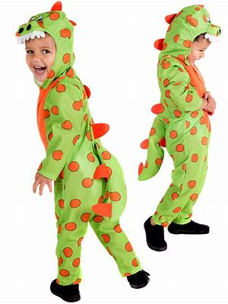
The children pretended to be dinosaurs.

Slide 44
s
The children pretended to be dinosaurs.

Slide 45
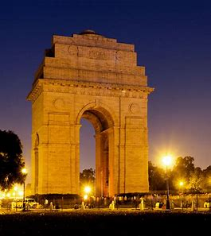
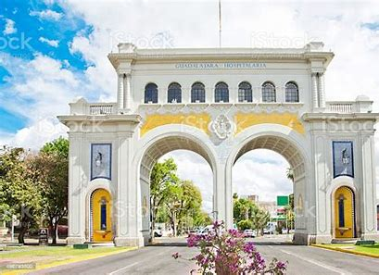
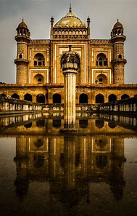
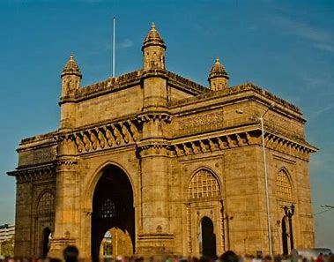
The tourist hoped to see many monuments.

Slide 46
s
The tourist hoped to see many monuments.

Slide 47
Thank you.
See you
next time!

