Slide 1
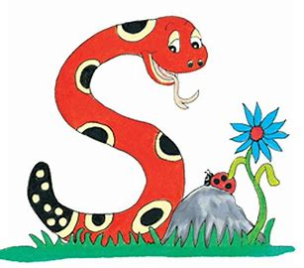
Jolly Grammar
4b-25

Slide 2
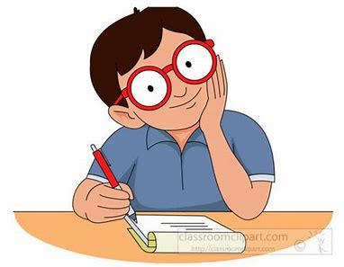
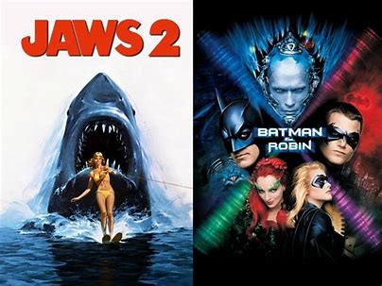
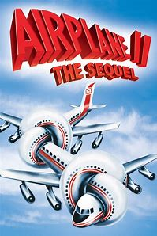
★
he will write a sequel to the novel

Slide 3
s
★
he will write a sequel to the novel

Slide 4
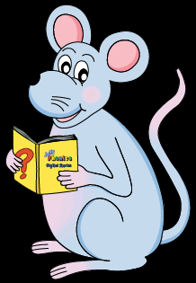
Let’s Review
Prefixes.

Slide 5
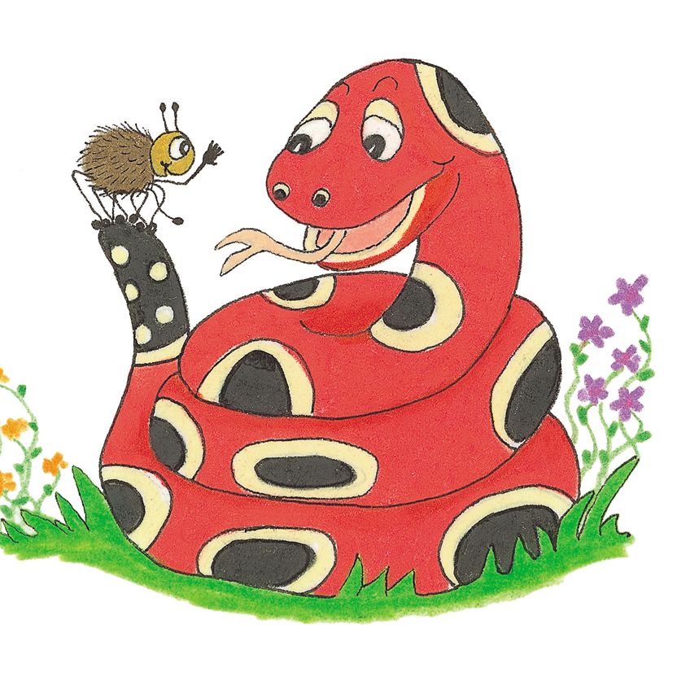
un | de | dis | mis | semi
unhappy unlucky undo unlock | decode decline | disappear disagree | misbehave mistake misunderstand | semifinal semicircle
im | non | re | mid | Good job!
impatient impossible immature | nonsense nonstop | rediscover refill | midnight midday

Slide 6
recycle

Slide 7
Activity Page
Spelling <pre->

Slide 8
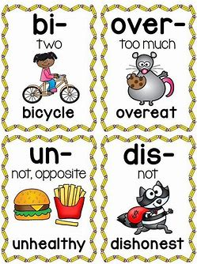
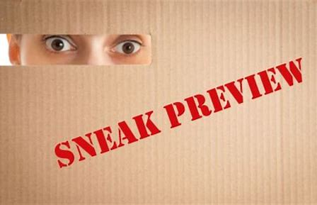
prepare prevent prefix
to make something ready, or to get ready for something
to stop something happening, or to stop someone doing something
A letter or some letters that are added at the beginning of a word to change its meaning.
prevail preview predict
to say that something will happen in the future

Slide 9
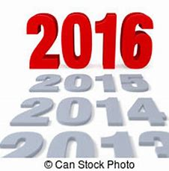
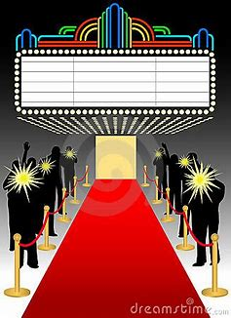
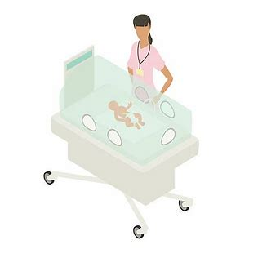
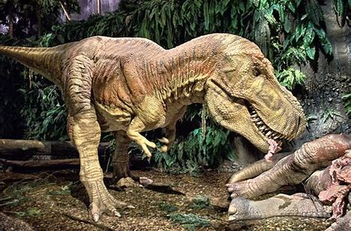
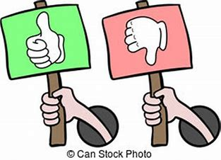
precede premiere precedent
prehistoric preference premature
From a very long time ago, before anything was written down

Slide 10
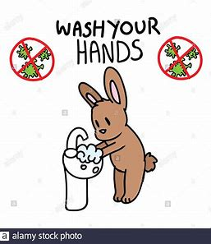
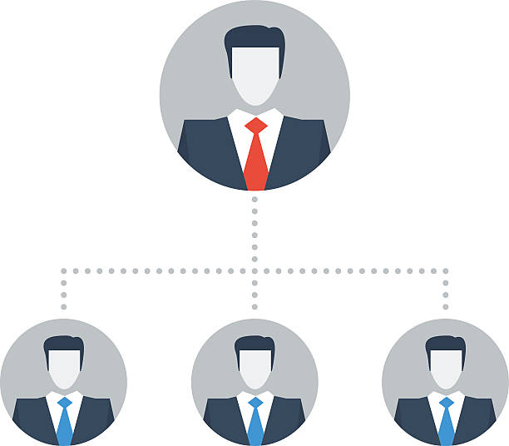
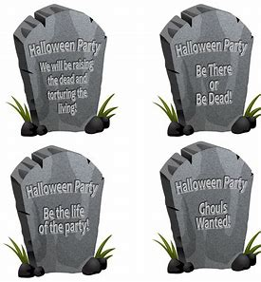
previously predecessor prearrange
Happening before something
preliminary presumption precautionary

Slide 13
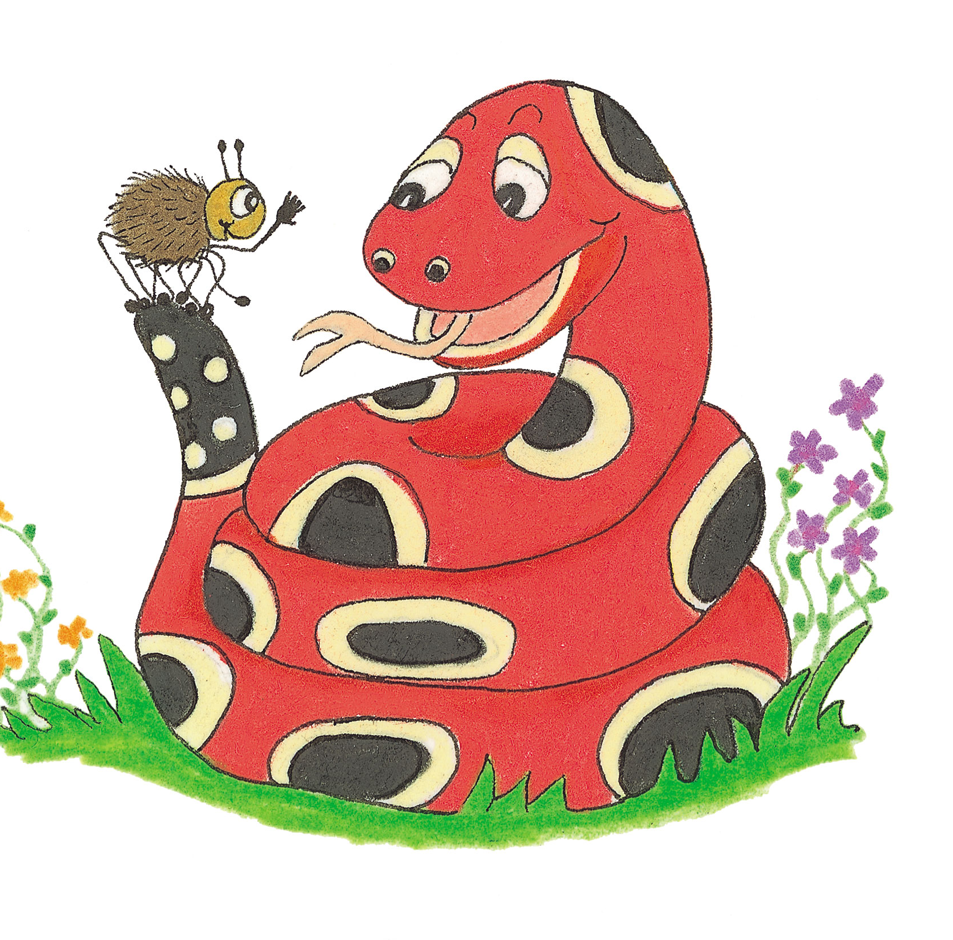
Activity Page
Spelling:
<pre->

Slide 14
parsing

Slide 15
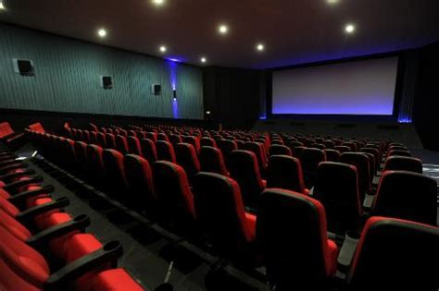
Delays were preventing the premiere of a controversial new play.

Slide 16
Delays were preventing the premiere of a controversial new play.

Slide 17
Delays were preventing the premiere of a controversial new play.

Slide 18
Delays were preventing the premiere of a controversial new play.

Slide 19
Delays were preventing the premiere of a controversial new play.

Slide 20
Delays were preventing the premiere of a controversial new play.

Slide 21
Delays were preventing the premiere of a controversial new play.

Slide 22
Delays were preventing the premiere of a controversial new play.

Slide 23
Delays were preventing the premiere of a controversial new play.
3rd person plural
Past continuous

Slide 24
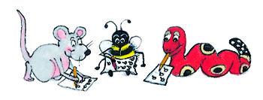
Dictation

Slide 25
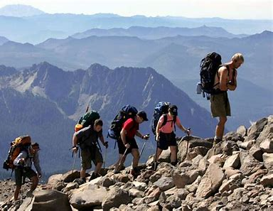

Slide 26
They prepared to ascend the majestic mountain.

Slide 27
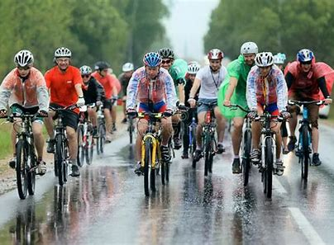

Slide 28
The cyclists had not predicted the abysmal weather.

Slide 29
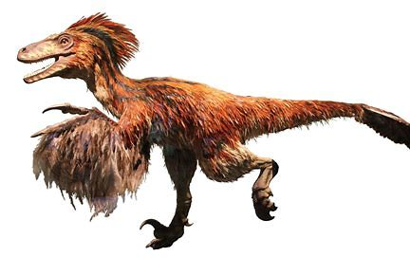
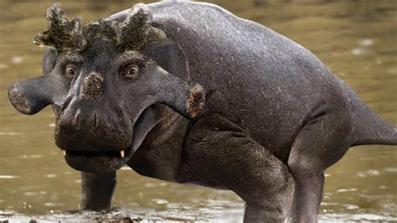

Slide 30
Prehistoric creatures preceded our modern animals.

Slide 31
Thank you.
See you
next time!

