Slide 1
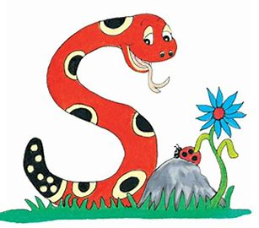
Jolly Grammar
4b-23

Slide 2
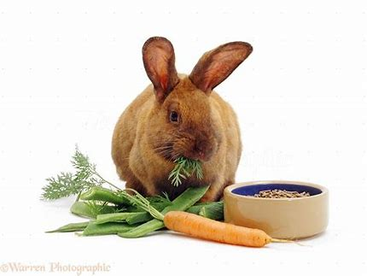
That young brown rabbit crunched
the tasty carrot.

Slide 3
That young brown rabbit crunched
the tasty carrot.

Slide 4
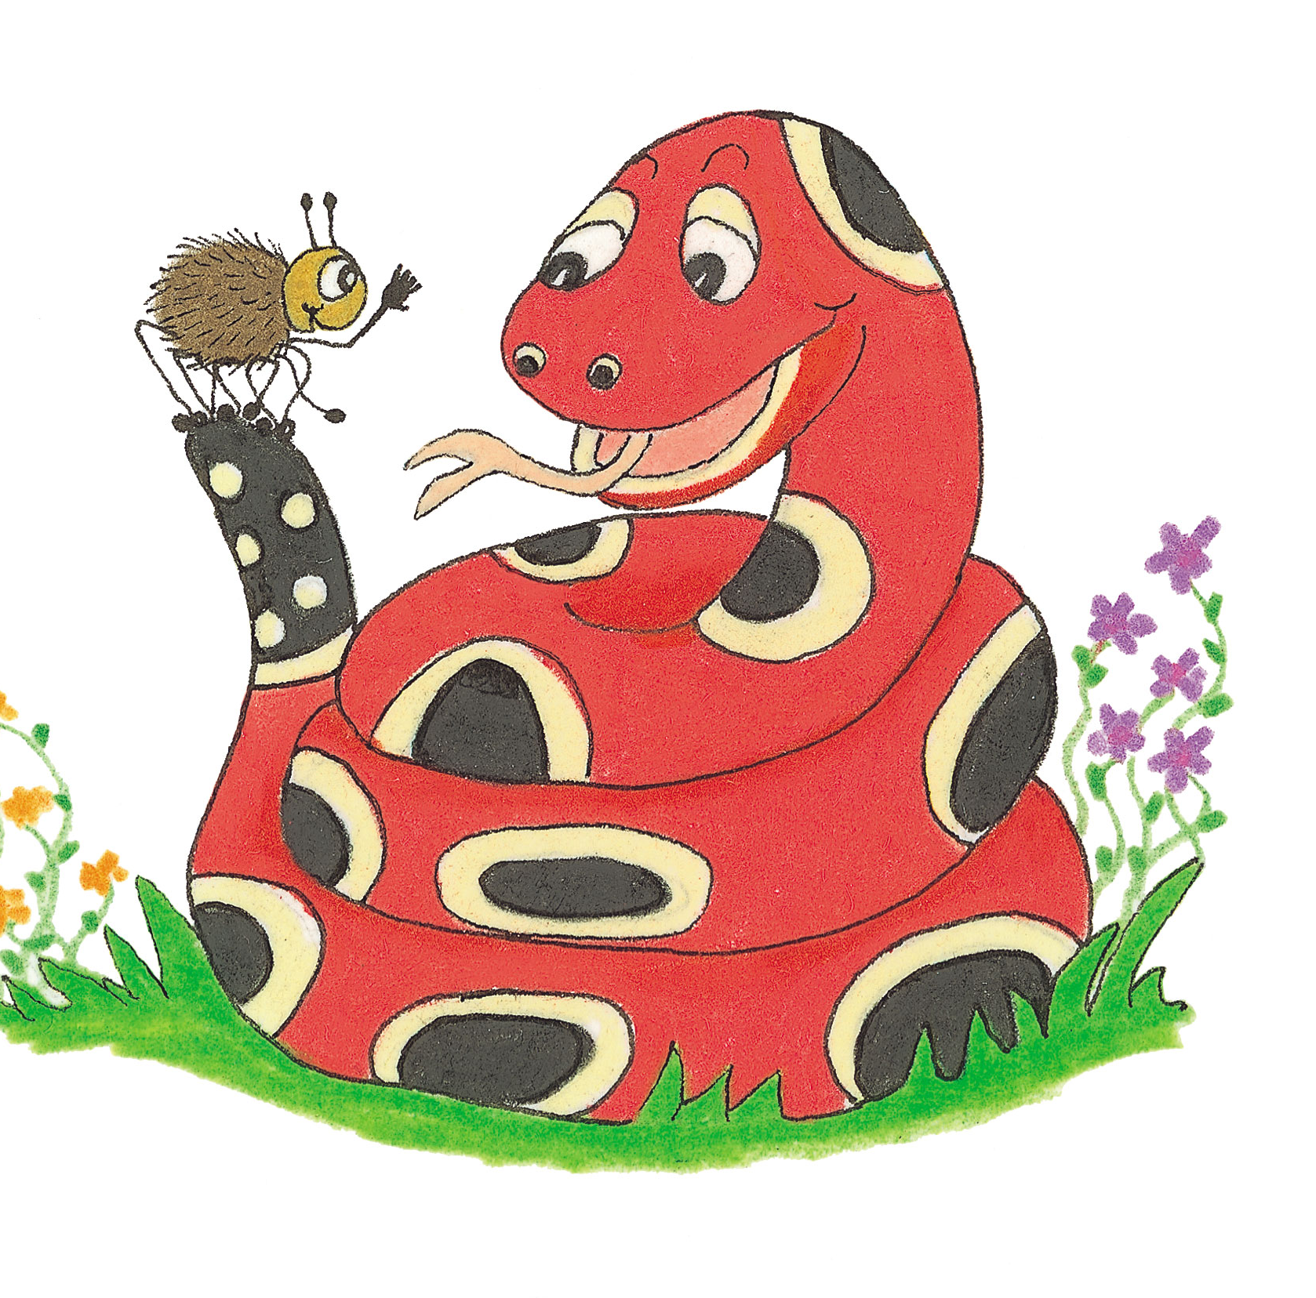
Activity Page
Grammar:
Nouns Phrases 2

Slide 5
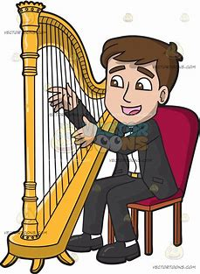
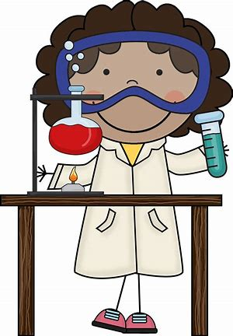
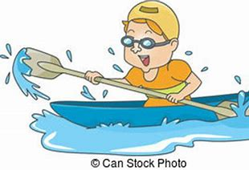
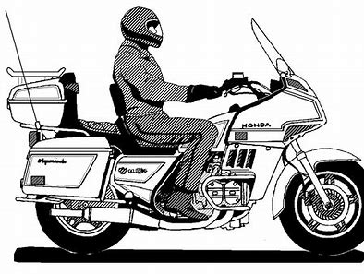
harpist
scientist
canoeist
dentist
motorist

Slide 6
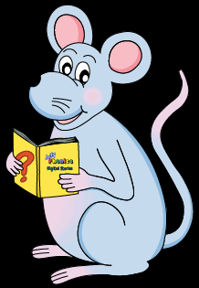
Activity Page
Spelling <-ist>

Slide 7
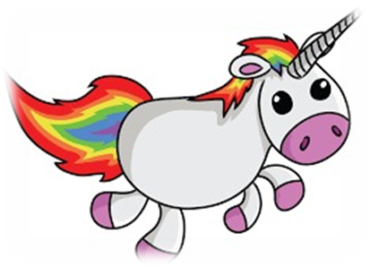
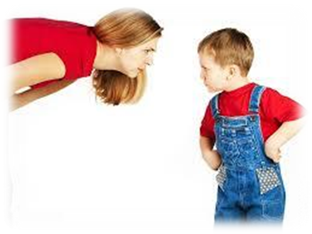
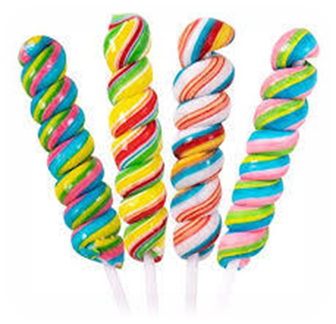
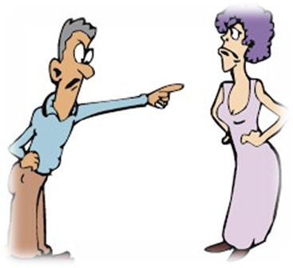
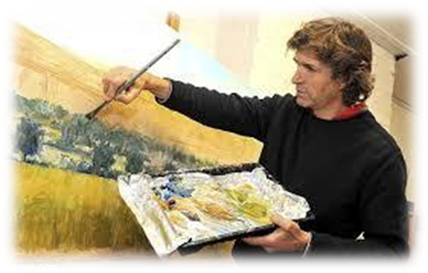
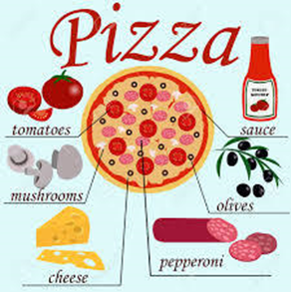
exist resist twist
to live or survive, to be real to fight against something to bend or turn something around
insist artist consist
to refuse to change your mind about something
to be made up of something

Slide 8
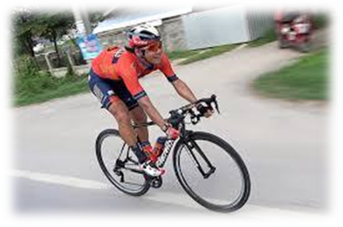
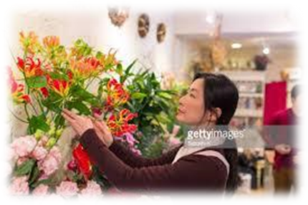
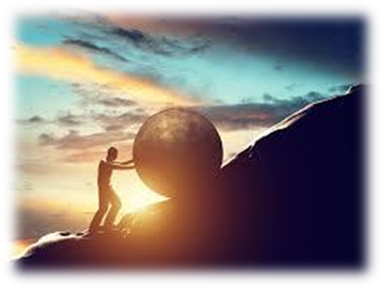
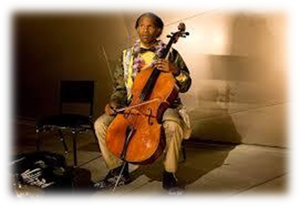
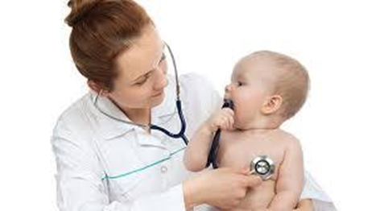
chemist cyclist florist
a person who prepares and sells medicines
a person rides or travels by bicycle
a person who sells or grows flowers
persist soloist specialist
to keep doing something for a long time
a person who performs a solo

Slide 9
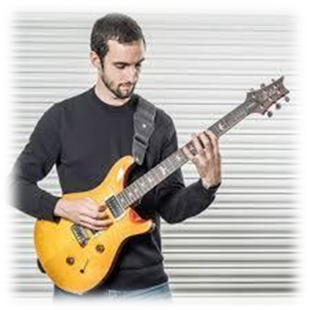
guitarist scientist linguist
a specialist in languages
tourist journalist therapist
someone who travels on vacation a person who gets news and writes about it
a trained person who helps patients with psychological problem

Slide 12
parsing

Slide 13
The scientist is persisting with his dangerous experiment.

Slide 14
The scientist is persisting with his dangerous experiment.

Slide 15
The scientist is persisting with his dangerous experiment.

Slide 16
The scientist is persisting with his dangerous experiment.

Slide 17
The scientist is persisting with his dangerous experiment.

Slide 18
The scientist is persisting with his dangerous experiment.

Slide 19
The scientist is persisting with his dangerous experiment.

Slide 20
The scientist is persisting with his dangerous experiment.
3rd person singular
Present continuous

Slide 21
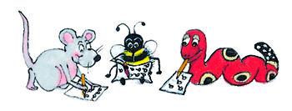
Dictation

Slide 22
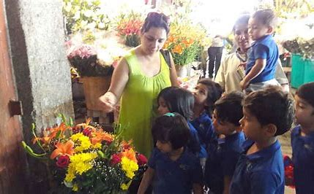

Slide 23
She insisted it was necessary to visit the florist.

Slide 24
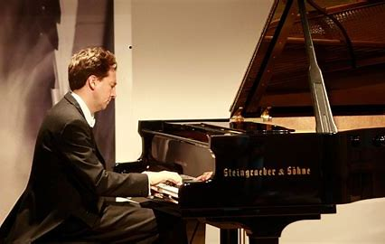

Slide 25
The soloist we heard at the rehearsal was a pianist.

Slide 26
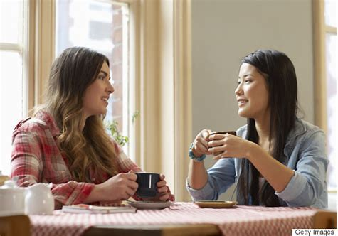
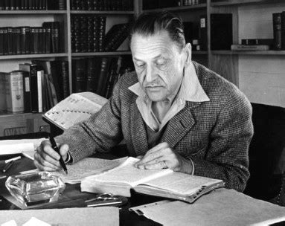

Slide 27
Miss Beech said, “The novelist wrote brilliantly.”

Slide 28
Thank you.
See you
next time!

