Slide 1
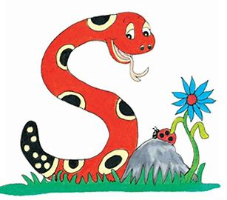
Jolly Grammar
4b-22

Slide 2
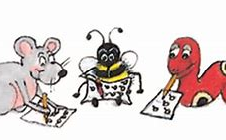
Spelling Test 29

Slide 3
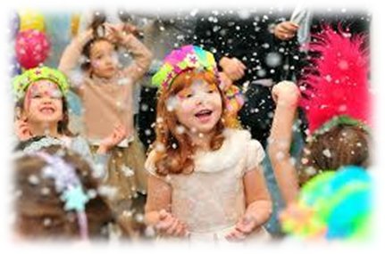
event

Slide 4
event
present

Slide 5
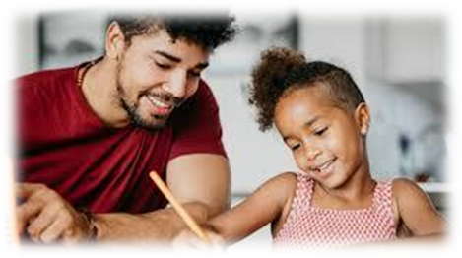
event
present
parent

Slide 6
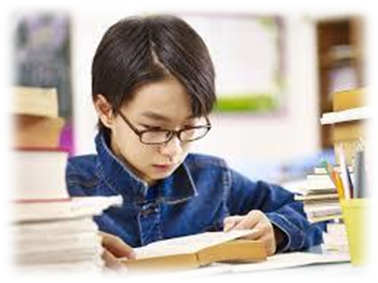
event
present
parent
spent

Slide 7
event
present
parent
spent
student

Slide 8
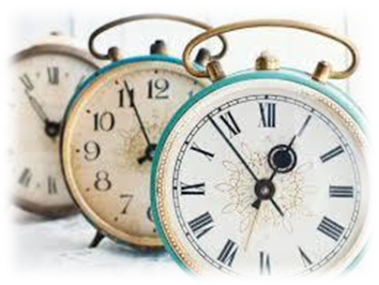
event
present
parent
spent
student
moment

Slide 9
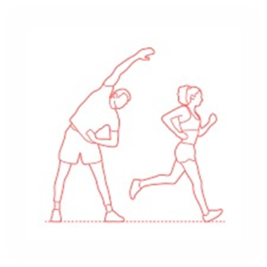
event
present
parent
spent
student
moment
7.movement

Slide 10
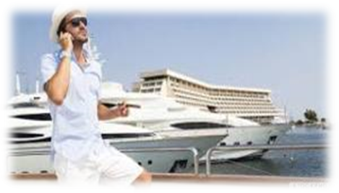
event
present
parent
spent
student
moment
7.movement
8.affluent

Slide 11
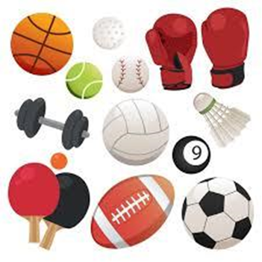
event
present
parent
spent
student
moment
7.movement
8.affluent
9.equipment

Slide 12
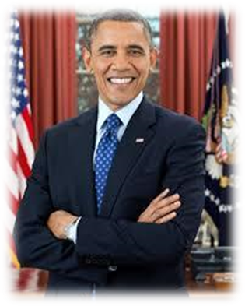
event
present
parent
spent
student
moment
7.movement
8.affluent
9.equipment
10.president

Slide 13
event
present
parent
spent
student
moment
7.movement
8.affluent
9.equipment
10.president
11.treatment

Slide 14
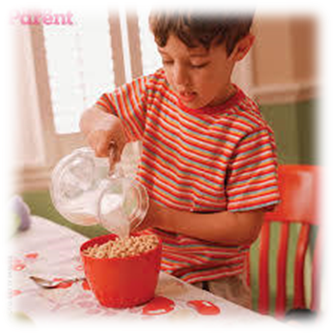
event
present
parent
spent
student
moment
7.movement
8.affluent
9.equipment
10.president
11.treatment
12.independent

Slide 15
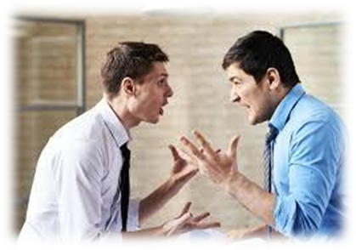
event
present
parent
spent
student
moment
7.movement
8.affluent
9.equipment
10.president
11.treatment
12.independent
13.argument

Slide 16
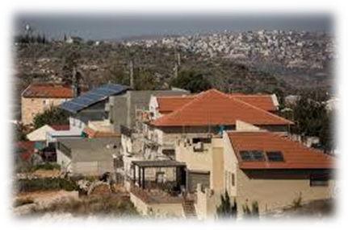
event
present
parent
spent
student
moment
7.movement
8.affluent
9.equipment
10.president
11.treatment
12.independent
13.argument
14.settlement

Slide 17
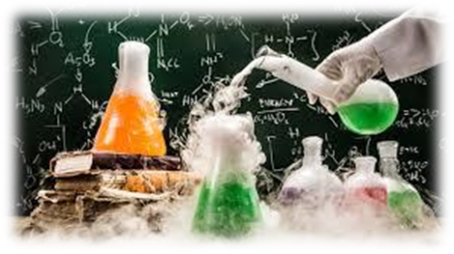
event
present
parent
spent
student
moment
7.movement
8.affluent
9.equipment
10.president
11.treatment
12.independent
13.argument
14.settlement
15.experiment

Slide 18
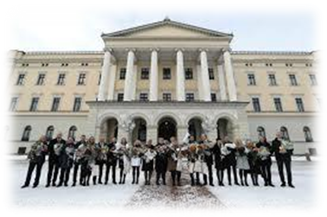
event
present
parent
spent
student
moment
7.movement
8.affluent
9.equipment
10.president
11.treatment
12.independent
13.argument
14.settlement
15.experiment
16.government

Slide 19
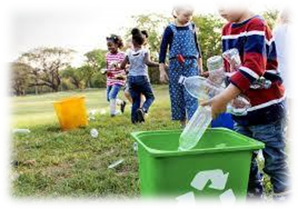
event
present
parent
spent
student
moment
7.movement
8.affluent
9.equipment
10.president
11.treatment
12.independent
13.argument
14.settlement
15.experiment
16.government
17.environment

Slide 20
event
present
parent
spent
student
moment
7.movement
8.affluent
9.equipment
10.president
11.treatment
12.independent
13.argument
14.settlement
15.experiment
16.government
17.environment
18.development

Slide 21
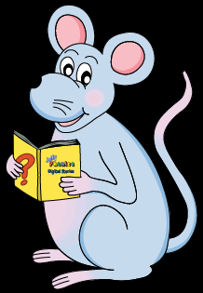
Let’s Review
Nouns

Slide 22
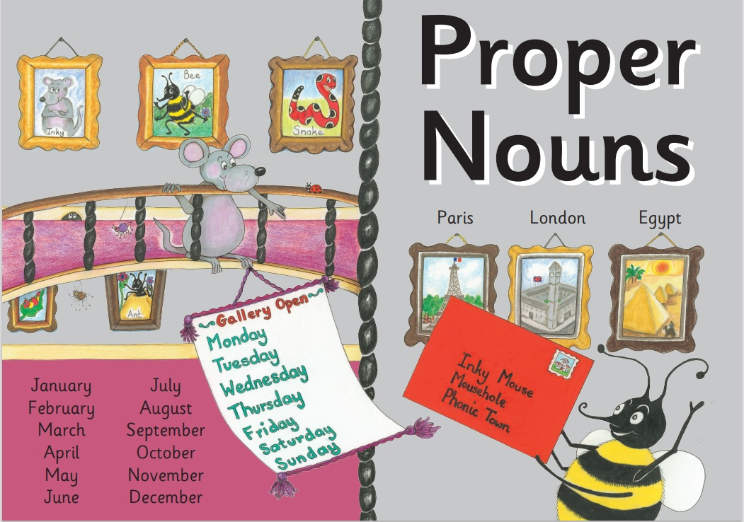

Slide 24
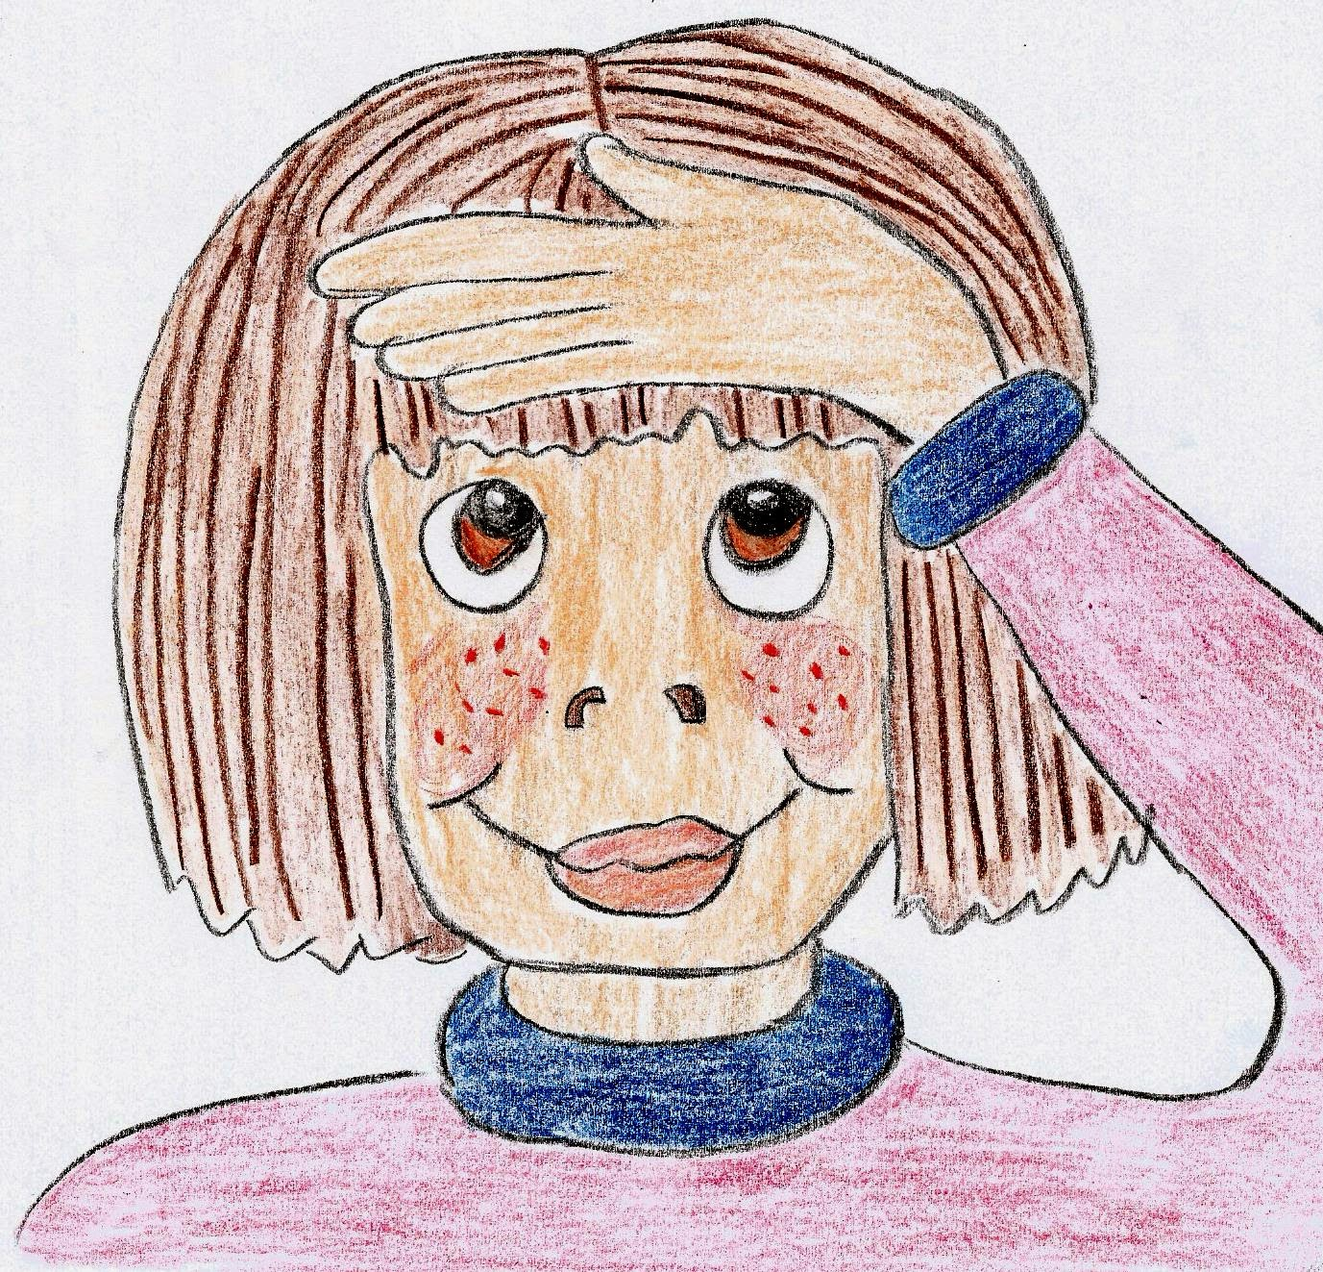
①concrete: photo, drum, flowers, ice
②collective: a class of children
a herd of cows
③abstract: love, trouble, friendship

Slide 25
Activity Page
Grammar:
Nouns Phrases 1

Slide 26
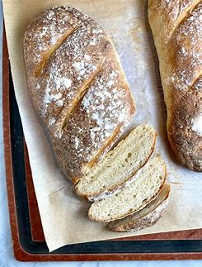
The hot crusty loaves smell wonderful.

Slide 27
The hot crusty loaves smell wonderful.
A noun, together with the words that describe it, is called a noun phrase. Identify the noun(s) in each sentence and underline them in black. Then find all the words that help describe the noun(s) and put a black box around the noun phrase(s).

Slide 28
The hot crusty loaves smell wonderful.
A noun, together with the words that describe it, is called a noun phrase. Identify the noun(s) in each sentence and underline them in black. Then find all the words that help describe the noun(s) and put a black box around the noun phrase(s).

Slide 29
The hot crusty loaves smell wonderful.
A noun, together with the words that describe it, is called a noun phrase. Identify the noun(s) in each sentence and underline them in black. Then find all the words that help describe the noun(s) and put a black box around the noun phrase(s).

Slide 30
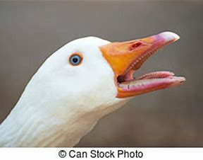
A big white goose honked noisily.

Slide 31
A big white goose honked noisily.

Slide 32
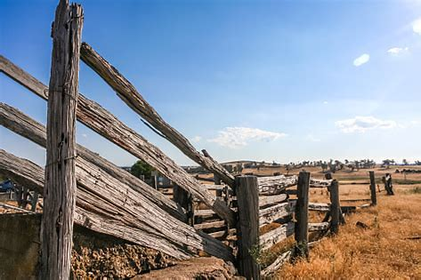
The old wooden fence fell down.

Slide 33
The old wooden fence fell down.

Slide 34
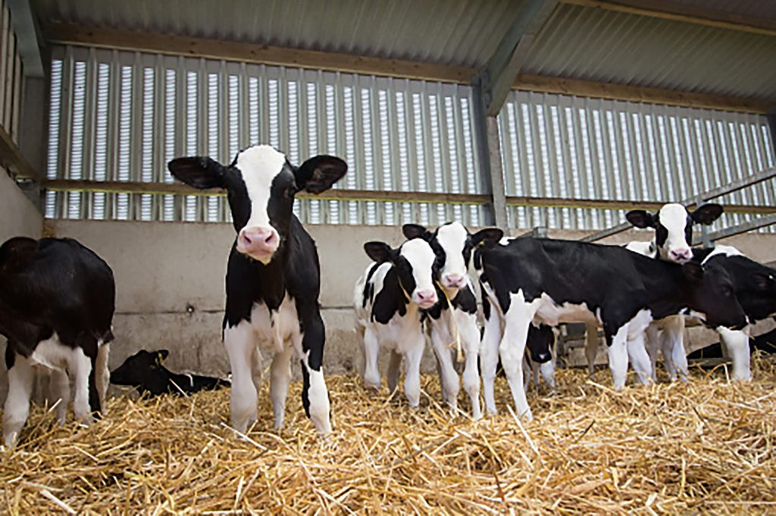
I suddenly saw twelve tiny calves.

Slide 35
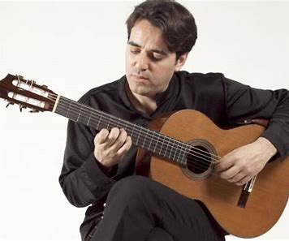
He played his new Spanish guitar.

Slide 36
He played his new Spanish guitar.

Slide 37
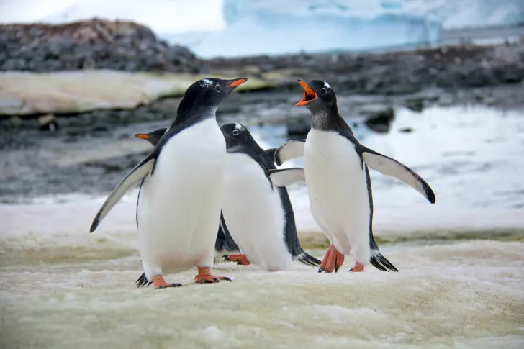
We went to see the black and white penguins.

Slide 38
We went to see the black and white
penguins.

Slide 39
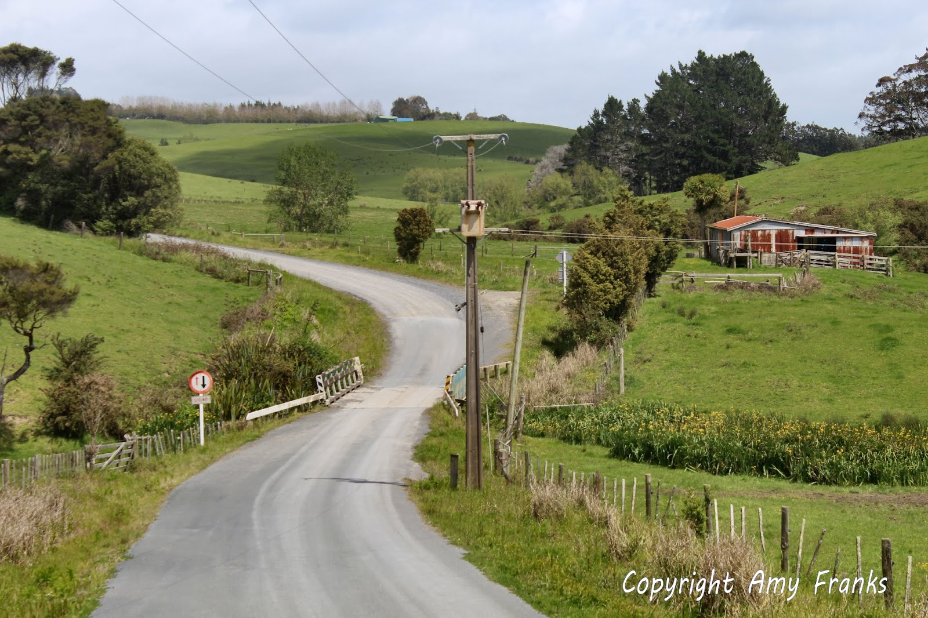
They drove along the dusty, narrow,
winding road.

Slide 40
They drove along the dusty, narrow,
winding road.

Slide 41
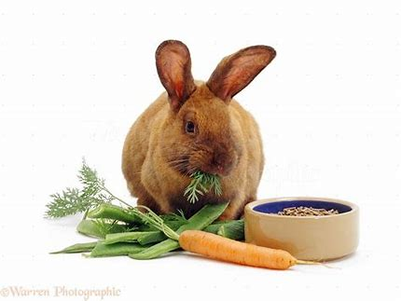
That young brown rabbit crunched
the tasty carrot.

Slide 42
That young brown rabbit crunched
the tasty carrot.

Slide 43
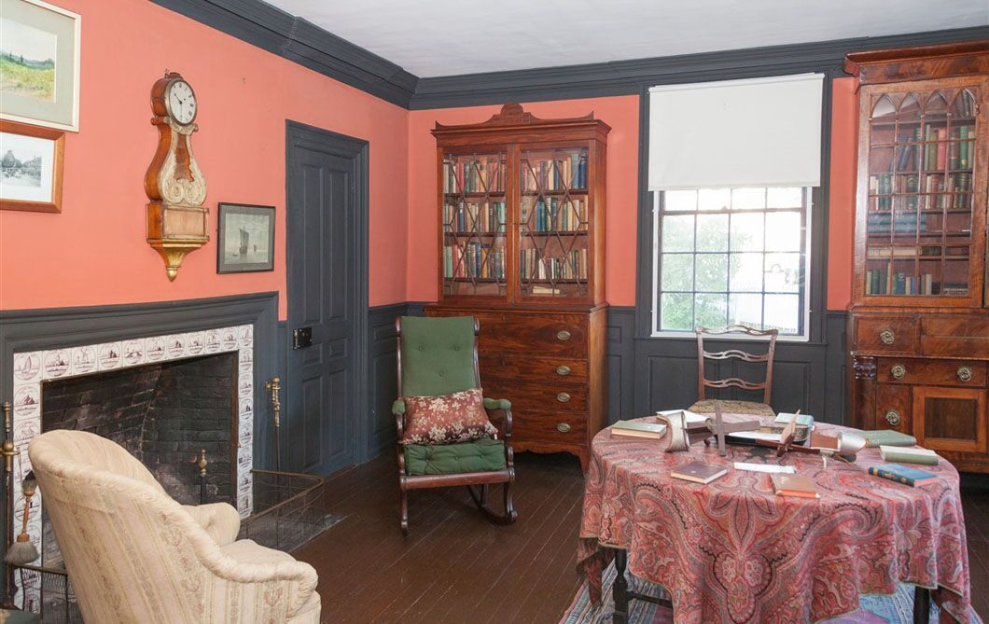
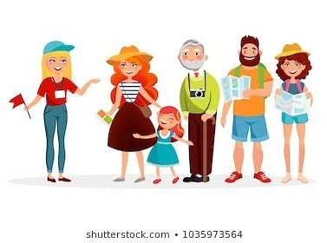
She showed some curious visitors
around the historic house.

Slide 44
She showed some curious visitors
around the historic house.

Slide 45
Activity Page
Grammar:
Nouns Phrases 2

Slide 46
When the words in a noun phrase come after the noun, they usually include another noun. In the phrases on the right, find the main noun and the noun helping to describe it. Then decide which nouns phrase is needed to complete each sentence.
〇 drive very fast.
the house next door.
He lives in 〇
Some cars on the road

Slide 47
the house next door.
The boys at school
a cat up a tree.
Some cars on the road
That man under the umbrella
the fastest horse in the race
the dog with a sore paw.
This picture above the fireplace
The firemen rescued
drive very fast.
He lives in
wear blue ties.
The vet treated
stayed dry during his walk.
is by a local artist.
They will give first prize to

Slide 48
the house next door.
The boys at school
a cat up a tree.
Some cars on the road
That man under the umbrella
the fastest horse in the race
the dog with a sore paw.
This picture above the fireplace
The firemen rescued
drive very fast.
He lives in
wear blue ties.
The vet treated
stayed dry during his walk.
is by a local artist.
They will give first prize to

Slide 49
The firemen rescued a cat up a tree.
Some cars on the road drive very fast.
He lives in the house next door.
The boys at school wear blue ties.
The vet treated the dog with a sore paw.
That man under the umbrella stayed dry during his walk.
This picture above the fireplace is by a local artist.
They will give first prize to the fastest horse in the race.

Slide 50
Activity Page
Grammar:
Nouns Phrases 3

Slide 51
Write a noun phrase of your own and draw a picture for it in the photo frame.

Slide 52
Write a noun phrase of your own and draw a picture for it in the photo frame.
a beautiful, smart English teacher at Bright Kids Garden

Slide 53
Thank you.
See you
next time!

