Slide 1
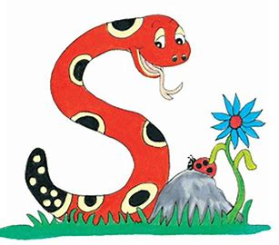
Jolly Grammar
4b-19

Slide 2
She will go to the library.
She will take out a book.
↓

Slide 3
She will go to the library.
She will take out a book.
↓
She will go to the library and she will take out a book.

Slide 4
<-ary><-ery><-ory>
theory
bravery
necessary
surgery
imaginary
history

Slide 5
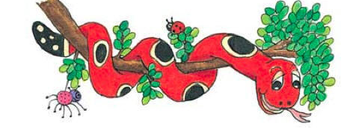
Activity Page :

Slide 6
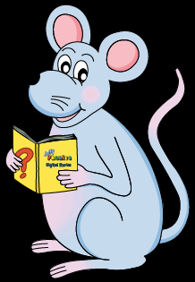
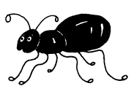
Activity Page
Spelling <-ant>

Slide 7
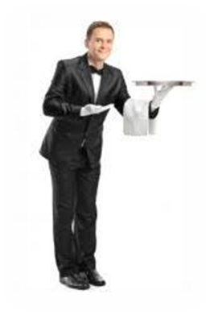
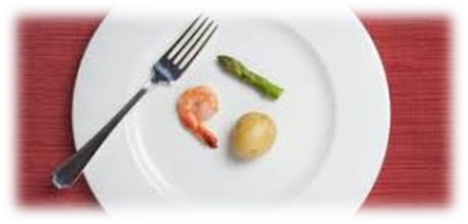
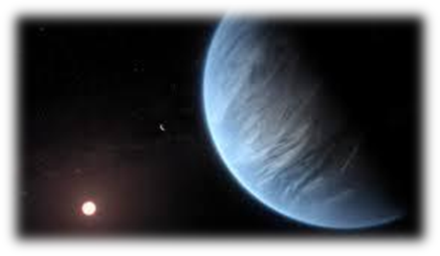
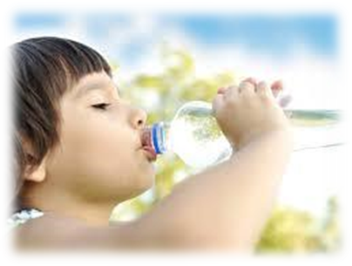
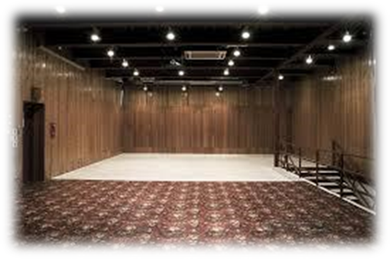
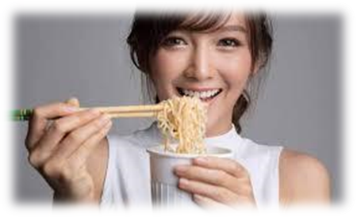
scant distant servant
important vacant instant

Slide 8
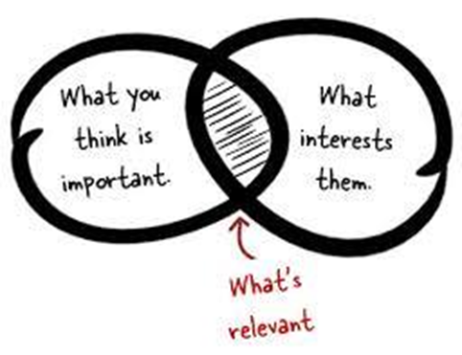
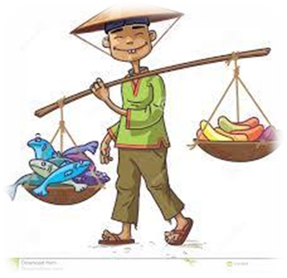
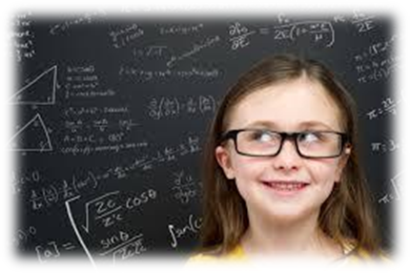
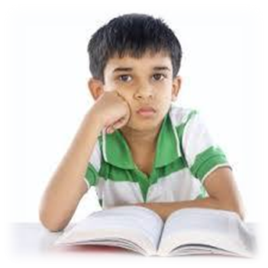
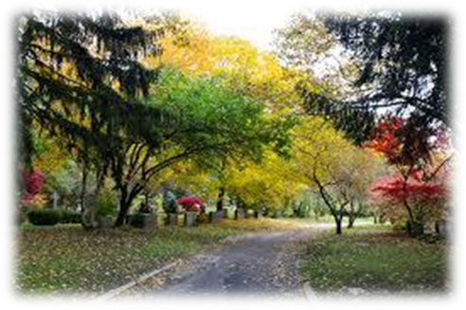
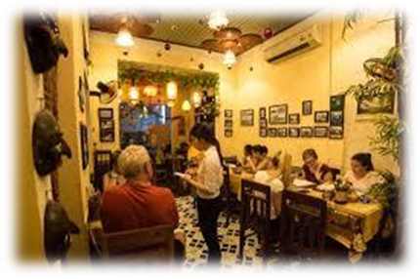
relevant merchant brilliant
reluctant pleasant restaurant

Slide 9
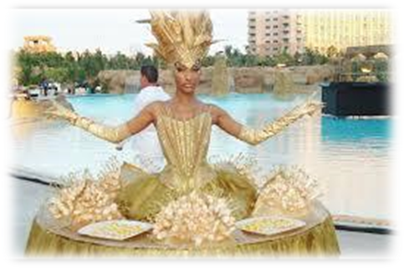
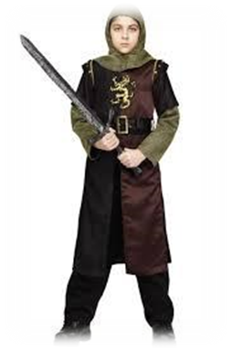
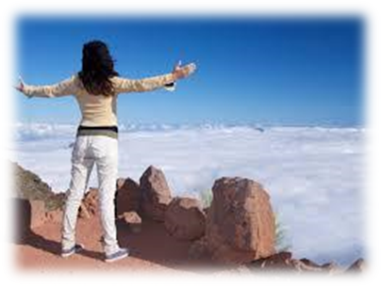
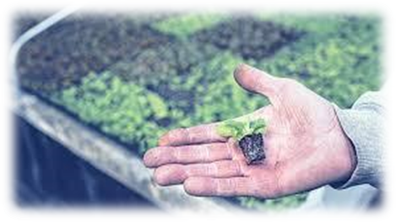
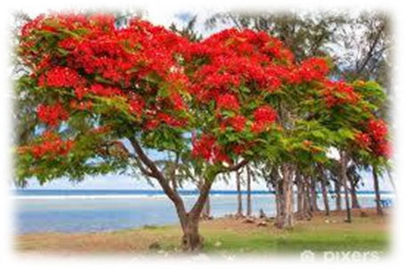
extravagant participant valiant
triumphant insignificant flamboyant

Slide 12
An antonym is a word with the opposite meaning. Write antonyms for the words below .

Slide 13
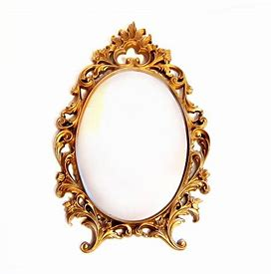
vacant distant important pleasant
brilliant reluctant insignificant relevant

Slide 14
vacant distant important pleasant
occupied
brilliant reluctant insignificant relevant

Slide 15
vacant distant important pleasant
occupied close
brilliant reluctant insignificant relevant

Slide 16
vacant distant important pleasant
occupied close unimportant
brilliant reluctant insignificant relevant

Slide 17
vacant distant important pleasant
occupied close unimportant unpleasant
brilliant reluctant insignificant relevant

Slide 18
vacant distant important pleasant
occupied close unimportant unpleasant
brilliant reluctant insignificant relevant
dull

Slide 19
vacant distant important pleasant
occupied close unimportant unpleasant
brilliant reluctant insignificant relevant
dull eager

Slide 20
vacant distant important pleasant
occupied close unimportant unpleasant
brilliant reluctant insignificant relevant
dull eager significant

Slide 21
vacant distant important pleasant
occupied close unimportant unpleasant
brilliant reluctant insignificant relevant
dull eager significant irrelevant

Slide 22
parsing

Slide 23
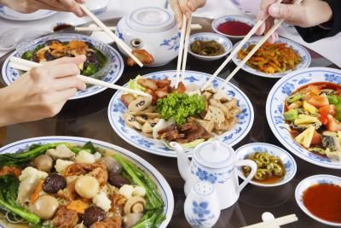
We were enjoying a pleasant dinner at a Chinese restaurant.

Slide 24
We were enjoying a pleasant dinner at a Chinese restaurant.

Slide 25
We were enjoying a pleasant dinner at a Chinese restaurant.

Slide 26
We were enjoying a pleasant dinner at a Chinese restaurant.

Slide 27
We were enjoying a pleasant dinner at a Chinese restaurant.

Slide 28
We were enjoying a pleasant dinner at a Chinese restaurant.

Slide 29
We were enjoying a pleasant dinner at a Chinese restaurant.

Slide 30
We were enjoying a pleasant dinner at a Chinese restaurant.

Slide 31
We were enjoying a pleasant dinner at a Chinese restaurant.
1st person plural
Past continuous

Slide 32
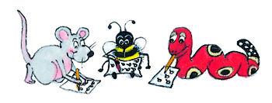
Dictation

Slide 33
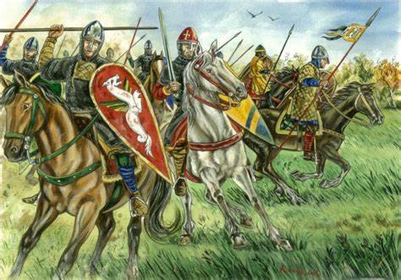

Slide 34
The valiant knights were triumphant in battle.

Slide 35
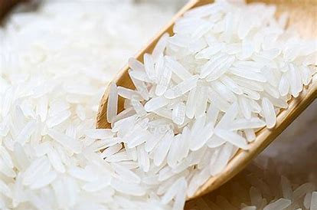
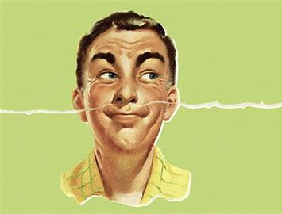

Slide 36
“It’s a truly fragrant rice,” the merchant said.

Slide 37
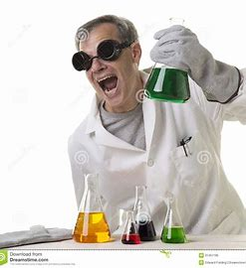

Slide 38
The laboratory assistant made a scientific discovery.

Slide 39
Thank you.
See you
next time!

