Slide 1
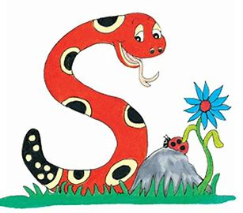
Jolly Grammar
4b-16

Slide 2
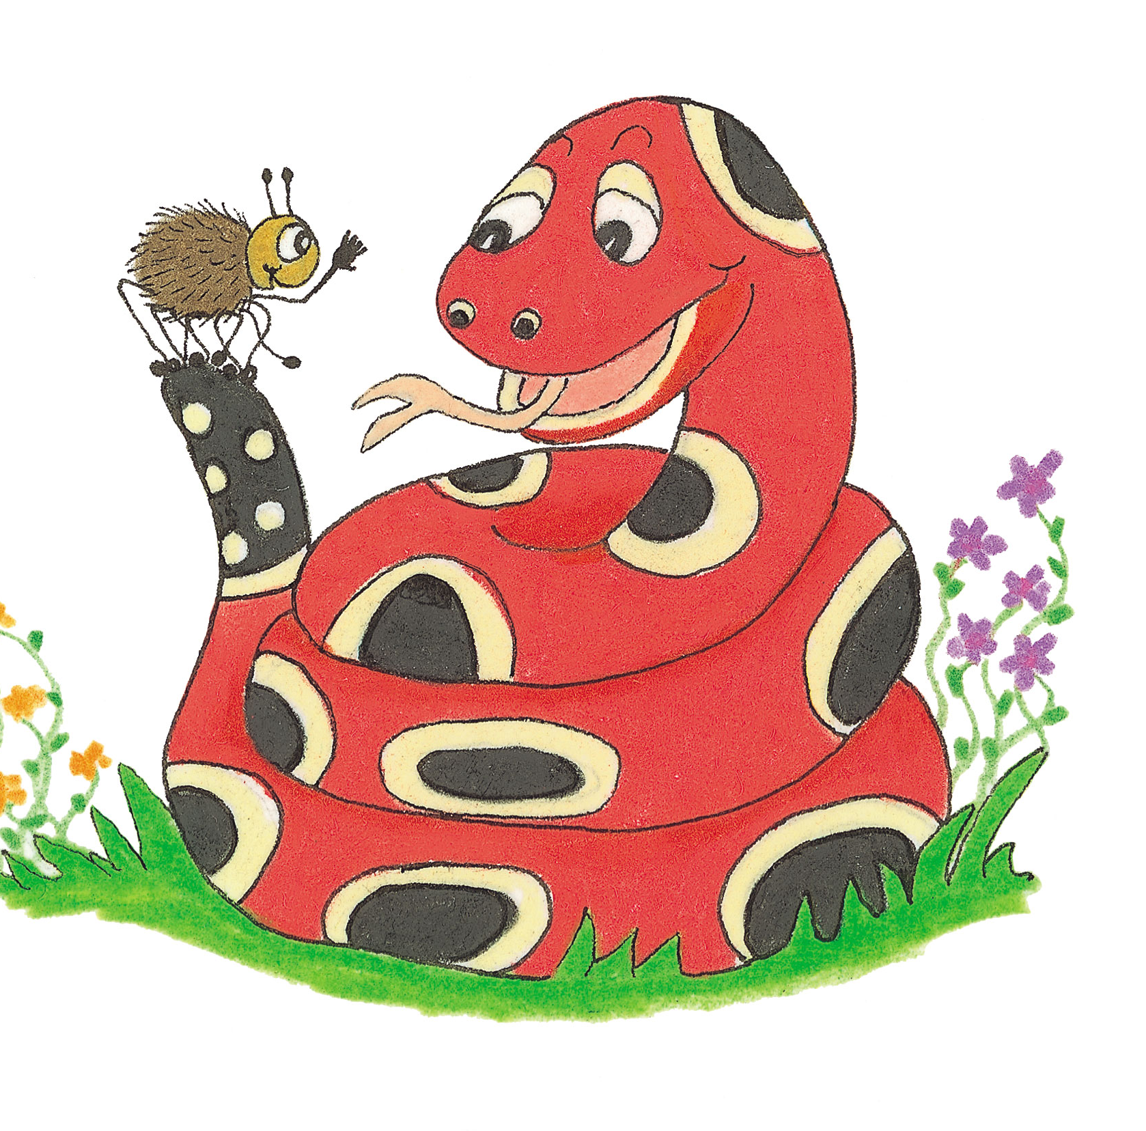
Spelling Test 26

Slide 3
literary

Slide 4
literary
primary

Slide 5
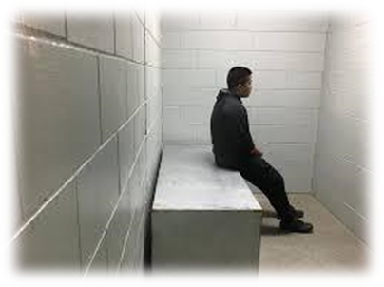
literary
primary
solitary

Slide 6
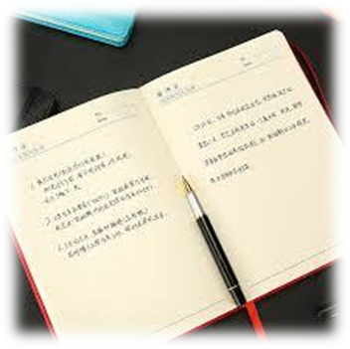
literary
primary
solitary
diary

Slide 7
literary
primary
solitary
diary
library

Slide 8
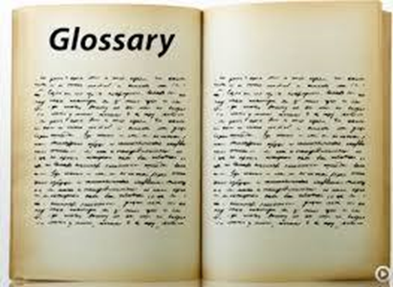
literary
primary
solitary
diary
library
glossary

Slide 9
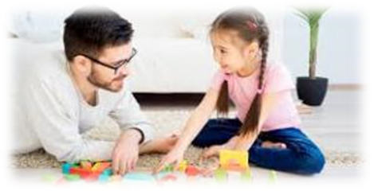
literary
primary
solitary
diary
library
glossary
7.ordinary

Slide 10
literary
primary
solitary
diary
library
glossary
7.ordinary
8.necessary

Slide 11
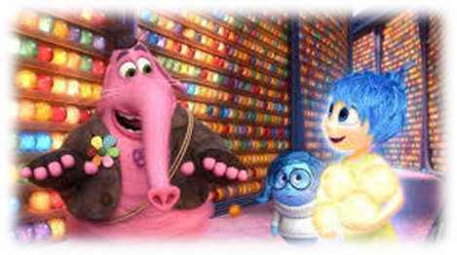
literary
primary
solitary
diary
library
glossary
7.ordinary
8.necessary
9.imaginary

Slide 12
literary
primary
solitary
diary
library
glossary
7.ordinary
8.necessary
9.imaginary
10.dictionary

Slide 13
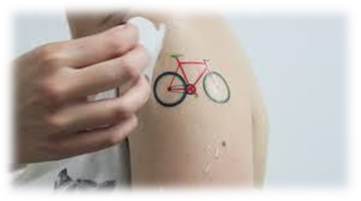
literary
primary
solitary
diary
library
glossary
7.ordinary
8.necessary
9.imaginary
10.dictionary
11.temporary

Slide 14
literary
primary
solitary
diary
library
glossary
7.ordinary
8.necessary
9.imaginary
10.dictionary
11.temporary
12.vocabulary

Slide 15
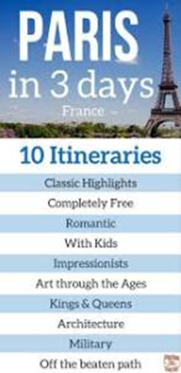
literary
primary
solitary
diary
library
glossary
7.ordinary
8.necessary
9.imaginary
10.dictionary
11.temporary
12.vocabulary
13.itinerary

Slide 16
literary
primary
solitary
diary
library
glossary
7.ordinary
8.necessary
9.imaginary
10.dictionary
11.temporary
12.vocabulary
13.itinerary
14.secetary

Slide 17
literary
primary
solitary
diary
library
glossary
7.ordinary
8.necessary
9.imaginary
10.dictionary
11.temporary
12.vocabulary
13.itinerary
14.secetary
15.hereditary

Slide 18
literary
primary
solitary
diary
library
glossary
7.ordinary
8.necessary
9.imaginary
10.dictionary
11.temporary
12.vocabulary
13.itinerary
14.secetary
15.hereditary
16.anniversary

Slide 19
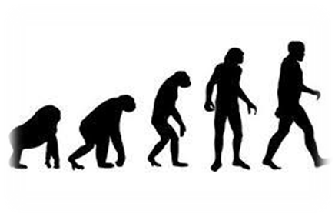
literary
primary
solitary
diary
library
glossary
7.ordinary
8.necessary
9.imaginary
10.dictionary
11.temporary
12.vocabulary
13.itinerary
14.secetary
15.hereditary
16.anniversary
17.evolutionary

Slide 20
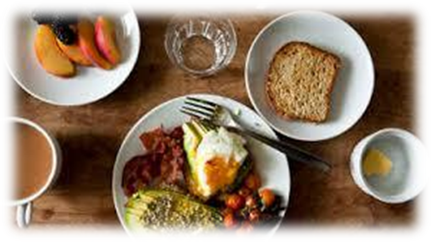
literary
primary
solitary
diary
library
glossary
7.ordinary
8.necessary
9.imaginary
10.dictionary
11.temporary
12.vocabulary
13.itinerary
14.secetary
15.hereditary
16.anniversary
17.evolutionary
18.complementary

Slide 21
3 types of sentences

Slide 22
●statement
I will do my homework tomorrow.
●question
When did you finish your homework?
●exclamation
I finally finished my homework!

Slide 23
Statement to question

Slide 24
● verb ‘to be’
They are in the tunnel.

Slide 25
● verb ‘to be’
They are in the tunnel.

Slide 26
● verb ‘to be’
They are in the tunnel.
Are they in the tunnel?

Slide 27
● auxiliary verb
has, had have, can, may,
could, should, would, must,
might, did, does

Slide 28
● auxiliary verb
has, had have, can, may,
could, should, would, must,
might, did, does
We will go in the tunnel.

Slide 29
● auxiliary verb
has, had have, can, may,
could, should, would, must,
might, did, does
We will go in the tunnel.

Slide 30
● auxiliary verb
has, had have, can, may,
could, should, would, must,
might, did, does
We will go in the tunnel.
Will we go in the tunnel?

Slide 31
Activity Page
Changing a statement into a Question

Slide 32
If you want to change a statement into a question and it has an auxiliary verb and a main verb, you only move the auxiliary verb to the beginning of the sentence. Rewrite these statements as questions by moving the auxiliary verb in bold.
The test has split down the side.
Has the tent split down the side?

Slide 33
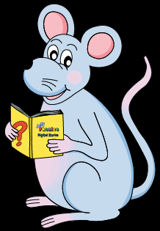
Activity Page

Slide 34
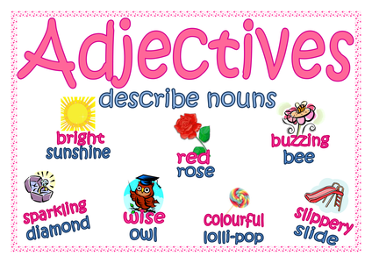
Can adjectives describe nouns?

Slide 35
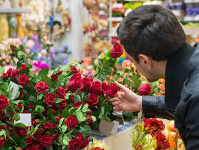
May I buy some flowers today?

Slide 36
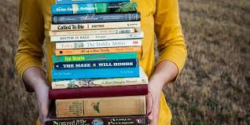
Had she read many classic novels?

Slide 37
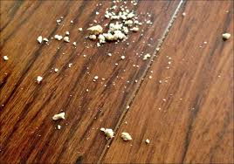
Have the crumbs fallen on the floor?

Slide 38
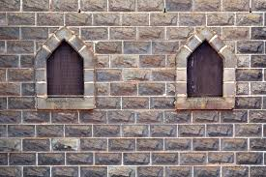
Should a castle have huge stone walls?

Slide 39
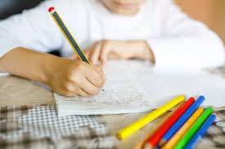
Must we finish our homework tonight?

Slide 40
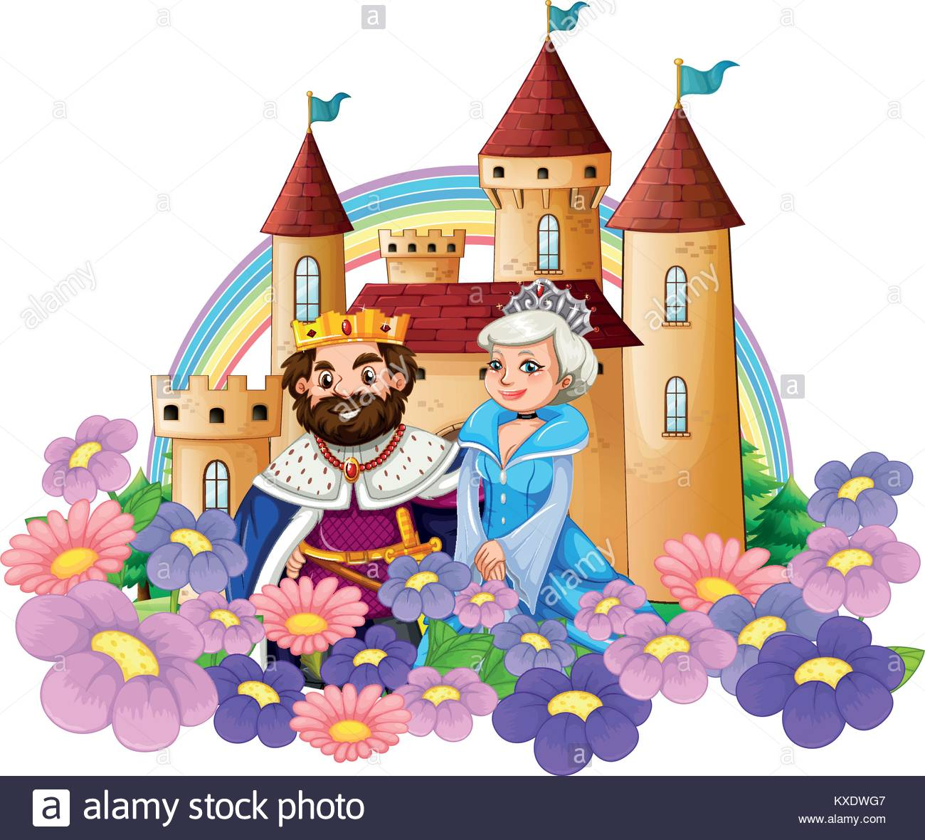
Would it be nice to live in a palace?

Slide 41
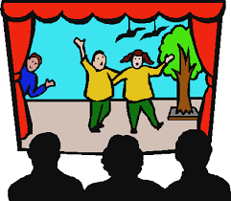
Could the play be more dramatic?

Slide 42
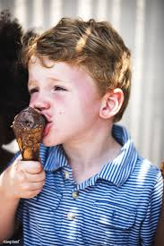
Does he like chocolate ice cream?

Slide 43
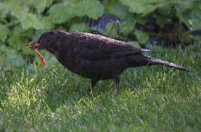
Was the blackbird looking for earthworms?

Slide 44
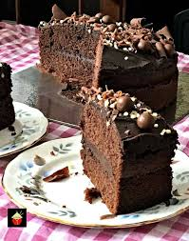
Might they have chocolate cake at the party?

Slide 45
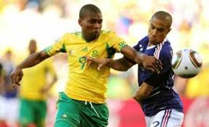
Did you get jostled in all the hustle and bustle?

Slide 46
Thank you.
See you
next time!

