Slide 1
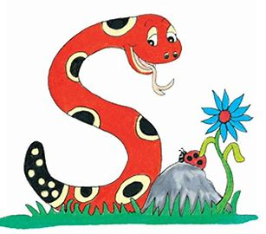
Jolly Grammar
4b-13

Slide 2
Sentence

Slide 3
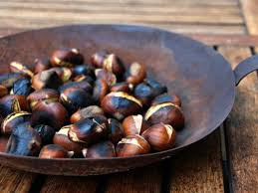
We will be roasting chestnuts.
1st person
plural
future
continuous

Slide 4
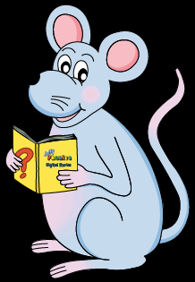
Let’s Revise
Schwa

Slide 5
<al><el><il> /ool/
April
level
several
tranquil
tunnel
plural

Slide 6
Activity Page
Spelling <-ery>

Slide 7
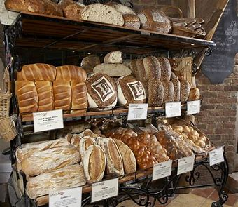
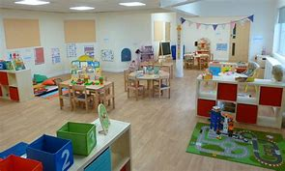
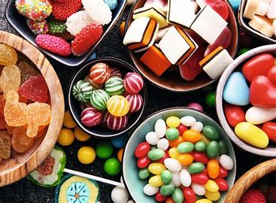
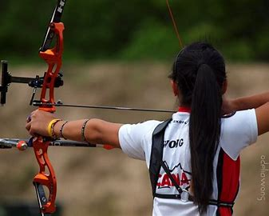
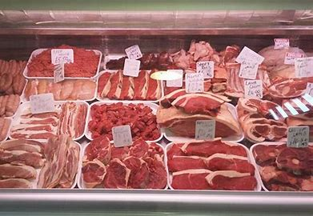
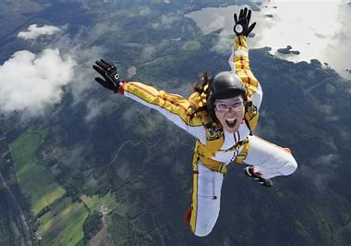
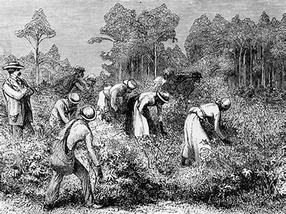
★a place for a business or activity
bakery nursery
★a type of collection
confectionery
★a practice or occupation
archery butchery
★a quality or characteristics
bravery
★ a state or condition
slavery

Slide 8
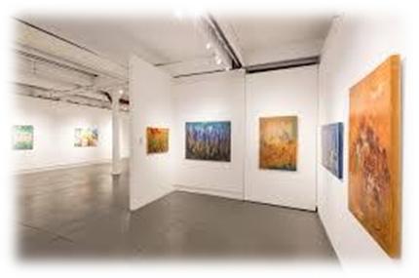
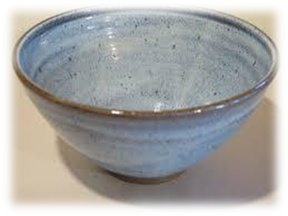
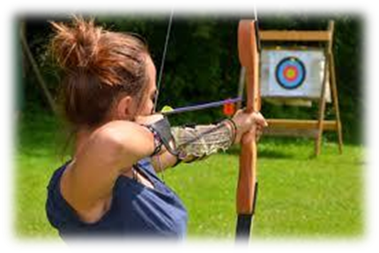
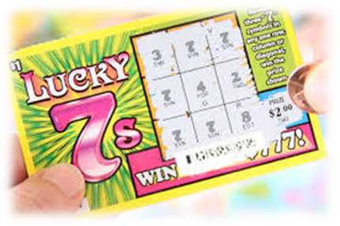
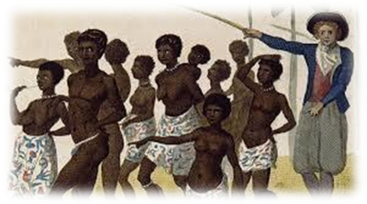
gallery pottery archery
lottery bravery slavery

Slide 9
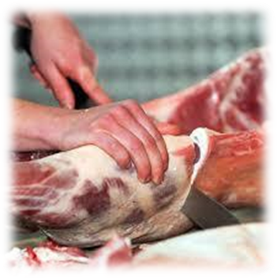
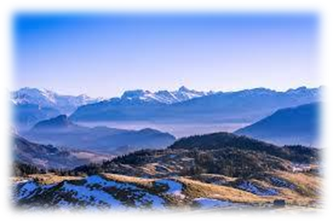
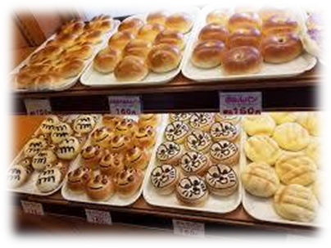
butchery scenery bakery
delivery imagery discovery

Slide 10
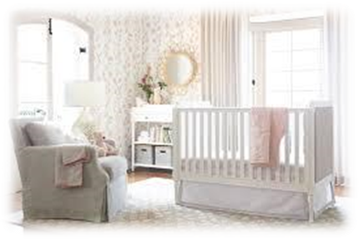
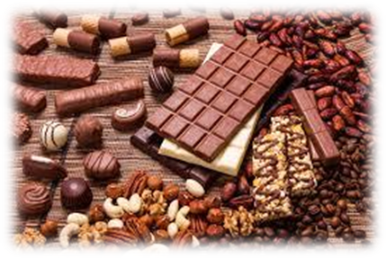
surgery nursery treachery
stationery confectionery skulduggery

Slide 13
bravery pottery lottery
bakery scenery
imagery delivery surgery
nursery treachery

Slide 14
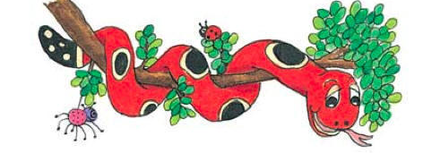
Activity Page : Spelling <-ery>

Slide 15
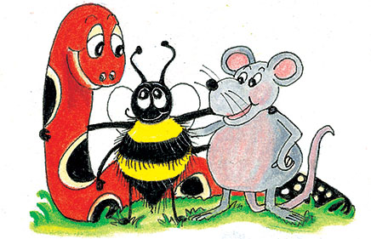
parsing

Slide 16
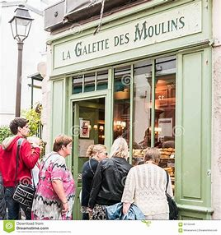
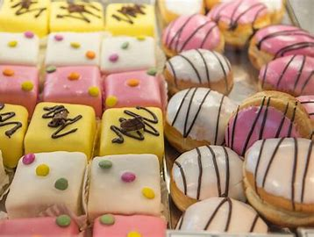
We looked hungrily at the confectionery in the bakery window.

Slide 17
We looked hungrily at the confectionery in the bakery window.

Slide 18
We looked hungrily at the confectionery in the bakery window.

Slide 19
We looked hungrily at the confectionery in the bakery window.

Slide 20
We looked hungrily at the confectionery in the bakery window.

Slide 21
We looked hungrily at the confectionery in the bakery window.

Slide 22
We looked hungrily at the confectionery in the bakery window.

Slide 23
We looked hungrily at the confectionery in the bakery window.

Slide 24
We looked hungrily at the confectionery in the bakery window.

Slide 25
We looked hungrily at the confectionery in the bakery window.
1st person
plural
simple
past

Slide 26
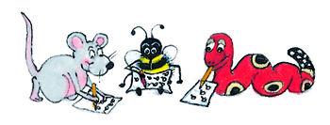
Dictation

Slide 27
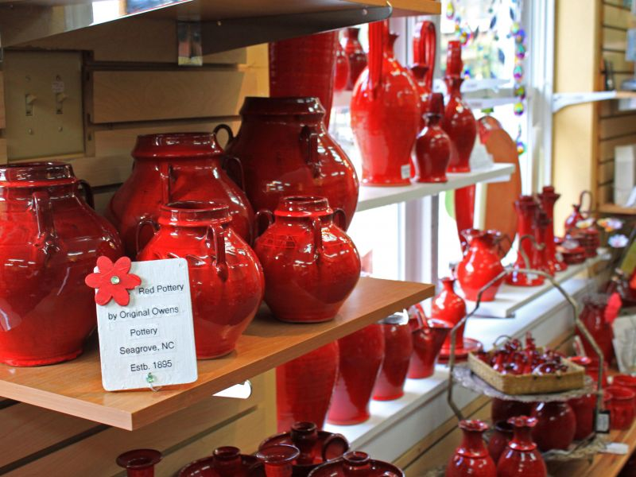

Slide 28
The visitors liked the pottery in the gallery.

Slide 30
“Did you cancel the delivery?” asked Jim.

Slide 31
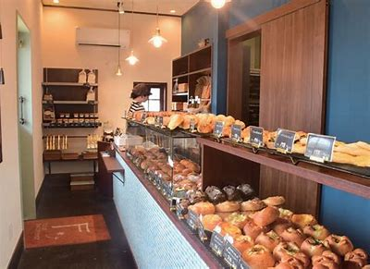
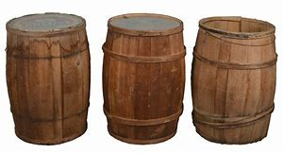

Slide 32
They keep barrels of flour at the bakery.

Slide 33
Thank you.
See you
next time!

