Slide 1
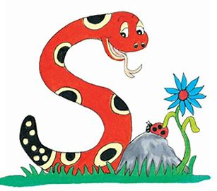
Jolly Grammar
4b-11

Slide 2
Punctuation

Slide 3
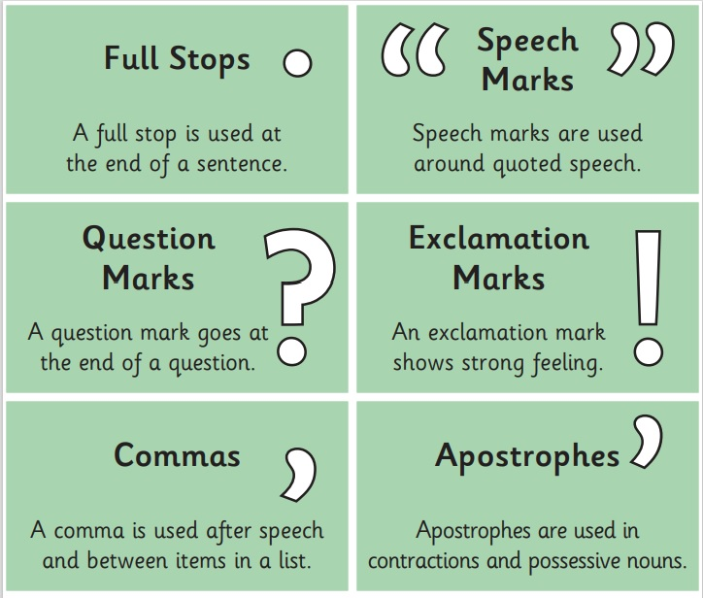

Slide 4
“Can I borrow your pencil?” asked the journalist.
The actor exclaimed, “You scoundrel!”
Parsley, basil, mint and rosemary are types of herb.
What is the final total?

Slide 5
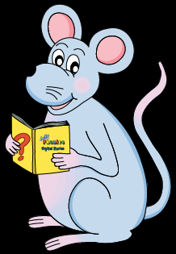
Let’s Revise
Schwa

Slide 6
<le> /ool/
candle
simple
puzzle
<al><el><il> /ool/
total
camel
pencil

Slide 7
Activity Page
Schwa <-il>

Slide 8
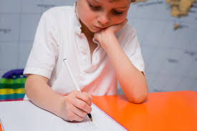
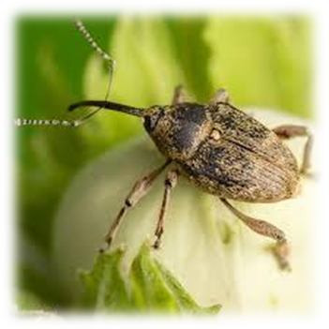
civil pupil pencil
weevil evil peril

Slide 9
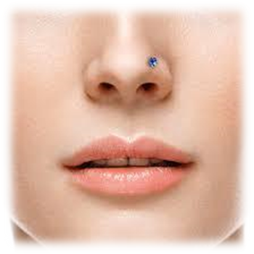
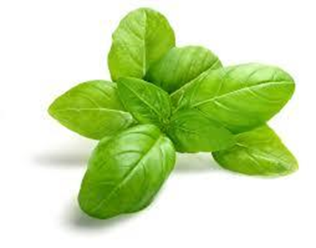
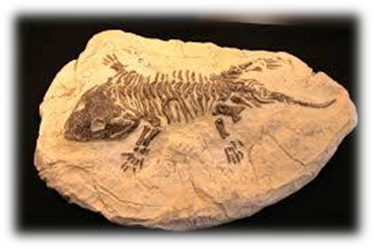
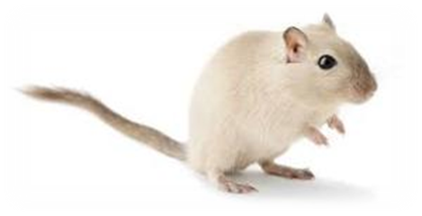
nostril basil April
fossil gerbil anvil

Slide 10
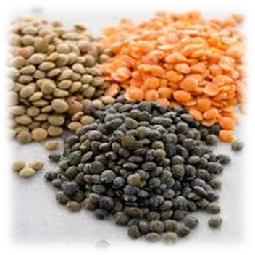
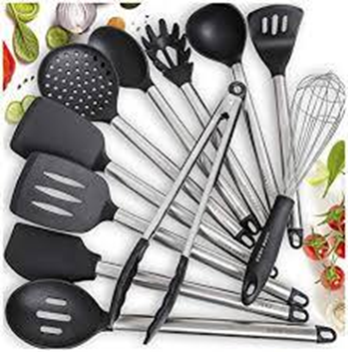
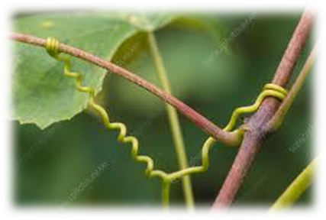
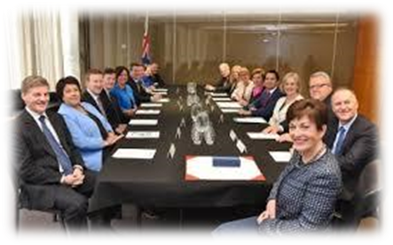
utensil tendril lentil
council stencil tranquil

Slide 13
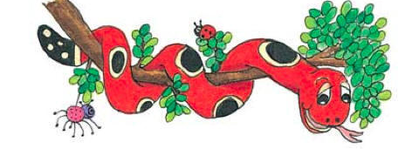
Activity Page : Schwa <il>

Slide 14
Homework
Unscramble the letter and
add them to <il> on the pencils
to make words from the spelling list.
cemp
pencil
il

Slide 15
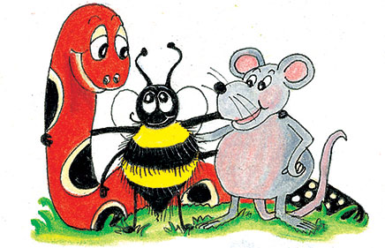
parsing

Slide 16
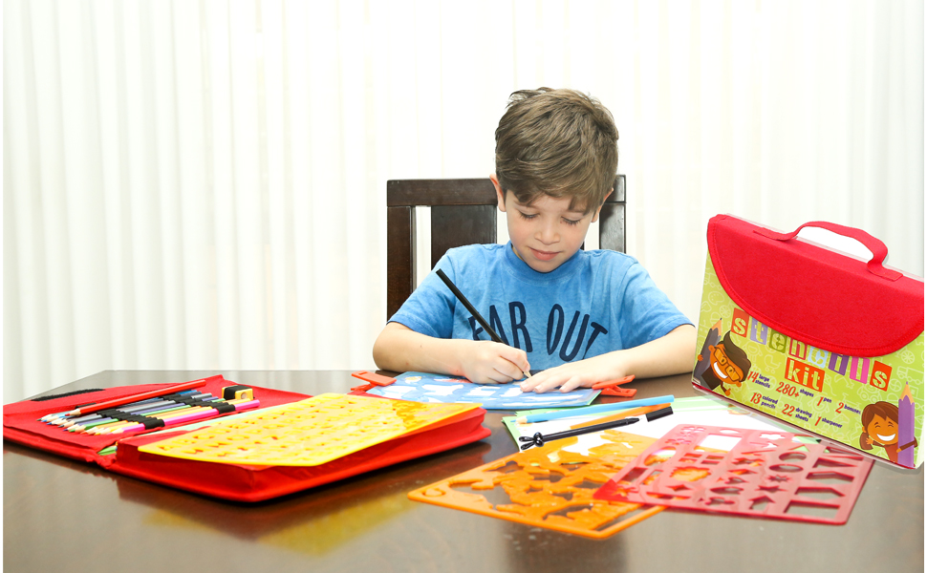
The pupil is drawing carefully inside the stencil with a green pencil.

Slide 17
The pupil is drawing carefully inside the stencil with a green pencil.

Slide 18
The pupil is drawing carefully inside the stencil with a green pencil.

Slide 19
The pupil is drawing carefully inside the stencil with a green pencil.

Slide 20
The pupil is drawing carefully inside the stencil with a green pencil.

Slide 21
The pupil is drawing carefully inside the stencil with a green pencil.

Slide 22
The pupil is drawing carefully inside the stencil with a green pencil.

Slide 23
The pupil is drawing carefully inside the stencil with a green pencil.

Slide 24
The pupil is drawing carefully inside the stencil with a green pencil.

Slide 25
The pupil is drawing carefully inside the stencil with a green pencil.
present continuous

Slide 26
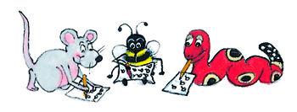
Dictation

Slide 27
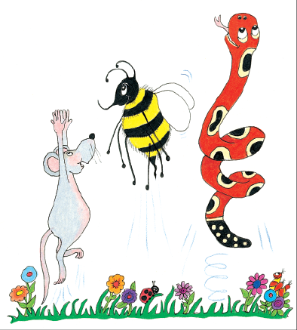
Dictation
1.
2.
3.

Slide 29
The scientists examined a massive fossil.

Slide 30
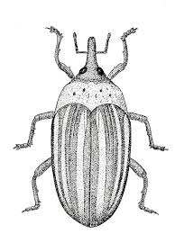

Slide 31
April drew an evil weevil.

Slide 32
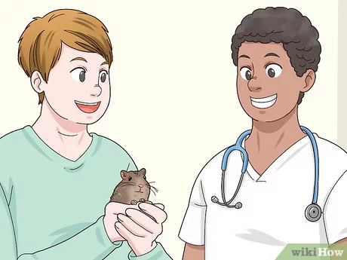
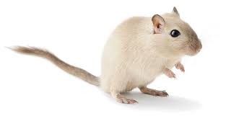

Slide 33
We took our gerbil to the animal hospital.

Slide 34
Thank you.
See you
next time!

