Slide 1
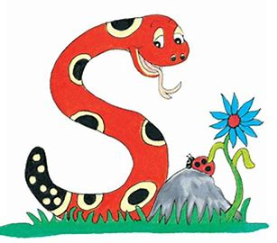
Jolly Grammar
4b-8

Slide 2
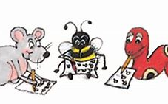
Spelling Test 22

Slide 3
animal

Slide 4
animal
coral

Slide 5
animal
coral
special

Slide 6
animal
coral
special
plural

Slide 7
animal
coral
special
plural
total

Slide 8
animal
coral
special
plural
total
equal

Slide 9
animal
coral
special
plural
total
equal
7.external

Slide 10
animal
coral
special
plural
total
equal
7.external
8.several

Slide 11
animal
coral
special
plural
total
equal
7.external
8.several
9.crystal

Slide 12
animal
coral
special
plural
total
equal
7.external
8.several
9.crystal
10.casual

Slide 13
animal
coral
special
plural
total
equal
7.external
8.several
9.crystal
10.casual
11.capital

Slide 14
animal
coral
special
plural
total
equal
7.external
8.several
9.crystal
10.casual
11.capital
12.hospital

Slide 15
animal
coral
special
plural
total
equal
7.external
8.several
9.crystal
10.casual
11.capital
12.hospital
13.abysmal

Slide 16
animal
coral
special
plural
total
equal
7.external
8.several
9.crystal
10.casual
11.capital
12.hospital
13.abysmal
14.natural

Slide 17
animal
coral
special
plural
total
equal
7.external
8.several
9.crystal
10.casual
11.capital
12.hospital
13.abysmal
14.natural
15.journal

Slide 18
animal
coral
special
plural
total
equal
7.external
8.several
9.crystal
10.casual
11.capital
12.hospital
13.abysmal
14.natural
15.journal
16.festival

Slide 19
animal
coral
special
plural
total
equal
7.external
8.several
9.crystal
10.casual
11.capital
12.hospital
13.abysmal
14.natural
15.journal
16.festival
17.material
18.cathedral

Slide 20
Let’s revise
Possessive Nouns.

Slide 21
Let’s revise
Pronouns.

Slide 22
Personal
Pronouns
singular
I
you
he/she/ it
plural
we
you
they

Slide 23
Personal
Pronouns
Possessive
Pronouns
singular
I
you
he/she/ it
mine
yours
his/hers/its
plural
we
you
they
ours
yours
theirs

Slide 24
Personal
Pronouns
Possessive
Pronouns
singular
I
you
he/she/ it
mine
yours
his/hers/its
plural
we
you
they
ours
yours
theirs

Slide 25
I
you
he/she/it
we
you
they
 | Singular | Plural
First Person
Second Person
Third Person

Slide 26
you
he/she/it
we
you
they
 | Singular | Plural
First Person | I
Second Person
Third Person

Slide 27
he/she/it
we
you
they
 | Singular | Plural
First Person | I
Second Person | you
Third Person

Slide 28
we
you
they
 | Singular | Plural
First Person | I
Second Person | you
Third Person | he/she/it

Slide 29
you
they
 | Singular | Plural
First Person | I | we
Second Person | you
Third Person | he/she/it

Slide 30
they
 | Singular | Plural
First Person | I | we
Second Person | you | you
Third Person | he/she/it

Slide 31
 | Singular | Plural
First Person | I | we
Second Person | you | you
Third Person | he/she/it | they

Slide 32
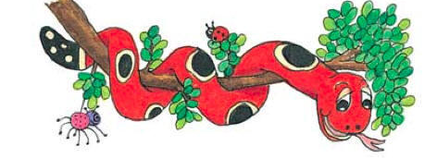
Activity Page : Grammatical Person

Slide 33
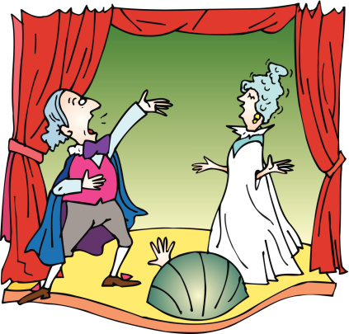
We went to the opera last night.

Slide 34
We went to the opera last night.

Slide 35
We went to the opera last night.
1st person plural

Slide 36
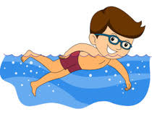
He is a good swimmer.

Slide 37
He is a good swimmer.

Slide 38
He is a good swimmer.
3rd person singular

Slide 39
They launched the magazine last year.

Slide 40
They launched the magazine last year.

Slide 41
They launched the magazine last year.
3rd person plural

Slide 42
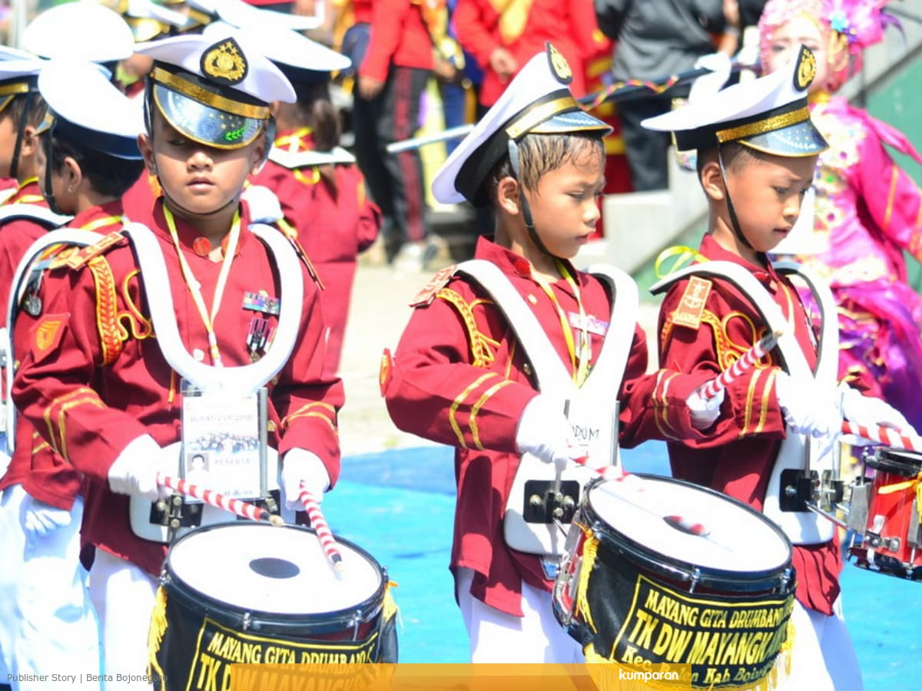
I play the drums in the band.

Slide 43
I play the drums in the band.

Slide 44
I play the drums in the band.
1st person singular

Slide 45
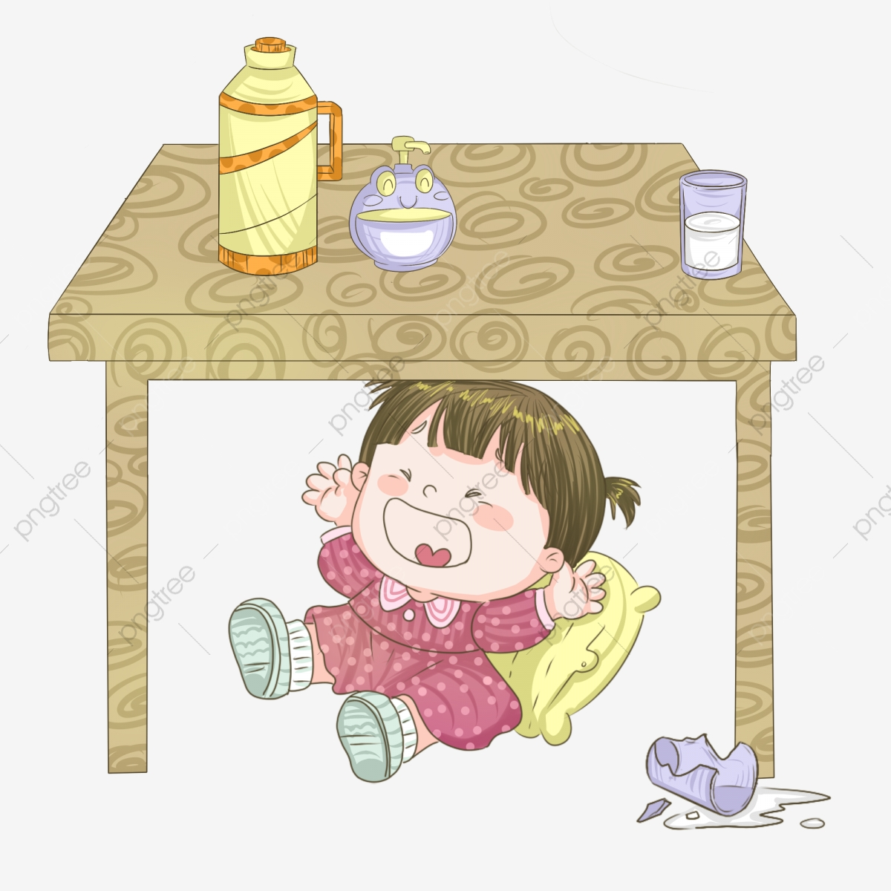
She felt scared during the earthquake.

Slide 46
She felt scared during the earthquake.

Slide 47
She felt scared during the earthquake.
3rd person singular

Slide 48
It was the world’s worst hurricane.

Slide 49
It was the world’s worst hurricane.

Slide 50
It was the world’s worst hurricane.
3rd person singular

Slide 51
You are the most enthusiastic workers.

Slide 52
You are the most enthusiastic workers.

Slide 53
You are the most enthusiastic workers.
2nd person plural

Slide 54
You painted the wall by yourself.

Slide 55
You painted the wall by yourself.

Slide 56
You painted the wall by yourself.
2nd person singular

Slide 57
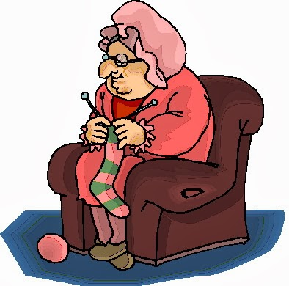
Granny knitted a hat and scarf.

Slide 58
Granny knitted a hat and scarf.
3rd person singular

Slide 59
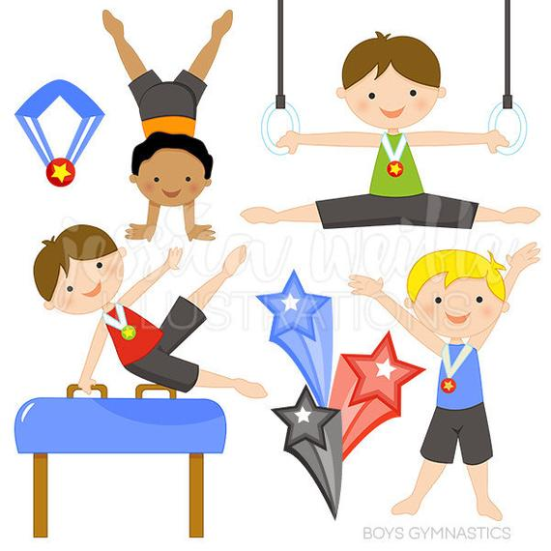
The Russian gymnasts won the tournament.

Slide 60
The Russian gymnasts won the tournament.
3rd person plural

Slide 61
The worm wiggled on the ground.

Slide 62
The worm wiggled on the ground.
3rd person singular

Slide 63
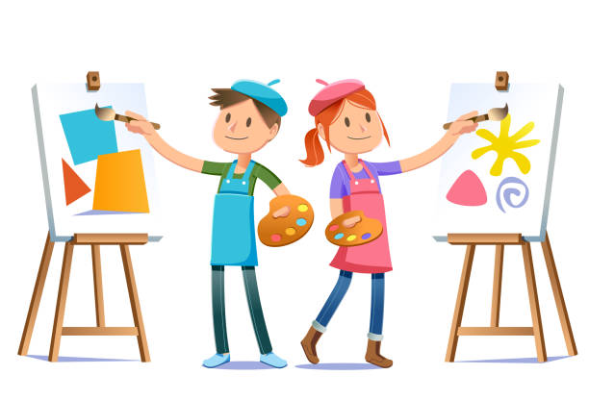
The art experts valued the painting.

Slide 64
The art experts valued the painting.
3rd person plural

Slide 65
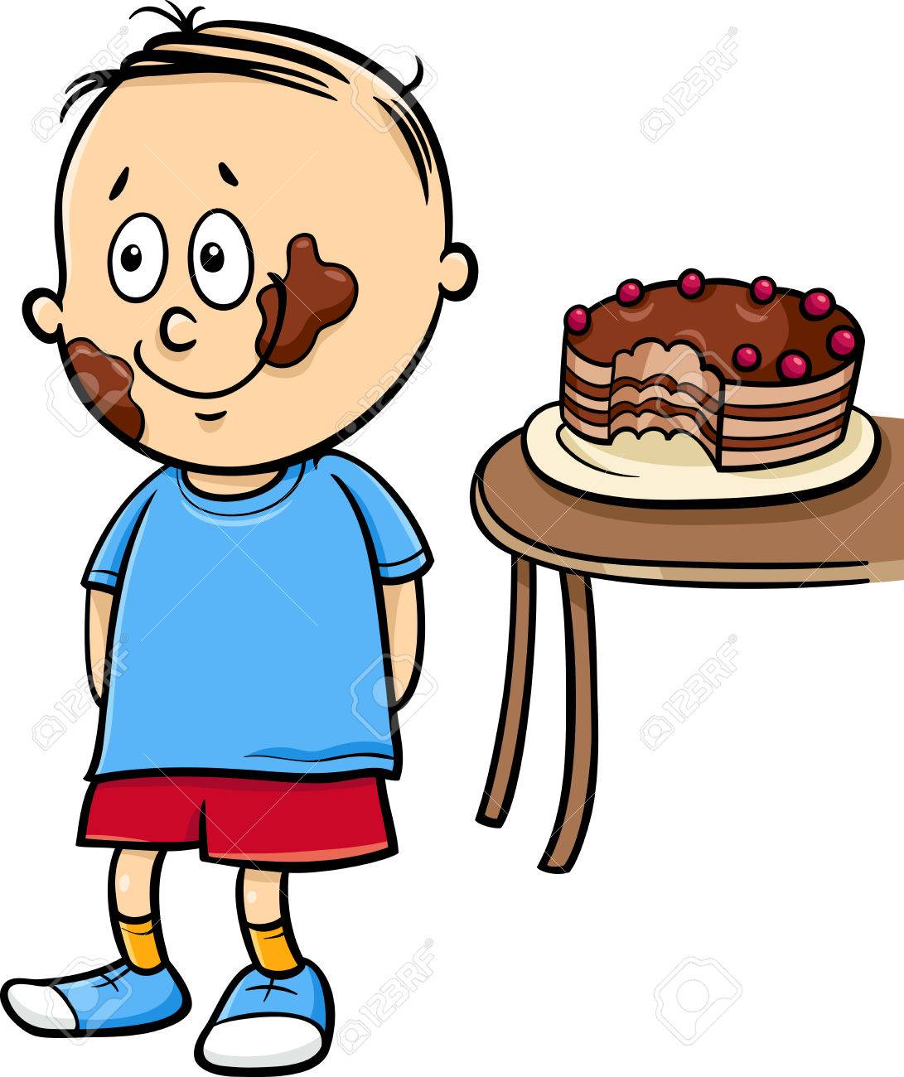
Zack ate the chocolate cake.

Slide 66
Zack ate the chocolate cake.
3rd person singular

Slide 67
Thank you.
See you
next time!

