Slide 1
Jolly Grammar 3b-26

Slide 2
Spelling Test 31

Slide 3
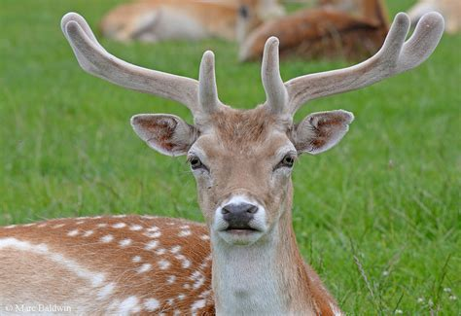
deer

Slide 4
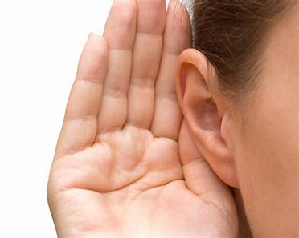
deer
hear

Slide 5
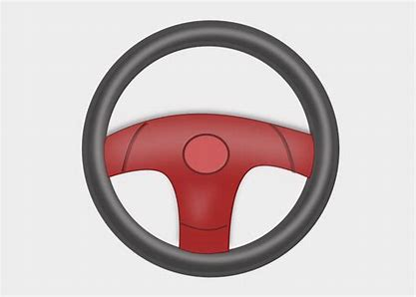
deer
hear
steer

Slide 6
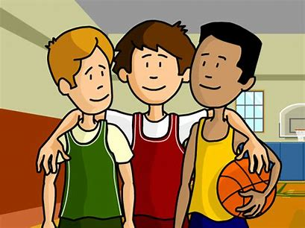
deer
hear
steer
peer

Slide 7
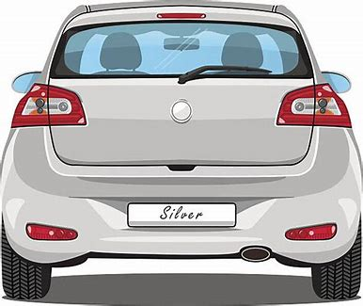
deer
hear
steer
peer
rear

Slide 8
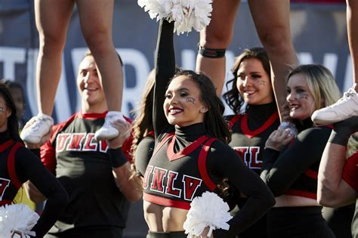
deer
hear
steer
peer
rear
cheer

Slide 9
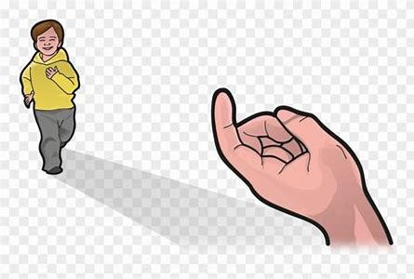
deer
hear
steer
peer
rear
cheer
7. here

Slide 10
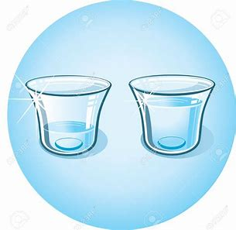
deer
hear
steer
peer
rear
cheer
7. here
8. clear

Slide 11
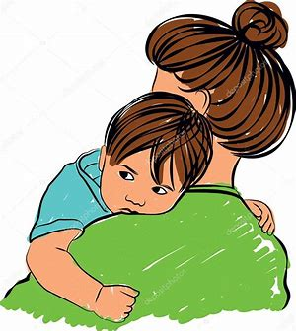
deer
hear
steer
peer
rear
cheer
7. here
8. clear
9. mere

Slide 12
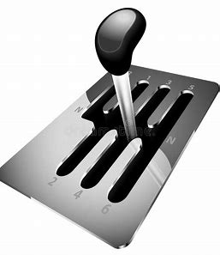
deer
hear
steer
peer
rear
cheer
7. here
8. clear
9. mere
10. gearbox

Slide 13
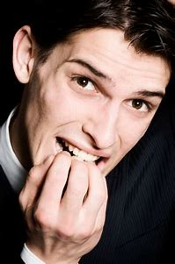
deer
hear
steer
peer
rear
cheer
7. here
8. clear
9. mere
10. gearbox
11. fearful

Slide 14
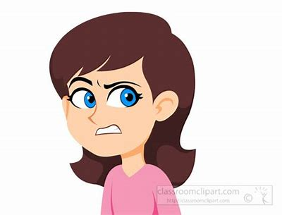
deer
hear
steer
peer
rear
cheer
7. here
8. clear
9. mere
10. gearbox
11. fearful
12. sneering

Slide 15
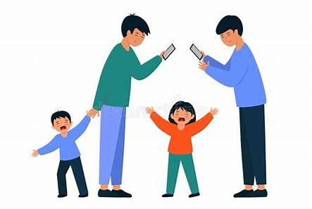
deer
hear
steer
peer
rear
cheer
7. here
8. clear
9. mere
10. gearbox
11. fearful
12. sneering
13. interfere

Slide 16
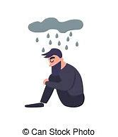
deer
hear
steer
peer
rear
cheer
7. here
8. clear
9. mere
10. gearbox
11. fearful
12. sneering
13. interfere
14. dreary

Slide 17
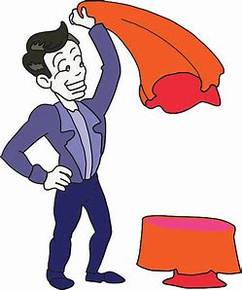
deer
hear
steer
peer
rear
cheer
7. here
8. clear
9. mere
10. gearbox
11. fearful
12. sneering
13. interfere
14. dreary
15. disappear

Slide 18
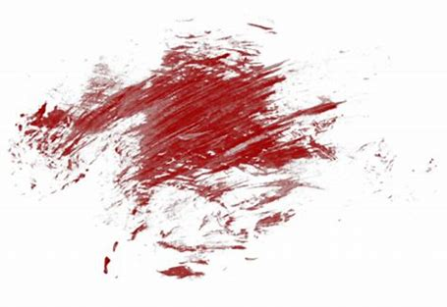
deer
hear
steer
peer
rear
cheer
7. here
8. clear
9. mere
10. gearbox
11. fearful
12. sneering
13. interfere
14. dreary
15. disappear
16. smeary

Slide 19
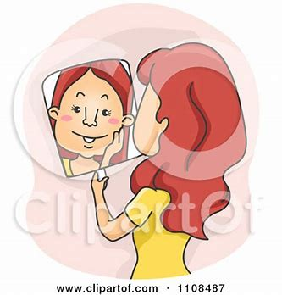
deer
hear
steer
peer
rear
cheer
7. here
8. clear
9. mere
10. gearbox
11. fearful
12. sneering
13. interfere
14. dreary
15. disappear
16. smeary
17. appearance

Slide 20
deer
hear
steer
peer
rear
cheer
7. here
8. clear
9. mere
10. gearbox
11. fearful
12. sneering
13. interfere
14. dreary
15. disappear
16. smeary
17. appearance
18. atmosphere

Slide 21
Let’s review
Speech marks.

Slide 22
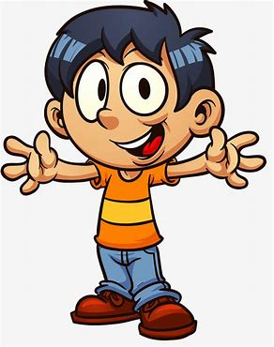
I saw you.

Slide 23
I saw you.
Bill said “I saw you.”

Slide 24
What is your name?

Slide 25
What is your name?
Bill said “What is your name?”

Slide 26
What is your name?
Bill said “What is your name?”
asked
questioned

Slide 27
Go away!

Slide 28
Go away!
Bill said “Go away!”
shouted
exclaimed

Slide 29
wondered, enquired, questioned
exclaimed, shouted, called, shrieked

Slide 30
wondered, enquired, questioned
exclaimed, shouted, called, shrieked

Slide 31
Thank you!

