Slide 1
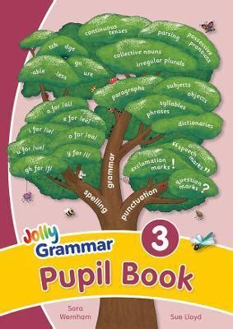
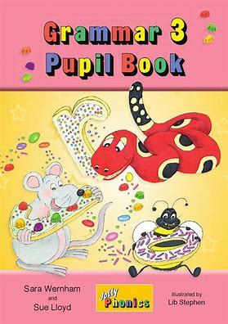
Jolly Grammar 3b-25

Slide 2
Let’s review
Homophones.

Slide 3
Put it over there!
They put on their hats.
They’re going to the park later.

Slide 4
Activity page

Slide 5
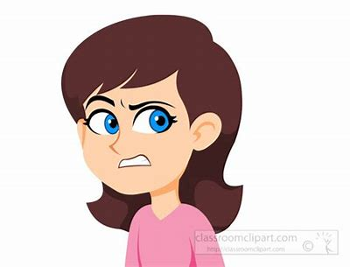
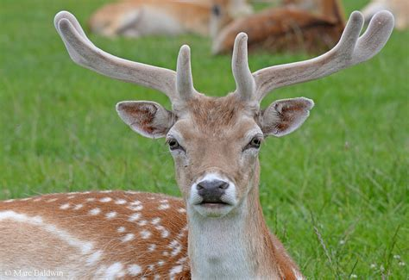
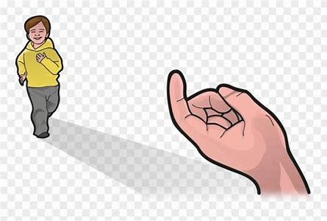
dear
/ear/
here
/ear/
sneering
/ear/

Slide 6
Spelling List

Slide 7
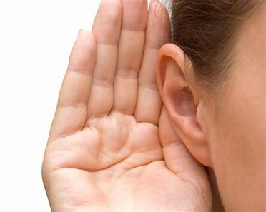
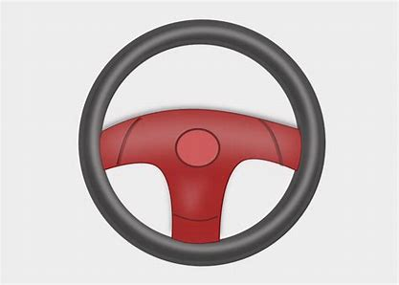
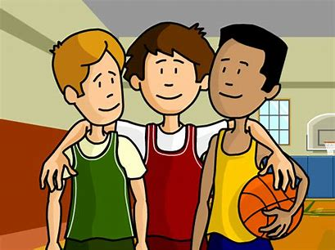
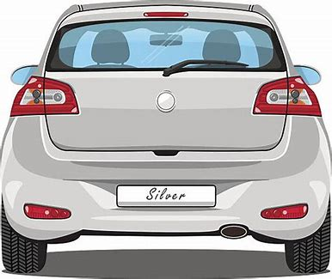
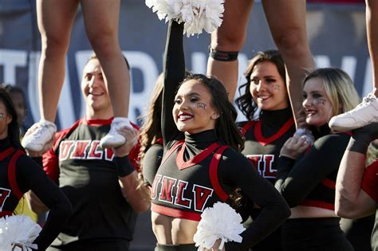
deer hear steer
peer rear cheer

Slide 8
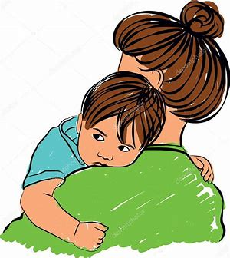
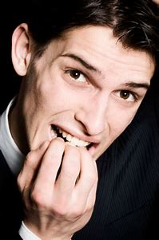
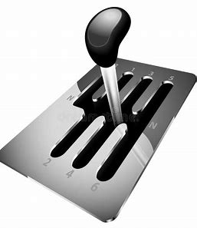
here clear mere
gearbox fearful sneering

Slide 9
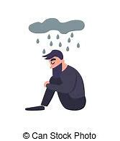
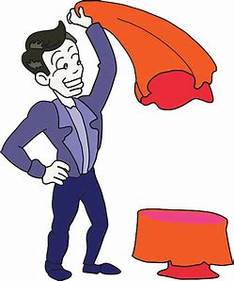
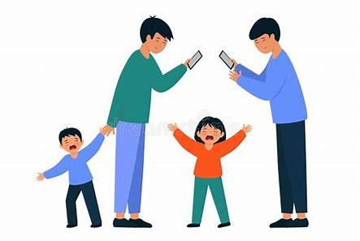
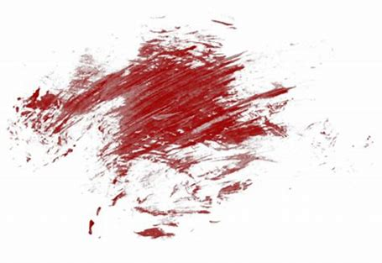
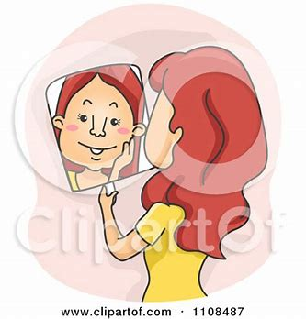
interfere dreary disappear
smeary appearance atmosphere

Slide 11
Fill in the missing letters.

Slide 12
Activity page
page.60

Slide 13
Let’s review
syllables.

Slide 14
cheerful
atmosphere
fearless
nearly
interfere

Slide 15
Let’s parse
sentences.

Slide 16
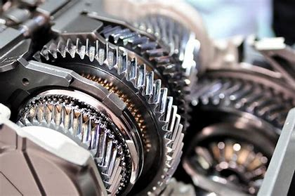
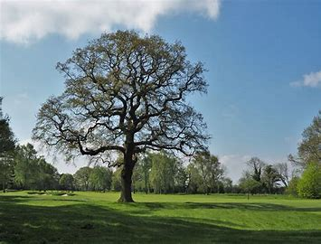
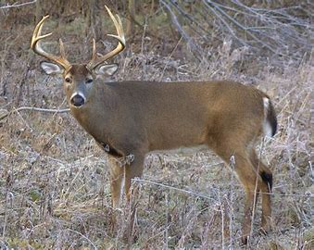
Parse these sentences.
The red car had a faulty gearbox.
The fearful deer stood hesitantly
by the big oak tree.

Slide 17
Parse these sentences.
The red car had a faulty gearbox.
The fearful deer stood hesitantly
by the big oak tree.

Slide 18
Parse these sentences.
The red car had a faulty gearbox.
The fearful deer stood hesitantly
by the big oak tree.

Slide 19
Parse these sentences.
The red car had a faulty gearbox.
The fearful deer stood hesitantly
by the big oak tree.

Slide 20
Parse these sentences.
The red car had a faulty gearbox.
The fearful deer stood hesitantly
by the big oak tree.

Slide 21
Parse these sentences.
The red car had a faulty gearbox.
The fearful deer stood hesitantly
by the big oak tree.

Slide 22
Parse these sentences.
The red car had a faulty gearbox.
The fearful deer stood hesitantly
by the big oak tree.

Slide 23
Parse these sentences.
The red car had a faulty gearbox.
The fearful deer stood hesitantly
by the big oak tree.

Slide 24
Parse these sentences.
The red car had a faulty gearbox.
The fearful deer stood hesitantly
by the big oak tree.

Slide 25
Parse these sentences.
The red car had a faulty gearbox.
The fearful deer stood hesitantly
by the big oak tree.

Slide 26
Parse these sentences.
The red car had a faulty gearbox.
The fearful deer stood hesitantly
by the big oak tree.

Slide 27
Parse these sentences.
The red car had a faulty gearbox.
The fearful deer stood hesitantly
by the big oak tree.

Slide 28
Parse these sentences.
The red car had a faulty gearbox.
The fearful deer stood hesitantly
by the big oak tree.

Slide 29
Dictation

Slide 30
Dictation
1.
2.
3.

Slide 31
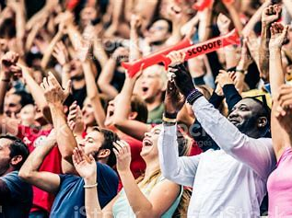

Slide 32
1.
The cheering crowd was waiting for the prince and princess’s appearance.

Slide 33
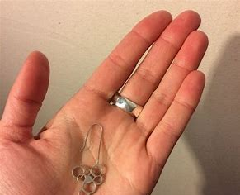

Slide 34
2.
“My best earrings have disappeared,” said Beth.

Slide 35
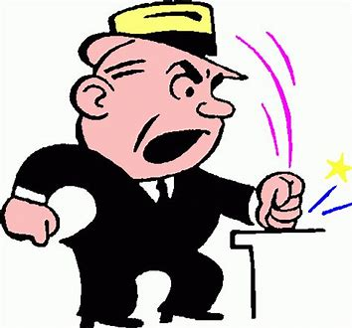

Slide 36
3. “Did you hear the dreary speech?” asked Bill.

Slide 37
Thank you!

