Slide 1
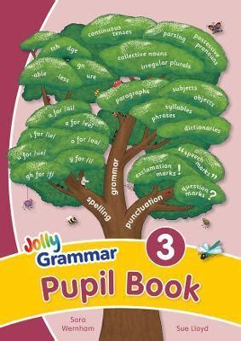
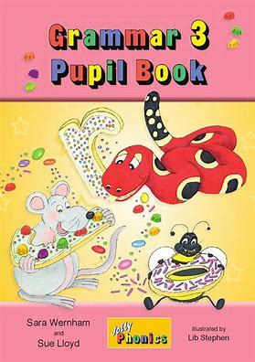
Jolly Grammar 3b-24

Slide 2
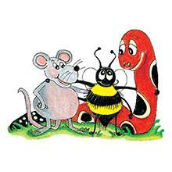
Spelling Test 30

Slide 3
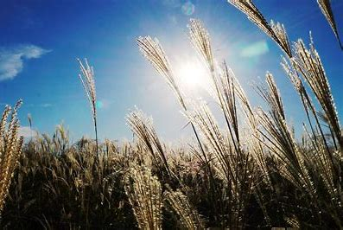
reed

Slide 4
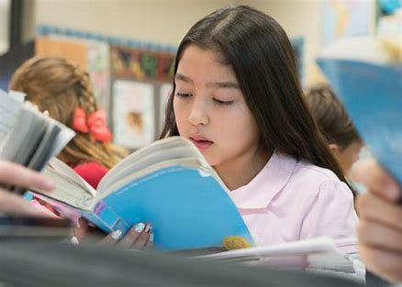
reed
read

Slide 5
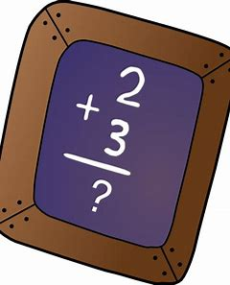
reed
read
sum

Slide 6
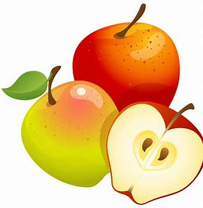
reed
read
sum
some

Slide 7
reed
read
sum
some
blue

Slide 8
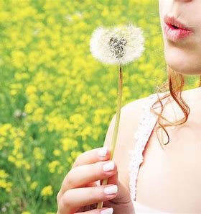
reed
read
sum
some
blue
blew

Slide 9
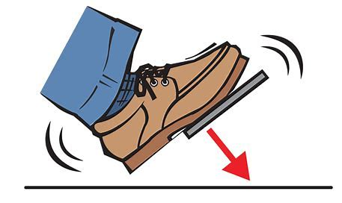
reed
read
sum
some
blue
blew
7. brake

Slide 10
reed
read
sum
some
blue
blue
7. brake
8. break

Slide 11
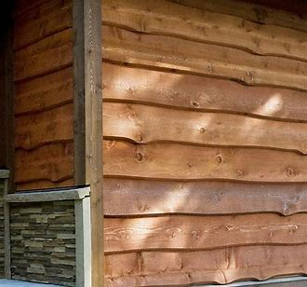
reed
read
sum
some
blue
blue
7. brake
8. break
9. wood

Slide 12
reed
read
sum
some
blue
blue
7. brake
8. break
9. wood
10. would

Slide 13
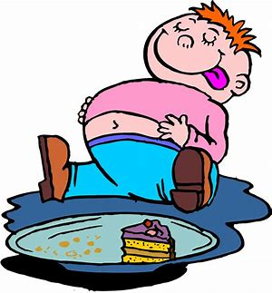
reed
read
sum
some
blue
blue
7. brake
8. break
9. wood
10. would
11. ate

Slide 14
reed
read
sum
some
blue
blue
7. brake
8. break
9. wood
10. would
11. ate
12. eight

Slide 15
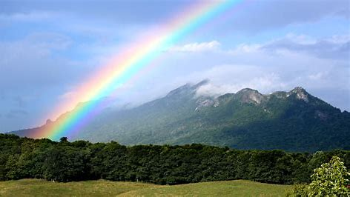
reed
read
sum
some
blue
blue
7. brake
8. break
9. wood
10. would
11. ate
12. eight
13. weather

Slide 16
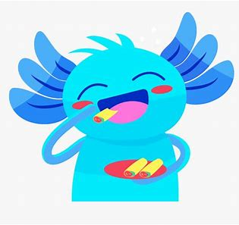
reed
read
sum
some
blue
blue
7. brake
8. break
9. wood
10. would
11. ate
12. eight
13. weather
14. whether

Slide 17
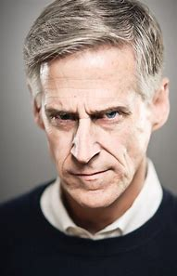
reed
read
sum
some
blue
blue
7. brake
8. break
9. wood
10. would
11. ate
12. eight
13. weather
14. whether
15. stare

Slide 18
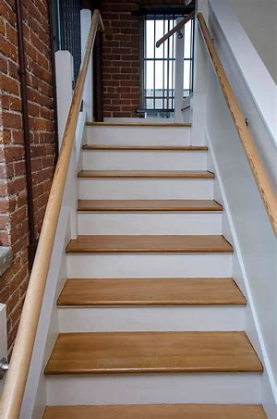
reed
read
sum
some
blue
blue
7. brake
8. break
9. wood
10. would
11. ate
12. eight
13. weather
14. whether
15. stare
16. stair

Slide 19
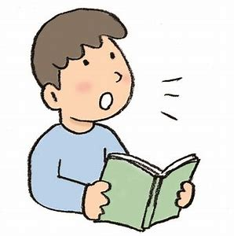
reed
read
sum
some
blue
blue
7. brake
8. break
9. wood
10. would
11. ate
12. eight
13. weather
14. whether
15. stare
16. stair
17. aloud

Slide 20
reed
read
sum
some
blue
blue
7. brake
8. break
9. wood
10. would
11. ate
12. eight
13. weather
14. whether
15. stare
16. stair
17. aloud
18. allowed

Slide 21
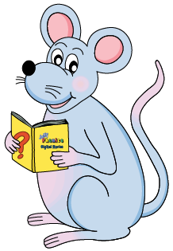
Let’s review
Possessive homophones.

Slide 22
Homophones
Homophones are words that sound similar to one another, but have different spellings and meanings.

Slide 23
We are putting our books on the table.

Slide 24
We are putting our books on the table.
verb
to be
possessive
adjectives
We put on our coats to play outside.
We are going to play outside.

Slide 25
Activity page
page.61

Slide 26
Put it over there!
They put on their hats.
They’re going to the park later.

Slide 27
Adverb
Put it over there!
adjective
They put on their hats.
They＋are (pronoun & verb)
They’re going to the park later.

Slide 28
Should it be ‘there’ ‘their’ or ‘they’re’?

Slide 29
Should it be ‘there’ ‘their’ or ‘they’re’?
They’re going to cut the cake now.
The twins invited their friends to the party.
There is a spider on the ceiling.
It was so cold they put on their coats.
Put the chairs back over there.
On Wednesday they’re playing hocky.

Slide 30
Should it be ‘there’ ‘their’ or ‘they’re’?

Slide 31
Should it be ‘there’ ‘their’ or ‘they’re’?
They put on their boots when it rains.
We went there by bus.
When they’re ready, we can go.
There is plenty of time before we leave.
They got their books out of the locker.
If they’re good, they will get a treat.
There are ten children with their parents
and they’re staying all day.

Slide 32
Thank you.

