Slide 1
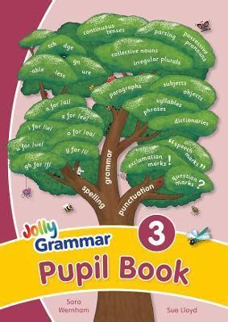
Jolly Grammar 3b-23

Slide 2
Let’s review
Possessive homophones.

Slide 3
Homophones
Homophones are words that sound similar to one another, but have different spellings and meanings.

Slide 4
We are putting our books on the table.

Slide 5
We are putting our books on the table.
verb
to be
possessive
adjectives
We put on our coats to play outside.
We are going to play outside.

Slide 6
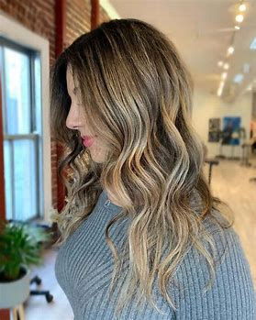
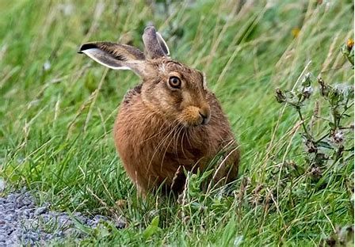
hair
/air/
hare
/air/

Slide 7
Spelling List
Homophones

Slide 8
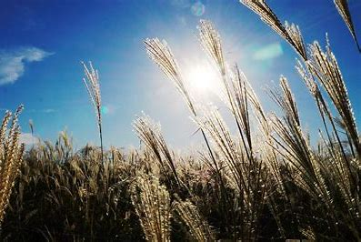
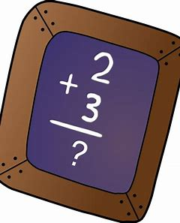
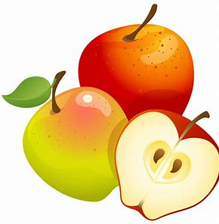
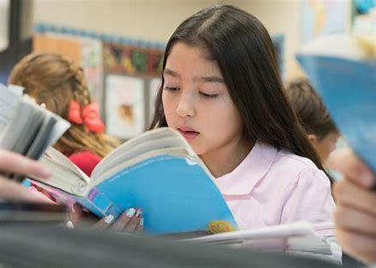
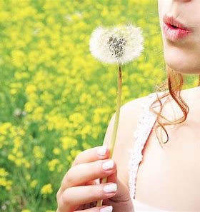
reed sum blue
read some blew

Slide 9
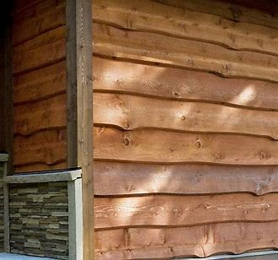
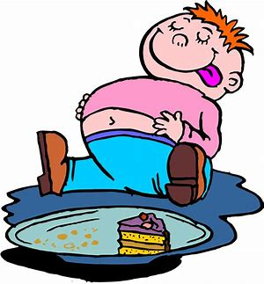
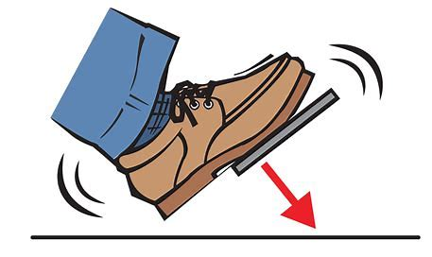
brake wood ate
break would eight

Slide 10
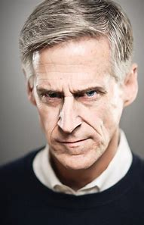
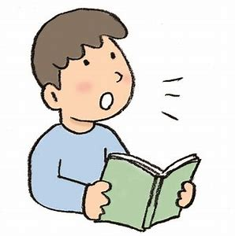
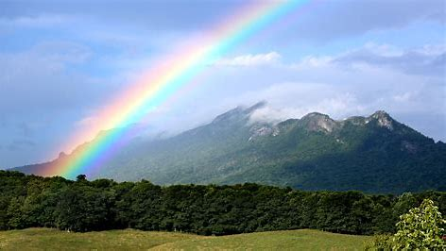
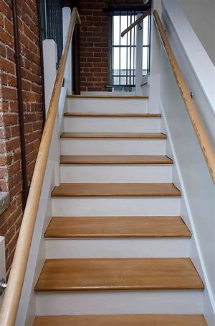
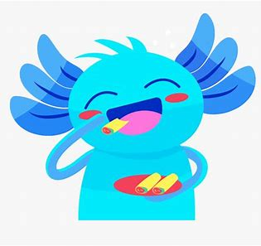
weather stare aloud
whether stair allowed

Slide 12
Activity page
page.60

Slide 13
Draw the correct picture.

Slide 14
Let’s review
syllables.

Slide 15
cell
leak
cymbal
sell
leak
symbol

Slide 16
Let’s parse
sentences.

Slide 17
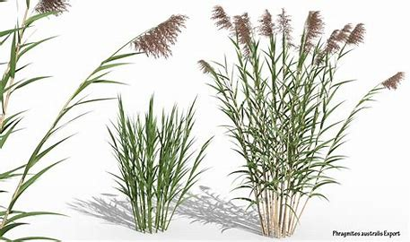
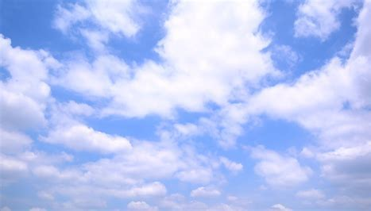
Parse these sentences.
I am reading a book about reeds.
The wind blew the clouds across the blue sky.

Slide 18
Parse these sentences.
I am reading a book about reeds.
The wind blew the clouds across the blue sky.

Slide 19
Parse these sentences.
I am reading a book about reeds.
The wind blew the clouds across the blue sky.

Slide 20
Parse these sentences.
I am reading a book about reeds.
The wind blew the clouds across the blue sky.

Slide 21
Parse these sentences.
I am reading a book about reeds.
The wind blew the clouds across the blue sky.

Slide 22
Parse these sentences.
I am reading a book about reeds.
The wind blew the clouds across the blue sky.

Slide 23
Parse these sentences.
I am reading a book about reeds.
The wind blew the clouds across the blue sky.

Slide 24
Parse these sentences.
I am reading a book about reeds.
The wind blew the clouds across the blue sky.

Slide 25
Parse these sentences.
I am reading a book about reeds.
The wind blew the clouds across the blue sky.

Slide 26
Parse these sentences.
I am reading a book about reeds.
The wind blew the clouds across the blue sky.

Slide 27
Parse these sentences.
I am reading a book about reeds.
The wind blew the clouds across the blue sky.

Slide 28
Parse these sentences.
I am reading a book about reeds.
The wind blew the clouds across the blue sky.

Slide 29
Dictation

Slide 30
Dictation
1.
2.
3.

Slide 31
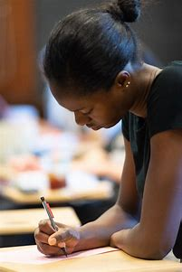

Slide 32
1.
I hope I write the right words.

Slide 33
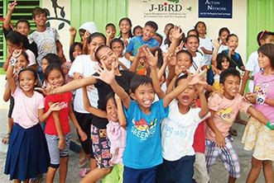
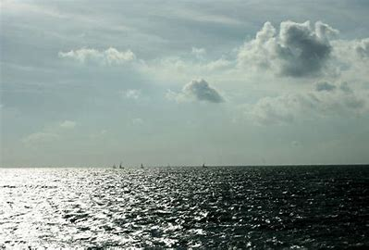

Slide 34
2.
“I can see the sea,” shouted the children excitedly.

Slide 35
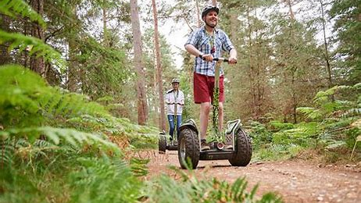

Slide 36
3. “I would like to go to the wood,” declared Tim.

Slide 37
Thank you!

