Slide 1
Jolly Grammar 3b-22

Slide 2
Spelling Test 29

Slide 3
halt

Slide 4
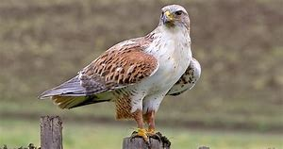
halt
hawk

Slide 5
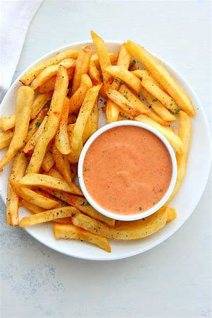
halt
hawk
sauce

Slide 6
halt
hawk
sauce
haul

Slide 7
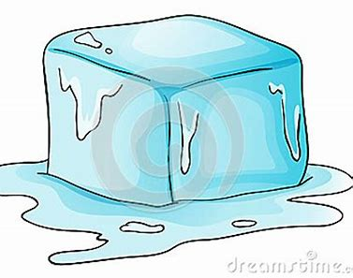
halt
hawk
sauce
haul
thaw

Slide 8
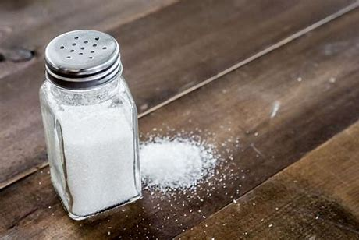
halt
hawk
sauce
haul
thaw
salt

Slide 9
halt
hawk
sauce
haul
thaw
salt
7. flaw

Slide 10
halt
hawk
sauce
haul
thaw
salt
7. flaw
8. drawn

Slide 11
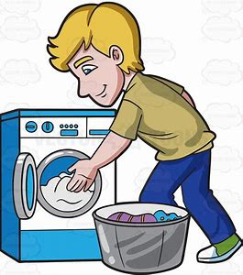
halt
hawk
sauce
haul
thaw
salt
7. flaw
8. drawn
9. laundry

Slide 12
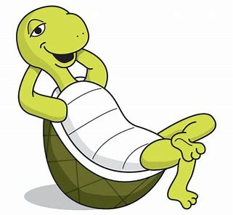
halt
hawk
sauce
haul
thaw
salt
7. flaw
8. drawn
9. laundry
10. dawdle

Slide 13
halt
hawk
sauce
haul
thaw
salt
7. flaw
8. drawn
9. laundry
10. dawdle
11. already

Slide 14
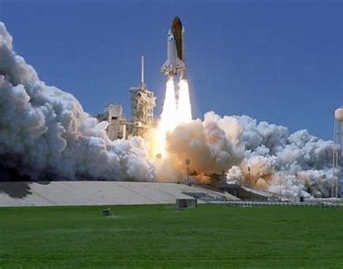
halt
hawk
sauce
haul
thaw
salt
7. flaw
8. drawn
9. laundry
10. dawdle
11. already
12. launch

Slide 15
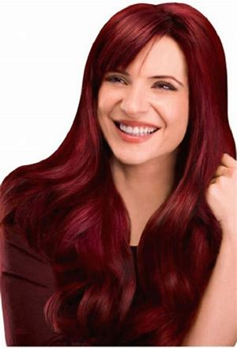
halt
hawk
sauce
haul
thaw
salt
7. flaw
8. drawn
9. laundry
10. dawdle
11. already
12. launch
13. auburn

Slide 16
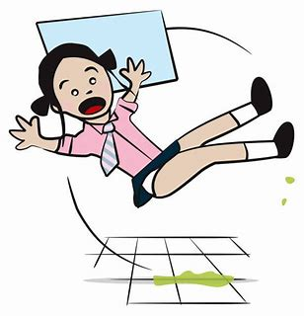
halt
hawk
sauce
haul
thaw
salt
7. flaw
8. drawn
9. laundry
10. dawdle
11. already
12. launch
13. auburn
14. awkward

Slide 17
halt
hawk
sauce
haul
thaw
salt
7. flaw
8. drawn
9. laundry
10. dawdle
11. already
12. launch
13. auburn
14. awkward
15. alternative

Slide 18
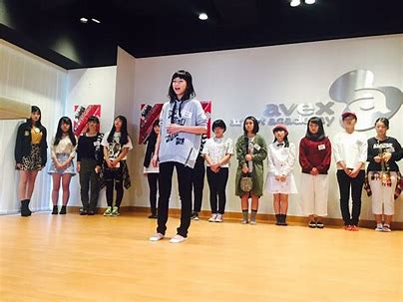
halt
hawk
sauce
haul
thaw
salt
7. flaw
8. drawn
9. laundry
10. dawdle
11. already
12. launch
13. auburn
14. awkward
15. alternative
16. audition

Slide 19
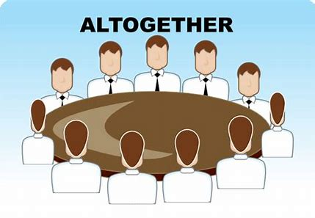
halt
hawk
sauce
haul
thaw
salt
7. flaw
8. drawn
9. laundry
10. dawdle
11. already
12. launch
13. auburn
14. awkward
15. alternative
16. audition
17. altogether

Slide 20
halt
hawk
sauce
haul
thaw
salt
7. flaw
8. drawn
9. laundry
10. dawdle
11. already
12. launch
13. auburn
14. awkward
15. alternative
16. audition
17. altogether
18. awesome

Slide 21
Let’s review
Possessive adjectives.

Slide 22
I have a pen.
The pen belongs to me.
It is my pen.
It is mine.

Slide 23
Possessive adjectives

Slide 24
Possessive adjectives
my pen

Slide 25
Possessive adjectives
my pen
your pen

Slide 26
Possessive adjectives
my pen
your pen
his pen

Slide 27
Possessive adjectives
my pen
your pen
his pen
her pen

Slide 28
Possessive adjectives
my pen
your pen
his pen
her pen
its pen

Slide 29
Possessive adjectives
my pen
your pen
his pen
her pen
its pen
our pen

Slide 30
Possessive adjectives
my pen
your pen
his pen
her pen
its pen
our pen
your pen

Slide 31
Possessive adjectives
my pen
your pen
his pen
her pen
its pen
our pen
your pen
their pen

Slide 32
Let’s review
Possessive pronouns.

Slide 33
Possessive adjectives
Possessive pronouns
my pen
your pen
his pen
her pen
its pen
our pen
your pen
their pen

Slide 34
I have a pen.
The pen belongs to me.
It is my pen.
It is mine.

Slide 35
Possessive adjectives
Possessive pronouns
my pen
your pen
his pen
her pen
its pen
our pen
your pen
their pen
mine

Slide 36
Possessive adjectives
Possessive pronouns
my pen
your pen
his pen
her pen
its pen
our pen
your pen
their pen
mine
yours

Slide 37
Possessive adjectives
Possessive pronouns
my pen
your pen
his pen
her pen
its pen
our pen
your pen
their pen
mine
yours
his

Slide 38
Possessive adjectives
Possessive pronouns
my pen
your pen
his pen
her pen
its pen
our pen
your pen
their pen
mine
yours
his
hers

Slide 39
Possessive adjectives
Possessive pronouns
my pen
your pen
his pen
her pen
its pen
our pen
your pen
their pen
mine
yours
his
hers
its

Slide 40
Possessive adjectives
Possessive pronouns
my pen
your pen
his pen
her pen
its pen
our pen
your pen
their pen
mine
yours
his
hers
its
ours

Slide 41
Possessive adjectives
Possessive pronouns
my pen
your pen
his pen
her pen
its pen
our pen
your pen
their pen
mine
yours
his
hers
its
ours
yours

Slide 42
Possessive adjectives
Possessive pronouns
my pen
your pen
his pen
her pen
its pen
our pen
your pen
their pen
mine
yours
his
hers
its
ours
yours
theirs

Slide 43
Let’s review
the irregular verb to be.

Slide 44
Verb to be
I tall.
You tall.
He tall.
She tall.
It tall.
We tall.
You tall.
They tall.

Slide 45
Verb to be
I am tall.
You tall.
He tall.
She tall.
It tall.
We tall.
You tall.
They tall.

Slide 46
Verb to be
I am tall.
You are tall.
He tall.
She tall.
It tall.
We tall.
You tall.
They tall.

Slide 47
Verb to be
I am tall.
You are tall.
He is tall.
She tall.
It tall.
We tall.
You tall.
They tall.

Slide 48
Verb to be
I am tall.
You are tall.
He is tall.
She is tall.
It tall.
We tall.
You tall.
They tall.

Slide 49
Verb to be
I am tall.
You are tall.
He is tall.
She is tall.
It is tall.
We tall.
You tall.
They tall.

Slide 50
Verb to be
I am tall.
You are tall.
He is tall.
She is tall.
It is tall.
We are tall.
You tall.
They tall.

Slide 51
Verb to be
I am tall.
You are tall.
He is tall.
She is tall.
It is tall.
We are tall.
You are tall.
They tall.

Slide 52
Verb to be
I am tall.
You are tall.
He is tall.
She is tall.
It is tall.
We are tall.
You are tall.
They are tall.

Slide 53
Verb to be
Possessive adjectives
I am tall.
You are tall.
He is tall.
She is tall.
It is tall.
We are tall.
You are tall.
They are tall.
my pen
your pen
his pen
her pen
its pen
our pen
your pen
their pen

Slide 54
Verb to be
Possessive adjectives
I am tall.
You are tall.
He is tall.
She is tall.
It is tall.
We are tall.
You are tall.
They are tall.
my pen
your pen
his pen
her pen
its pen
our pen
your pen
their pen

Slide 55
Homophones
Homophones are words that sound similar to one another, but have different spellings and meanings.

Slide 56
We are putting our books on the table.

Slide 57
We are putting our books on the table.
verb
to be

Slide 58
We are putting our books on the table.
verb
to be
possessive
adjectives

Slide 59
We are putting our books on the table.
verb
to be
possessive
adjectives

Slide 60
We are putting our books on the table.
verb
to be
possessive
adjectives
We put on coats to play outside.
We going to play outside.

Slide 61
We are putting our books on the table.
verb
to be
possessive
adjectives
We put on our coats to play outside.
We going to play outside.

Slide 62
We are putting our books on the table.
verb
to be
possessive
adjectives
We put on our coats to play outside.
We are going to play outside.

Slide 63
Activity page
page.59

Slide 64
Is it ‘are’ or ‘our’?

Slide 65
Is it ‘are’ or ‘our’?
How are you?

Slide 66
Is it ‘are’ or ‘our’?
How are you?
This is our house.

Slide 67
Is it ‘are’ or ‘our’?
How are you?
This is our house.
Javid is in our team.

Slide 68
Is it ‘are’ or ‘our’?
How are you?
This is our house.
Javid is in our team.
Where are you going on Saturday?

Slide 69
Is it ‘are’ or ‘our’?
How are you?
This is our house.
Javid is in our team.
Where are you going on Saturday?
The pencils are in the cupboard.

Slide 70
Is it ‘are’ or ‘our’?
How are you?
This is our house.
Javid is in our team.
Where are you going on Saturday?
The pencils are in the cupboard.
The circus acrobats are very good.

Slide 71
Is it ‘are’ or ‘our’?
How are you?
This is our house.
Javid is in our team.
Where are you going on Saturday?
The pencils are in the cupboard.
The circus acrobats are very good.
We put the picnic things in our car.

Slide 72
Is it ‘are’ or ‘our’?
How are you?
This is our house.
Javid is in our team.
Where are you going on Saturday?
The pencils are in the cupboard.
The circus acrobats are very good.
We put the picnic things in our car.
Our dog is very friendly.

Slide 73
Should it be ‘are’ or ‘our’?

Slide 74
Should it be ‘are’ or ‘our’?
We are going to the beach at the weekend.

Slide 75
Should it be ‘are’ or ‘our’?
We are going to the beach at the weekend.
When are they arriving?

Slide 76
Should it be ‘are’ or ‘our’?
We are going to the beach at the weekend.
When are they arriving?
We stayed at our cousin’s house in the holidays.

Slide 77
Should it be ‘are’ or ‘our’?
We are going to the beach at the weekend.
When are they arriving?
We stayed at our cousin’s house in the holidays.
Which blouse are you going to wear?

Slide 78
Should it be ‘are’ or ‘our’?
We are going to the beach at the weekend.
When are they arriving?
We stayed at our cousin’s house in the holidays.
Which blouse are you going to wear?
Our grandma is a very good cook.

Slide 79
Should it be ‘are’ or ‘our’?
We are going to the beach at the weekend.
When are they arriving?
We stayed at our cousin’s house in the holidays.
Which blouse are you going to wear?
Our grandma is a very good cook.
Can we go when we have put on our coats?

Slide 80
Should it be ‘are’ or ‘our’?
We are going to the beach at the weekend.
When are they arriving?
We stayed at our cousin’s house in the holidays.
Which blouse are you going to wear?
Our grandma is a very good cook.
Can we go when we have put on our coats?
The cakes are in the spotty yellow tin.

Slide 81
Should it be ‘are’ or ‘our’?
We are going to the beach at the weekend.
When are they arriving?
We stayed at our cousin’s house in the holidays.
Which blouse are you going to wear?
Our grandma is a very good cook.
Can we go when we have put on our coats?
The cakes are in the spotty yellow tin.
How are our friends getting to the zoo tomorrow?

Slide 82
Thank you!

