Slide 1
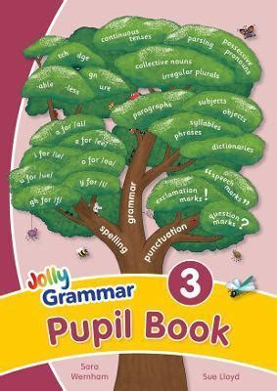
Jolly Grammar 3b-21

Slide 2
Let’s review
Possessive
pronouns.

Slide 3
This hat belongs to me.
It is my hat.
It is mine.
This coat belongs to him.
It is his coat.
It is his.
That dog belong to you all.
It is your dog.
It is yours.
This brush belong to her.
It is her brush.
It is hers.
This book belongs to us.
It is our book.
It is ours.
That teddy belongs to you.
It is your teddy.
It is yours.
That cat belongs to them.
It is their cat.
It is theirs.

Slide 4
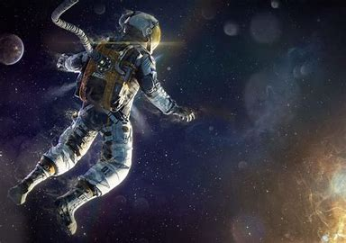
astronaut
/or/

Slide 5
or

Slide 6
horse
fork
storm
forty
morning
corn
sort
worn
or

Slide 7
horse
fork
storm
forty
morning
corn
sort
worn
walk
talk
stalk
wall
call
halt
salt
or

Slide 8
horse
fork
storm
forty
morning
corn
sort
worn
walk
talk
stalk
wall
call
halt
salt
fault
autumn
haunt
August
astronaut
haul
launch
or

Slide 9
horse
fork
storm
forty
morning
corn
sort
worn
walk
talk
stalk
wall
call
halt
salt
fault
autumn
haunt
August
astronaut
haul
launch
saw
claw
dawn
prawn
strawberry
or

Slide 10
horse
fork
storm
forty
morning
corn
sort
worn
walk
talk
stalk
wall
call
halt
salt
fault
autumn
haunt
August
astronaut
haul
launch
saw
claw
dawn
prawn
strawberry
more
before
store
wore
snore
core
or

Slide 11
Spelling List
Spelling
<al><au><aw>
for /or/ sound

Slide 12
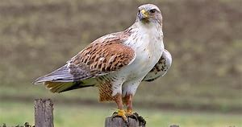
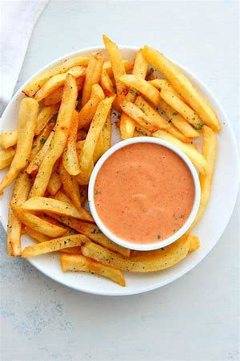
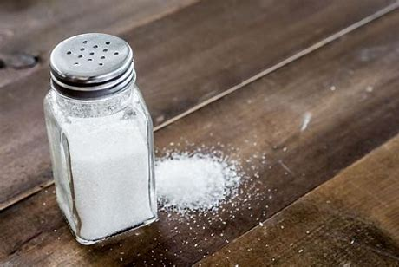
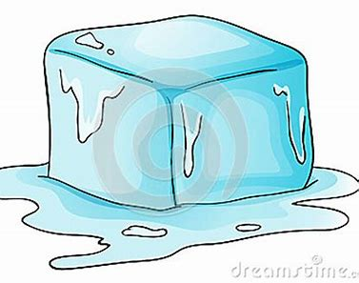
halt hawk sauce
haul thaw salt

Slide 13
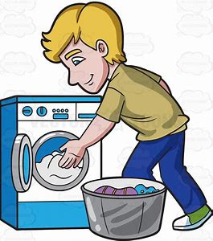
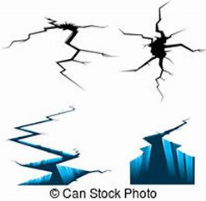
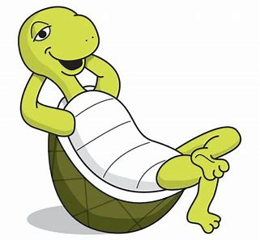
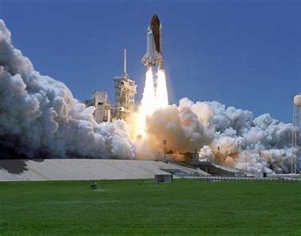
flaw drawn laundry
dawdle already launch

Slide 14
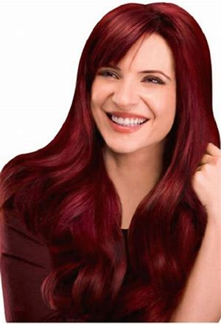
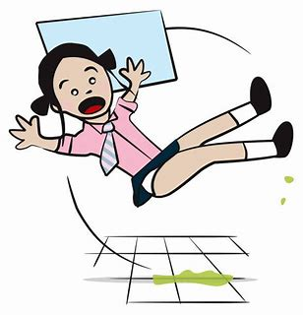
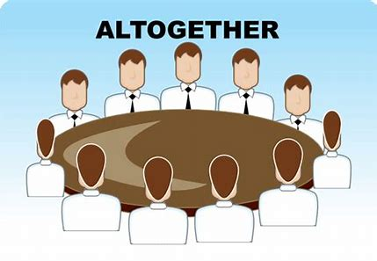
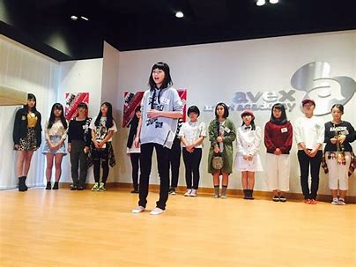
auburn awkward alternative
audition altogether awesome

Slide 16
Activity page
page.58

Slide 17
Let’s review
syllables.

Slide 18
awkward
autumn
lawnmower
awesome
astronaut

Slide 19
Let’s parse
sentences.

Slide 20
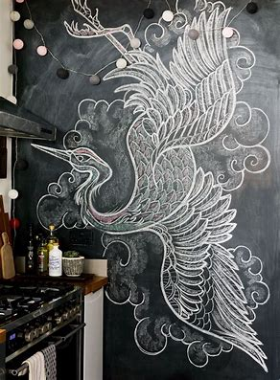
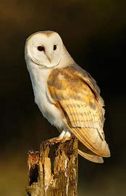
Parse these sentences.
They chalked a giant picture on
the tall wall.
The barn owl hooted and called loudly until dawn.

Slide 21
Parse these sentences.
They chalked a giant picture on
the tall wall.
The barn owl hooted and called loudly until dawn.

Slide 22
Parse these sentences.
They chalked a giant picture on
the tall wall.
The barn owl hooted and called loudly until dawn.

Slide 23
Parse these sentences.
They chalked a giant picture on
the tall wall.
The barn owl hooted and called loudly until dawn.

Slide 24
Parse these sentences.
They chalked a giant picture on
the tall wall.
The barn owl hooted and called loudly until dawn.

Slide 25
Parse these sentences.
They chalked a giant picture on
the tall wall.
The barn owl hooted and called loudly until dawn.

Slide 26
Parse these sentences.
They chalked a giant picture on
the tall wall.
The barn owl hooted and called loudly until dawn.

Slide 27
Parse these sentences.
They chalked a giant picture on
the tall wall.
The barn owl hooted and called loudly until dawn.

Slide 28
Parse these sentences.
They chalked a giant picture on
the tall wall.
The barn owl hooted and called loudly until dawn.

Slide 29
Parse these sentences.
They chalked a giant picture on
the tall wall.
The barn owl hooted and called loudly until dawn.

Slide 30
Parse these sentences.
They chalked a giant picture on
the tall wall.
The barn owl hooted and called loudly until dawn.

Slide 31
Parse these sentences.
They chalked a giant picture on
the tall wall.
The barn owl hooted and called loudly until dawn.

Slide 32
Parse these sentences.
They chalked a giant picture on
the tall wall.
The barn owl hooted and called loudly until dawn.

Slide 33
Parse these sentences.
They chalked a giant picture on
the tall wall.
The barn owl hooted and called loudly until dawn.

Slide 34
Parse these sentences.
They chalked a giant picture on
the tall wall.
The barn owl hooted and called loudly until dawn.

Slide 35
Parse these sentences.
They chalked a giant picture on
the tall wall.
The barn owl hooted and called loudly until dawn.

Slide 36
Word description

Slide 37
salt

Slide 38
salt
thaw

Slide 39
salt
thaw
laundry

Slide 40
salt
thaw
laundry
alternative

Slide 41
salt
thaw
laundry
alternative
launch

Slide 42
salt
thaw
laundry
alternative
launch
6. auburn

Slide 43
salt
thaw
laundry
alternative
launch
6. auburn
7. hawk

Slide 44
salt
thaw
laundry
alternative
launch
6. auburn
7. hawk
8. halt

Slide 45
salt
thaw
laundry
alternative
launch
6. auburn
7. hawk
8. halt
9. haul

Slide 46
salt
thaw
laundry
alternative
launch
6. auburn
7. hawk
8. halt
9. haul
10. awkward

Slide 47
Dictation

Slide 48
Dictation
1.
2.
3.

Slide 50
1.
They still talk about the great storm last August.

Slide 51
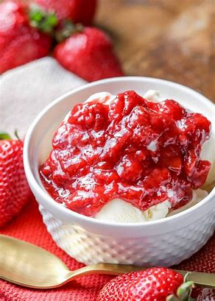
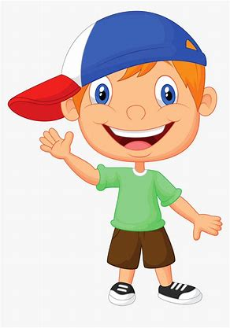

Slide 52
2.
“I like strawberry sauce on my ice cream.” commented Sam.

Slide 53
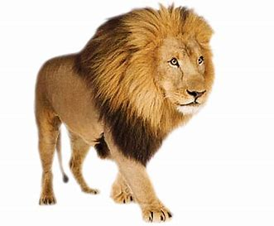
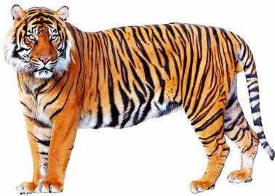
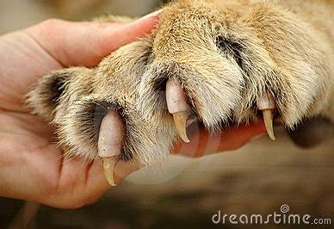

Slide 54
3. The lions and tigers have big claws.

Slide 55
Homework

