Slide 1
Jolly Grammar 3b-20

Slide 2
Spelling Test 28

Slide 3
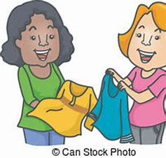
swap

Slide 4
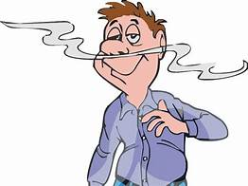
swap
waft

Slide 5
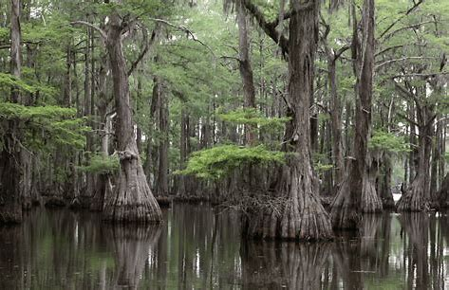
swap
waft
swamp

Slide 6
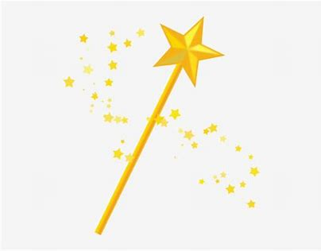
swap
waft
swamp
wand

Slide 7
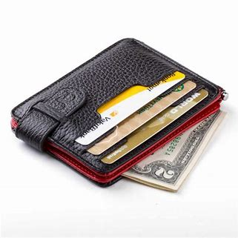
swap
waft
swamp
wand
wallet

Slide 8
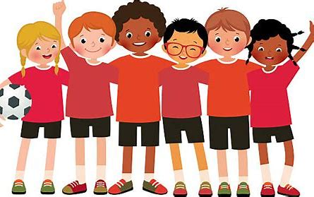
swap
waft
swamp
wand
wallet
squad

Slide 9
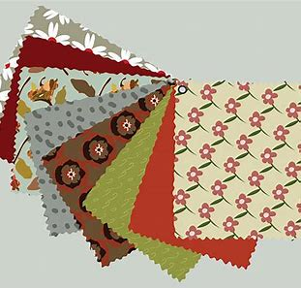
swap
waft
swamp
wand
wallet
squad
7. swatch

Slide 10
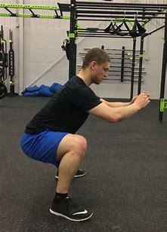
swap
waft
swamp
wand
wallet
squad
7. swatch
8. squat

Slide 11
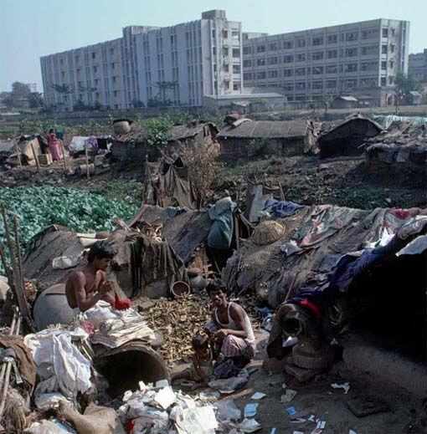
swap
waft
swamp
wand
wallet
squad
7. swatch
8. squat
9. squalid

Slide 12
swap
waft
swamp
wand
wallet
squad
7. swatch
8. squat
9. squalid
10. quality

Slide 13
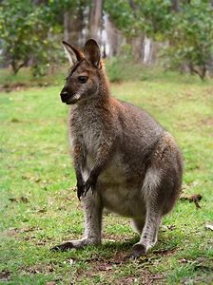
swap
waft
swamp
wand
wallet
squad
7. swatch
8. squat
9. squalid
10. quality
11. wallaby

Slide 14
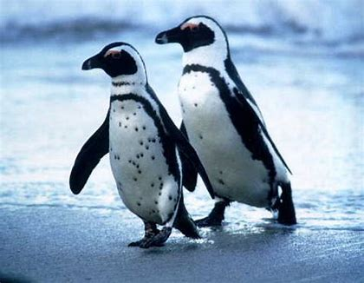
swap
waft
swamp
wand
wallet
squad
7. swatch
8. squat
9. squalid
10. quality
11. wallaby
12. waddle

Slide 15
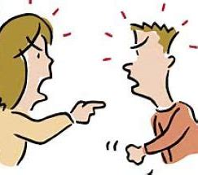
swap
waft
swamp
wand
wallet
squad
7. swatch
8. squat
9. squalid
10. quality
11. wallaby
12. waddle
13. squabble

Slide 16
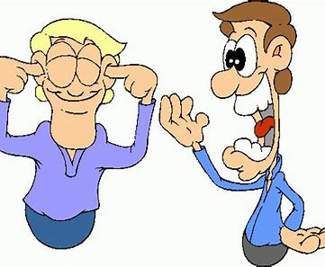
swap
waft
swamp
wand
wallet
squad
7. swatch
8. squat
9. squalid
10. quality
11. wallaby
12. waddle
13. squabble
14. twaddle

Slide 17
swap
waft
swamp
wand
wallet
squad
7. swatch
8. squat
9. squalid
10. quality
11. wallaby
12. waddle
13. squabble
14. twaddle
15. quandary

Slide 18
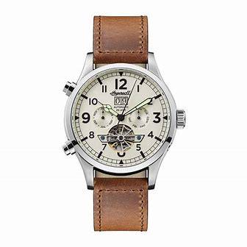
swap
waft
swamp
wand
wallet
squad
7. swatch
8. squat
9. squalid
10. quality
11. wallaby
12. waddle
13. squabble
14. twaddle
15. quandary
16. wristwatch

Slide 19
swap
waft
swamp
wand
wallet
squad
7. swatch
8. squat
9. squalid
10. quality
11. wallaby
12. waddle
13. squabble
14. twaddle
15. quandary
16. wristwatch
17. quantity

Slide 20
swap
waft
swamp
wand
wallet
squad
7. swatch
8. squat
9. squalid
10. quality
11. wallaby
12. waddle
13. squabble
14. twaddle
15. quandary
16. wristwatch
17. quantity
18. qualification

Slide 21
Let’s review
pronouns.

Slide 22
Subject Pronouns | Object Pronouns | Possessive Adjectives | Possessive Pronouns
I | me | my | mine
you
he/she/it
we
you
They

Slide 23
I have a pen.
The pen belongs to me.
It is my pen.
It is mine.

Slide 24
Possessive Pronouns

Slide 25
I have a pen.
The pen belongs to me.
It is my pen.
It is .

Slide 26
I have a pen.
The pen belongs to me.
It is my pen.
It is mine.

Slide 27
You have a pen.
The pen belongs to you.
It is your pen.
It is .

Slide 28
You have a pen.
The pen belongs to you.
It is your pen.
It is yours.

Slide 29
He has a pen.
The pen belongs to him.
It is his pen.
It is .

Slide 30
He has a pen.
The pen belongs to him.
It is his pen.
It is his.

Slide 31
She has a pen.
The pen belongs to her.
It is her pen.
It is .

Slide 32
She has a pen.
The pen belongs to her.
It is her pen.
It is hers.

Slide 33
It has a pen.
The pen belongs to it.
It is its pen.
It is .

Slide 34
It has a pen.
The pen belongs to it.
It is its pen.
It is its.

Slide 35
We have a pen.
The pen belongs to us.
It is our pen.
It is .

Slide 36
We have a pen.
The pen belongs to us.
It is our pen.
It is ours.

Slide 37
You have a pen.
The pen belongs to you.
It is your pen.
It is .

Slide 38
You have a pen.
The pen belongs to you.
It is your pen.
It is yours.

Slide 39
They have a pen.
The pen belongs to them.
It is their pen.
It is .

Slide 40
They have a pen.
The pen belongs to them.
It is their pen.
It is theirs.

Slide 41
Subject Pronouns | Object Pronouns | Possessive Adjectives | Possessive Pronouns
I | me | my | mine
you | you | your | yours
he/she/it | him/her/it | his/hers/its | his/hers/its
we | us | our | ours
you | you | your | yours
they | them | their | theirs

Slide 42
Activity page

Slide 43
This hat belongs to me.
It is my hat.
It is mine.
This coat belongs to him.
It is his coat.
It is his.
That dog belong to you all.
It is your dog.
It is yours.
This brush belong to her.
It is her brush.
It is hers.
This book belongs to us.
It is our book.
It is ours.
That teddy belongs to you.
It is your teddy.
It is yours.
That cat belongs to them.
It is their cat.
It is theirs.

Slide 44
This hat belongs to me.
It is my hat.
It is mine.
This coat belongs to him.
It is his coat.
It is his.
That dog belong to you all.
It is your dog.
It is yours.
This brush belong to her.
It is her brush.
It is hers.
This book belongs to us.
It is our book.
It is ours.
That teddy belongs to you.
It is your teddy.
It is yours.
That cat belongs to them.
It is their cat.
It is theirs.

Slide 45
This hat belongs to me.
It is my hat.
It is mine.
This coat belongs to him.
It is his coat.
It is his.
That dog belong to you all.
It is your dog.
It is yours.
This brush belong to her.
It is her brush.
It is hers.
This book belongs to us.
It is our book.
It is ours.
That teddy belongs to you.
It is your teddy.
It is yours.
That cat belongs to them.
It is their cat.
It is theirs.

Slide 46
This hat belongs to me.
It is my hat.
It is mine.
This coat belongs to him.
It is his coat.
It is his.
That dog belong to you all.
It is your dog.
It is yours.
This brush belong to her.
It is her brush.
It is hers.
This book belongs to us.
It is our book.
It is ours.
That teddy belongs to you.
It is your teddy.
It is yours.
That cat belongs to them.
It is their cat.
It is theirs.

Slide 47
This hat belongs to me.
It is my hat.
It is mine.
This coat belongs to him.
It is his coat.
It is his.
That dog belong to you all.
It is your dog.
It is yours.
This brush belong to her.
It is her brush.
It is hers.
This book belongs to us.
It is our book.
It is ours.
That teddy belongs to you.
It is your teddy.
It is yours.
That cat belongs to them.
It is their cat.
It is theirs.

Slide 48
This hat belongs to me.
It is my hat.
It is mine.
This coat belongs to him.
It is his coat.
It is his.
That dog belong to you all.
It is your dog.
It is yours.
This brush belong to her.
It is her brush.
It is hers.
This book belongs to us.
It is our book.
It is ours.
That teddy belongs to you.
It is your teddy.
It is yours.
That cat belongs to them.
It is their cat.
It is theirs.

Slide 49
This hat belongs to me.
It is my hat.
It is mine.
This coat belongs to him.
It is his coat.
It is his.
That dog belong to you all.
It is your dog.
It is yours.
This brush belong to her.
It is her brush.
It is hers.
This book belongs to us.
It is our book.
It is ours.
That teddy belongs to you.
It is your teddy.
It is yours.
That cat belongs to them.
It is their cat.
It is theirs.

Slide 50
This hat belongs to me.
It is my hat.
It is mine.
This coat belongs to him.
It is his coat.
It is his.
That dog belong to you all.
It is your dog.
It is yours.
This brush belong to her.
It is her brush.
It is hers.
This book belongs to us.
It is our book.
It is ours.
That teddy belongs to you.
It is your teddy.
It is yours.
That cat belongs to them.
It is their cat.
It is theirs.

Slide 51
Thank you!

