Slide 1
Jolly Grammar 3b-19

Slide 2
Let’s review
Subjects and Objects.

Slide 3
subject
verb
object
s
o
The cat chased a mouse.

Slide 4
Spelling List
Spelling
The <a> Spelling of the /o/ Sound

Slide 5
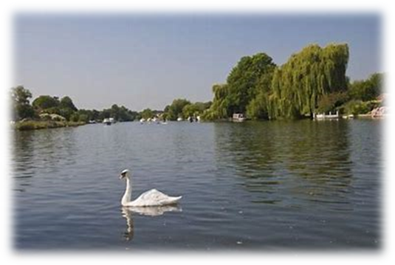
swan
/o/

Slide 6
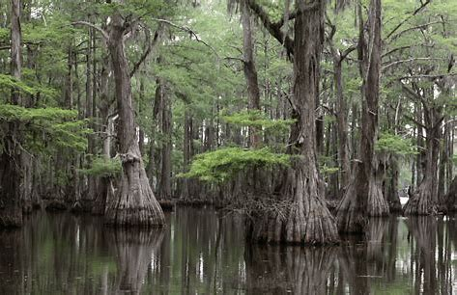
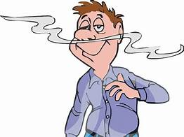
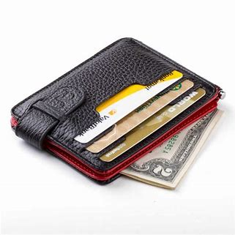
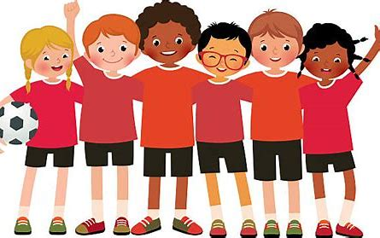
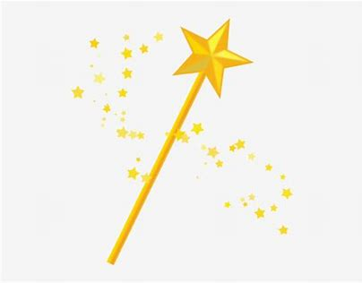
swap waft swamp
wand wallet squad

Slide 7
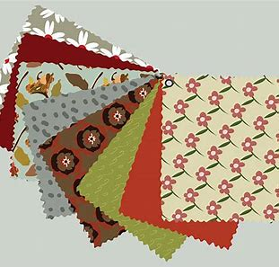
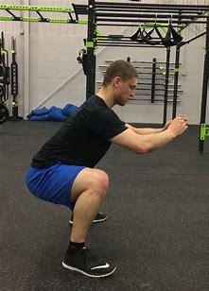
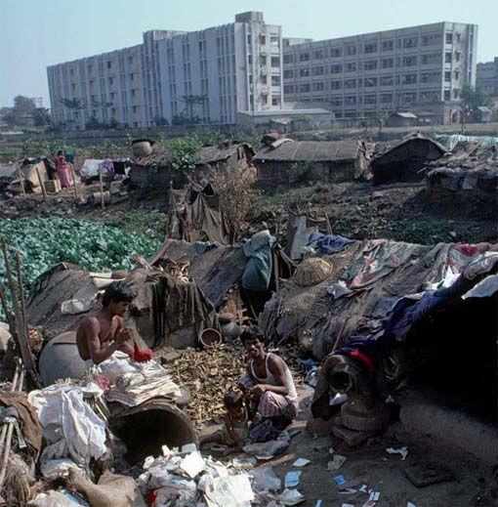
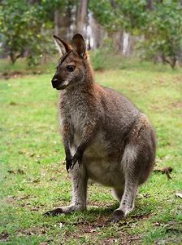
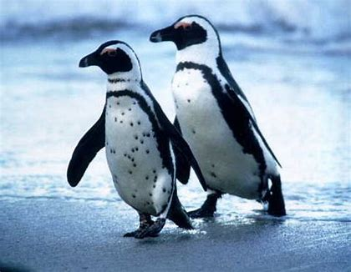
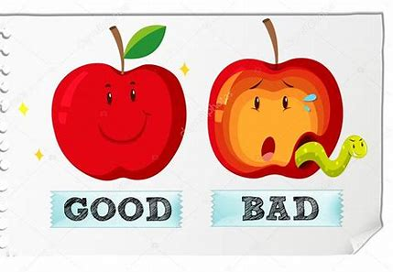
swatch squat squalid
quality wallaby waddle

Slide 8
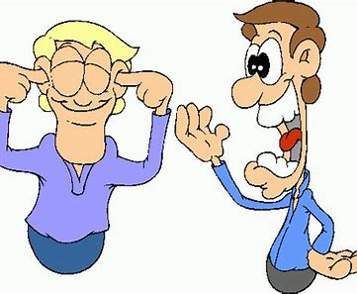
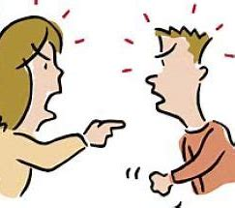
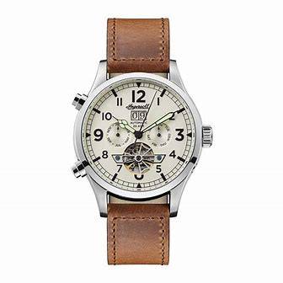
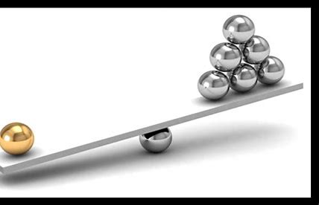
squabble twaddle quandary
wristwatch quantity qualification

Slide 9
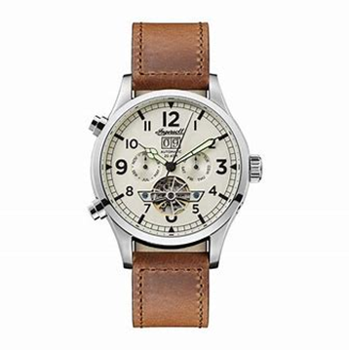

Slide 10
Activity page

Slide 11
Let’s review
syllables.

Slide 12
squash
quarry
wander
wallet
twaddle

Slide 13
Let’s parse
sentences.

Slide 14
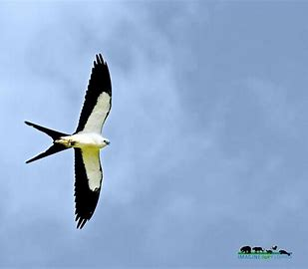
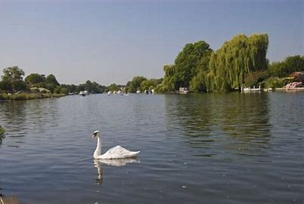
Parse these sentences.
The swallow swoops high into the sunny sky.
The white swan is floating gracefully along the River Thames.

Slide 15
Parse these sentences.
The swallow swoops high into the sunny sky.
The white swan is floating gracefully along the River Thames.

Slide 16
Parse these sentences.
The swallow swoops high into the sunny sky.
The white swan is floating gracefully along the River Thames.

Slide 17
Parse these sentences.
The swallow swoops high into the sunny sky.
The white swan is floating gracefully along the River Thames.

Slide 18
Parse these sentences.
The swallow swoops high into the sunny sky.
The white swan is floating gracefully along the River Thames.

Slide 19
Parse these sentences.
The swallow swoops high into the sunny sky.
The white swan is floating gracefully along the River Thames.

Slide 20
Parse these sentences.
The swallow swoops high into the sunny sky.
The white swan is floating gracefully along the River Thames.

Slide 21
Parse these sentences.
The swallow swoops high into the sunny sky.
The white swan is floating gracefully along the River Thames.

Slide 22
Parse these sentences.
The swallow swoops high into the sunny sky.
The white swan is floating gracefully along the River Thames.

Slide 23
Parse these sentences.
The swallow swoops high into the sunny sky.
The white swan is floating gracefully along the River Thames.

Slide 24
Parse these sentences.
The swallow swoops high into the sunny sky.
The white swan is floating gracefully along the River Thames.

Slide 25
Parse these sentences.
The swallow swoops high into the sunny sky.
The white swan is floating gracefully along the River Thames.

Slide 26
Parse these sentences.
The swallow swoops high into the sunny sky.
The white swan is floating gracefully along the River Thames.

Slide 27
Dictation

Slide 28
Dictation
1.
2.
3.

Slide 29
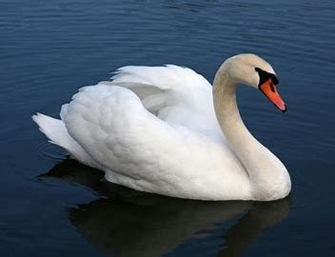
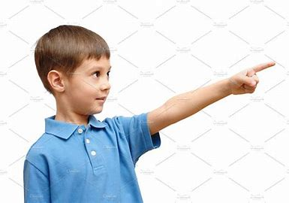

Slide 30
“Look at the white swan,” called the child.

Slide 31
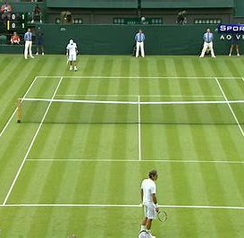

Slide 32
They are watching a tennis match against a Dutch team.

Slide 33
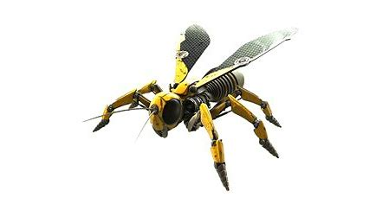
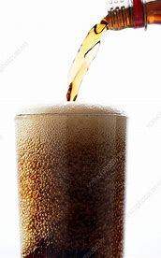

Slide 34
The wasps buzzed around the fizzy drinks.

Slide 35
Thank you!

