Slide 1
Jolly Grammar 3b-18

Slide 2
Spelling Test 27

Slide 3
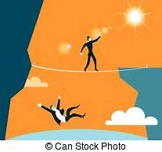
abyss

Slide 4
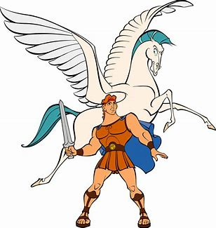
abyss
myth

Slide 5
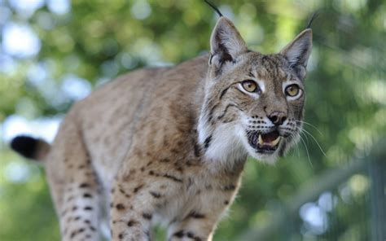
abyss
myth
lynx

Slide 6
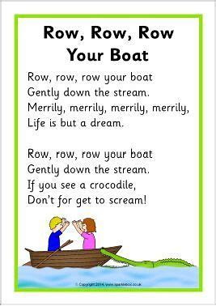
abyss
myth
lynx
lyrics

Slide 7
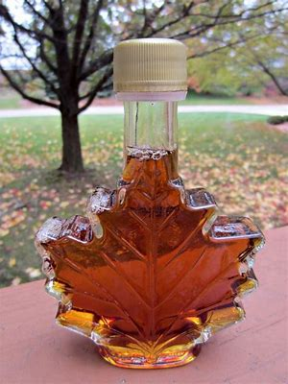
abyss
myth
lynx
lyrics
syrup

Slide 8
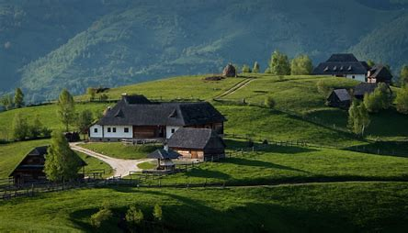
abyss
myth
lynx
lyrics
syrup
idyllic

Slide 9
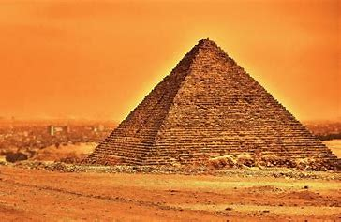
abyss
myth
lynx
lyrics
syrup
idyllic
7. pyramid

Slide 10
abyss
myth
lynx
lyrics
syrup
idyllic
7. pyramid
8. symbol

Slide 11
abyss
myth
lynx
lyrics
syrup
idyllic
7. pyramid
8. symbol
9. cymbal

Slide 12
abyss
myth
lynx
lyrics
syrup
idyllic
7. pyramid
8. symbol
9. cymbal
10. system

Slide 13
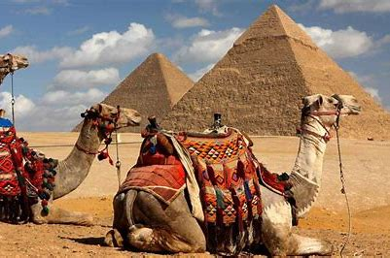
abyss
myth
lynx
lyrics
syrup
idyllic
7. pyramid
8. symbol
9. cymbal
10. system
11. Egypt

Slide 14
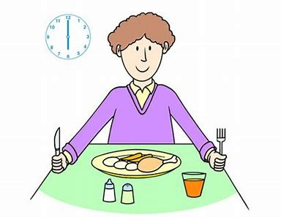
abyss
myth
lynx
lyrics
syrup
idyllic
7. pyramid
8. symbol
9. cymbal
10. system
11. Egypt
12. typical

Slide 15
abyss
myth
lynx
lyrics
syrup
idyllic
7. pyramid
8. symbol
9. cymbal
10. system
11. Egypt
12. typical

Slide 16
abyss
myth
lynx
lyrics
syrup
idyllic
7. pyramid
8. symbol
9. cymbal
10. system
11. Egypt
12. typical
13. syllable

Slide 17
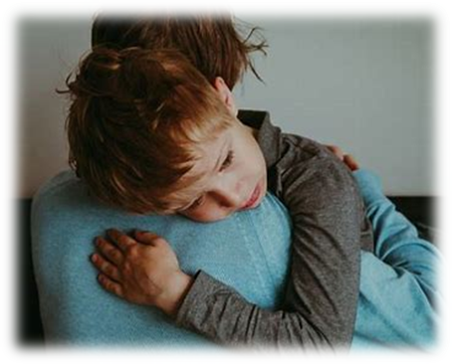
abyss
myth
lynx
lyrics
syrup
idyllic
7. pyramid
8. symbol
9. cymbal
10. system
11. Egypt
12. typical
13. syllable
14. sympathy

Slide 18
abyss
myth
lynx
lyrics
syrup
idyllic
7. pyramid
8. symbol
9. cymbal
10. system
11. Egypt
12. typical
13. syllable
14. sympathy
15. mystery

Slide 19
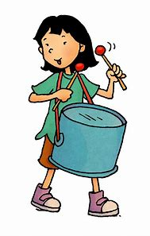
abyss
myth
lynx
lyrics
syrup
idyllic
7. pyramid
8. symbol
9. cymbal
10. system
11. Egypt
12. typical
13. syllable
14. sympathy
15. mystery
16. rhythm

Slide 20
abyss
myth
lynx
lyrics
syrup
idyllic
7. pyramid
8. symbol
9. cymbal
10. system
11. Egypt
12. typical
13. syllable
14. sympathy
15. mystery
16. rhythm
17. acrylic

Slide 21
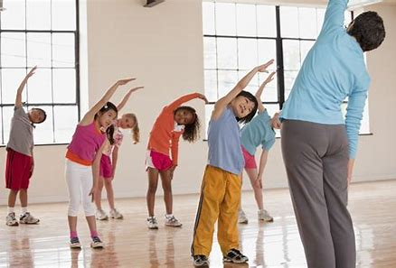
abyss
myth
lynx
lyrics
syrup
idyllic
7. pyramid
8. symbol
9. cymbal
10. system
11. Egypt
12. typical
13. syllable
14. sympathy
15. mystery
16. rhythm
17. acrylic
18. physical

Slide 22
Subject and Object Pronouns

Slide 23
subject
verb
object
s
o
The cat chased a mouse.

Slide 24
Activity page

Slide 25
Subject Pronouns
Object Pronouns
I
1st Person Singular
2nd Person Singular
3rd Person Singular
1st Person Plural
2nd Person Plural
3rd Person Plural

Slide 26
Subject Pronouns
Object Pronouns
I
you
he/she/ it
we
you
they
1st Person Singular
2nd Person Singular
3rd Person Singular
1st Person Plural
2nd Person Plural
3rd Person Plural

Slide 27
Subject Pronouns
Object Pronouns
I
you
he/she/ it
we
you
they
1st Person Singular
2nd Person Singular
3rd Person Singular
1st Person Plural
2nd Person Plural
3rd Person Plural
me
you
him/her/ it
us
you
them

Slide 28
subject
verb
object
s
o
The cat chased a mouse.

Slide 29
You hugged Granny. Granny hugged you.

Slide 30
s
o
You hugged Granny. Granny hugged you.

Slide 31
s
o
I hit the ball. The ball hit me.

Slide 32
o
s
The baby amused her. She amused the baby.

Slide 33
s
o
He phoned the school. The school phoned him.

Slide 34
o
s
The teacher helped them. They helped the teacher.

Slide 35
s
o
We invited some friends. The animals saw you all.

Slide 36
s
o
You all saw the animals. The animals saw you all.

Slide 37
s
o
It explains everything. That explains it.

Slide 38
Activity page

Slide 39
You like horses. Hoses like you too.
I heard Adam. Adam heard me.
The boy pushed her.
She pushed the boy.
The crowd followed them.
They followed the crowd.
We took the train to the teach.
The train took us there.

Slide 40
You like horses. Hoses like you too.
I heard Adam. Adam heard me.
The boy pushed her.
She pushed the boy.
The crowd followed them.
They followed the crowd.
We took the train to the teach.
The train took us there.

Slide 41
You like horses. Hoses like you too.
I heard Adam. Adam heard me.
The boy pushed her.
She pushed the boy.
The crowd followed them.
They followed the crowd.
We took the train to the teach.
The train took us there.

Slide 42
You like horses. Hoses like you too.
I heard Adam. Adam heard me.
The boy pushed her.
She pushed the boy.
The crowd followed them.
They followed the crowd.
We took the train to the teach.
The train took us there.

Slide 43
You like horses. Hoses like you too.
I heard Adam. Adam heard me.
The boy pushed her.
She pushed the boy.
The crowd followed them.
They followed the crowd.
We took the train to the teach.
The train took us there.

Slide 44
You like horses. Hoses like you too.
I heard Adam. Adam heard me.
The boy pushed her.
She pushed the boy.
The crowd followed them.
They followed the crowd.
We took the train to the teach.
The train took us there.

Slide 45
Homework

