Slide 1
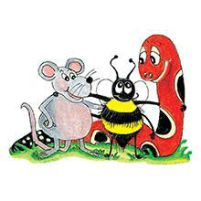
Jolly Grammar 3b-15

Slide 2
noun or
pronoun
subject
s
The farmer grows vegetables in the garden.
simple subject

Slide 3
Spelling List
Spelling
The <ie> Spelling of the /ee/ Sound

Slide 4
believe
/ee/

Slide 5
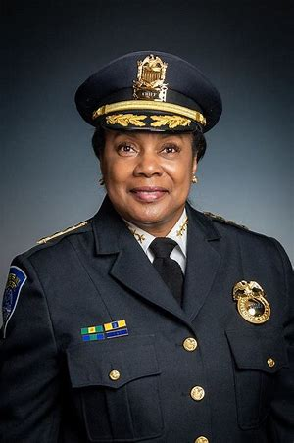
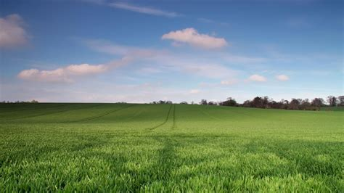
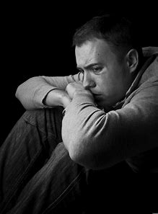
field chief piece
brief shield grief

Slide 6
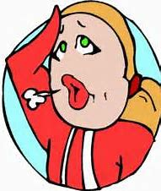
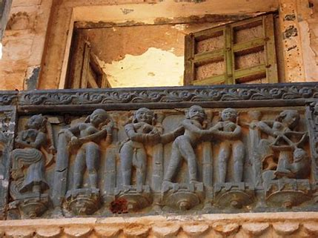
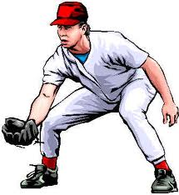
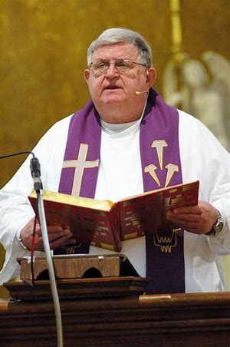
relief frieze fielder
priest believe achieve

Slide 7
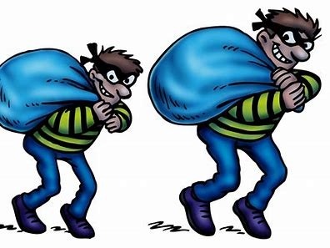
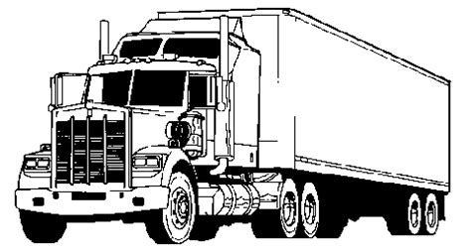
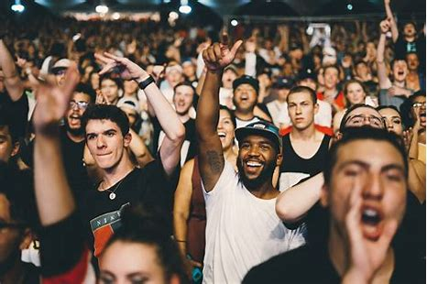
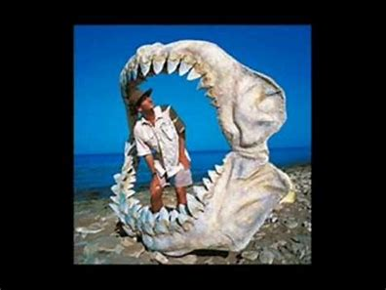
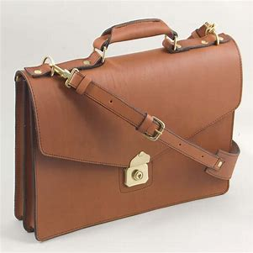
diesel thieves besiege
audience briefcase unbelievable

Slide 8
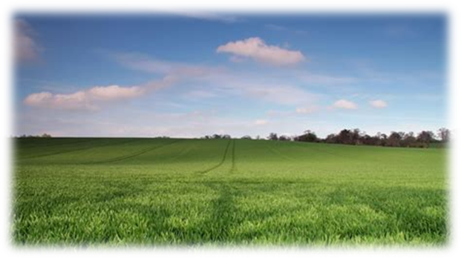

Slide 9
Activity page

Slide 10
Let’s review
syllables.

Slide 11
shriek
mantelpiece
diesel
briefcase
grieve

Slide 12
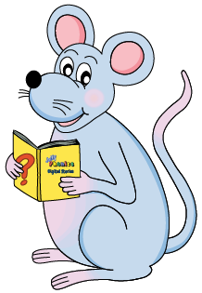
Let’s parse
sentences.

Slide 13
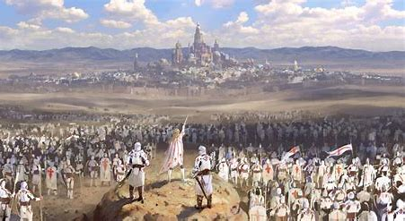
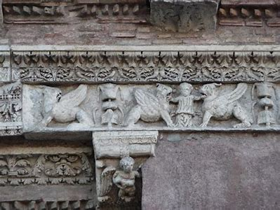
Parse these sentences.
The mighty army was besieging
the huge castle.
They carefully painted a beautiful frieze on the tallest wall.

Slide 14
Parse these sentences.
The mighty army was besieging
the huge castle.
They carefully painted a beautiful frieze on the tallest wall.

Slide 15
Parse these sentences.
The mighty army was besieging
the huge castle.
They carefully painted a beautiful frieze on the tallest wall.

Slide 16
Parse these sentences.
The mighty army was besieging
the huge castle.
They carefully painted a beautiful frieze on the tallest wall.

Slide 17
Parse these sentences.
The mighty army was besieging
the huge castle.
They carefully painted a beautiful frieze on the tallest wall.

Slide 18
Parse these sentences.
The mighty army was besieging
the huge castle.
They carefully painted a beautiful frieze on the tallest wall.

Slide 19
Parse these sentences.
The mighty army was besieging
the huge castle.
They carefully painted a beautiful frieze on the tallest wall.

Slide 20
Parse these sentences.
The mighty army was besieging
the huge castle.
They carefully painted a beautiful frieze on the tallest wall.

Slide 21
Parse these sentences.
The mighty army was besieging
the huge castle.
They carefully painted a beautiful frieze on the tallest wall.

Slide 22
Parse these sentences.
The mighty army was besieging
the huge castle.
They carefully painted a beautiful frieze on the tallest wall.

Slide 23
Parse these sentences.
The mighty army was besieging
the huge castle.
They carefully painted a beautiful frieze on the tallest wall.

Slide 24
Parse these sentences.
The mighty army was besieging
the huge castle.
They carefully painted a beautiful frieze on the tallest wall.

Slide 25
Parse these sentences.
The mighty army was besieging
the huge castle.
They carefully painted a beautiful frieze on the tallest wall.

Slide 26
Parse these sentences.
The mighty army was besieging
the huge castle.
They carefully painted a beautiful frieze on the tallest wall.

Slide 27
Dictation

Slide 28
Dictation
1.
2.
3.

Slide 29
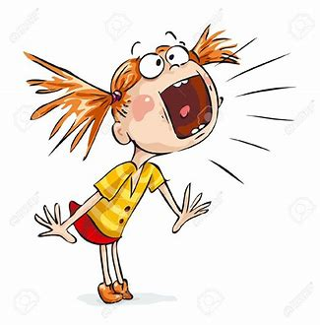
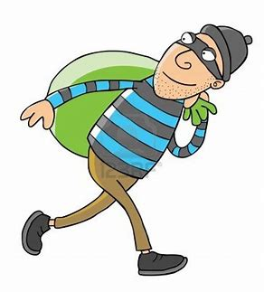

Slide 30
“I think he is a thief,” she shouted.

Slide 32
My niece and I will be shopping on Saturday.

Slide 33
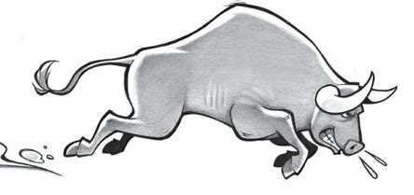

Slide 34
They shrieked as the bull charged across the field.

Slide 35
Thank you!

