Slide 1
Jolly Grammar 3b-14

Slide 2
ask

Slide 3
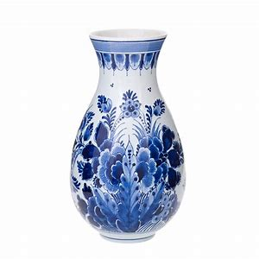
ask
vase

Slide 4
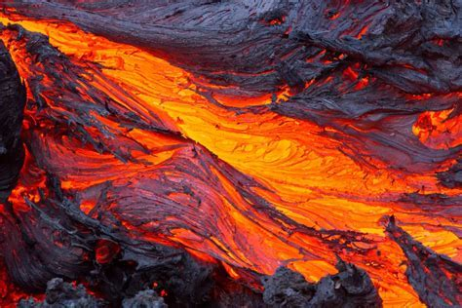
ask
vase
lava

Slide 5
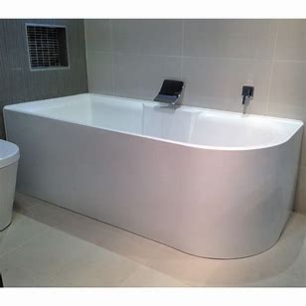
ask
vase
lava
bath

Slide 6
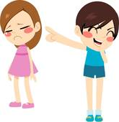
ask
vase
lava
bath
nasty

Slide 7
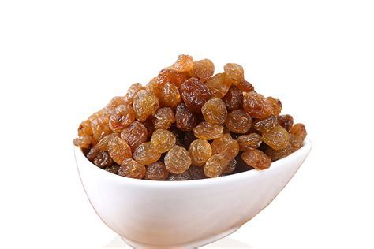
ask
vase
lava
bath
nasty
sultana

Slide 8
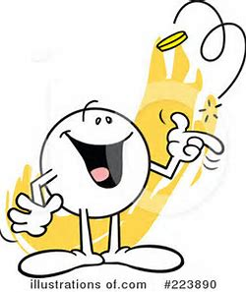
ask
vase
lava
bath
nasty
sultana
7. chance

Slide 9
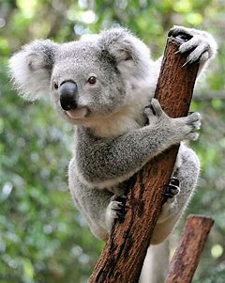
ask
vase
lava
bath
nasty
sultana
7. chance
8. koala

Slide 10
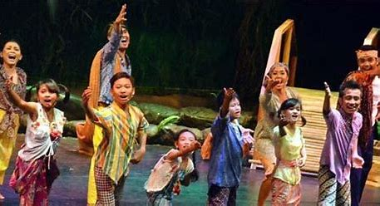
ask
vase
lava
bath
nasty
sultana
7. chance
8. koala
9. drama

Slide 11
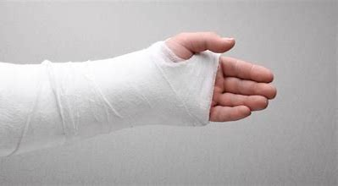
ask
vase
lava
bath
nasty
sultana
7. chance
8. koala
9. drama
10. plaster

Slide 12
ask
vase
lava
bath
nasty
sultana
7. chance
8. koala
9. drama
10. plaster
11. pyjamas

Slide 13
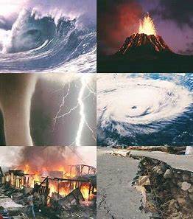
ask
vase
lava
bath
nasty
sultana
7. chance
8. koala
9. drama
10. plaster
11. pyjamas
12. disaster

Slide 14
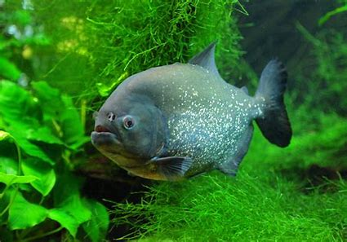
ask
vase
lava
bath
nasty
sultana
7. chance
8. koala
9. drama
10. plaster
11. pyjamas
12. disaster
13. piranha

Slide 15
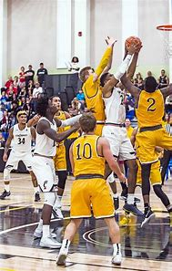
ask
vase
lava
bath
nasty
sultana
7. chance
8. koala
9. drama
10. plaster
11. pyjamas
12. disaster
13. piranha
14. basketball

Slide 16
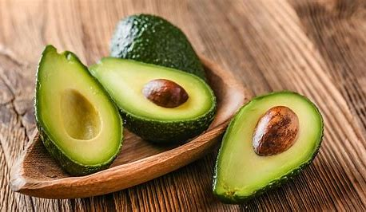
ask
vase
lava
bath
nasty
sultana
7. chance
8. koala
9. drama
10. plaster
11. pyjamas
12. disaster
13. piranha
14. basketball
15. avocado

Slide 17
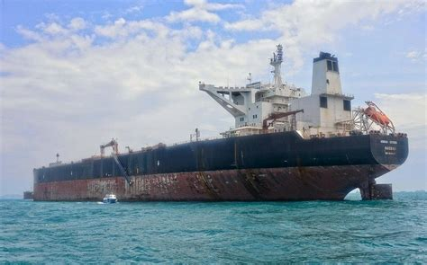
ask
vase
lava
bath
nasty
sultana
7. chance
8. koala
9. drama
10. plaster
11. pyjamas
12. disaster
13. piranha
14. basketball
15. avocado
16. armada

Slide 18
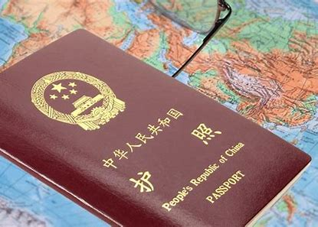
ask
vase
lava
bath
nasty
sultana
7. chance
8. koala
9. drama
10. plaster
11. pyjamas
12. disaster
13. piranha
14. basketball
15. avocado
16. armada
17. passport

Slide 19
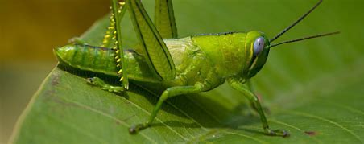
ask
vase
lava
bath
nasty
sultana
7. chance
8. koala
9. drama
10. plaster
11. pyjamas
12. disaster
13. piranha
14. basketball
15. avocado
16. armada
17. passport
18. grasshopper

Slide 20
Let’s review
sentences.

Slide 21
the farmer grows vegetables in.

Slide 22
the farmer grows vegetables in.
It needs to make sense.

Slide 23
the farmer grows vegetables in.
It needs to make sense.
It needs to start with a capital letter.

Slide 24
the farmer grows vegetables in.
It needs to make sense.
It needs to start with a capital letter.
It needs to end with the correct punctuation.

Slide 25
the farmer grows vegetables in.
The farmer grows vegetables in the garden.
It needs to make sense.
It needs to start with a capital letter.
It needs to end with the correct punctuation.

Slide 26
The giant orange pumpkin.
It needs to make sense.
It needs to start with a capital letter.
It needs to end with the correct punctuation.

Slide 27
The giant orange pumpkin.
It needs to make sense.
It needs to start with a capital letter.
It needs to end with the correct punctuation.
It needs a verb.

Slide 28
The giant orange pumpkin grow in the garden.
It needs to make sense.
It needs to start with a capital letter.
It needs to end with the correct punctuation.
It needs a verb.

Slide 29
The farmer grows vegetables in the garden.

Slide 30
The farmer grows vegetables in the garden.

Slide 31
The farmer grows vegetables in the garden.

Slide 32
subject
The farmer grows vegetables in the garden.

Slide 33
subject
s
The farmer grows vegetables in the garden.

Slide 34
noun or
pronoun
subject
s
The farmer grows vegetables in the garden.
simple subject

Slide 35
The subject of
a sentence

Slide 36
The birds ate some seeds.

Slide 37
The birds ate some seeds.

Slide 38
s
The birds ate some seeds.

Slide 39
Activity page

Slide 40
s
The birds ate some seeds.

Slide 41
s
Sam likes basketball.

Slide 42
s
The man fell over.

Slide 43
s
The cat chased a mouse.

Slide 44
s
Sophie scored the winning goal.

Slide 45
s
The rancher lassosed the cow.

Slide 46
s
She sent me an email.

Slide 47
s
The vase is very old and vulnerable.

Slide 48
s
You will be visiting me in the holidays.

Slide 49
s
The wind blew down an old tree.

Slide 50
s
Ann ran in the cross-country race.

Slide 51
s
The rattlesnake shook his tale and hissed.

Slide 52
s
I made a cake today.

Slide 53
s
Sue played with her kitten.

Slide 54
s
The kitten played with Sue.

Slide 55
s
The seal was swimming close to the beach.

Slide 56
Thank you!

