Slide 1
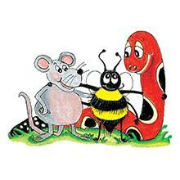
Jolly Grammar 3b-12

Slide 2
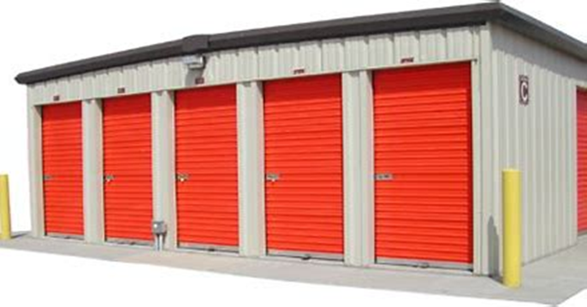
unit

Slide 3
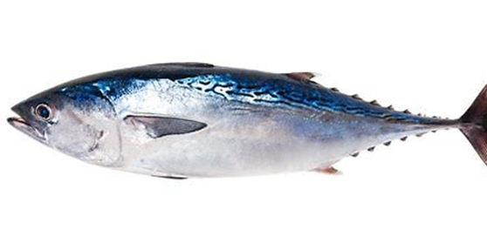
unit
tuna

Slide 4
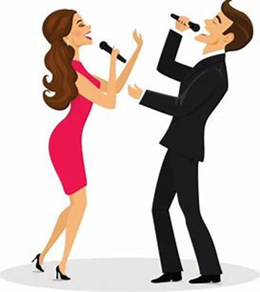
unit
tuna
duet

Slide 5
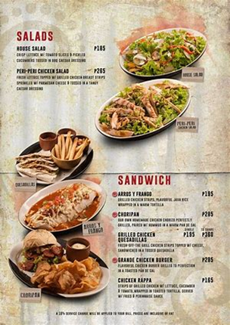
unit
tuna
duet
menu

Slide 6
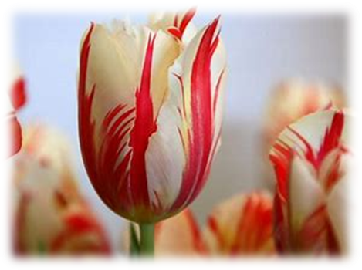
unit
tuna
duet
menu
tulip

Slide 7
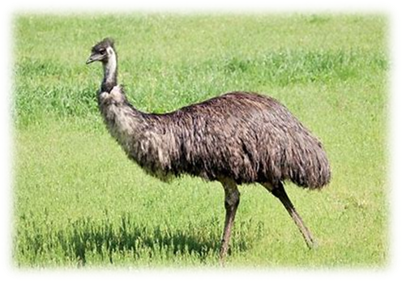
unit
tuna
duet
menu
tulip
emu

Slide 8
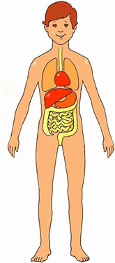
unit
tuna
duet
menu
tulip
emu
7. human

Slide 9
unit
tuna
duet
menu
tulip
emu
7. human
8. music

Slide 10
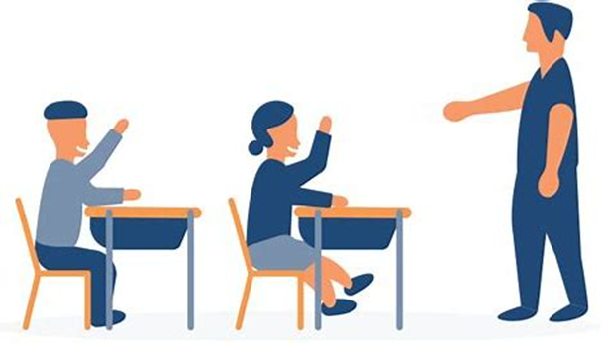
unit
tuna
duet
menu
tulip
emu
7. human
8. music
9. usual

Slide 11
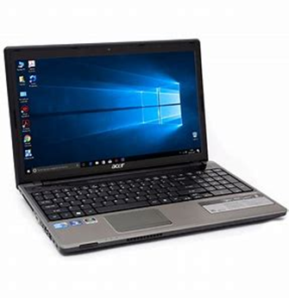
unit
tuna
duet
menu
tulip
emu
7. human
8. music
9. usual
10. computer

Slide 12
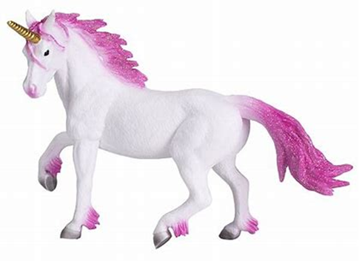
unit
tuna
duet
menu
tulip
emu
7. human
8. music
9. usual
10. computer
11. unicorn

Slide 13
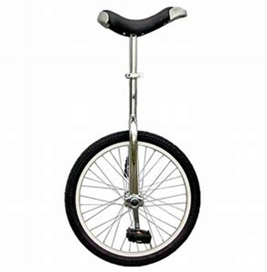
unit
tuna
duet
menu
tulip
emu
7. human
8. music
9. usual
10. computer
11. unicorn
12. unicycle

Slide 14
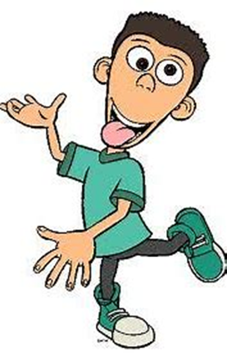
unit
tuna
duet
menu
tulip
emu
7. human
8. music
9. usual
10. computer
11. unicorn
12. unicycle
13. peculiar

Slide 15
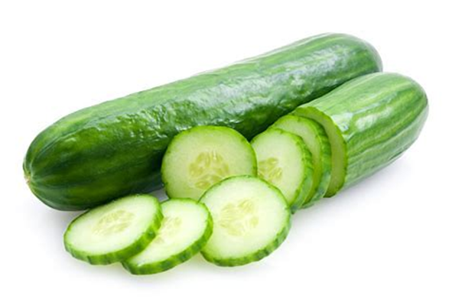
unit
tuna
duet
menu
tulip
emu
7. human
8. music
9. usual
10. computer
11. unicorn
12. unicycle
13. peculiar
14. cucumber

Slide 16
unit
tuna
duet
menu
tulip
emu
7. human
8. music
9. usual
10. computer
11. unicorn
12. unicycle
13. peculiar
14. cucumber
15. unique

Slide 17
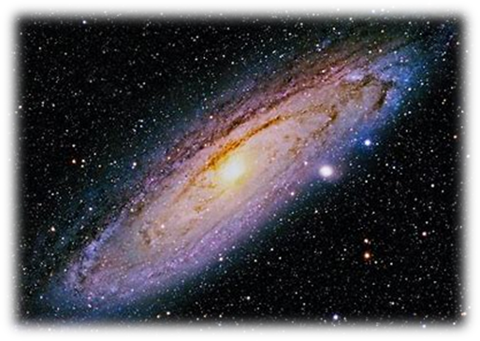
unit
tuna
duet
menu
tulip
emu
7. human
8. music
9. usual
10. computer
11. unicorn
12. unicycle
13. peculiar
14. cucumber
15. unique
16. universe

Slide 18
unit
tuna
duet
menu
tulip
emu
7. human
8. music
9. usual
10. computer
11. unicorn
12. unicycle
13. peculiar
14. cucumber
15. unique
16. universe
17. communicate

Slide 19
unit
tuna
duet
menu
tulip
emu
7. human
8. music
9. usual
10. computer
11. unicorn
12. unicycle
13. peculiar
14. cucumber
15. unique
16. universe
17. communicate
18. solution

Slide 20
Let’s review
plural

Slide 21
dog
house
car
watch
bush
glass
tomato
potato
tornado
boy
day
key
cherry
fly
party

Slide 22
dogs
house
car
watch
bush
glass
tomato
potato
tornado
boy
day
key
cherry
fly
party

Slide 23
dogs
houses
car
watch
bush
glass
tomato
potato
tornado
boy
day
key
cherry
fly
party

Slide 24
dogs
houses
cars
watch
bush
glass
tomato
potato
tornado
boy
day
key
cherry
fly
party

Slide 25
dogs
houses
cars
watches
bush
glass
tomato
potato
tornado
boy
day
key
cherry
fly
party

Slide 26
dogs
houses
cars
watches
bushes
glass
tomato
potato
tornado
boy
day
key
cherry
fly
party

Slide 27
dogs
houses
cars
watches
bushes
glasses
tomato
potato
tornado
boy
day
key
cherry
fly
party

Slide 28
dogs
houses
cars
watches
bushes
glasses
tomatoes
potato
tornado
boy
day
key
cherry
fly
party

Slide 29
dogs
houses
cars
watches
bushes
glasses
tomatoes
potatoes
tornado
boy
day
key
cherry
fly
party

Slide 30
dogs
houses
cars
watches
bushes
glasses
tomatoes
potatoes
tornadoes
boy
day
key
cherry
fly
party

Slide 31
dogs
houses
cars
watches
bushes
glasses
tomatoes
potatoes
tornadoes
boys
day
key
cherry
fly
party

Slide 32
dogs
houses
cars
watches
bushes
glasses
tomatoes
potatoes
tornadoes
boys
days
key
cherry
fly
party

Slide 33
dogs
houses
cars
watches
bushes
glasses
tomatoes
potatoes
tornadoes
boys
days
keys
cherry
fly
party

Slide 34
dogs
houses
cars
watches
bushes
glasses
tomatoes
potatoes
tornadoes
boys
days
keys
cherry cherries
fly
party

Slide 35
dogs
houses
cars
watches
bushes
glasses
tomatoes
potatoes
tornadoes
boys
days
keys
cherry cherries
fly flies
party

Slide 36
dogs
houses
cars
watches
bushes
glasses
tomatoes
potatoes
tornadoes
boys
days
keys
cherry cherries
fly flies
party parties

Slide 37
Irregular Plurals

Slide 38
sheep
deer
fish
moose
salmon
foot
mouse
man
person
child

Slide 39
sheep
deer
fish
moose
salmon
foot
mouse
man
person
child
sheep

Slide 40
sheep
deer
fish
moose
salmon
foot
mouse
man
person
child
sheep
deer

Slide 41
sheep
deer
fish
moose
salmon
foot
mouse
man
person
child
sheep
deer
fish

Slide 42
sheep
deer
fish
moose
salmon
foot
mouse
man
person
child
sheep
deer
fish
moose

Slide 43
sheep
deer
fish
moose
salmon
foot
mouse
man
person
child
sheep
deer
fish
moose
salmon

Slide 44
sheep
deer
fish
moose
salmon
foot
mouse
man
person
child
sheep
deer
fish
moose
salmon
feet

Slide 45
sheep
deer
fish
moose
salmon
foot
mouse
man
person
child
sheep
deer
fish
moose
salmon
feet
mice

Slide 46
sheep
deer
fish
moose
salmon
foot
mouse
man
person
child
sheep
deer
fish
moose
salmon
feet
mice
men

Slide 47
sheep
deer
fish
moose
salmon
foot
mouse
man
person
child
sheep
deer
fish
moose
salmon
feet
mice
men
people

Slide 48
sheep
deer
fish
moose
salmon
foot
mouse
man
person
child
sheep
deer
fish
moose
salmon
feet
mice
men
people
children

Slide 49
Thank you!

