Slide 1
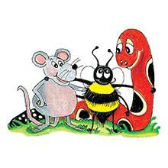
Jolly Grammar 3b-10

Slide 2
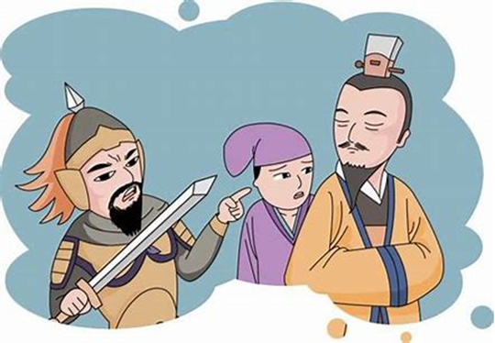
ago

Slide 3
ago
hero

Slide 4
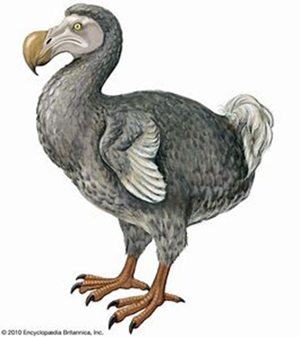
ago
hero
dodo

Slide 5
ago
hero
dodo
zero

Slide 6
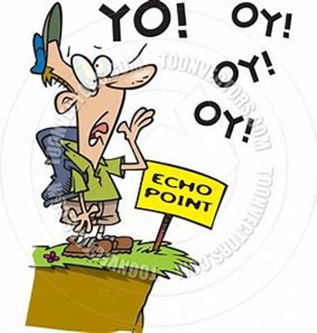
ago
hero
dodo
zero
echo

Slide 7
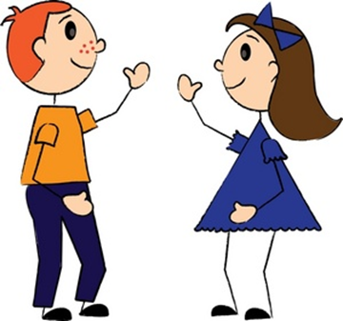
ago
hero
dodo
zero
echo
hello

Slide 8
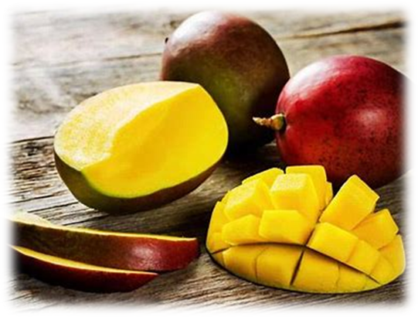
ago
hero
dodo
zero
echo
hello
7. mango

Slide 9
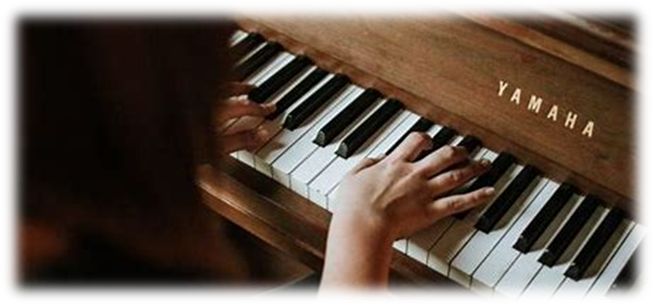
ago
hero
dodo
zero
echo
hello
7. mango
8. pianos

Slide 10
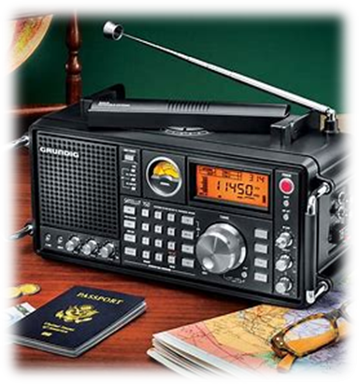
ago
hero
dodo
zero
echo
hello
7. mango
8. pianos
9. radios

Slide 11
ago
hero
dodo
zero
echo
hello
7. mango
8. pianos
9. radios
10. videos

Slide 12
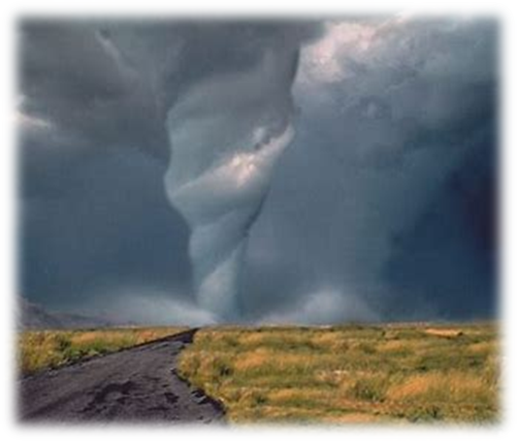
ago
hero
dodo
zero
echo
hello
7. mango
8. pianos
9. radios
10. videos
11. tornado

Slide 13
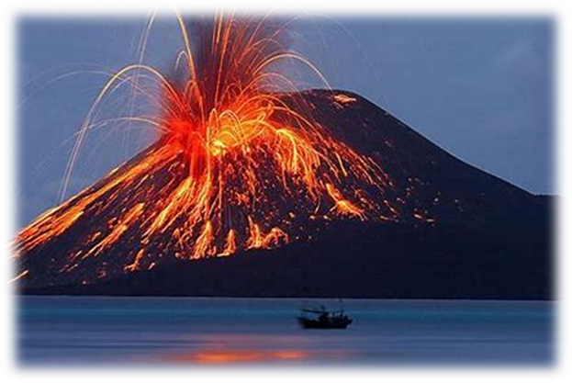
ago
hero
dodo
zero
echo
hello
7. mango
8. pianos
9. radios
10. videos
11. tornado
12. volcano

Slide 14
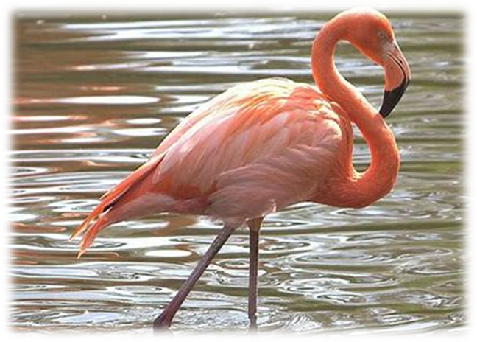
ago
hero
dodo
zero
echo
hello
7. mango
8. pianos
9. radios
10. videos
11. tornado
12. volcano
13. flamingo

Slide 15
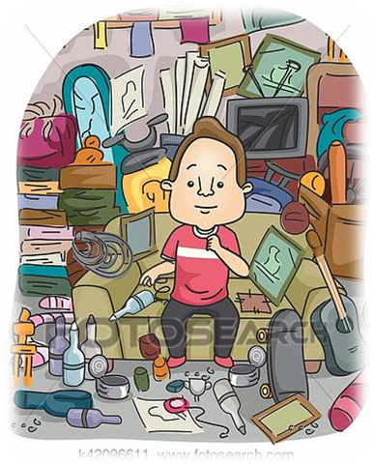
ago
hero
dodo
zero
echo
hello
7. mango
8. pianos
9. radios
10. videos
11. tornado
12. volcano
13. flamingo
14. memento

Slide 16
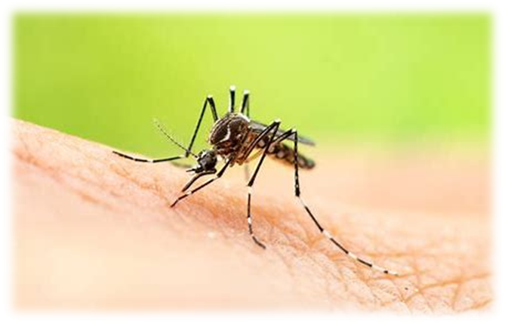
ago
hero
dodo
zero
echo
hello
7. mango
8. pianos
9. radios
10. videos
11. tornado
12. volcano
13. flamingo
14. memento
15. mosquito

Slide 17
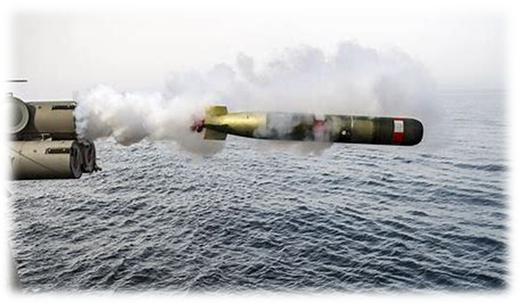
ago
hero
dodo
zero
echo
hello
7. mango
8. pianos
9. radios
10. videos
11. tornado
12. volcano
13. flamingo
14. memento
15. mosquito
16. torpedoes

Slide 18
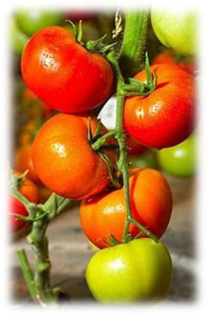
ago
hero
dodo
zero
echo
hello
7. mango
8. pianos
9. radios
10. videos
11. tornado
12. volcano
13. flamingo
14. memento
15. mosquito
16. torpedoes
17. tomatoes

Slide 19
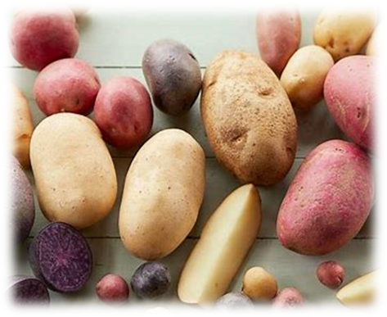
ago
hero
dodo
zero
echo
hello
7. mango
8. pianos
9. radios
10. videos
11. tornado
12. volcano
13. flamingo
14. memento
15. mosquito
16. torpedoes
17. tomatoes
18. potatoes

Slide 20
Let’s review

Slide 21
It was a soft cushion.

Slide 22
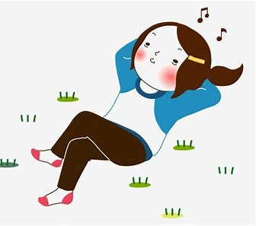
It was a soft cushion.
She hummed softly.

Slide 23
Adjectives
(made by adding
–y to nouns)

Slide 24
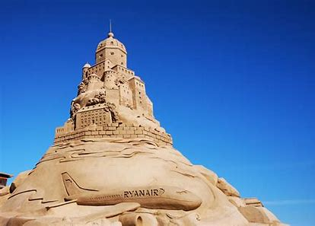
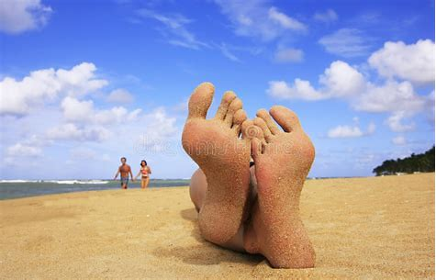
I made a fantastic sandcastle.
I have a sandy feet.
My feet got sandy on the beach.

Slide 25
Nouns dust spice mud noise hair spot

Slide 26
Nouns dust spice mud noise hair spot
Adjectives dusty

Slide 27
Nouns dust spice mud noise hair spot
Adjectives dusty spicy

Slide 28
Nouns dust spice mud noise hair spot
Adjectives dusty spicy muddy

Slide 29
Nouns dust spice mud noise hair spot
Adjectives dusty spicy muddy noisy

Slide 30
Nouns dust spice mud noise hair spot
Adjectives dusty spicy muddy noisy hairy

Slide 31
Nouns dust spice mud noise hair spot
Adjectives dusty spicy muddy noisy hairy spotty

Slide 32
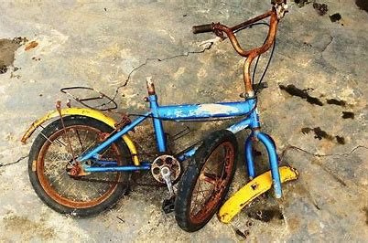
The old bike had lots of rust.

Slide 33
The old bike had lots of rust.
It was a rusty bike.

Slide 34
Wish on the star for luck.

Slide 35
Wish on the star for luck.
It is a lucky star.

Slide 36
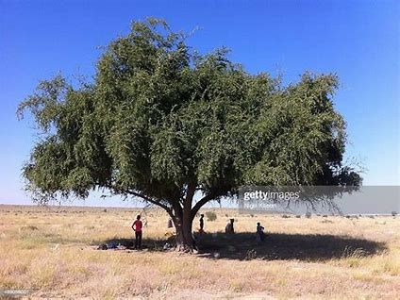
They sat in the shade of the tree.

Slide 37
They sat in the shade of the tree.
It was a shady tree.

Slide 38
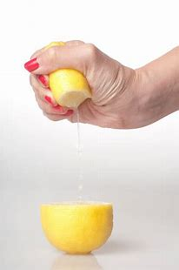
We squeezed juice from the lemon.

Slide 39
We squeezed juice from the lemon.
The lemon was juicy.

Slide 40
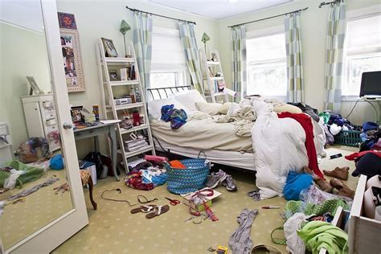
My bedroom is in a mess.

Slide 41
My bedroom is in a mess.
My bedroom is messy.

Slide 42
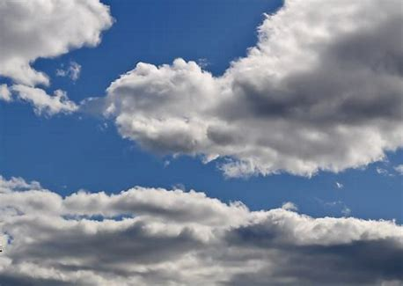
There are many clouds in the sky.

Slide 43
There are many clouds in the sky.
The sky is cloudy.

Slide 44
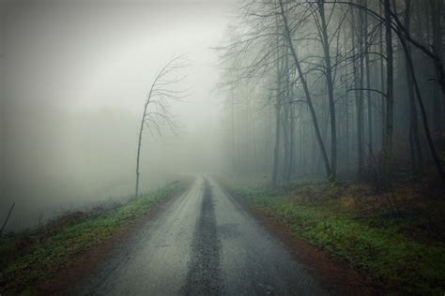
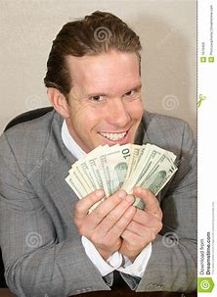
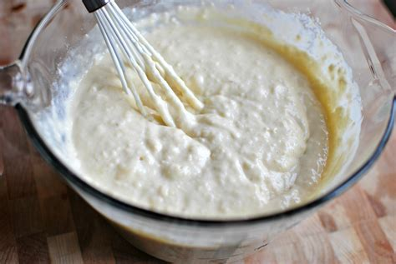
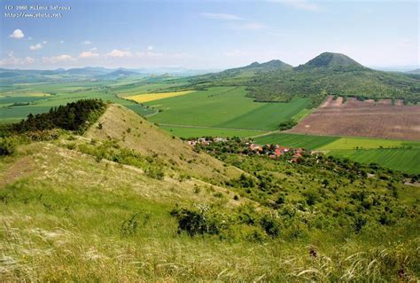
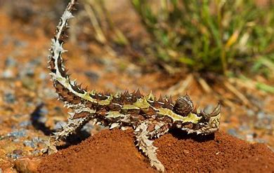
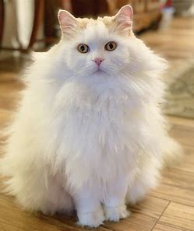
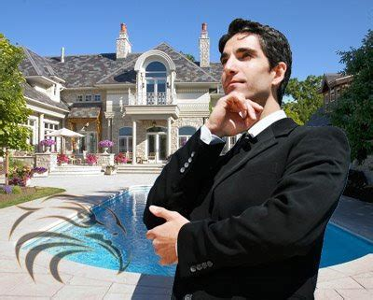
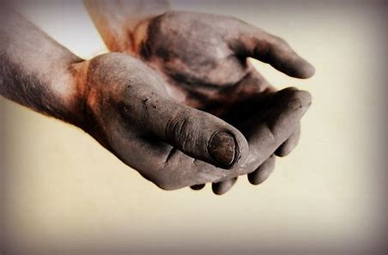
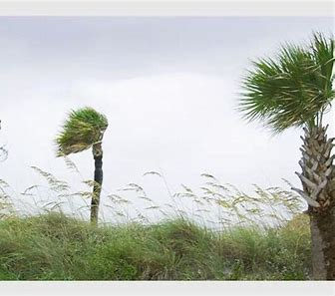
foggy greedy lumpy rosy
hilly thorny fluffy wealthy dirty
windy

Slide 45
My dog is cute and fluffy.
My birds are cute fluffy.
My socks are dirty.
My house is dirty.
Kanahebi’s tails are thorny.
My cat and dogs are fluffy.
My hands are clean.

Slide 46
Thank you!

