Slide 1
Jolly Grammar
6a-26

Slide 2
Spelling Test 13

Slide 3
address

Slide 4
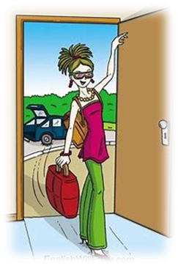
address
arrive

Slide 5
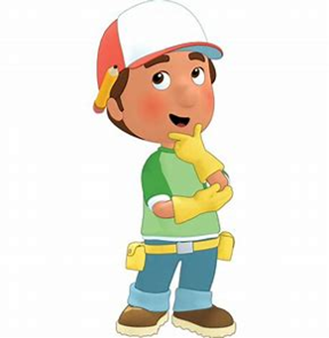
address
arrive
suppose

Slide 6
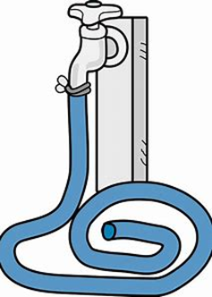
address
arrive
suppose
attached

Slide 7
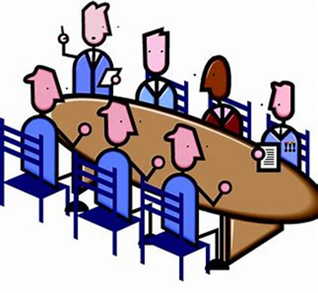
address
arrive
suppose
attached
committee

Slide 8
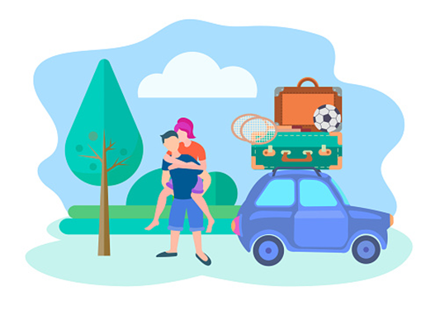
address
arrive
suppose
attached
committee
equipped

Slide 9
address
arrive
suppose
attached
committee
equipped
programmed

Slide 10
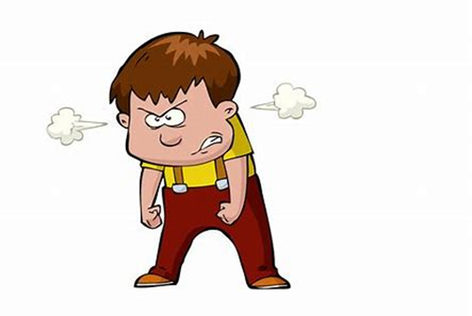
address
arrive
suppose
attached
committee
equipped
programmed
aggressive

Slide 11
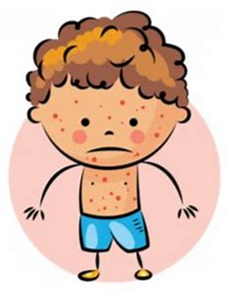
address
arrive
suppose
attached
committee
equipped
programmed
aggressive
apparent

Slide 12
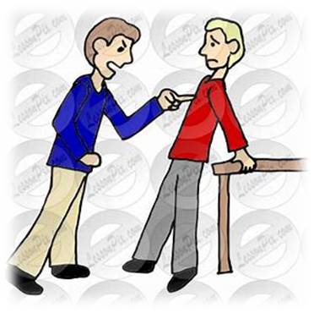
address
arrive
suppose
attached
committee
equipped
programmed
aggressive
apparent
10. harass

Slide 13
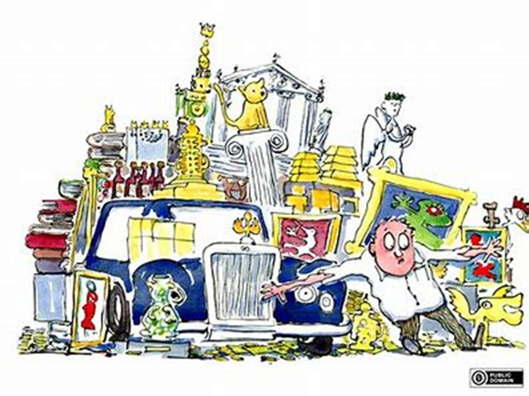
address
arrive
suppose
attached
committee
equipped
programmed
aggressive
apparent
10. harass
11. possession

Slide 14
address
arrive
suppose
attached
committee
equipped
programmed
aggressive
apparent
10. harass
11. possession
12. community

Slide 15
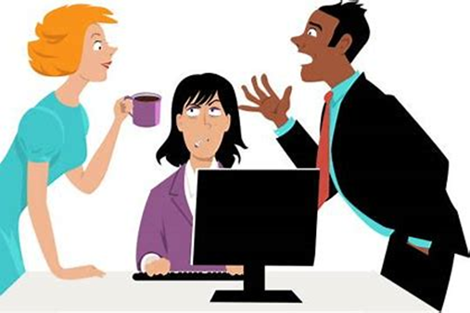
address
arrive
suppose
attached
committee
equipped
programmed
aggressive
apparent
10. harass
11. possession
12. community
13. interruption

Slide 16
address
arrive
suppose
attached
committee
equipped
programmed
aggressive
apparent
10. harass
11. possession
12. community
13. interruption
14. communicate

Slide 17
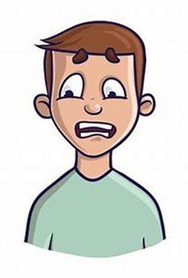
address
arrive
suppose
attached
committee
equipped
programmed
aggressive
apparent
10. harass
11. possession
12. community
13. interruption
14. communicate
15. embarrass

Slide 18
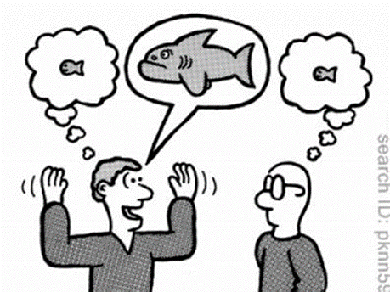
address
arrive
suppose
attached
committee
equipped
programmed
aggressive
apparent
10. harass
11. possession
12. community
13. interruption
14. communicate
15. embarrass
16. exaggerate

Slide 19
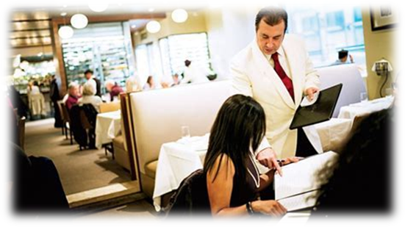
address
arrive
suppose
attached
committee
equipped
programmed
aggressive
apparent
10. harass
11. possession
12. community
13. interruption
14. communicate
15. embarrass
16. exaggerate
17. recommend

Slide 20
address
arrive
suppose
attached
committee
equipped
programmed
aggressive
apparent
10. harass
11. possession
12. community
13. interruption
14. communicate
15. embarrass
16. exaggerate
17. recommend
18. correspond

Slide 21
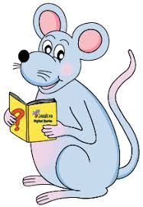
Let’s revise
Conjunctions

Slide 22
Let’s learn
how conjunction creates a natural flow and helps us digest information more easily.

Slide 23
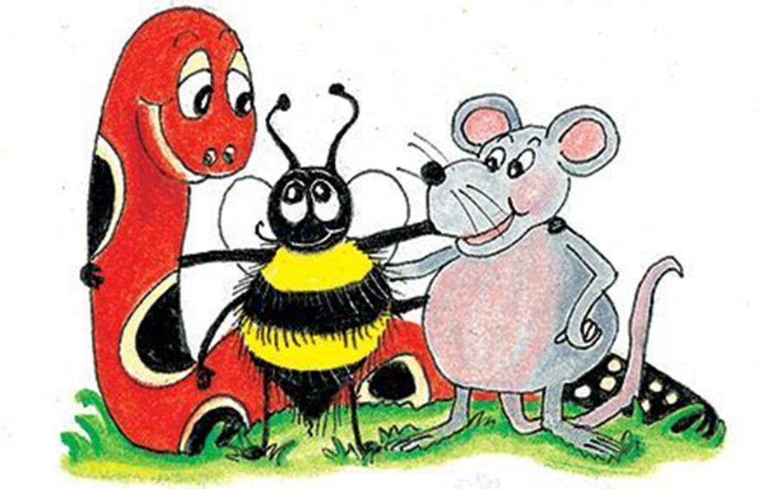
Joe put on his coat.
Joe put on his scarf.
Jess put on her coat.
Jess put on her scarf.

Slide 24
Joe put on his coat.
Joe put on his scarf.
Jess put on her coat.
Jess put on her scarf.
↓
Joe and Jess put on their coats
and scarves.

Slide 25
Did you leave your book at home,
or did you leave it in the car? ↓

Slide 26
Did you leave your book at home,
or did you leave it in the car? ↓
Did you leave your book at home
or in the car?

Slide 27
Coordinating conjunctions
and: gives more information added
or: provides an alternative
so: shows us the consequences
but: provides a general contrast
yet: provides a strong contrast
for: introduces further information
as an explanation
nor: excludes more information

Slide 28
Coordinating conjunctions
nor: excludes more information
I am not tired, nor am I hungry.

Slide 29
Coordinating Conjunctions

Slide 30
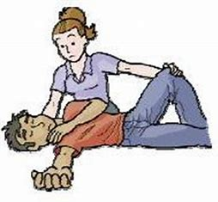
Is the patient conscious or unconscious?

Slide 31
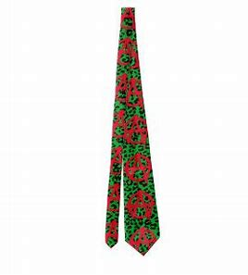
The tie was hideous so my dad never
wore it.

Slide 32
His latest book was not well-written, nor was it especially interesting.

Slide 33
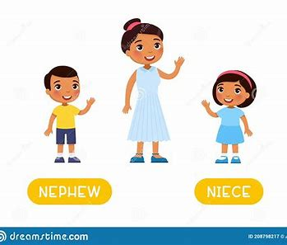
Who is the eldest, your niece or your nephew?

Slide 34
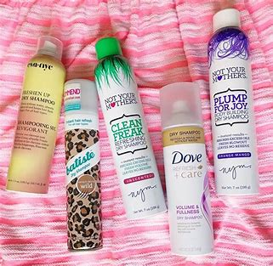
I tried two kinds of shampoo but I did not like either of them.

Slide 35
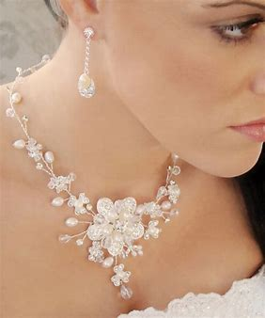
For my birthday I got a gorgeous necklace and a matching pair of earrings.

Slide 36
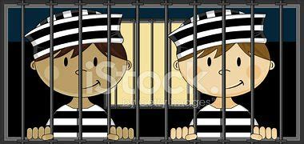
They spent many years in jail, for their crimes were truly malicious.

Slide 37
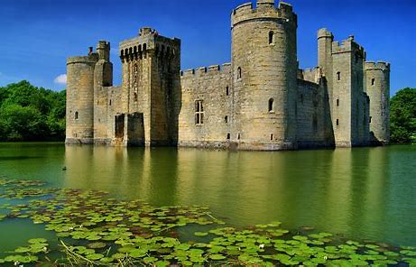
The ancient castle is not in France, nor is it in Spain.

Slide 38
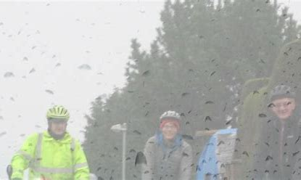
The weather was atrocious, and yet they insisted on going for a walk.

Slide 39
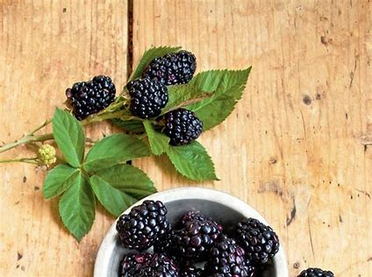
Those luscious blackberries were sweet and very juicy.

Slide 40
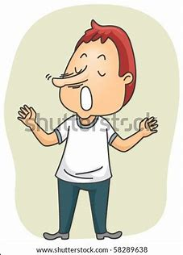
It was an outrageous lie and yet they still believed him.

Slide 41
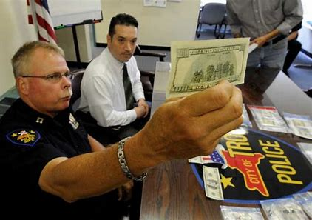
The money was counterfeit so they called the police.

Slide 42
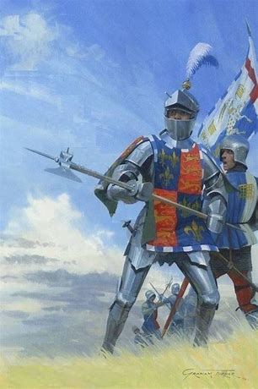
The knight was famous throughout the land, for he was courageous in battle.

Slide 43
It seems like a spontaneous decision, but I had thought about it very carefully.

Slide 44
See you
next time!

