Slide 1
Jolly Grammar
6a-25

Slide 2
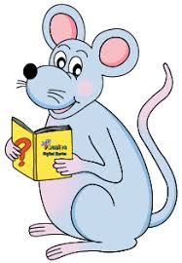
Spelling Point

Slide 3
equipped
programmed

Slide 4
equipped
programmed
suppose (sub＋ponere)
address (ad ＋ directus)

Slide 5
Spelling List

Slide 6
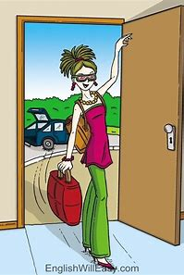
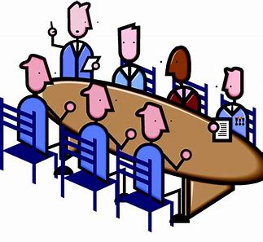
address arrive suppose
attached committee equipped

Slide 7
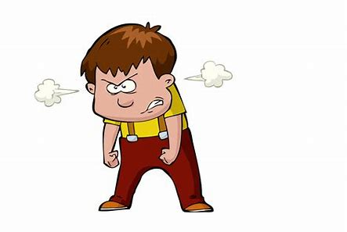
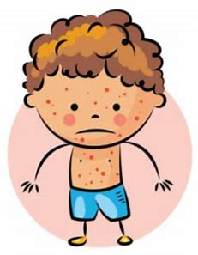
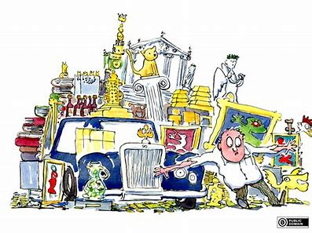
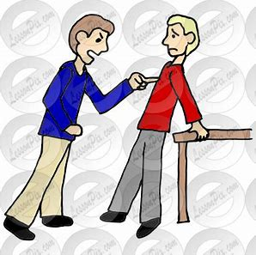
programmed aggressive apparent
harass possession community

Slide 8
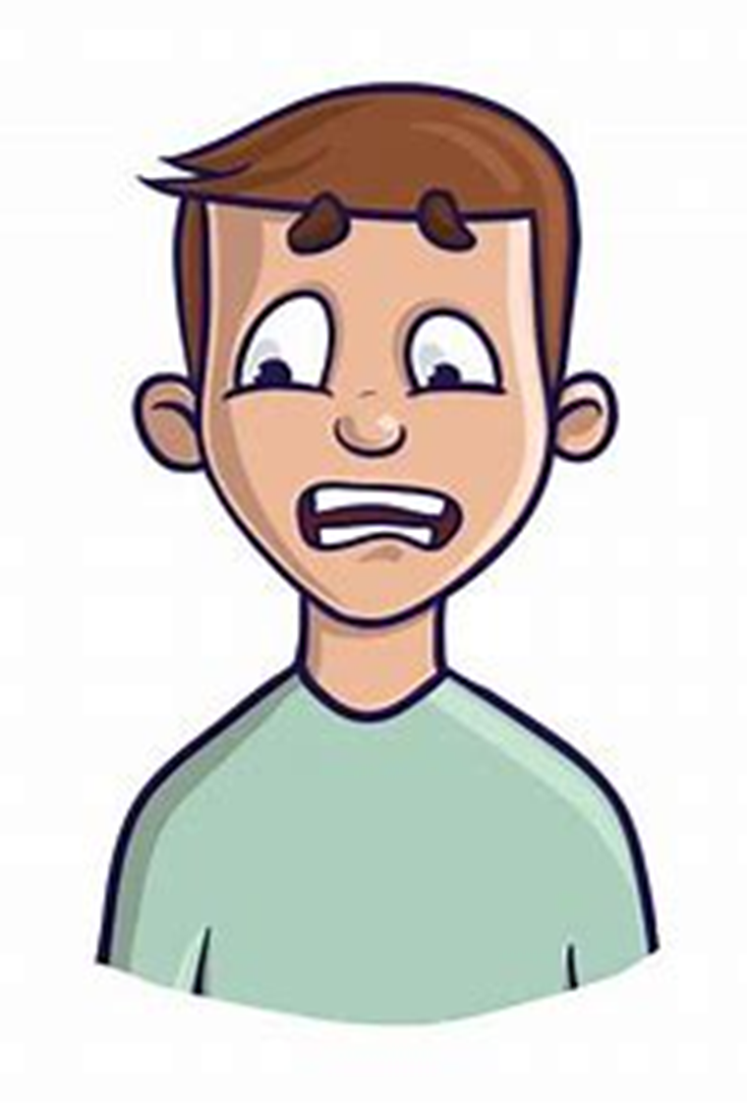
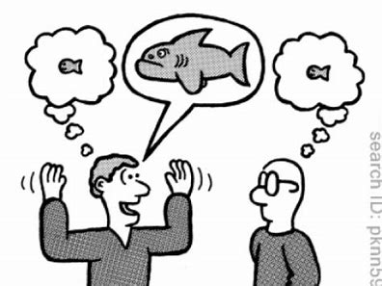
interruption communicate embarrass
exaggerate recommend correspond

Slide 9
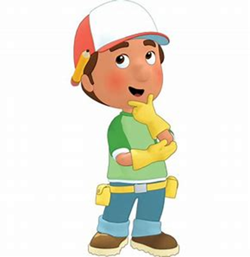
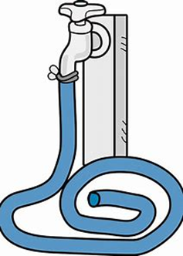
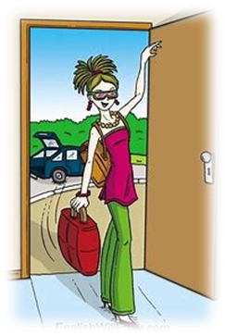
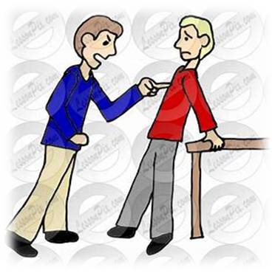
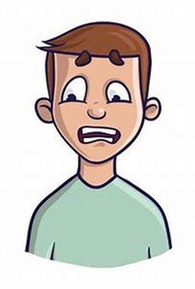

Slide 10
Activity Page
Spelling:
Double Letters

Slide 11
The dog (in the park) was very aggressive.
Subject
dog
The/
in the park
Verb
was/
aggressive(very)
Object
(linking)

Slide 12
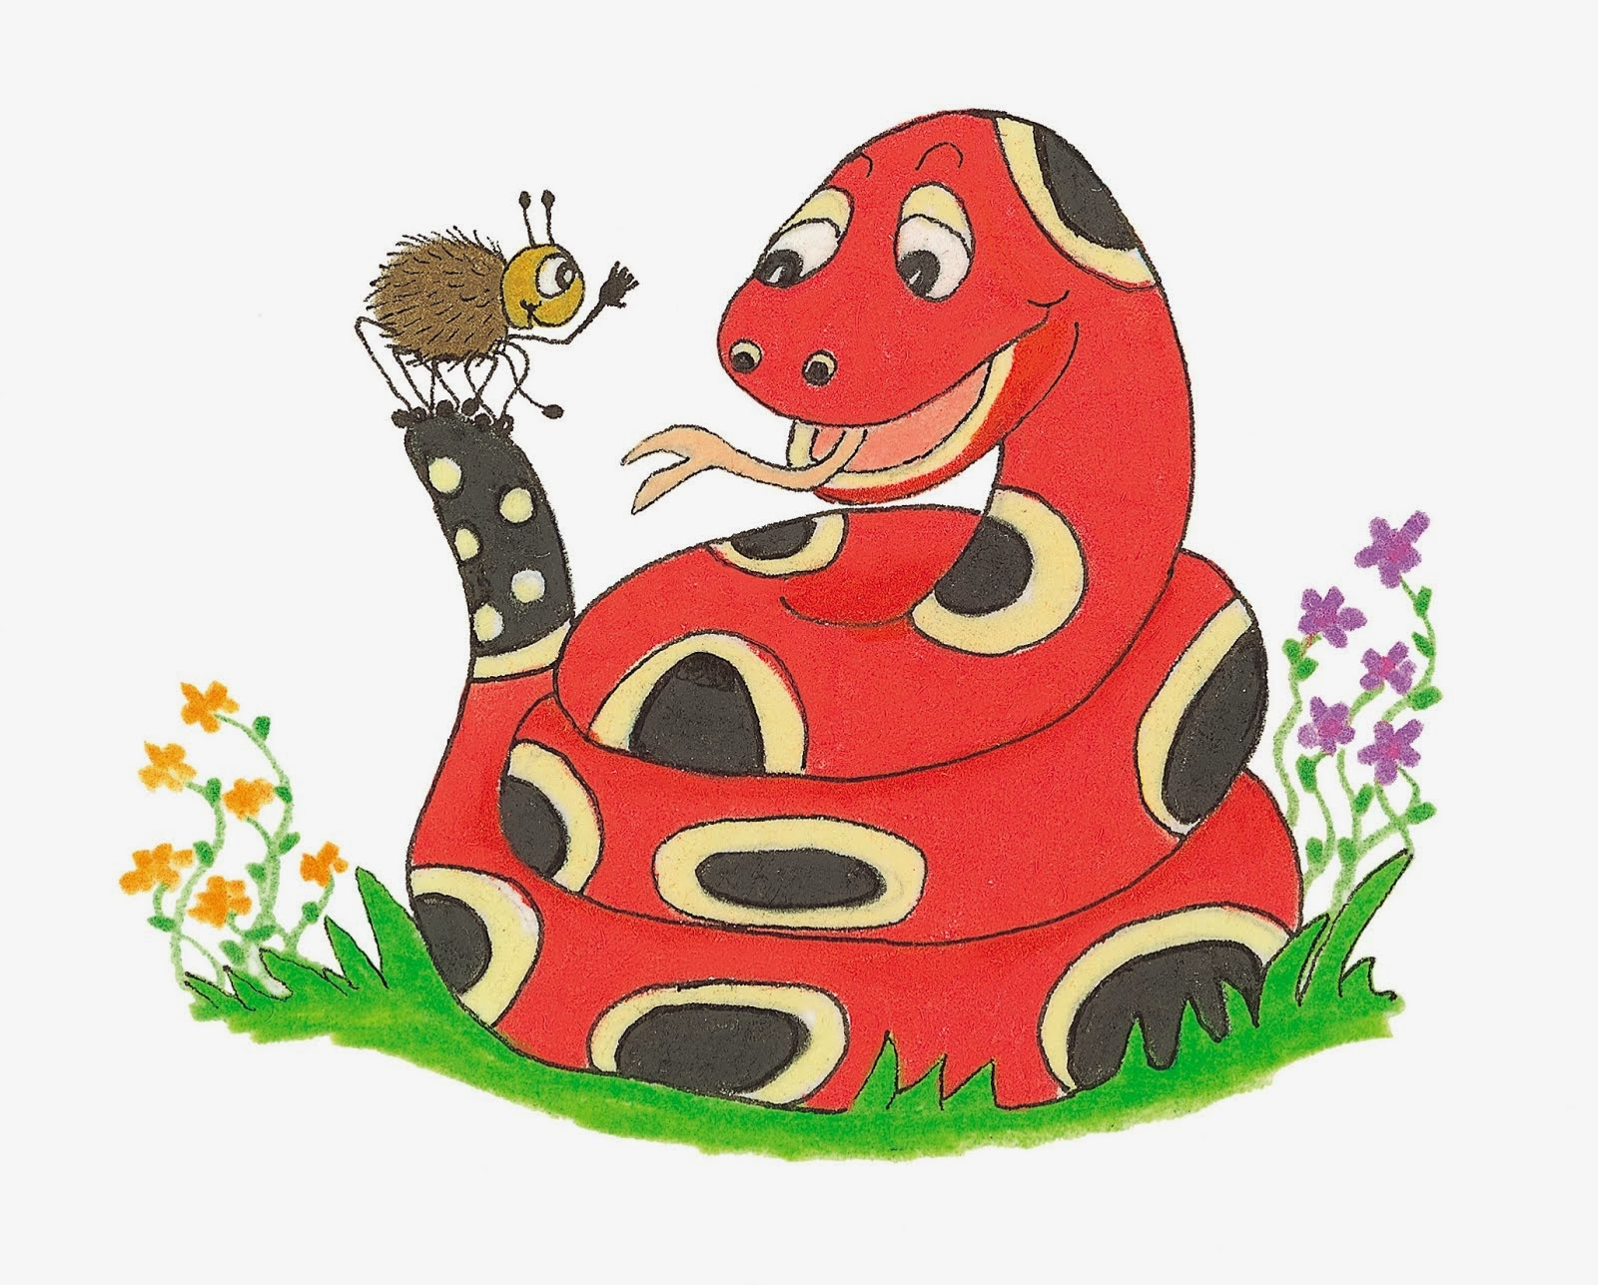
Dictation

Slide 13
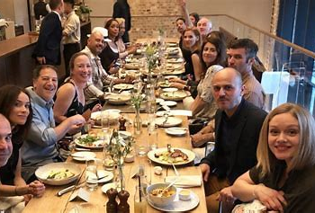

Slide 14
We were supposed to arrive before dinner.

Slide 15
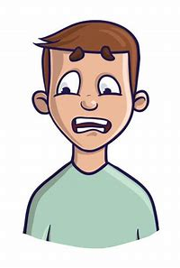

Slide 16
“I was so embarrassed!” exclaimed Sam.

Slide 18
There were no interruptions during the lesson.

Slide 19
See you
next time!

