Slide 1
Jolly Grammar
6a-24

Slide 2
Spelling Test 12

Slide 3
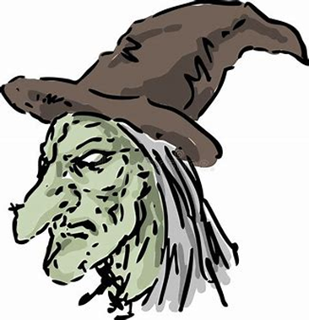
hideous

Slide 4
hideous
gorgeous

Slide 5
hideous
gorgeous
piteous

Slide 6
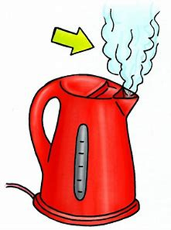
hideous
gorgeous
piteous
gaseous

Slide 7
hideous
gorgeous
piteous
gaseous
righteous

Slide 8
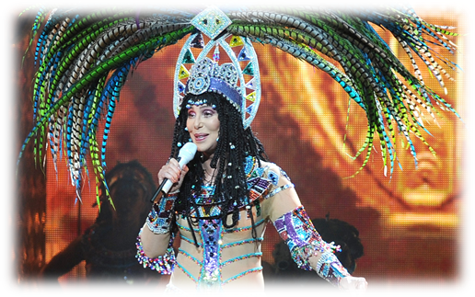
hideous
gorgeous
piteous
gaseous
righteous
outrageous

Slide 9
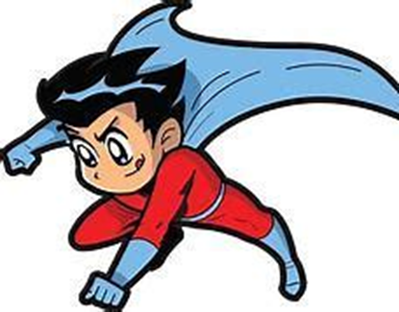
hideous
gorgeous
piteous
gaseous
righteous
outrageous
courageous

Slide 10
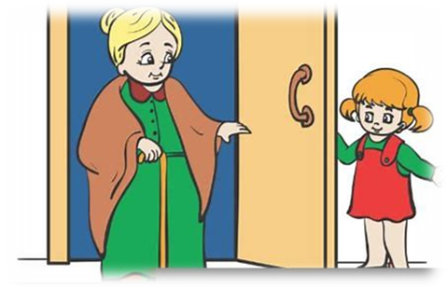
hideous
gorgeous
piteous
gaseous
righteous
outrageous
courageous
courteous

Slide 11
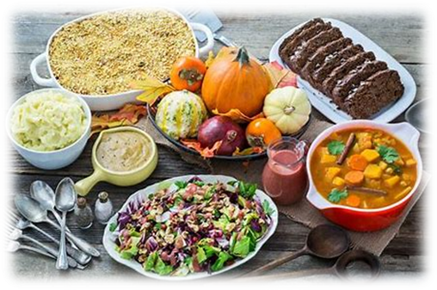
hideous
gorgeous
piteous
gaseous
righteous
outrageous
courageous
courteous
bounteous

Slide 12
hideous
gorgeous
piteous
gaseous
righteous
outrageous
courageous
courteous
bounteous
10. erroneous

Slide 13
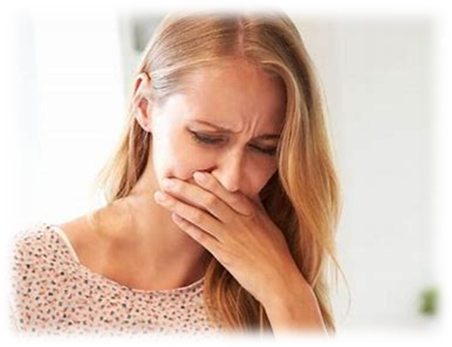
hideous
gorgeous
piteous
gaseous
righteous
outrageous
courageous
courteous
bounteous
10. erroneous
11. nauseous

Slide 14
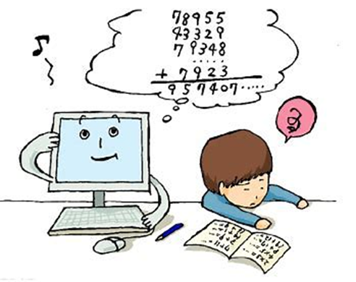
hideous
gorgeous
piteous
gaseous
righteous
outrageous
courageous
courteous
bounteous
10. erroneous
11. nauseous
12. advantageous

Slide 15
hideous
gorgeous
piteous
gaseous
righteous
outrageous
courageous
courteous
bounteous
10. erroneous
11. nauseous
12. advantageous
13. extraneous

Slide 16
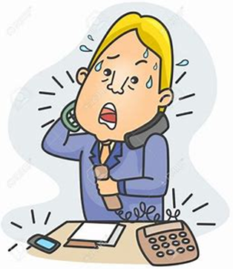
hideous
gorgeous
piteous
gaseous
righteous
outrageous
courageous
courteous
bounteous
10. erroneous
11. nauseous
12. advantageous
13. extraneous
14. simultaneous

Slide 17
hideous
gorgeous
piteous
gaseous
righteous
outrageous
courageous
courteous
bounteous
10. erroneous
11. nauseous
12. advantageous
13. extraneous
14. simultaneous
15. spontaneous

Slide 18
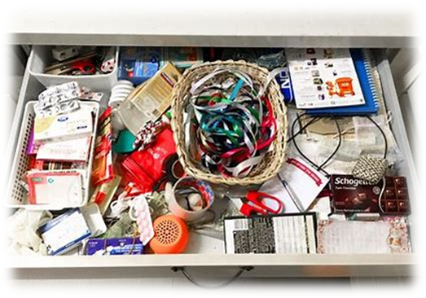
hideous
gorgeous
piteous
gaseous
righteous
outrageous
courageous
courteous
bounteous
10. erroneous
11. nauseous
12. advantageous
13. extraneous
14. simultaneous
15. spontaneous
16. miscellaneous

Slide 19
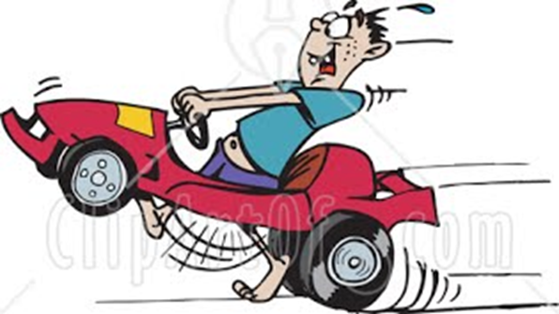
hideous
gorgeous
piteous
gaseous
righteous
outrageous
courageous
courteous
bounteous
10. erroneous
11. nauseous
12. advantageous
13. extraneous
14. simultaneous
15. spontaneous
16. miscellaneous
17. instantaneous

Slide 20
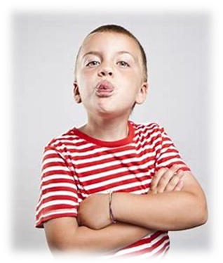
hideous
gorgeous
piteous
gaseous
righteous
outrageous
courageous
courteous
bounteous
10. erroneous
11. nauseous
12. advantageous
13. extraneous
14. simultaneous
15. spontaneous
16. miscellaneous
17. instantaneous
18. discourteous

Slide 21
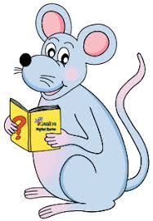
Let’s revise
Relative clauses

Slide 22
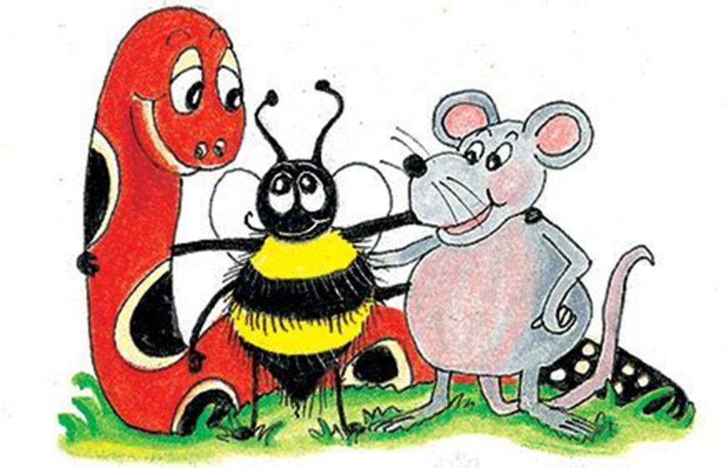
Relative clauses
the day when the triplets were born
the ancient city where the treasure was found
the reason why octopuses have eight tentacles
the museum where we saw the foreign coins
the year when she won the heptathlon
the reason why triceratops had three horns

Slide 23
Let’s learn
Two kinds of clauses.

Slide 24
Relative clauses
She is the girl (who won the race).
Paris, (which is the capital of France), is a beautiful city.

Slide 25
Relative clauses
● Defining clause
She is the girl (who won the race).
● Non-defining clause
Paris, (which is the capital of France), is a beautiful city.

Slide 26
Relative clauses
John is in the park where his friends are playing.
John is in the park, where his friends are playing.

Slide 27
Relative clauses
● Defining clause
John is in the park where his friends are playing.
● Non-defining clause
John is in the park, where his friends are playing.

Slide 28
Relative Clauses in Sentences

Slide 29
defining clauses ＝ essential information
We saw the woman who owns a blue bicycle in the park.

Slide 30
defining clauses ＝ essential information
We saw the woman (who owns a blue bicycle) in the park.

Slide 31
defining clauses ＝ essential information
We saw the woman (who owns a blue bicycle) in the park.
Which woman did we see in the park?

Slide 32
defining clauses ＝ essential information
We saw the woman (who owns a blue bicycle) in the park.
Which woman did we see in the park?
the one who owns a blue bicycle

Slide 33
defining clauses ＝ essential information
They have caught the ferocious lion (which escaped from the zoo).

Slide 34
defining clauses ＝ essential information
They have caught the ferocious lion (which escaped from the zoo).
Which ferocious lion have they caught?

Slide 35
defining clauses ＝ essential information
They have caught the ferocious lion (which escaped from the zoo).
Which ferocious lion have they caught?
the one which escaped from the zoo

Slide 36
defining clauses ＝ essential information
They rescued the man (whose ceiling had collapsed).

Slide 37
defining clauses ＝ essential information
They rescued the man (whose ceiling had collapsed).
Which man did they rescue?

Slide 38
defining clauses ＝ essential information
They rescued the man (whose ceiling had collapsed).
Which man did they rescue?
the one whose ceiling had collapsed

Slide 39
defining clauses ＝ essential information
They author (whom you like) has written a new trilogy.

Slide 40
defining clauses ＝ essential information
They author (whom you like) has written a new trilogy.
Which author has written a new trilogy?

Slide 41
defining clauses ＝ essential information
They author (whom you like) has written a new trilogy.
Which author has written a new trilogy?
the one whom you like

Slide 42
defining clauses ＝ essential information
The pie (that my niece is baking) smells delicious.

Slide 43
defining clauses ＝ essential information
The pie (that my niece is baking) smells delicious.
Which pie smells delicious?

Slide 44
defining clauses ＝ essential information
The pie (that my niece is baking) smells delicious.
Which pie smells delicious?
the one that my niece is baking

Slide 45
non-defining clauses ＝ extra information
My dad, who loves gardening, especially likes roses.

Slide 46
non-defining clauses ＝ extra information
I had some semi-precious stones, which my sister gave me.

Slide 47
non-defining clauses ＝ extra information
His friend, whose name is Tom, is rather unsocial.

Slide 48
non-defining clauses ＝ extra information
They would like to visit Rome, where their cousins live.

Slide 49
non-defining clauses ＝ extra information
Jenny, whom they met forty years ago, is coming to stay.

Slide 50
Assignment
Split words into syllables
in page 38.

Slide 51
See you
next time!

