Slide 1
Jolly Grammar
6a-23

Slide 2
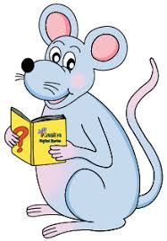
Let’s review.

Slide 3
gracious
infectious
noxious
religious
serious
obvious
dubious

Slide 4
Spelling Point

Slide 5
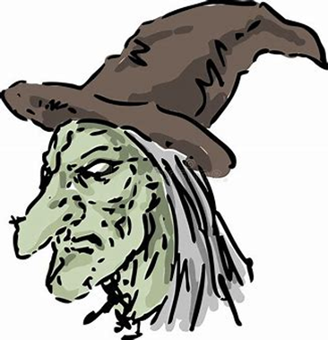
hideous

Slide 6
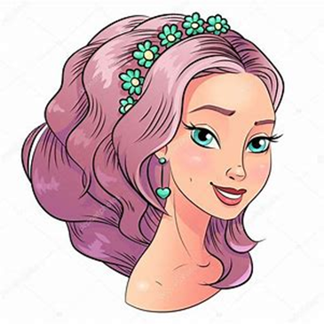
hideous
gorgeous

Slide 7
hideous
gorgeous

Slide 8
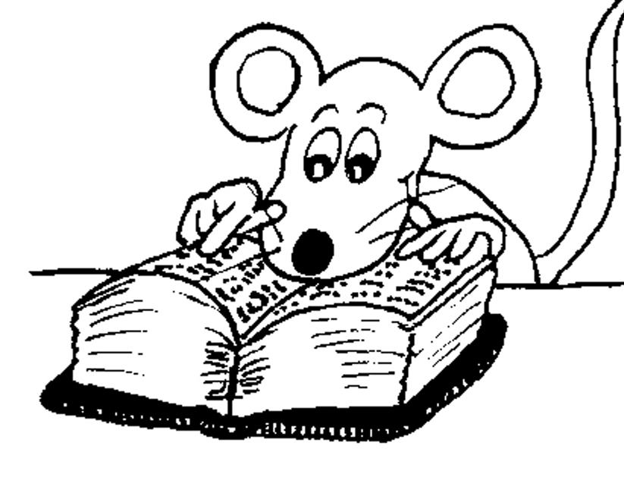
Spelling List

Slide 9
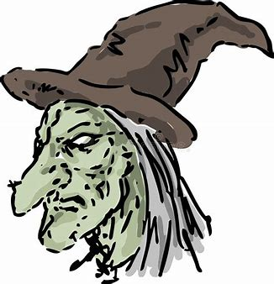
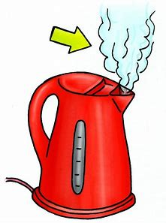
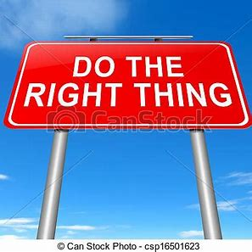
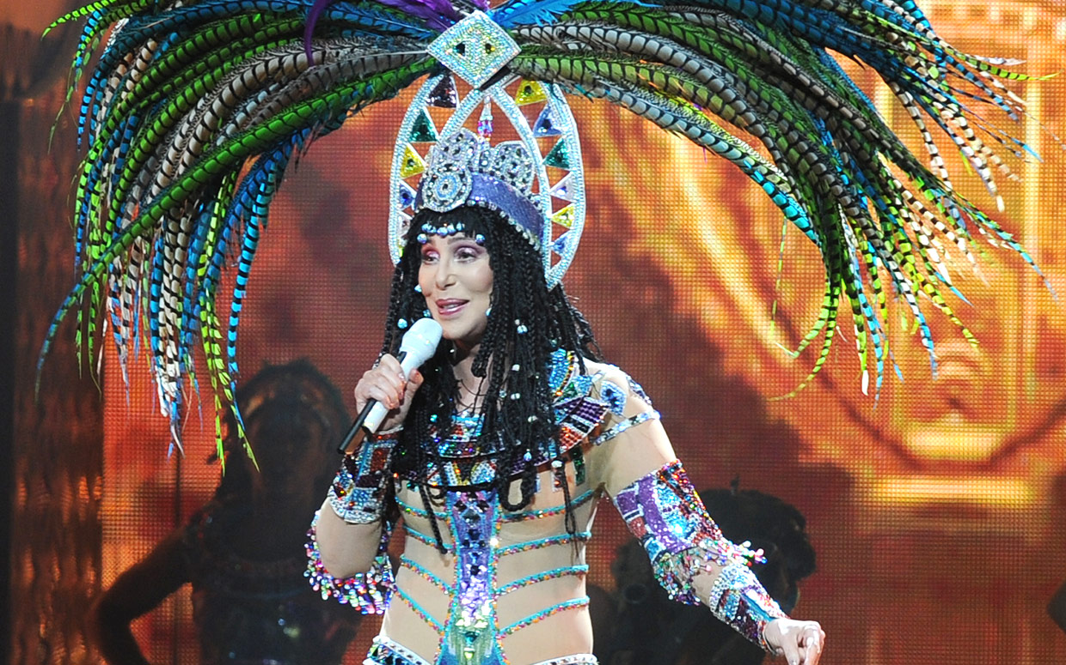
hideous gorgeous piteous
gaseous righteous outrageous

Slide 10
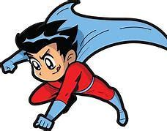
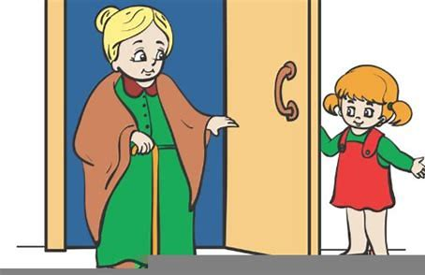
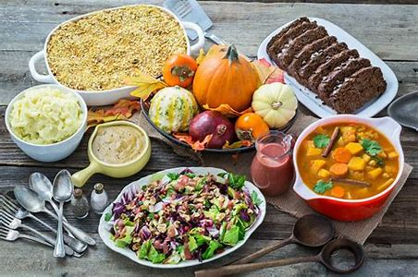
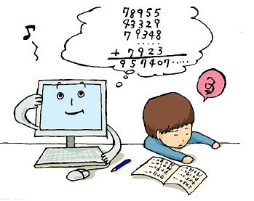
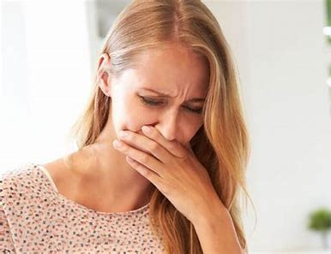
courageous courteous bounteous
erroneous nauseous advantageous

Slide 11
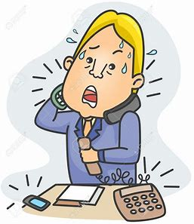
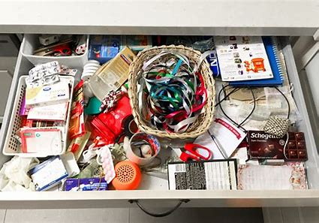
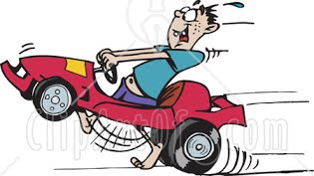
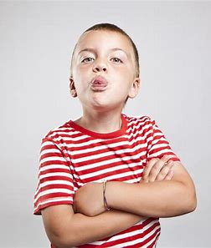
extraneous simultaneous spontaneous
miscellaneous instantaneous discourteous

Slide 13
Activity Page
Spelling:
<-eous>

Slide 15
The outrageous heroes received their medals courteously.
Subject
heroes
The outrageous
Verb
received
courteously
Object
medals
their
(action)

Slide 16
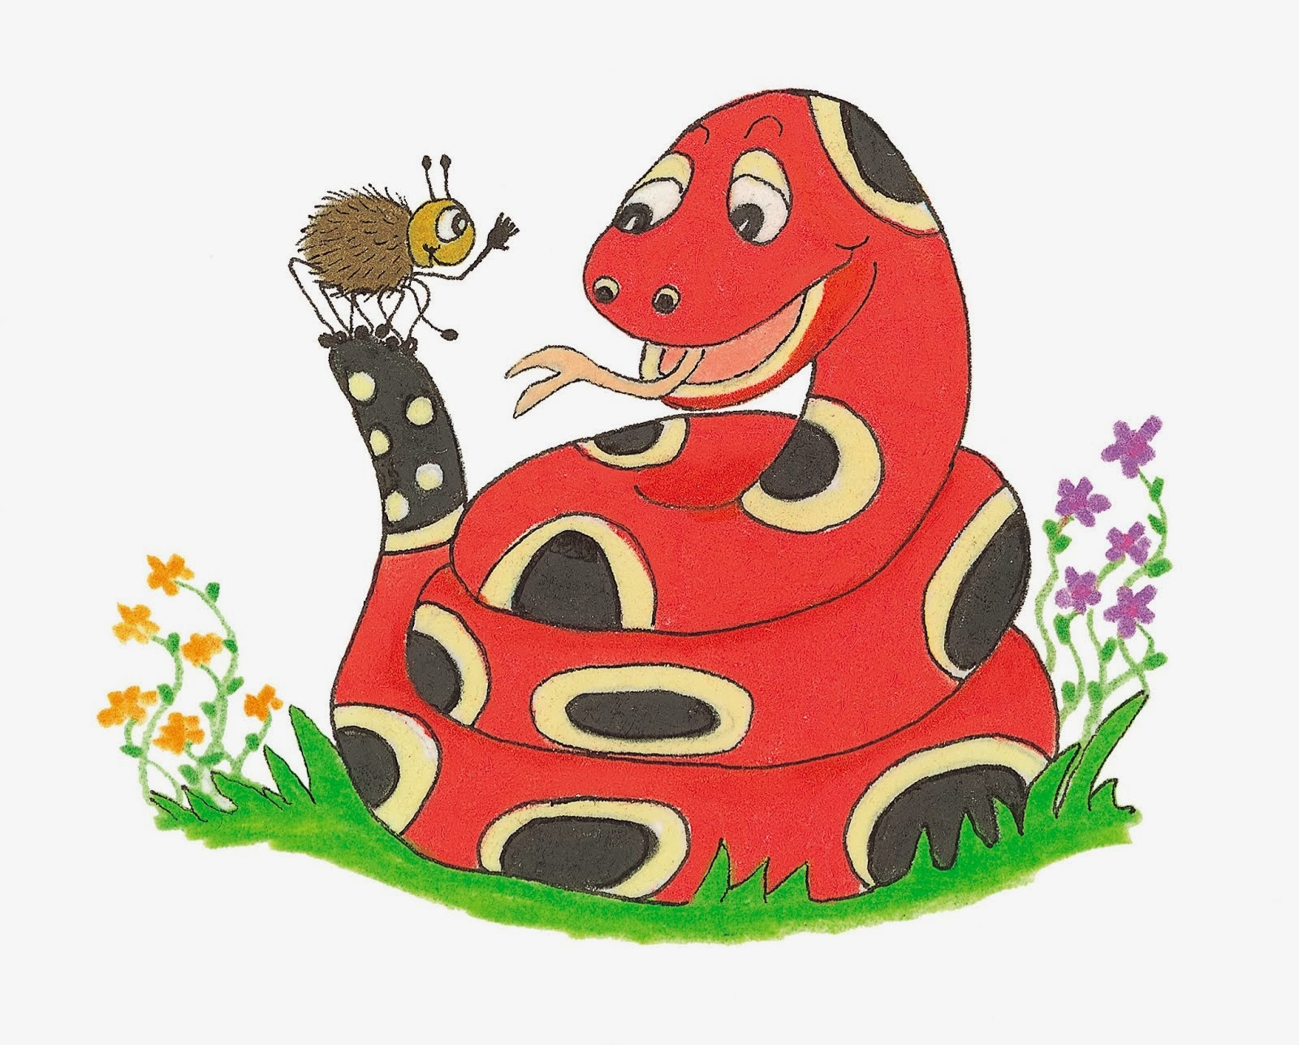
Dictation

Slide 17
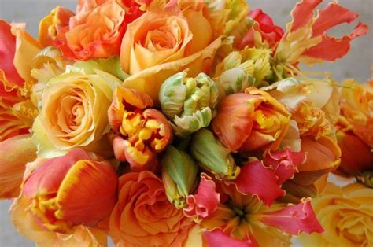

Slide 18
“What gorgeous flowers!”
I exclaimed.

Slide 19
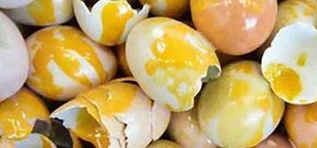
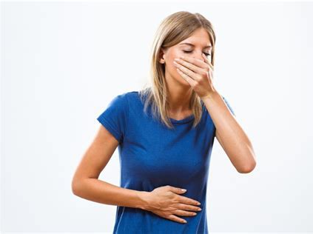

Slide 20
The smell of rotten eggs is nauseous.

Slide 21
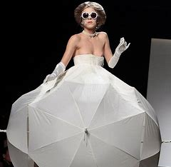

Slide 22
Do you think
it is an outrageous idea?

Slide 23
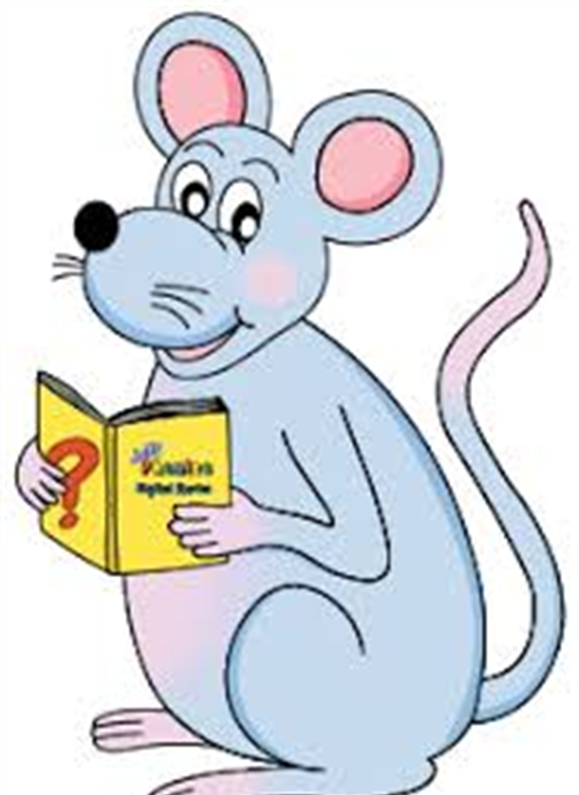
Assignment
Learn Words in the List
Complete Sentence Wall

Slide 24
See you
next time!

