Slide 1
Jolly Grammar
6a-22

Slide 2
Spelling Test 11

Slide 3
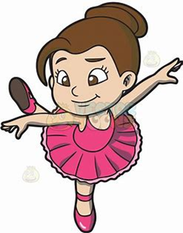
graciously

Slide 4
graciously
conscious

Slide 5
graciously
conscious
viciously

Slide 6
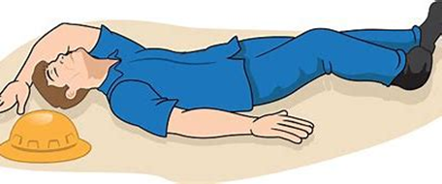
graciously
conscious
viciously
unconscious

Slide 7
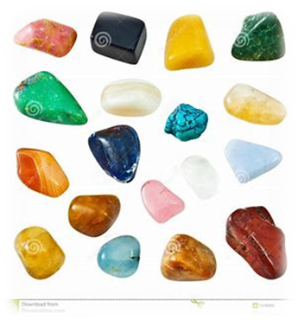
graciously
conscious
viciously
unconscious
semi-precious

Slide 8
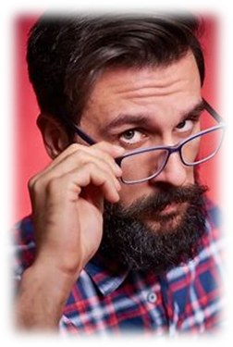
graciously
conscious
viciously
unconscious
semi-precious
suspiciously

Slide 9
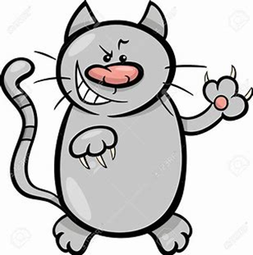
graciously
conscious
viciously
unconscious
semi-precious
suspiciously
malicious

Slide 10
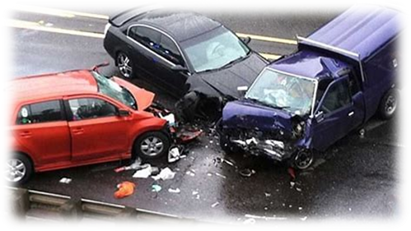
graciously
conscious
viciously
unconscious
semi-precious
suspiciously
malicious
atrocious

Slide 11
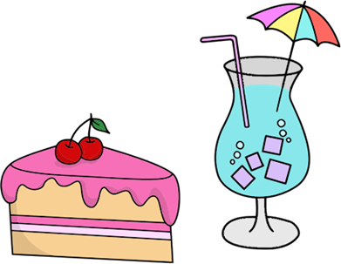
graciously
conscious
viciously
unconscious
semi-precious
suspiciously
malicious
atrocious
luscious

Slide 12
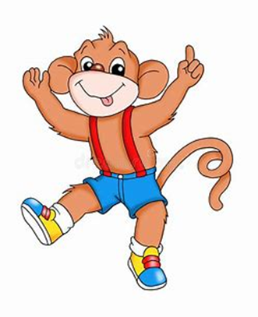
graciously
conscious
viciously
unconscious
semi-precious
suspiciously
malicious
atrocious
luscious
10. vivacious

Slide 13
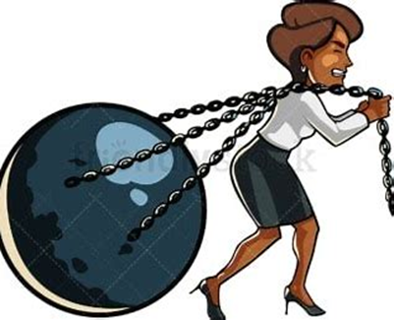
graciously
conscious
viciously
unconscious
semi-precious
suspiciously
malicious
atrocious
luscious
10. vivacious
11. tenacious

Slide 14
graciously
conscious
viciously
unconscious
semi-precious
suspiciously
malicious
atrocious
luscious
10. vivacious
11. tenacious
12. ferociously

Slide 15
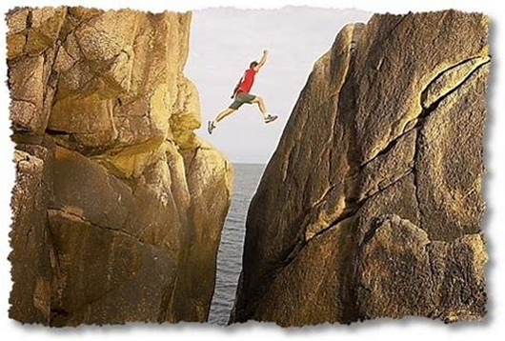
graciously
conscious
viciously
unconscious
semi-precious
suspiciously
malicious
atrocious
luscious
10. vivacious
11. tenacious
12. ferociously
13. audacious

Slide 16
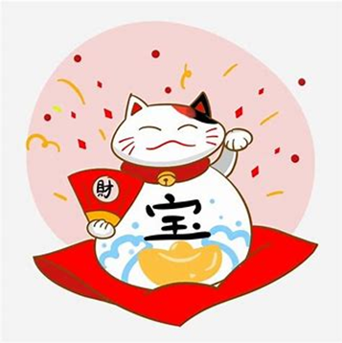
graciously
conscious
viciously
unconscious
semi-precious
suspiciously
malicious
atrocious
luscious
10. vivacious
11. tenacious
12. ferociously
13. audacious
14. auspicious

Slide 17
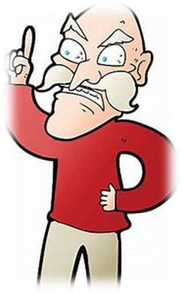
graciously
conscious
viciously
unconscious
semi-precious
suspiciously
malicious
atrocious
luscious
10. vivacious
11. tenacious
12. ferociously
13. audacious
14. auspicious
15. officious

Slide 18
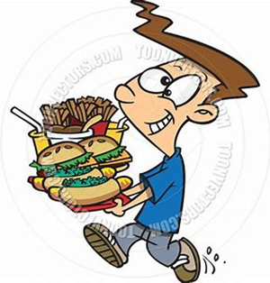
graciously
conscious
viciously
unconscious
semi-precious
suspiciously
malicious
atrocious
luscious
10. vivacious
11. tenacious
12. ferociously
13. audacious
14. auspicious
15. officious
16. voracious

Slide 19
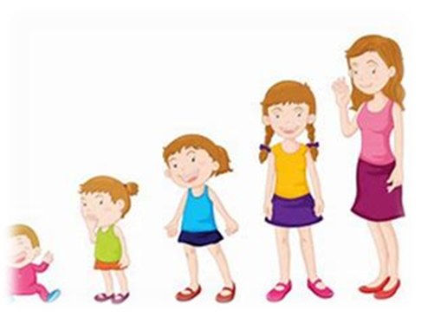
graciously
conscious
viciously
unconscious
semi-precious
suspiciously
malicious
atrocious
luscious
10. vivacious
11. tenacious
12. ferociously
13. audacious
14. auspicious
15. officious
16. voracious
17. precocious

Slide 20
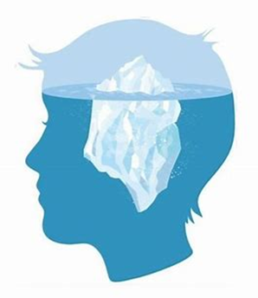
graciously
conscious
viciously
unconscious
semi-precious
suspiciously
malicious
atrocious
luscious
10. vivacious
11. tenacious
12. ferociously
13. audacious
14. auspicious
15. officious
16. voracious
17. precocious
18. subconscious

Slide 21
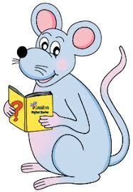
Let’s revise pronouns

Slide 22
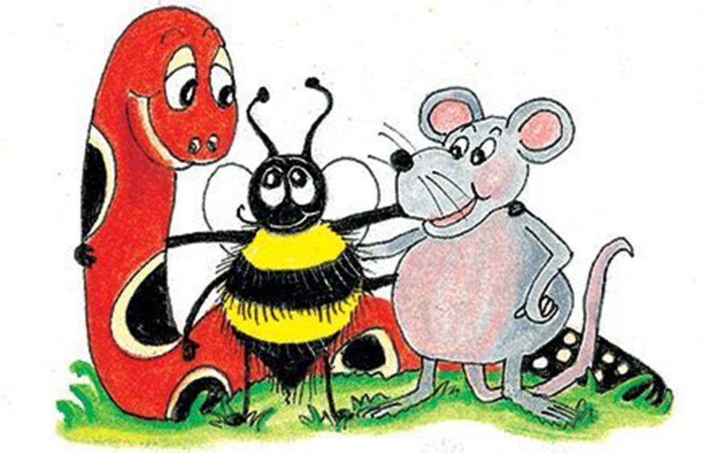
pronouns
I have a dog.
The dog belongs to me.
It is mine.

Slide 23
pronouns
I have a dog.
The dog belongs to me.
It is mine.

Slide 24
pronouns
I have a dog.
The dog belongs to me.
It is mine.

Slide 25
pronouns
I have a dog.
The dog belongs to me.
It is mine.

Slide 26
Personal pronouns
(subject)
pronouns
I have a dog.
The dog belongs to me.
It is mine.

Slide 27
Personal pronouns
(subject)
Personal pronouns
(object)
pronouns
I have a dog.
The dog belongs to me.
It is mine.

Slide 28
Personal pronouns
(subject)
Personal pronouns
(object)
pronouns
I have a dog.
The dog belongs to me.
It is mine.
Possessive pronouns

Slide 29
Let’s review
clauses.

Slide 30
clauses
I have a dog because I love animals.

Slide 31
clauses
→ groups of words which make sense
and contains a subject and verb
I have a dog because I love animals.

Slide 32
clauses
→ groups of words which make sense
and contains a subject and verb
I have a dog because I love animals.

Slide 33
clauses
→ groups of words which make sense
and contains a subject and verb
I have a dog because I love animals.
independent clause

Slide 34
clauses
→ groups of words which make sense
and contains a subject and verb
I have a dog because I love animals.
independent clause dependent (subordinate) clause

Slide 35
Let’s learn
Relative clauses.

Slide 36
Relative clauses
the girl in the green dress
the girl who has a green dress

Slide 37
Relative clauses
the girl (in the green dress)
the girl who has a green dress

Slide 38
Relative clauses
the girl (in the green dress)
the girl who has a green dress

Slide 39
Relative clauses
the girl (in the green dress)
the girl who has a green dress
relative clause

Slide 40
Relative clauses
the girl (in the green dress)
the girl who has a green dress
relative clause
● dependent clause

Slide 41
Relative clauses
the girl (in the green dress)
the girl who has a green dress
relative clause
● dependent clause
● relative clause

Slide 42
Relative clauses
the girl who has a green dress
relative clause

Slide 43
Relative clauses
the girl who has a green dress
relative clause
relative pronoun

Slide 44
Relative clauses
the girl who has a green dress
relative clause
relative pronoun
who, which, that
whom, whose

Slide 45
Relative clauses
the letter which arrived this morning
the music that we like
the friend whom I often visit
the writer whose books you enjoy

Slide 46
Relative clauses
the letter (which arrived this morning)
the music (that we like)
the friend (whom I often visit)
the writer (whose books you enjoy)

Slide 47
Relative clauses
the tripod (that he bought for his camera)
my niece (whose birthday is in September)
the castle (which they build in the
twelfth century)
the weightlifter (who won first prize
in the competition)

Slide 48
Relative Clauses

Slide 49
Relative clauses
in which
on which
at which
for which

Slide 50
Relative clauses
in which
on which when, where, why
at which
for which

Slide 51
Relative clauses
in which
on which when, where, why
at which the day on which
I was born
for which

Slide 52
Relative clauses
in which
on which when, where, why
at which the day on which when
I was born
for which

Slide 53
Relative clauses
the day when the triplets were born
the ancient city where the treasure was found
the reason why octopuses have eight tentacles
the museum where we saw the foreign coins
the year when she won the heptathlon
the reason why triceratops had three horns

Slide 54
See you
next time!

