Slide 1
Jolly Grammar
6a-21

Slide 2
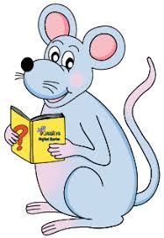
Let’s identify this sound.

Slide 3
pension
reassure
essential
expression
official
chef
ensure
obnoxious

Slide 4
pension
reassure
essential
expression /sh/
official
chef
ensure
obnoxious

Slide 5
Spelling Point

Slide 6
suspicious
ambitious
anxious

Slide 7
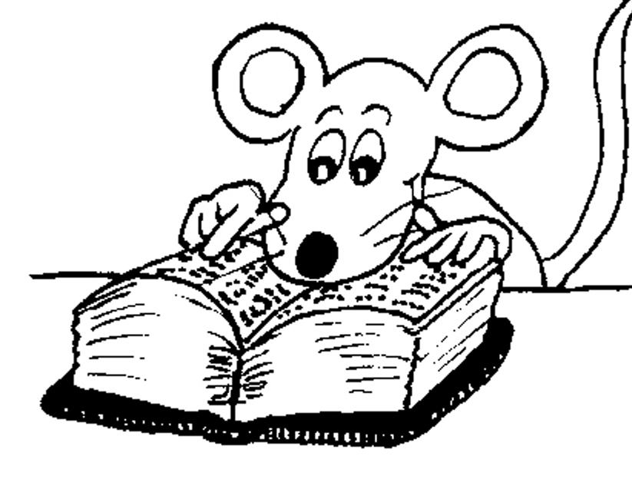
Spelling List

Slide 8
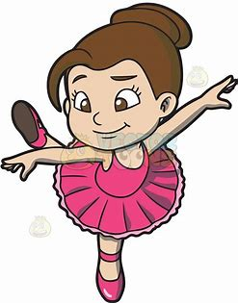
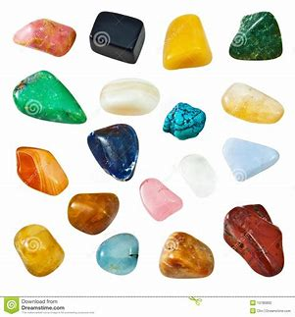
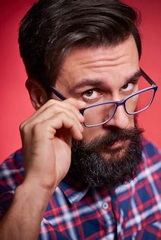
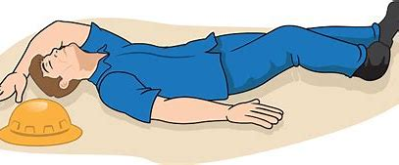
graciously conscious viciously
unconscious semi-precious suspiciously

Slide 9
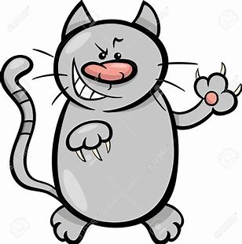
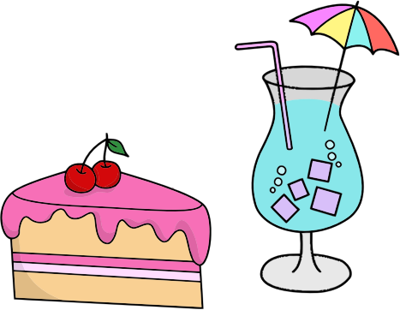
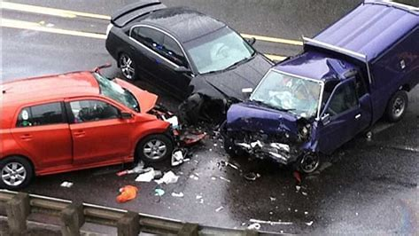
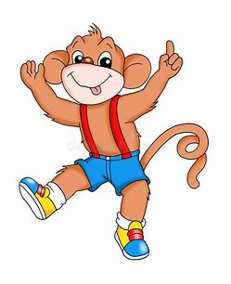
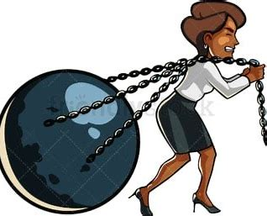
malicious atrocious luscious
vivacious tenacious ferociously

Slide 10
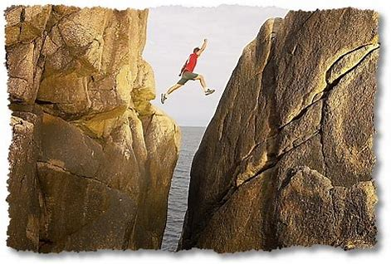
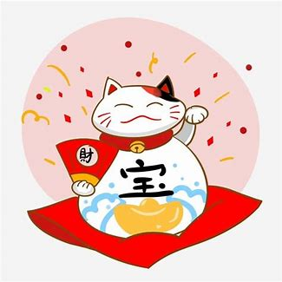
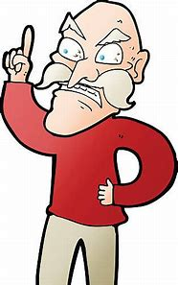
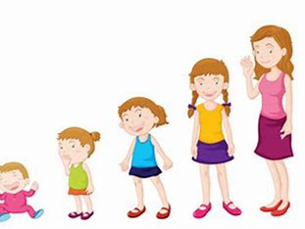
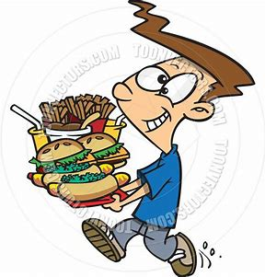
audacious auspicious officious
voracious precocious subconscious

Slide 11
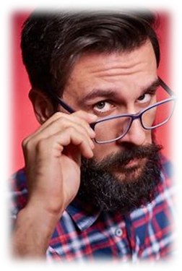
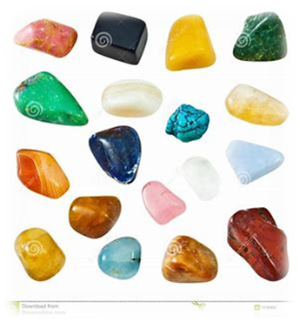
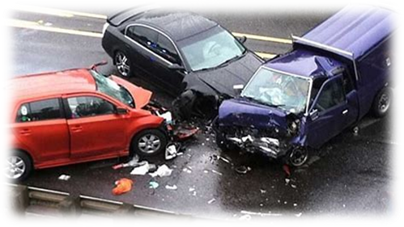
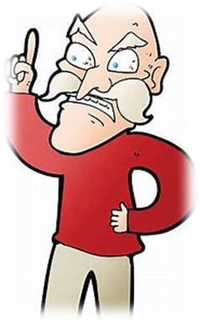
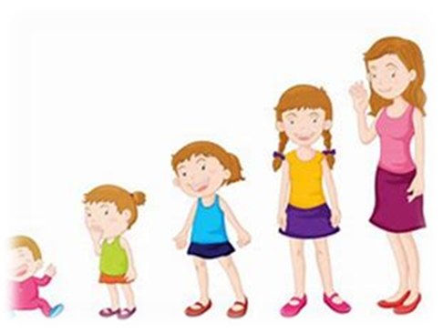

Slide 12
Activity Page
Spelling:
<cious>

Slide 13
S e m i – p r e c i o u s

Slide 14
The spiced pumpkin soup tasted delicious.
Subject
soup
The spiced
pumpkin
Verb
tasted
/ delicious
Object
(linking)

Slide 15
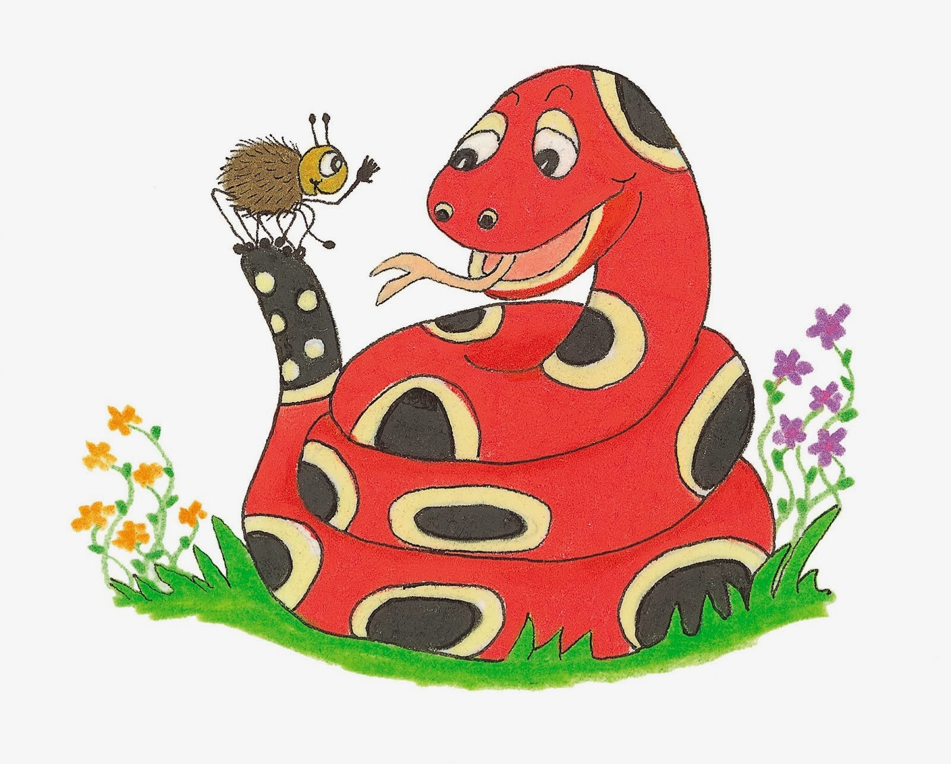
Dictation

Slide 16
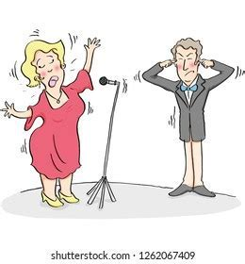
Fred.

Slide 17
“What an atrocious song!” exclaimed Fred.

Slide 18
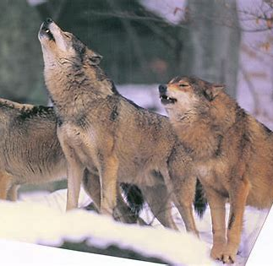

Slide 19
The fierce pack of wolves howled ferociously.

Slide 20
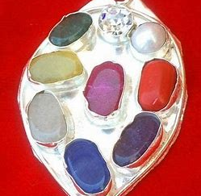

Slide 21
Her silver locket was decorated with semi-precious stones.

Slide 22
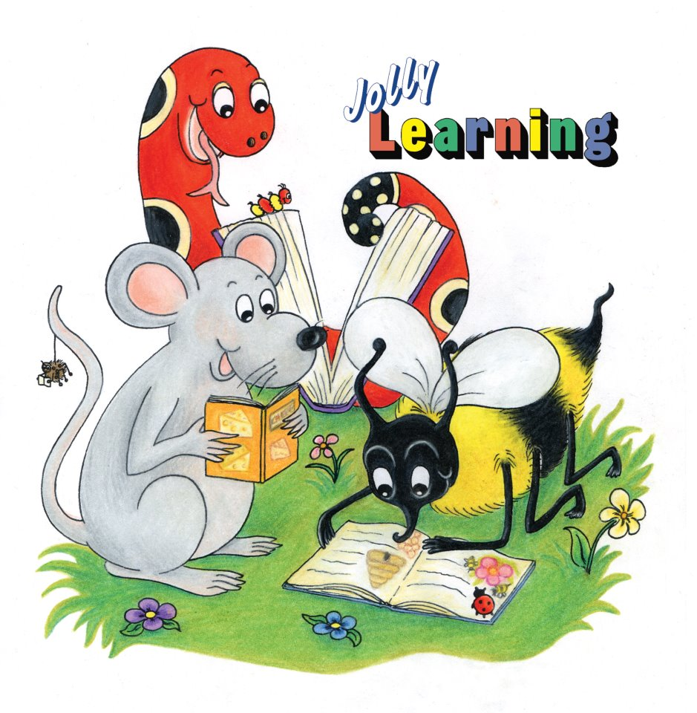
See you
next time!

