Slide 1
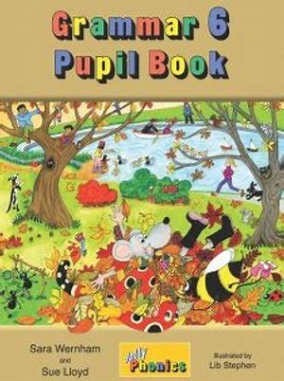
Jolly Grammar
6a-20

Slide 2
Spelling Test 10

Slide 3
ancient

Slide 4
ancient
unsocial

Slide 5
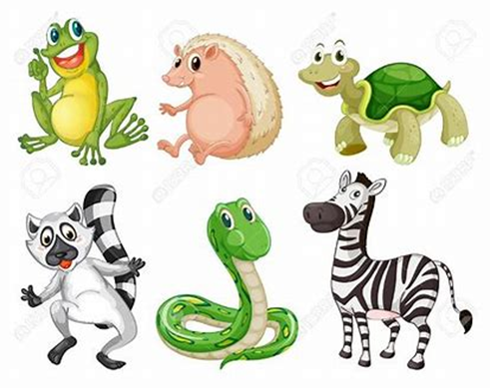
ancient
unsocial
species

Slide 6
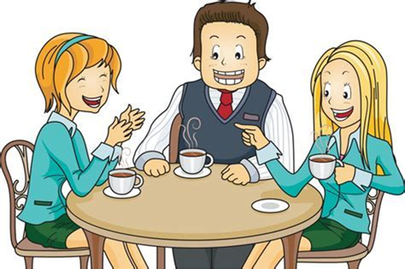
ancient
unsocial
species
sociable

Slide 7
ancient
unsocial
species
sociable
specially

Slide 8
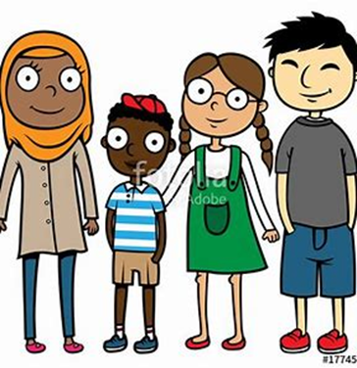
ancient
unsocial
species
sociable
specially
multiracial

Slide 9
ancient
unsocial
species
sociable
specially
multiracial
efficient

Slide 10
ancient
unsocial
species
sociable
specially
multiracial
efficient
sufficient

Slide 11
ancient
unsocial
species
sociable
specially
multiracial
efficient
sufficient
suspicion

Slide 12
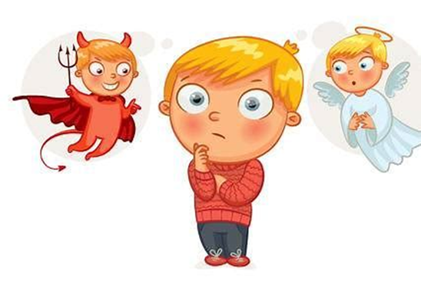
ancient
unsocial
species
sociable
specially
multiracial
efficient
sufficient
suspicion
10. conscience

Slide 13
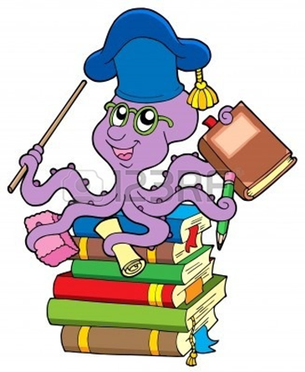
ancient
unsocial
species
sociable
specially
multiracial
efficient
sufficient
suspicion
10. conscience
11. proficient

Slide 14
ancient
unsocial
species
sociable
specially
multiracial
efficient
sufficient
suspicion
10. conscience
11. proficient
12. especially

Slide 15
ancient
unsocial
species
sociable
specially
multiracial
efficient
sufficient
suspicion
10. conscience
11. proficient
12. especially
13. appreciation

Slide 16
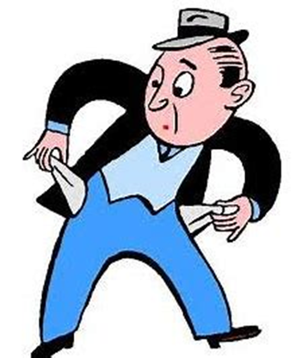
ancient
unsocial
species
sociable
specially
multiracial
efficient
sufficient
suspicion
10. conscience
11. proficient
12. especially
13. appreciation
14. insufficient

Slide 17
ancient
unsocial
species
sociable
specially
multiracial
efficient
sufficient
suspicion
10. conscience
11. proficient
12. especially
13. appreciation
14. insufficient
15. coercion

Slide 18
ancient
unsocial
species
sociable
specially
multiracial
efficient
sufficient
suspicion
10. conscience
11. proficient
12. especially
13. appreciation
14. insufficient
15. coercion
16. inefficient

Slide 19
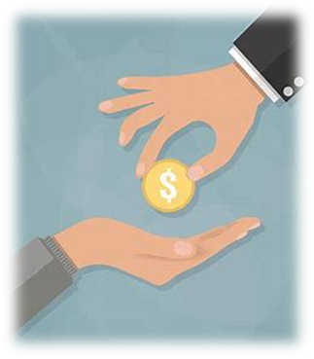
ancient
unsocial
species
sociable
specially
multiracial
efficient
sufficient
suspicion
10. conscience
11. proficient
12. especially
13. appreciation
14. insufficient
15. coercion
16. inefficient
17. beneficiary

Slide 20
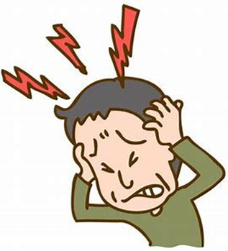
ancient
unsocial
species
sociable
specially
multiracial
efficient
sufficient
suspicion
10. conscience
11. proficient
12. especially
13. appreciation
14. insufficient
15. coercion
16. inefficient
17. beneficiary
18. excruciating

Slide 21
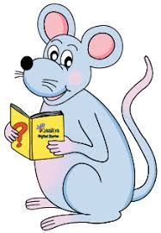
Let’s revise prepositional phrases

Slide 22
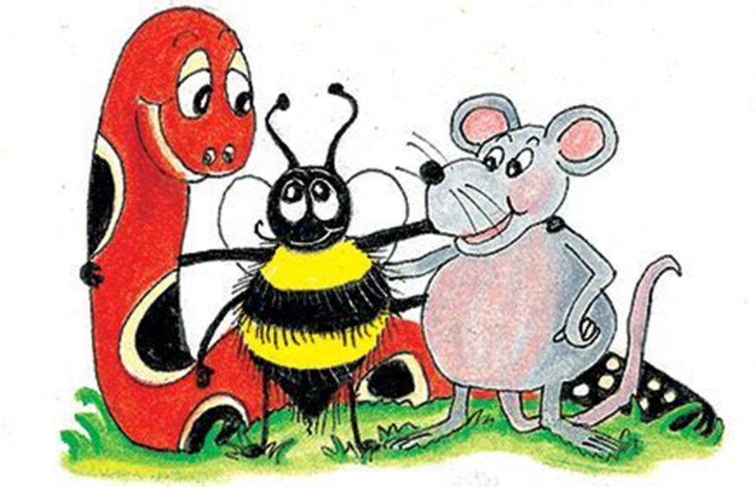
prepositional phrases

Slide 23
prepositional phrases
The birds were singing
in the old oak tree.

Slide 24
prepositional phrases
The birds were singing
[in the old oak tree].

Slide 25
The birds were singing
[in the old oak tree].

Slide 26
The birds were singing
[in the old oak tree].
In the old oak tree,
the birds were singing.

Slide 27
Let’s learn.

Slide 28
prepositional phrases as Adjectives
The birds in the old oak tree were singing.

Slide 29
prepositional phrases as Adjectives
The birds [in the old oak tree] were singing.

Slide 30
prepositional phrases as Adjectives
The birds [in the old oak tree] were singing.
the boy in the red coat
the handkerchief with blue spots
a tube of toothpaste
the plates on the table

Slide 31
prepositional phrases as Adjectives
The birds [in the old oak tree] were singing.
the boy [in the red coat]
the handkerchief with blue spots
a tube of toothpaste
the pates on the table

Slide 32
prepositional phrases as Adjectives
The birds [in the old oak tree] were singing.
the boy [in the red coat]
the handkerchief [with blue spots]
a tube of toothpaste
the pates on the table

Slide 33
prepositional phrases as Adjectives
The birds [in the old oak tree] were singing.
the boy [in the red coat]
the handkerchief [with blue spots]
a tube [of toothpaste]
the plates on the table

Slide 34
prepositional phrases as Adjectives
The birds [in the old oak tree] were singing.
the boy [in the red coat]
the handkerchief [with blue spots]
a tube [of toothpaste]
the pates [on the table]

Slide 35
Prepositional Phrases as Adjectives

Slide 36
The horses (in the field) were neighing loudly.
Which horses were neighing loudly?
the ones in the field

Slide 37
I recently received (a box of chocolates).
What kind of box did I recently receive?
a box of chocolate

Slide 38
Anna is the girl (with the kaleidoscope).
Which girl is Anna?
the one with the kaleidoscope

Slide 39
November is the month (after October).
Which month is November?
the one after October

Slide 40
She gave her niece a bottle (of perfume).
What kind of bottle did she give her niece?
a bottle of perfume

Slide 41
The eiderdown (on the bed) is a family heirloom.
Which eiderdown is a family heiroom?
the one on the bed

Slide 42
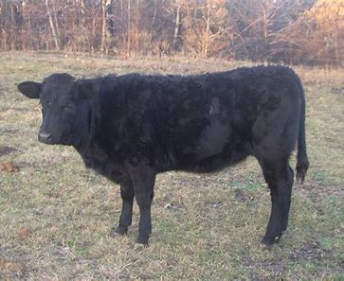
the next to the feisty heifer
after the weird smell
with the fiendish laughter
in a pretty handkerchief

Slide 43
my elementary school up the road
his expensive car inside the box
my big clock under the tree
my colorful soccer ball near the park

Slide 44
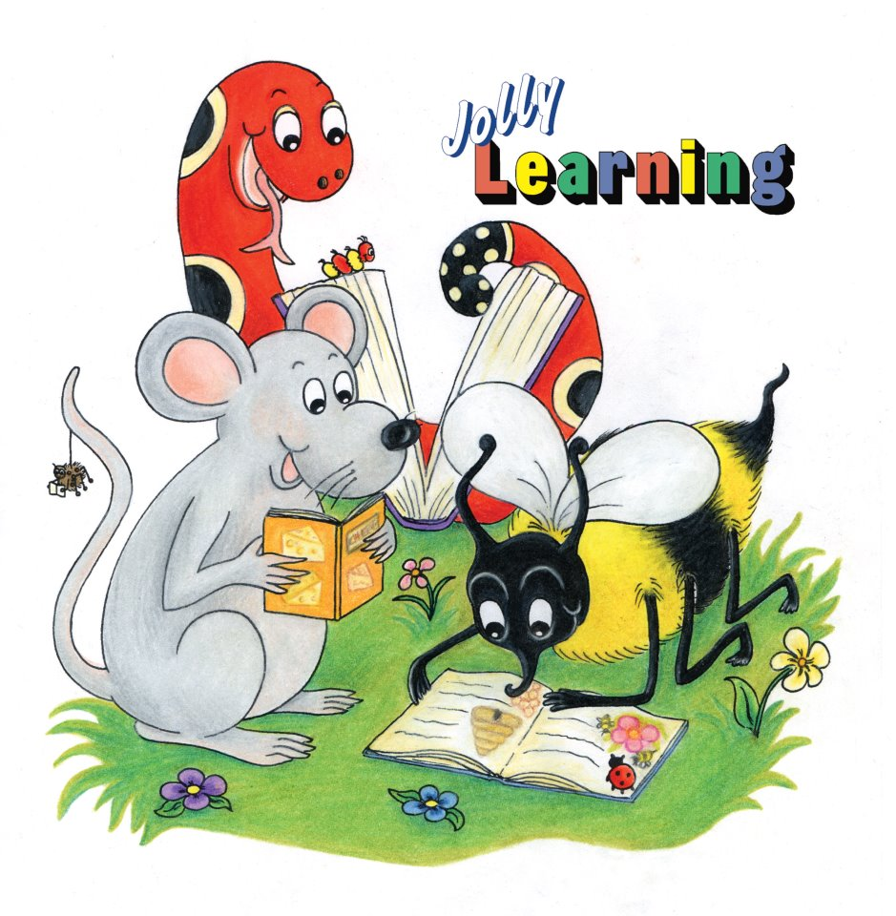
See you
next time!

