Slide 1
Jolly Grammar
6a-19

Slide 2
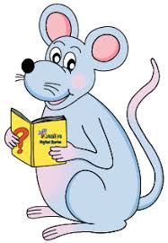
Let’s review
Linking verbs

Slide 3
verb ～ doing words
to run
to cook
to sing
～ being words
to be
to seem to remain to smell
to appear to look to taste
to become to sound to feel

Slide 4
verb ～ doing words (action)
to run
to cook
to sing
～ being words (linking)
to be
to seem to remain to smell
to appear to look to taste
to become to sound to feel

Slide 5
The lady looks at her garden everyday.
The garden looks very pretty.

Slide 6
The lady looks at her garden everyday. action
The garden looks very pretty.

Slide 7
The lady looks at her garden everyday. action
The garden looks very pretty.
linking

Slide 8
Activity Page

Slide 9
Spelling Point

Slide 10
station
suspicion
negotiable
sociable
beneficiary
patient
ancient
patience
conscience
Egyptian
musician

Slide 11
station
suspicion
negotiable
sociable
beneficiary
patient
ancient
patience
conscience
Egyptian
musician
/sh/

Slide 12
station
suspicion
negotiable
sociable
beneficiary
patient
ancient
patience
conscience
Egyptian
musician
<ci>
/sh/

Slide 13
Spelling List

Slide 14
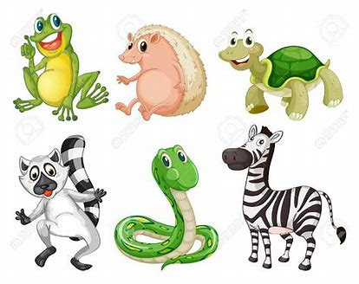
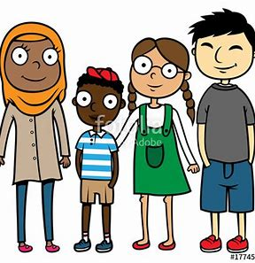
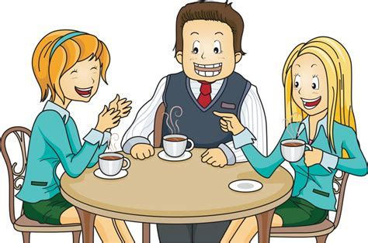
ancient unsocial species
sociable specially multiracial

Slide 15
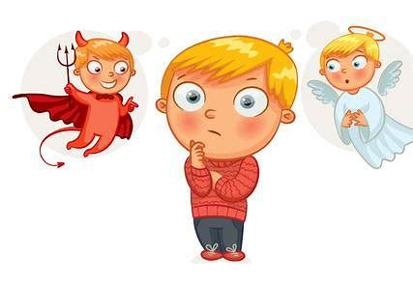
efficient sufficient suspicion
conscience proficient especially

Slide 16
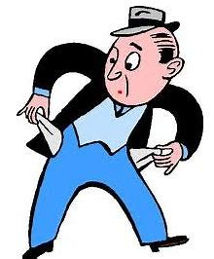
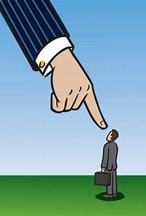
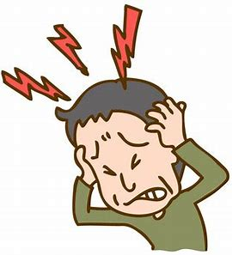
appreciation insufficient coercion
inefficient beneficiary excruciating

Slide 17
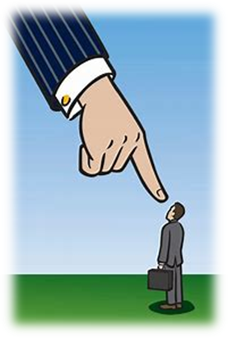

Slide 18
Activity Page
Spelling:
<ci> for the /sh/ sound

Slide 19
Her assistant is extremely efficient.
Subject
assistant
Her
Verb
is /
efficient
extremely
Object
(linking)

Slide 20
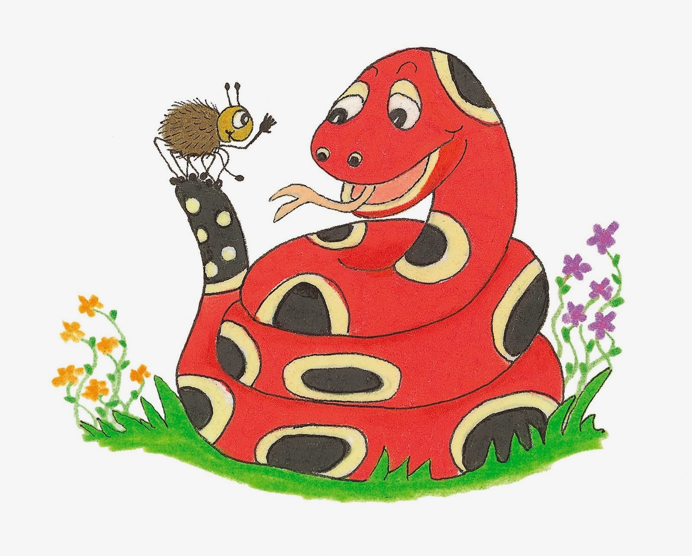
Dictation

Slide 21
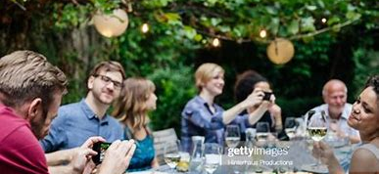

Slide 22
The detective regarded everyone with suspicion.

Slide 24
“Is Jane a beneficiary of her mother’s will?” we asked.

Slide 26
He had shown his appreciation for all their kindness.

Slide 27
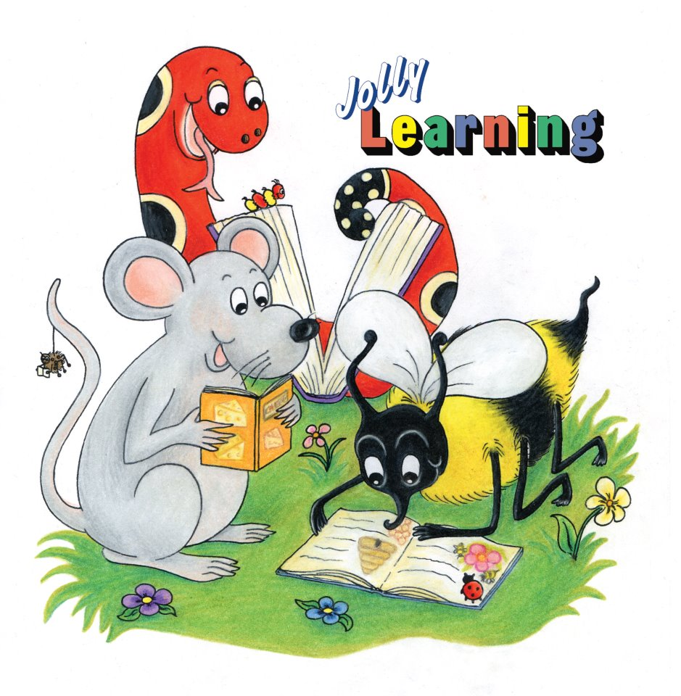
See you
next time!

