Slide 1
Jolly Grammar
6a-18

Slide 2
Spelling Test 9

Slide 3
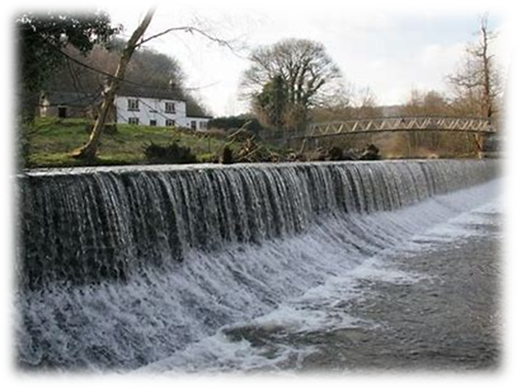
weir

Slide 4
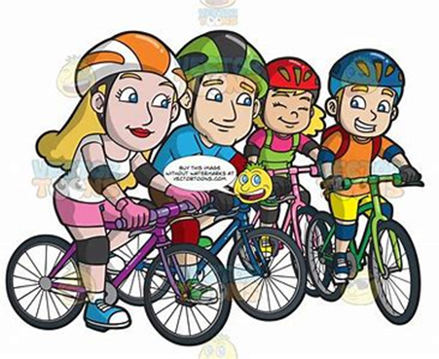
weir
their

Slide 5
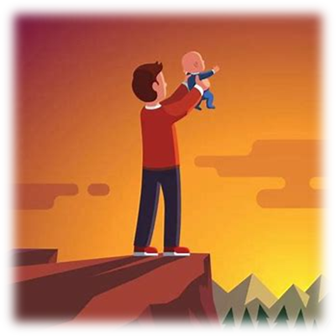
weir
their
heir

Slide 6
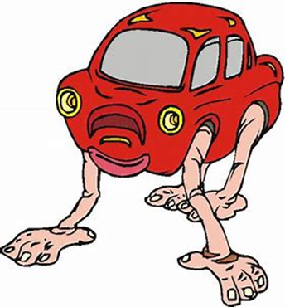
weir
their
heir
weird

Slide 7
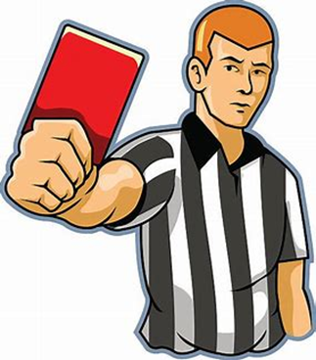
weir
their
heir
weird
forfeit

Slide 8
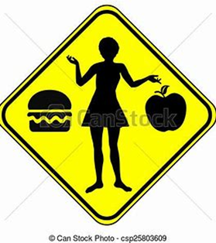
weir
their
heir
weird
forfeit
either

Slide 9
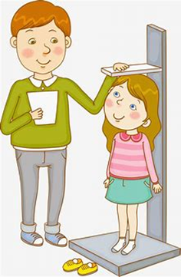
weir
their
heir
weird
forfeit
either
height

Slide 10
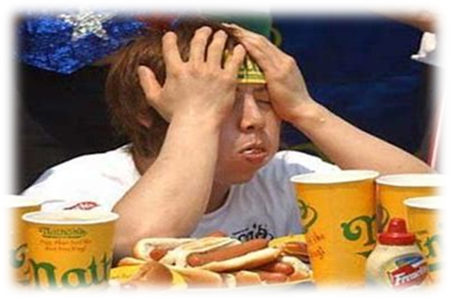
weir
their
heir
weird
forfeit
either
height
surfeit

Slide 11
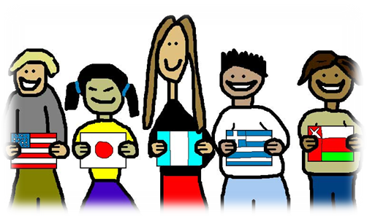
weir
their
heir
weird
forfeit
either
height
surfeit
foreign

Slide 12
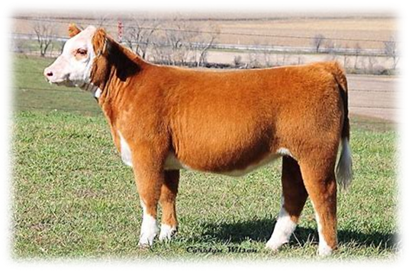
weir
their
heir
weird
forfeit
either
height
surfeit
foreign
10. heifer

Slide 13
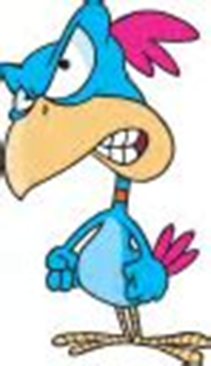
weir
their
heir
weird
forfeit
either
height
surfeit
foreign
10. heifer
11. feisty

Slide 14
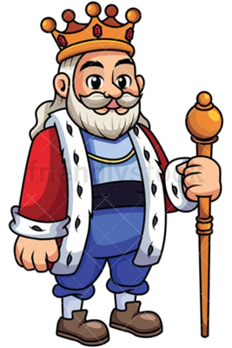
weir
their
heir
weird
forfeit
either
height
surfeit
foreign
10. heifer
11. feisty
12. sovereign

Slide 15
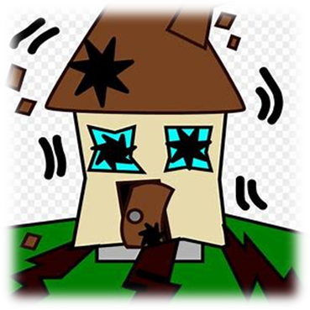
weir
their
heir
weird
forfeit
either
height
surfeit
foreign
10. heifer
11. feisty
12. sovereign
13. seismic

Slide 16
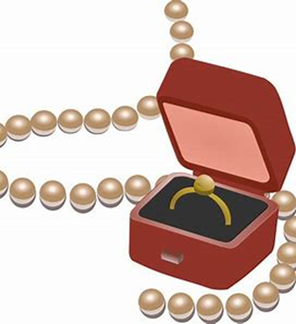
weir
their
heir
weird
forfeit
either
height
surfeit
foreign
10. heifer
11. feisty
12. sovereign
13. seismic
14. heirloom

Slide 17
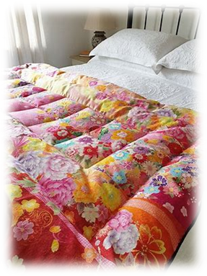
weir
their
heir
weird
forfeit
either
height
surfeit
foreign
10. heifer
11. feisty
12. sovereign
13. seismic
14. heirloom
15. eiderdown

Slide 18
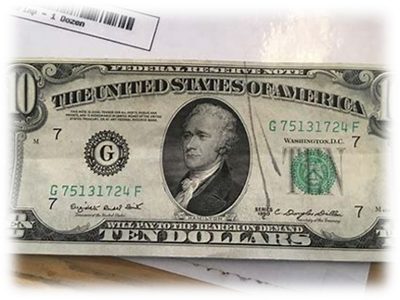
weir
their
heir
weird
forfeit
either
height
surfeit
foreign
10. heifer
11. feisty
12. sovereign
13. seismic
14. heirloom
15. eiderdown
16. counterfeit

Slide 19
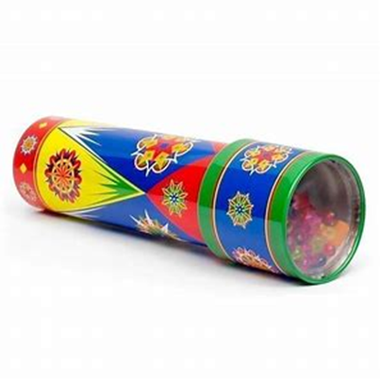
weir
their
heir
weird
forfeit
either
height
surfeit
foreign
10. heifer
11. feisty
12. sovereign
13. seismic
14. heirloom
15. eiderdown
16. counterfeit
17. kaleidoscope

Slide 20
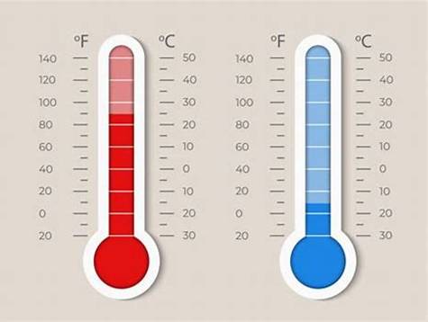
weir
their
heir
weird
forfeit
either
height
surfeit
foreign
10. heifer
11. feisty
12. sovereign
13. seismic
14. heirloom
15. eiderdown
16. counterfeit
17. kaleidoscope
18. Fahrenheit

Slide 21
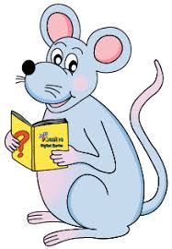
Let’s revise prepositional phrases

Slide 22
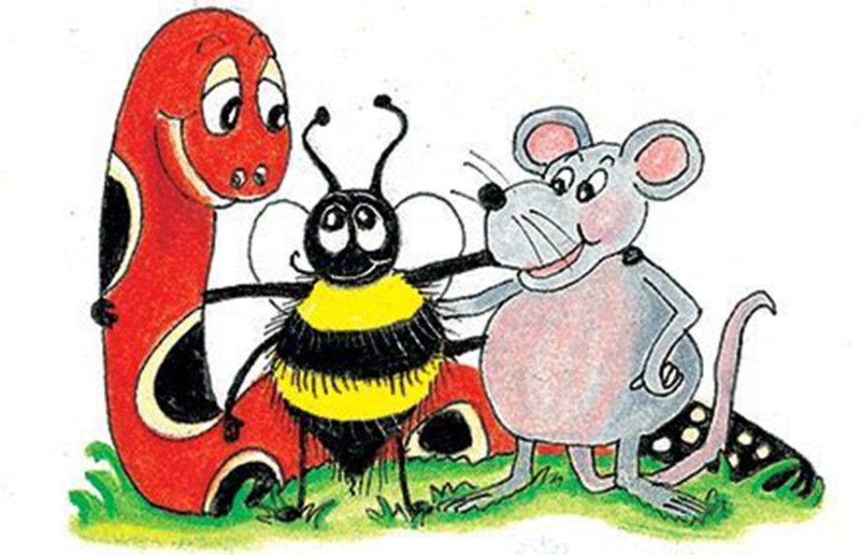
prepositional phrases

Slide 23
prepositional phrases
at

Slide 24
prepositional phrases
at the moment

Slide 25
prepositional phrases
at the moment
in

Slide 26
prepositional phrases
at the moment
in an hour

Slide 27
prepositional phrases
at the moment
in an hour
above

Slide 28
prepositional phrases
at the moment
in an hour
above the treetops

Slide 29
prepositional phrases
at the moment
in an hour
above the treetops
on

Slide 30
prepositional phrases
at the moment
in an hour
above the treetops
on the table

Slide 31
prepositional phrases
at the moment
in an hour
above the treetops
on the table
after

Slide 32
prepositional phrases
at the moment
in an hour
above the treetops
on the table
after the storm

Slide 33
prepositional phrases
at the moment
in an hour
above the treetops
on the table
after the storm
without

Slide 34
prepositional phrases
at the moment
in an hour
above the treetops
on the table
after the storm
without warning

Slide 35
prepositional phrases as adverbs

Slide 36
prepositional phrases as adverbs
When:

Slide 37
prepositional phrases as adverbs
When: I will go[in an hour].

Slide 38
prepositional phrases as adverbs
When: I will go[in an hour].
Where: The birds soared [above the
treetops].

Slide 39
prepositional phrases as adverbs
When: I will go[in an hour].
Where: The birds soared [above the
treetops].
How: They left [without warning].

Slide 40
Let’s learn.

Slide 41
Zack recently broke his arm.

Slide 42
Zack recently broke his arm.

Slide 43
Zack recently broke his arm.
Zack broke his arm recently.

Slide 44
Zack recently broke his arm.
Zack broke his arm recently.
Recently, Zack broke his arm.

Slide 45
I heard a strange noise in the middle of the night.

Slide 46
I heard a strange noise [in the middle of the night].

Slide 47
I heard a strange noise [in the middle of the night].
In the middle of the night, I heard a strange noise.

Slide 48
I slept peacefully [under the soft, warm eiderdown].
Under the soft, warm eiderdown, I slept peacefully.

Slide 49
The owl flew off quickly [with a short, sharp shriek].
With a short, sharp shriek, the owl flew off quickly.

Slide 50
We could see a billion stars [in the dark night sky].
In the dark night sky, we could see a billion stars.

Slide 51
The gardens are closed [between early December and late March].
Between early December and late March, the gardens are closed.

Slide 52
The diver spotted a large octopus [among the rocks and seaweed].
Among the rocks and seaweed, the diver spotted a large octopus.

Slide 53
Prepositional Phrases as Adverbs

Slide 55
See you
next time!

