Slide 1
Jolly Grammar
6a-17

Slide 2
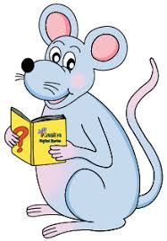
Spelling Point

Slide 3
veil
eight
/ai/

Slide 4
veil
eight
/ai/
receive
/ee/

Slide 5
veil
eight
/ai/
receive
/ee/
height
feisty
/ie/

Slide 6
veil
eight
/ai/
receive
/ee/
height
feisty
/ie/
their
/air/
weird
/ear/

Slide 7
veil
eight
/ai/
receive
/ee/
height
feisty
/ie/
their
/air/
weird
/ear/
counterfeit
/i/

Slide 8
veil
eight
/ai/
receive
/ee/
height
feisty
/ie/
their
/air/
weird
/ear/
counterfeit
/i/
heifer
/e/

Slide 9
Spelling List

Slide 10
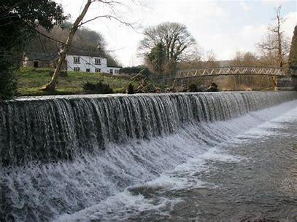
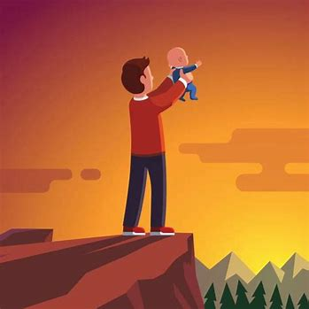
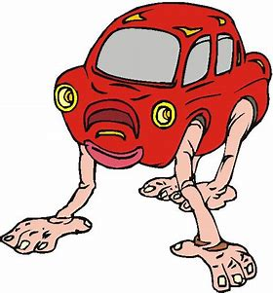
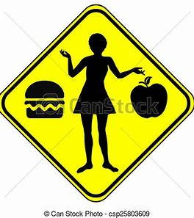
weir wéɚ their heir
weird forfeit fˈɔɚfɪt either

Slide 11
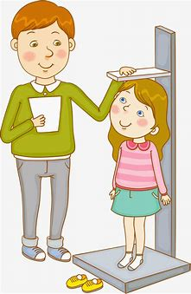
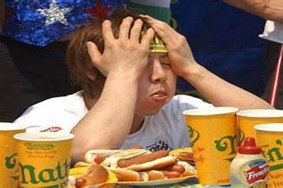
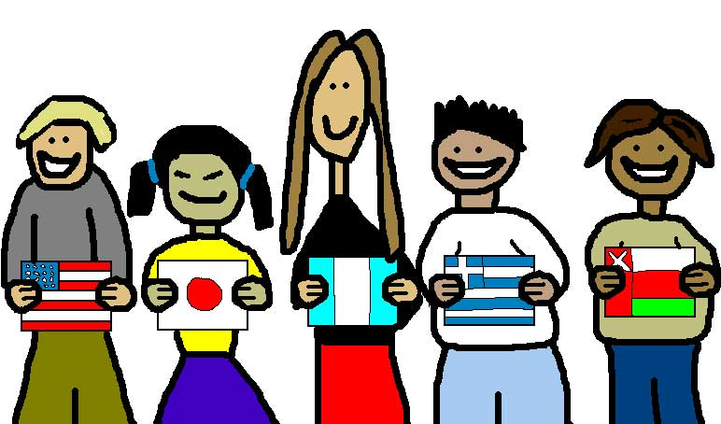
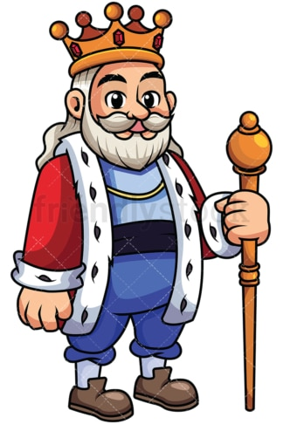
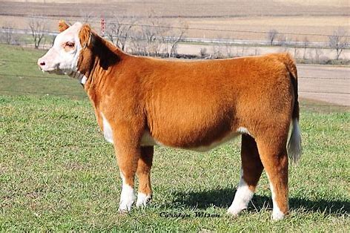
height surfeit sˈɚːfət foreign
heifer héfɚ feisty fάɪsti sovereignsάv(ə)rən

Slide 12
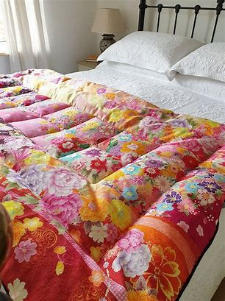
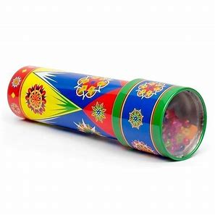
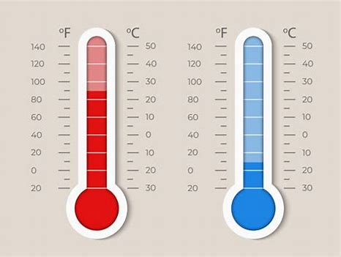
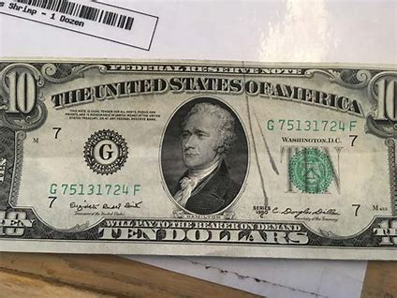
seismic sάɪzmɪk heirloom eiderdown
counterfeit kaleidoscope Fahrenheit

Slide 13
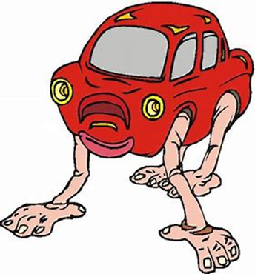
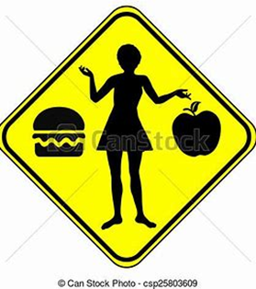
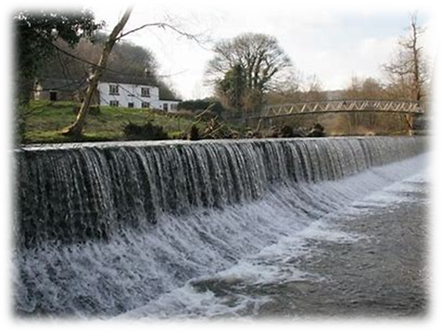
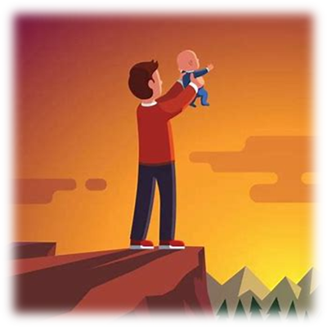
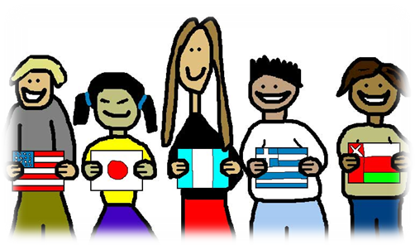
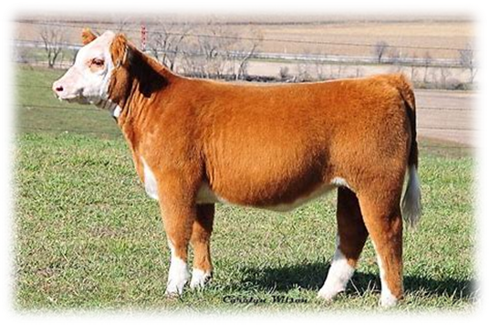
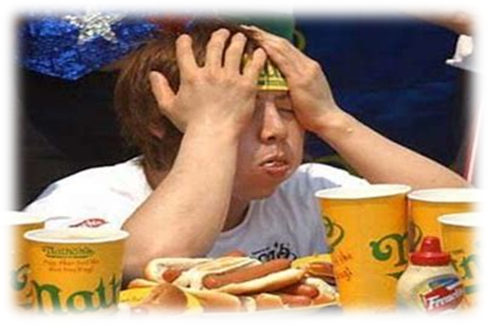
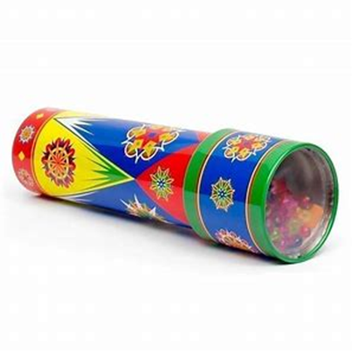
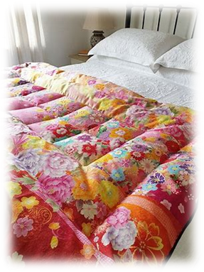
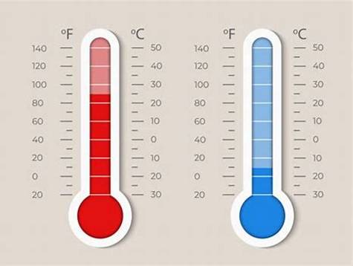
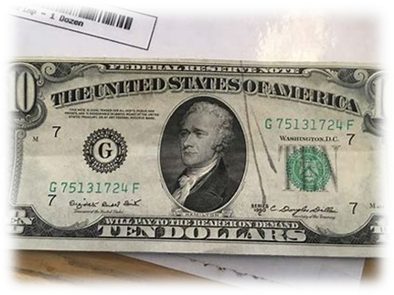

Slide 14
Activity Page
Spelling:
<ei> <eigh>and <eir> for the

Slide 15
weird height their weir feisty
seismic heirloom eiderdown kaleidoscope Fahrenheit

Slide 16
weird height their weir feisty
seismic heirloom eiderdown kaleidoscope Fahrenheit
/air/
their
heirloom

Slide 17
weird height their weir feisty
seismic heirloom eiderdown kaleidoscope Fahrenheit
/air/
their
heirloom
/ear/
weird
weir

Slide 18
weird height their weir feisty
seismic heirloom eiderdown kaleidoscope Fahrenheit
/air/
their
heirloom
/ear/
weird
weir
/ie/
height
feisty
seismic
eiderdown
kaleidoscope
Fahrenheit

Slide 19
The gold sovereigns were counterfeit.
Subject
sovereigns
The gold
Verb
were
counterfeit
Object
(linking)

Slide 20
Dictation

Slide 21
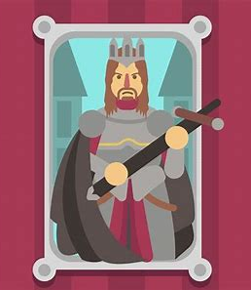

Slide 22
Their sovereign reigned for fifty-two years.

Slide 23
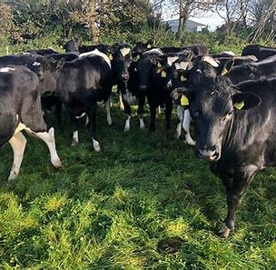

Slide 24
The farmer keeps eighty-two heifers in the field.

Slide 26
“What is your height and weight?” asked the nurse.

Slide 27
See you
next time!

