Slide 1
Jolly Grammar
6a-16

Slide 2
Spelling Test 8

Slide 3
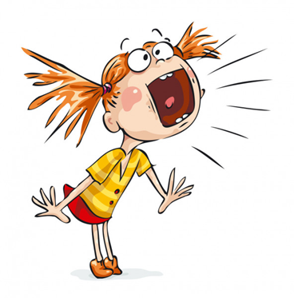
shriek

Slide 4
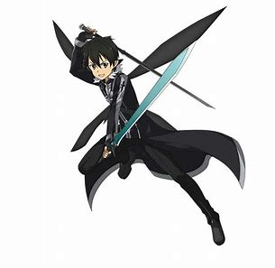
shriek
wield

Slide 5
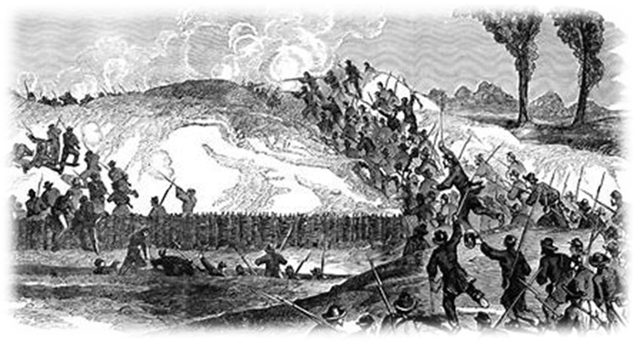
shriek
wield
siege

Slide 6
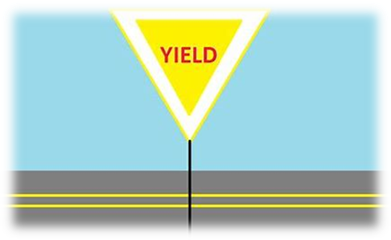
shriek
wield
siege
yield

Slide 7
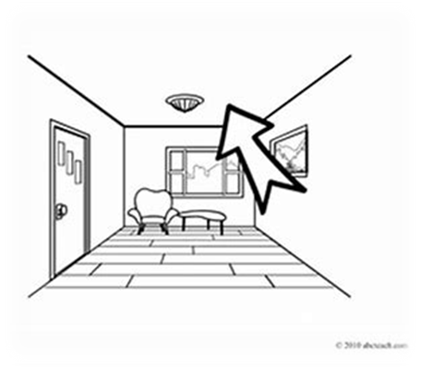
shriek
wield
siege
yield
ceiling

Slide 8
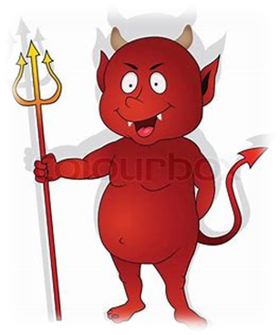
shriek
wield
siege
yield
ceiling
fiendish

Slide 9
shriek
wield
siege
yield
ceiling
fiendish
niece

Slide 10
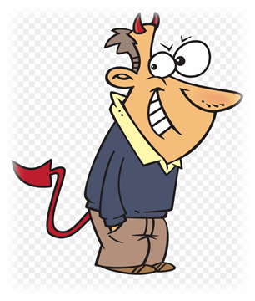
shriek
wield
siege
yield
ceiling
fiendish
niece
deceit

Slide 11
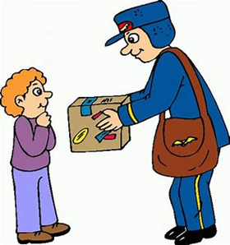
shriek
wield
siege
yield
ceiling
fiendish
niece
deceit
receive

Slide 12
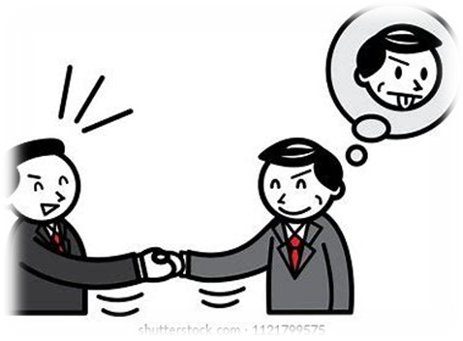
shriek
wield
siege
yield
ceiling
fiendish
niece
deceit
receive
10. deceive

Slide 13
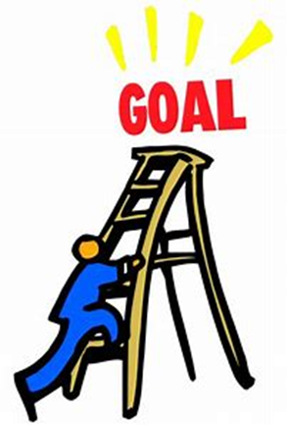
shriek
wield
siege
yield
ceiling
fiendish
niece
deceit
receive
10. deceive
11. achieve

Slide 14
shriek
wield
siege
yield
ceiling
fiendish
niece
deceit
receive
10. deceive
11. achieve
12. conceited

Slide 15
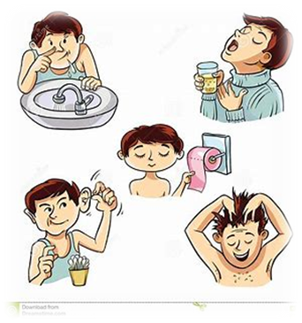
shriek
wield
siege
yield
ceiling
fiendish
niece
deceit
receive
10. deceive
11. achieve
12. conceited
13. hygiene

Slide 16
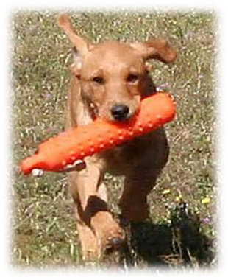
shriek
wield
siege
yield
ceiling
fiendish
niece
deceit
receive
10. deceive
11. achieve
12. conceited
13. hygiene
14. retrieve

Slide 17
shriek
wield
siege
yield
ceiling
fiendish
niece
deceit
receive
10. deceive
11. achieve
12. conceited
13. hygiene
14. retrieve
15. perceive

Slide 18
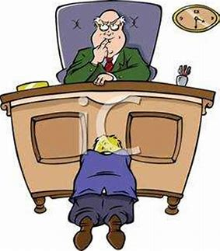
shriek
wield
siege
yield
ceiling
fiendish
niece
deceit
receive
10. deceive
11. achieve
12. conceited
13. hygiene
14. retrieve
15. perceive
16. reprieve

Slide 19
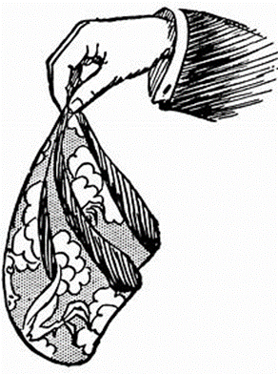
shriek
wield
siege
yield
ceiling
fiendish
niece
deceit
receive
10. deceive
11. achieve
12. conceited
13. hygiene
14. retrieve
15. perceive
16. reprieve
17. handkerchief

Slide 20
shriek
wield
siege
yield
ceiling
fiendish
niece
deceit
receive
10. deceive
11. achieve
12. conceited
13. hygiene
14. retrieve
15. perceive
16. reprieve
17. handkerchief
18. inconceivable

Slide 21
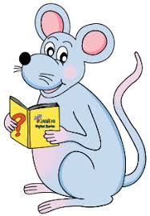
Let’s check your assignment.

Slide 22
His younger sisters are athletes.
Subject
sisters
His younger
Verb
are
/athletes
Object
(linking)

Slide 23
Let’s revise.

Slide 24
verb ～ doing words
to run
to cook
to sing
～ being words
to be

Slide 25
The dog was really fierce.
Jane is a farmer.

Slide 26
The dog was really fierce.
Jane is a farmer.

Slide 27
The dog was really fierce.
Jane is a farmer.

Slide 28
The dog was really fierce.
Jane is a farmer.

Slide 29
The dog was really fierce.
Jane is a farmer.

Slide 30
The dog was really fierce.
Jane is a farmer.

Slide 31
The dog was really fierce.
Jane is a farmer.

Slide 32
The dog was really fierce.
Jane is a farmer.

Slide 33
verb ～ doing words
to run
to cook
to sing
～ being words
to be

Slide 34
verb ～ doing words
to run
to cook
to sing
～ being words
to be
to seem to remain to smell
to appear to look to taste
to become to sound to feel

Slide 35
The dog was really fierce.
Jane is a farmer.
Subject complement

Slide 36
Let’s learn.

Slide 37
Linking Verbs

Slide 38
s
They are being very naughty.

Slide 39
s
The ceiling was incredibly high.

Slide 40
s
Both actors were rather conceited.

Slide 41
s
The children had been quite excited.

Slide 42
s
Those pretty handkerchiefs were a present.

Slide 43
s
The journey has been long.

Slide 44
s
You have been really busy.

Slide 45
s
We will be millionaires.

Slide 46
s
Our niece is a doctor.

Slide 47
s
I am a weightlifter.

Slide 48
The flowers in the garden smell sweet.
The rabbit’s fur feels soft and silky.
This evening you look tired but happy.
Her voice sounds quite young on the phone.
The sandwiches taste better than they look.

Slide 49
His younger sister are athletes.
Subject
sisters
His younger
Verb
are/athletes
Object
(linking)

Slide 50
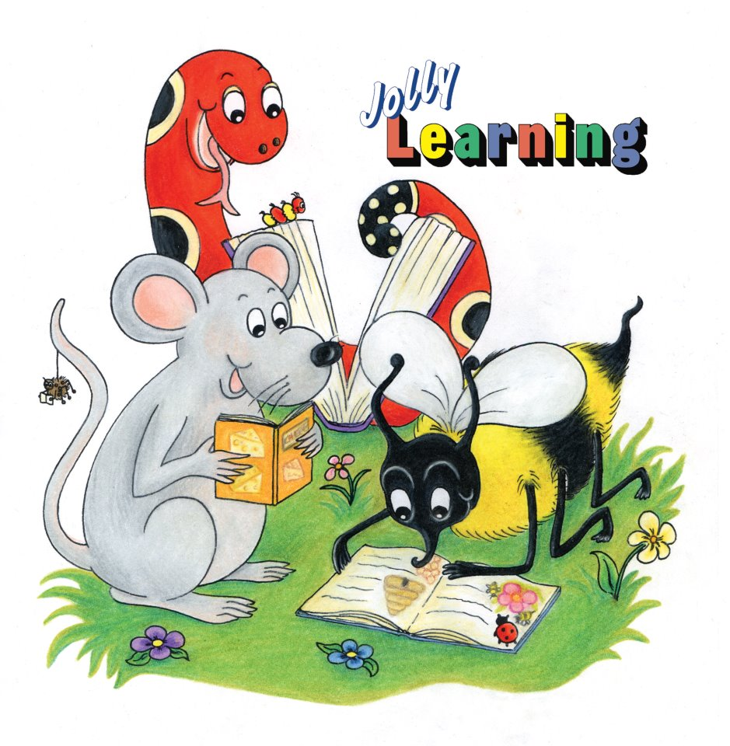
See you
next time!

