Slide 1
Jolly Grammar
6a-15

Slide 2
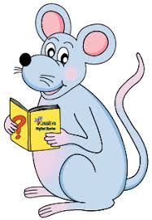
Spelling Point

Slide 3
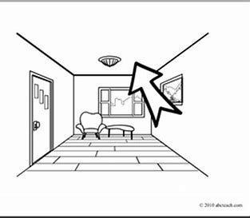
niece
ceiling

Slide 4
niece
ceiling
/ee/

Slide 5
niece
ceiling
/ee/

Slide 6
niece
ceiling
/ee/
seize neither protein nor caffein.

Slide 7
Spelling List

Slide 8
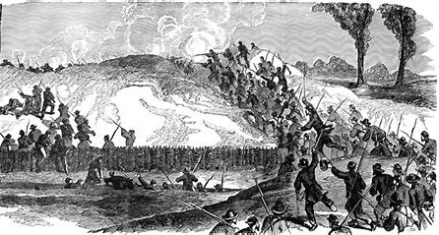
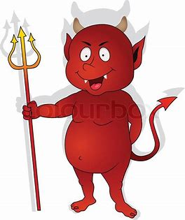
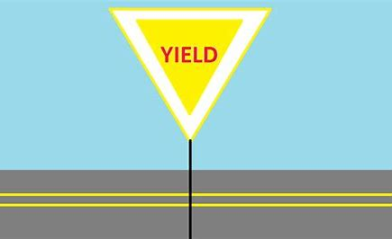
shriek wield siege
yield ceiling fiendish

Slide 9
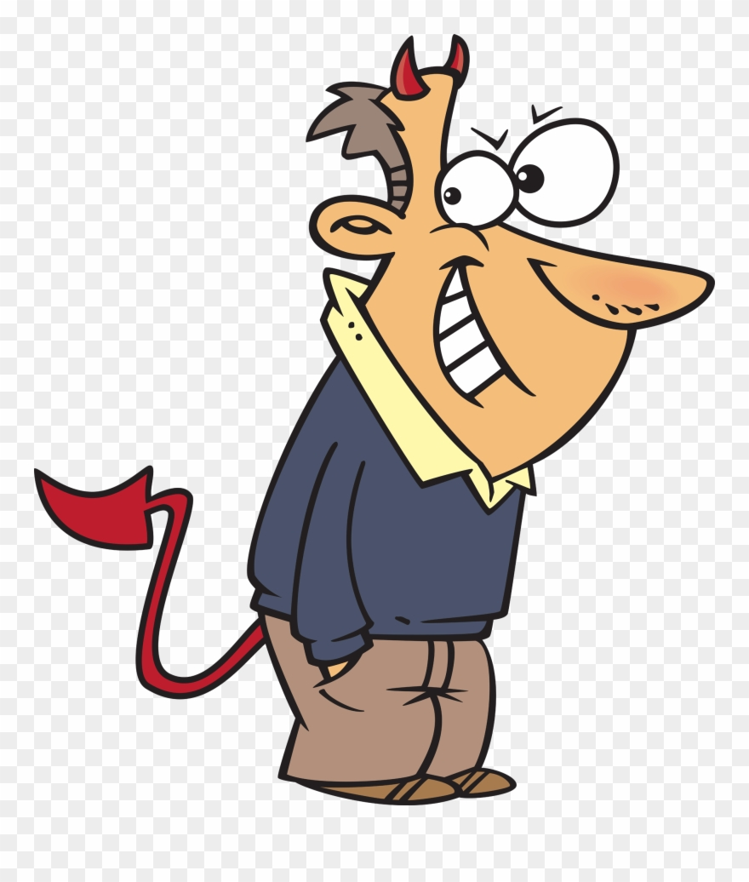
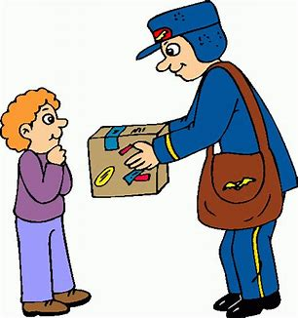
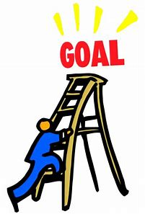
niece deceit receive
deceive achieve conceited

Slide 10
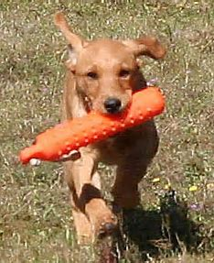
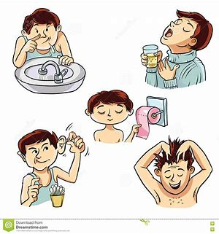
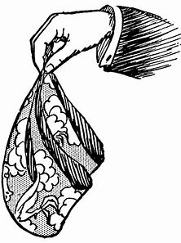
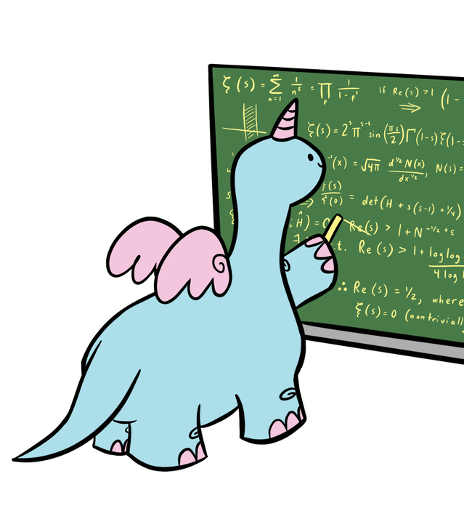
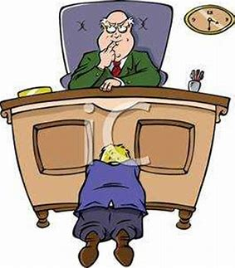
hygiene retrieve perceive
reprieve handkerchief inconceivable

Slide 12
Activity Page
Spelling:
<ei> and <ie> for the /ee/ sound

Slide 13
Mr. Brown will have bought his niece
some handkerchiefs.
Subject
Mr. Brown
Verb
will have bought
Object
handkerchiefs
some
niece/his
(transitive)

Slide 14
Let’s talk about numbers.

Slide 15
20 = twenty twenty ＋ i ＋ eth 20th＝twentieth

Slide 16
20 = twenty twenty ＋ i ＋ eth 20th＝twentieth
30th thirtieth 40th fortieth
50th fiftieth 60th sixtieth
70th seventieth 80th eightieth

Slide 17
20 = twenty twenty ＋ i ＋ eth 20th＝twentieth
30th thirtieth 40th fortieth
50th fiftieth 60th sixtieth
70th seventieth 80th eightieth
52

Slide 18
20 = twenty twenty ＋ i ＋ eth 20th＝twentieth
30th thirtieth 40th fortieth
50th fiftieth 60th sixtieth
70th seventieth 80th eightieth
90th ninetieth
52 fifty-two

Slide 19
20 = twenty twenty ＋ i ＋ eth 20th＝twentieth
30th thirtieth 40th fortieth
50th fiftieth 60th sixtieth
70th seventieth 80th eightieth
52 fifty-two 86 eighty-six
35 thirty-five 48 forty-eight

Slide 20
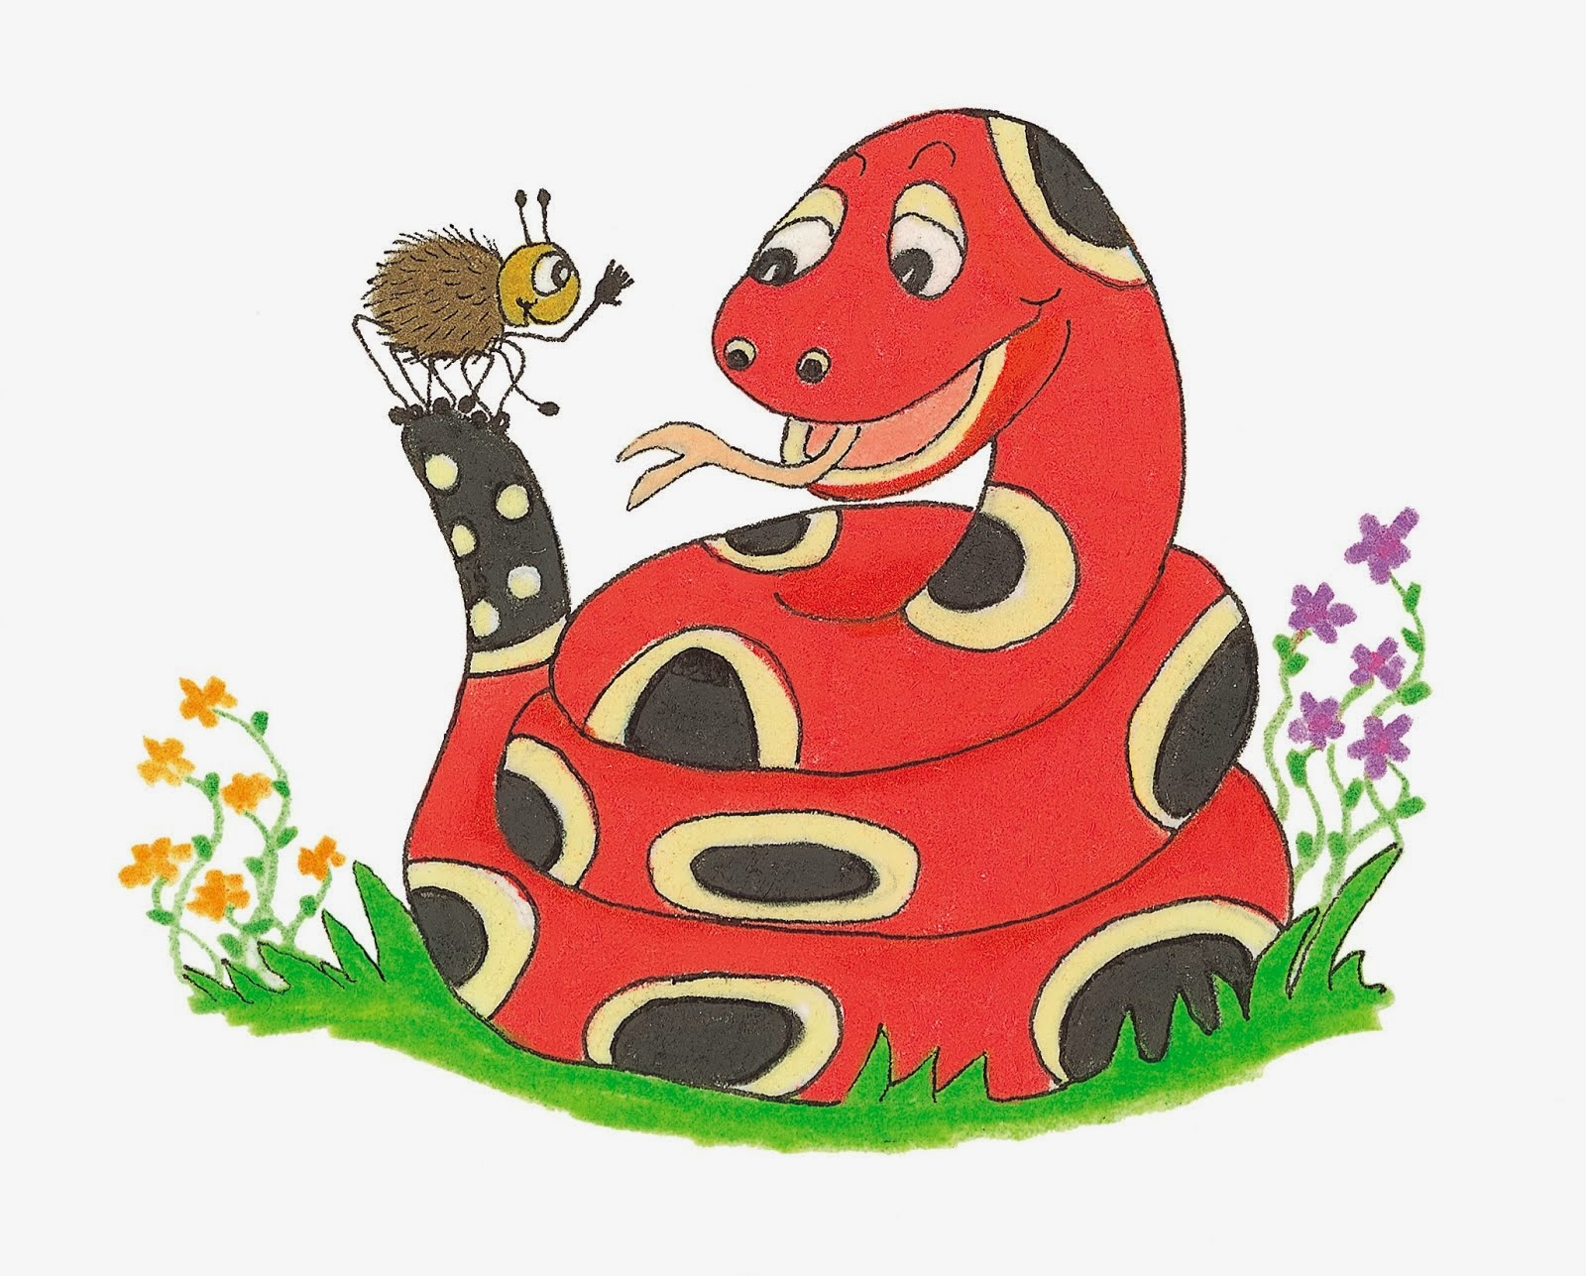
Dictation

Slide 22
My niece is never vain or conceited.

Slide 23
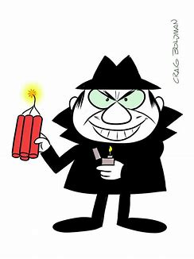

Slide 24
“What a fiendish plan!” the reader exclaimed.

Slide 26
The knight wielded his sword many times in battle.

Slide 27
See you
next time!

