Slide 1
Jolly Grammar
6a-14

Slide 2
Spelling Test 7

Slide 3
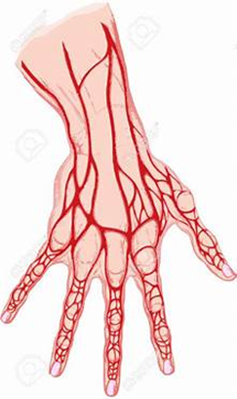
vein

Slide 4
vein
veil

Slide 5
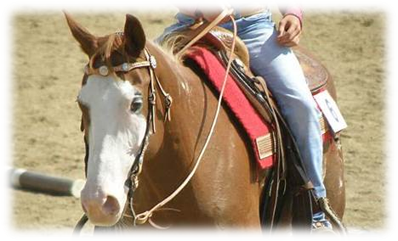
vein
veil
rein

Slide 6
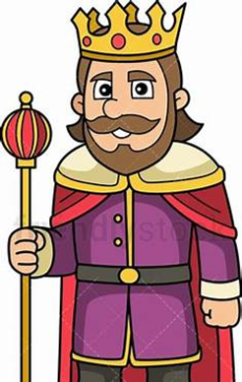
vein
veil
rein
reign

Slide 7
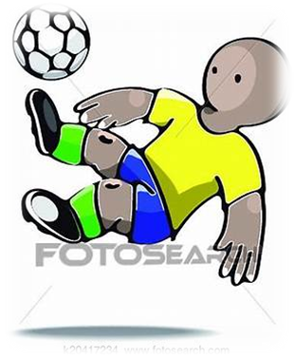
vein
veil
rein
reign
feint

Slide 8
vein
veil
rein
reign
feint
weigh

Slide 9
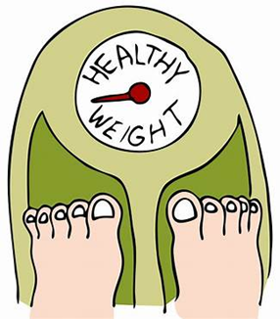
vein
veil
rein
reign
feint
weigh
weight

Slide 10
vein
veil
rein
reign
feint
weigh
weight
beige

Slide 11
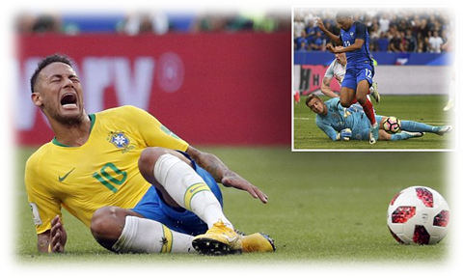
vein
veil
rein
reign
feint
weigh
weight
beige
feign

Slide 12
vein
veil
rein
reign
feint
weigh
weight
beige
feign
10. eighth

Slide 13
vein
veil
rein
reign
feint
weigh
weight
beige
feign
10. eighth
11. neigh

Slide 14
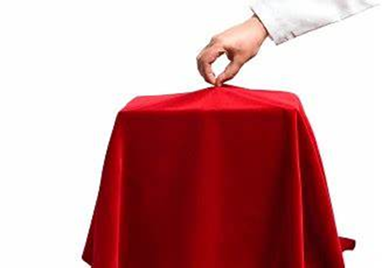
vein
veil
rein
reign
feint
weigh
weight
beige
feign
10. eighth
11. neigh
12. unveil

Slide 15
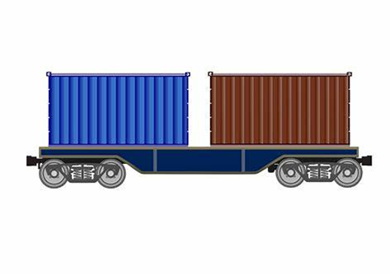
vein
veil
rein
reign
feint
weigh
weight
beige
feign
10. eighth
11. neigh
12. unveil
13. freight

Slide 16
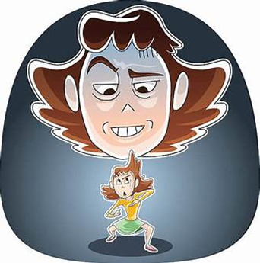
vein
veil
rein
reign
feint
weigh
weight
beige
feign
10. eighth
11. neigh
12. unveil
13. freight
14. inveigle

Slide 17
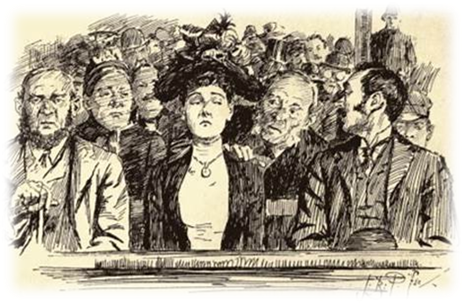
vein
veil
rein
reign
feint
weigh
weight
beige
feign
10. eighth
11. neigh
12. unveil
13. freight
14. inveigle
15. deign

Slide 18
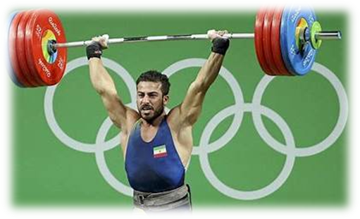
vein
veil
rein
reign
feint
weigh
weight
beige
feign
10. eighth
11. neigh
12. unveil
13. freight
14. inveigle
15. deign
16. weightlifter

Slide 19
vein
veil
rein
reign
feint
weigh
weight
beige
feign
10. eighth
11. neigh
12. unveil
13. freight
14. inveigle
15. deign
16. weightlifter
17. surveillance

Slide 20
vein
veil
rein
reign
feint
weigh
weight
beige
feign
10. eighth
11. neigh
12. unveil
13. freight
14. inveigle
15. deign
16. weightlifter
17. surveillance
18. neighbourhood

Slide 21
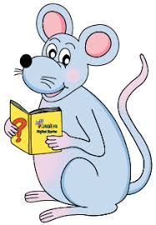
Let’s revise.

Slide 22
Sally offered her friend a cheese sandwich.

Slide 23
Sally offered her friend a cheese sandwich.

Slide 24
s
Sally offered her friend a cheese sandwich.

Slide 25
s
o
Sally offered her friend a cheese sandwich.
direct
object

Slide 26
s
o
Sally offered her friend a cheese sandwich.
indirect
object
direct
object

Slide 27
Let’s learn.

Slide 28
Indirect Objects and Sentence Walls

Slide 29
Sally offered her friend a cheese sandwich.
Sally
offered
sandwich
a cheese
friend/her
s
v
o
i.o.

Slide 30
Indirect Objects and Direct Objects

Slide 31
s
o
She told her neighbors the exciting news .
indirect
object
direct
object

Slide 32
s
o
Bill’s father sent him an interesting book.
indirect
object
direct
object

Slide 33
s
o
Dad read the children a bedtime story.
indirect
object
direct
object

Slide 34
s
o
Aunt Jill and Sam threw Liz the rope.
indirect
object
direct
object

Slide 35
s
o
My cousin made me a beautiful dress.
indirect
object
direct
object

Slide 36
s
o
He wrote his girlfriend some poems.
indirect
object
direct
object

Slide 37
s
o
Grampa bought the baby a toy octopus.
indirect
object
direct
object

Slide 38
s
Their grandparents sang their
babies a lullaby .
o
indirect
object
direct
object

Slide 39
s
Firmly, the centurion gave
the soldiers an order.
o
indirect
object
direct
object

Slide 40
s
The twins immediately took
their mother the note.
o
indirect
object
direct
object

Slide 41
s
I patiently knitted Grandma
a beige hat and scarf.
indirect
object
o
direct
object

Slide 42
s
Excitedly, Alex and Meg showed
Uncle Jim the photos.
o
indirect
object
direct
object

Slide 43
See you
next time!

