Slide 1
Jolly Grammar
6a-13

Slide 2
Let’s revise
Homophones.

Slide 3
Spelling Point

Slide 4
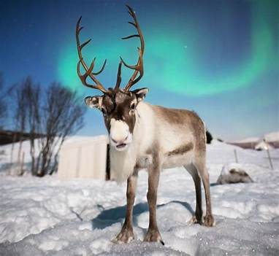
reindeer
eight

Slide 5
reindeer
eight
/ai/

Slide 6
Spelling List

Slide 7
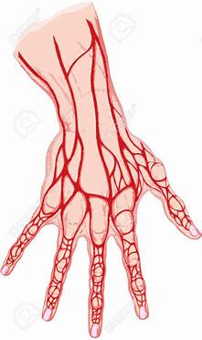
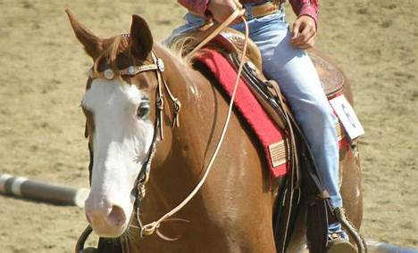
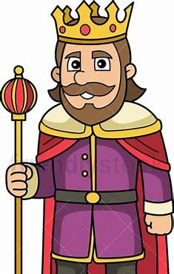
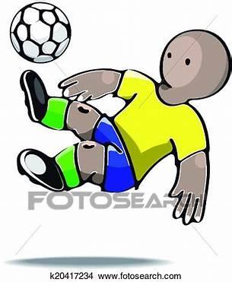
vein veil rein
reign feint weigh

Slide 8
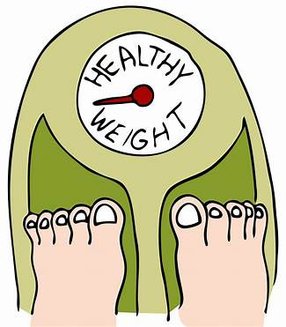
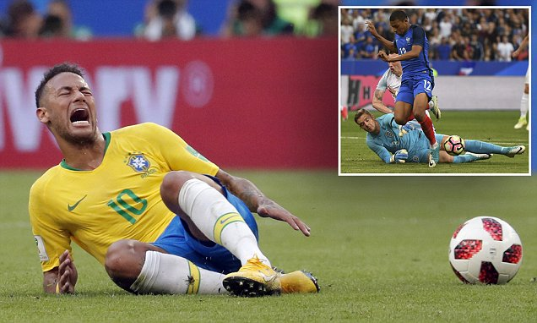
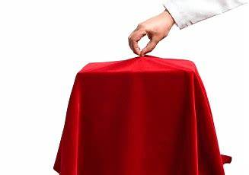
weight beige feign
eighth neigh unveil

Slide 9
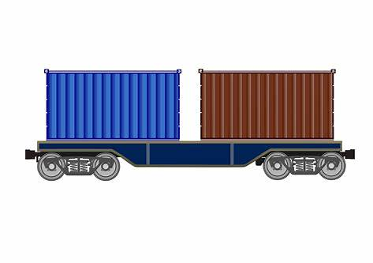
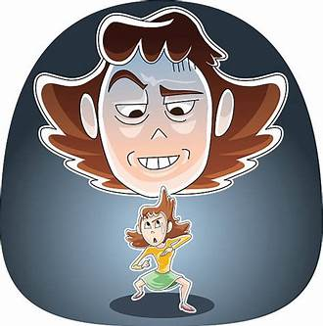
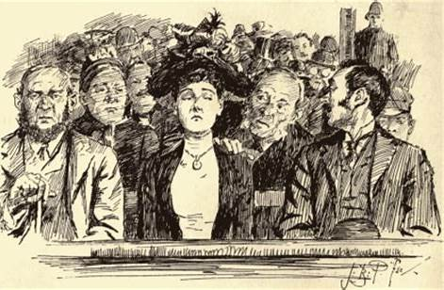
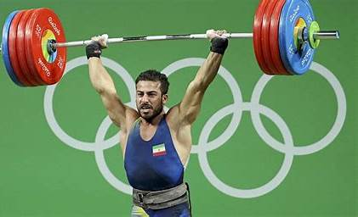
freight inveigle deign
weightlifter surveillance neighbourhood

Slide 10
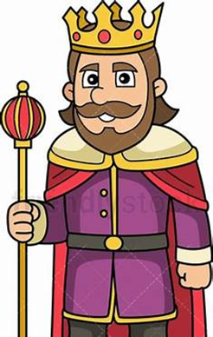
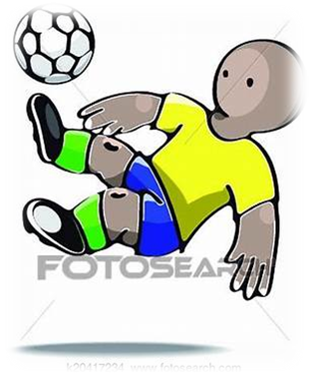
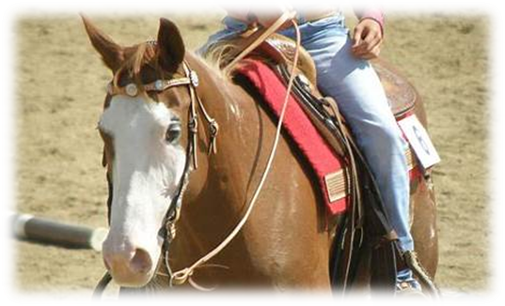
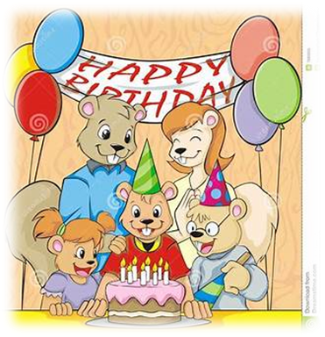
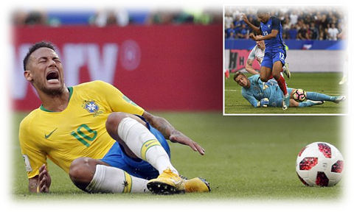
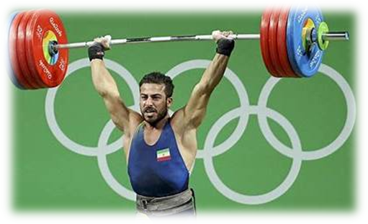
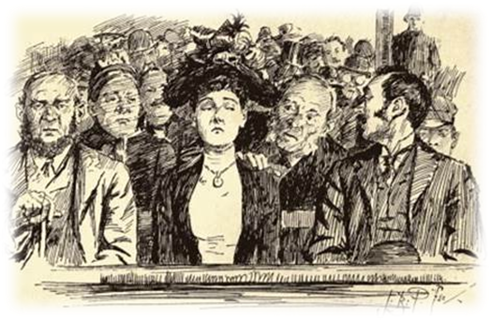

Slide 11
Activity Page
Spelling:
<ei> and <eigh> for the /ai/ sound

Slide 12
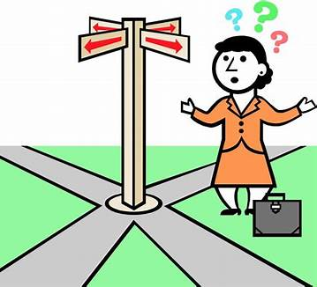
rein
reign
weigh
way
feint
faint
vein
vain

Slide 13
The baker has weighed
the cake’s ingredients precisely.

Slide 14
The baker has weighed
the cake’s ingredients precisely.
Subject
baker
The
Verb
has weighed
precisely
Object
ingredients
the cake’s
(transitive)

Slide 15
Dictation

Slide 16
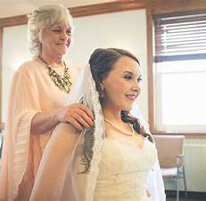

Slide 17
The bride wore her grandmother’s veil.

Slide 18
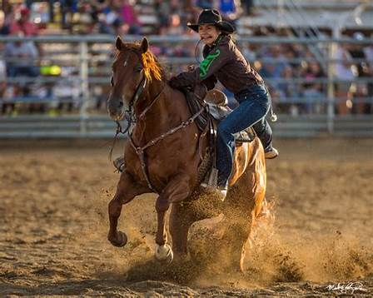

Slide 19
The horses neighed and shook their reins.

Slide 20
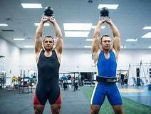

Slide 21
“How much weight can they lift?” we wondered.

Slide 22
See you
next time!

