Slide 1
Jolly Grammar
6a-12

Slide 2
Spelling Test 6

Slide 3
decagon

Slide 4
decagon
decade

Slide 5
decagon
decade
twice

Slide 6
decagon
decade
twice
forty

Slide 7
decagon
decade
twice
forty
hundred

Slide 8
decagon
decade
twice
forty
hundred
December

Slide 9
decagon
decade
twice
forty
hundred
December
twelfth

Slide 10
decagon
decade
twice
forty
hundred
December
twelfth
twentieth

Slide 11
decagon
decade
twice
forty
hundred
December
twelfth
twentieth
percent

Slide 12
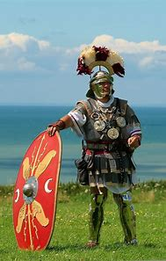
decagon
decade
twice
forty
hundred
December
twelfth
twentieth
percent
10. centurion

Slide 13
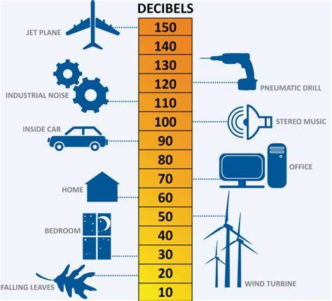
decagon
decade
twice
forty
hundred
December
twelfth
twentieth
percent
10. centurion
11. decibel

Slide 14
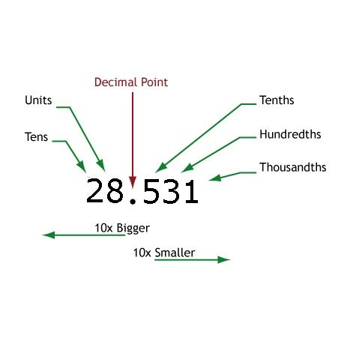
decagon
decade
twice
forty
hundred
December
twelfth
twentieth
percent
10. centurion
11. decibel
12. decimal

Slide 15
decagon
decade
twice
forty
hundred
December
twelfth
twentieth
percent
10. centurion
11. decibel
12. decimal
13. percentage

Slide 16
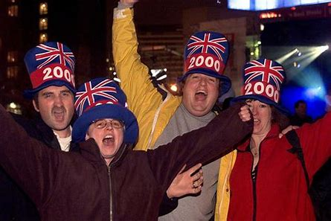
decagon
decade
twice
forty
hundred
December
twelfth
twentieth
percent
10. centurion
11. decibel
12. decimal
13. percentage
14. millennium

Slide 17
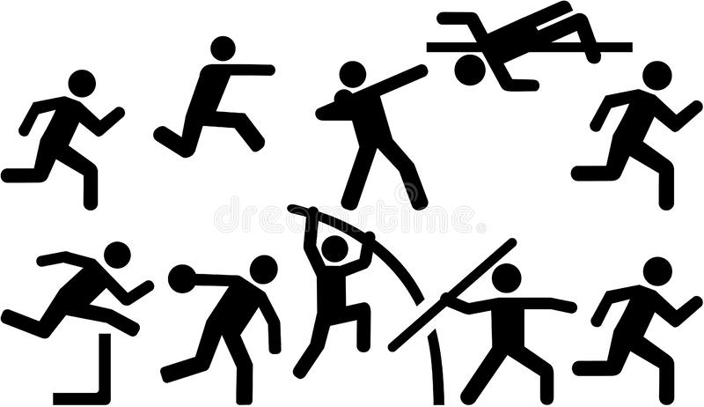
decagon
decade
twice
forty
hundred
December
twelfth
twentieth
percent
10. centurion
11. decibel
12. decimal
13. percentage
14. millennium
15. decathlon

Slide 18
decagon
decade
twice
forty
hundred
December
twelfth
twentieth
percent
10. centurion
11. decibel
12. decimal
13. percentage
14. millennium
15. decathlon
16. millionaire

Slide 19
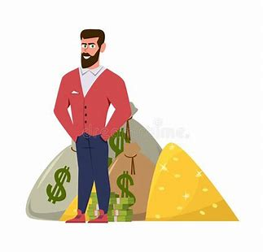
decagon
decade
twice
forty
hundred
December
twelfth
twentieth
percent
10. centurion
11. decibel
12. decimal
13. percentage
14. millennium
15. decathlon
16. millionaire
17. billionaire

Slide 20
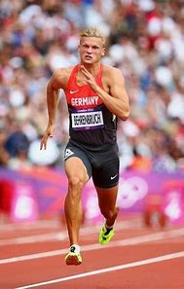
decagon
decade
twice
forty
hundred
December
twelfth
twentieth
percent
10. centurion
11. decibel
12. decimal
13. percentage
14. millennium
15. decathlon
16. millionaire
17. billionaire
18. decathlete

Slide 21
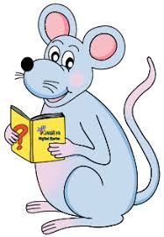
Let’s revise.

Slide 22
Dan and Sam are cooking their evening meal.

Slide 23
s
Dan and Sam are cooking their evening meal.

Slide 24
o
s
Dan and Sam are cooking their evening meal.

Slide 25
o
s
Dan and Sam are cooking their evening meal.

Slide 26
s
Dan and Sam are cooking.

Slide 27
s
Dan and Sam are cooking.
intransitive

Slide 28
o
s
Dan and Sam are cooking their evening meal.

Slide 29
s
o
Dan and Sam are cooking their evening meal.
transitive

Slide 30
Let’s learn.

Slide 31
Dan is cooking Jane a meal.

Slide 32
s
Dan is cooking Jane a meal.

Slide 33
s
Dan is cooking Jane a meal.

Slide 34
o
s
Dan is cooking Jane a meal.

Slide 35
o
s
Dan is cooking Jane a meal.

Slide 36
o
s
Dan is cooking Jane a meal.
direct
object

Slide 37
o
s
Dan is cooking Jane a meal.
indirect
object
direct
object

Slide 38
Dan is cooking a meal for Jane.
⇔
o
s
Dan is cooking Jane a meal.
indirect
object
direct
object

Slide 39
Direct and Indirect Objects

Slide 40
o
s
Bill sent his cousin an expensive present.
indirect
object
direct
object

Slide 41
s
o
The little girl sang her granny a song.
indirect
object
direct
object

Slide 42
o
s
Aunt Jill made us sandwiches.
indirect
object
direct
object

Slide 43
s
o
He gave his mother some flowers .
indirect
object
direct
object

Slide 44
o
s
I wrote my friend a long letter.
indirect
object
direct
object

Slide 45
o
s
Liz threw me the old football.
indirect
object
direct
object

Slide 46
s
o
Dad bought Sam a new uniform.
indirect
object
direct
object

Slide 47
s
o
Miss Beech read her class a story.
indirect
object
direct
object

Slide 48
o
s
We cooked our guests a tasty meal.
indirect
object
direct
object

Slide 49
s
Alex and Jo showed Miss Beech
their homework.
indirect
object
o
direct
object

Slide 50
They baked a lovely cake for Meg.
→
Uncle Jim got a new tricycle for his son.
→
The local farm sells fresh milk and eggs for the villagers.
→

Slide 51
They baked a lovely cake for Meg.
→They baked Meg a lovely cake.
Uncle Jim got a new tricycle for his son.
→
The local farm sells fresh milk and eggs for the villagers.
→

Slide 52
They baked a lovely cake for Meg.
→They baked Meg a lovely cake.
Uncle Jim got a new tricycle for his son.
→Uncle Jim got his sone a new tricycle.
The local farm sells fresh milk and eggs for the villagers.
→

Slide 53
They baked a lovely cake for Meg.
→They baked Meg a lovely cake.
Uncle Jim got a new tricycle for his son.
→Uncle Jim got his sone a new tricycle.
The local farm sells fresh milk and eggs for the villagers.
→The local farm sells the villagers fresh milk and eggs.

Slide 54
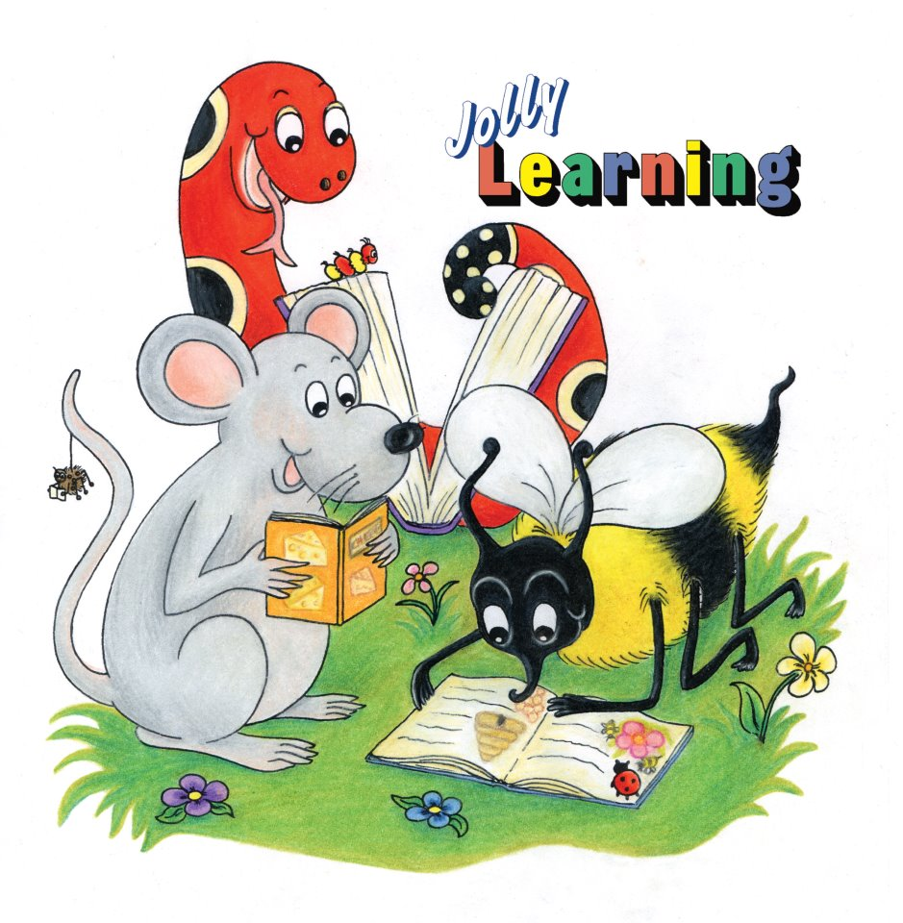
See you
next time!

