Slide 1
Jolly Grammar
6a-11

Slide 2
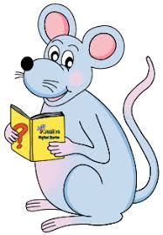
Let’s revise
Homophones.
(Assignment)

Slide 3
where were wear

Slide 4
・Where were the hundred gold coins found?
・Prices were reduced by forty percent in the sale.
・The famous actress will never wear the same
dress twice.
・My family moved to the country, where
we lived for over a decade.
・Her brother wants to wear a centurion’s
costume to the party.
・We all tried to guess where the millionaire
would be staying this summer.
・All the decathletes were training hard.
・You were celebrating your granny’s birthday on
the twelfth of December.

Slide 5
May and Daisy are celebrating their twentieth birthday today.
Subject
May-and-
Daisy
Verb
are celebrating
today
Object
birthday
their twentieth
(transitive)

Slide 6
Spelling Point

Slide 7
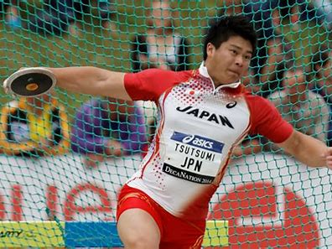
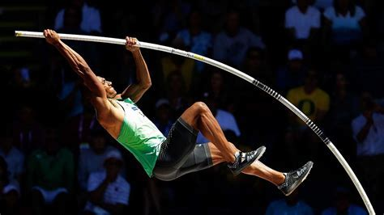
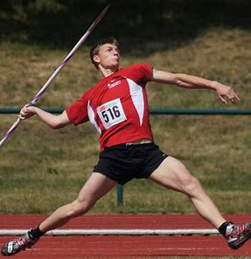
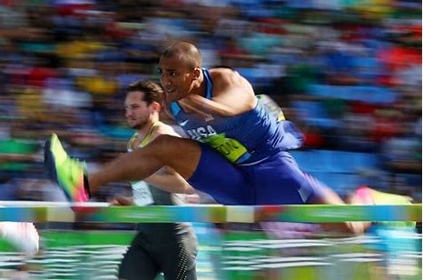
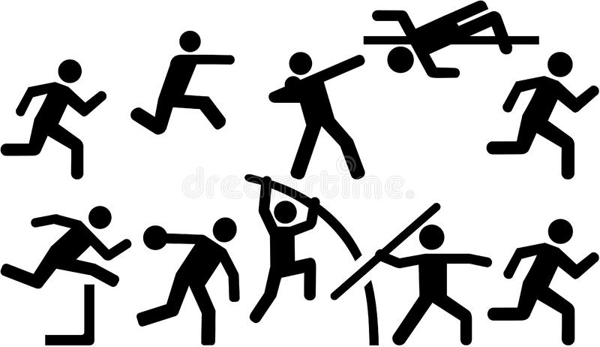
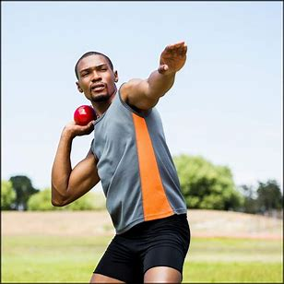
decathlon
Day 1
100 metres
Long jump
Shot put
High jump
400 metres
Day 2
110 metres hurdles
Discus throw
Pole vault
Javelin throw
1500 metres
Day 1
100 metres
Discus throw
Pole vault
Javelin throw
400 metres
Day 2
100 metres hurdles
Long jump
Shot put
High jump
1500 metres

Slide 8
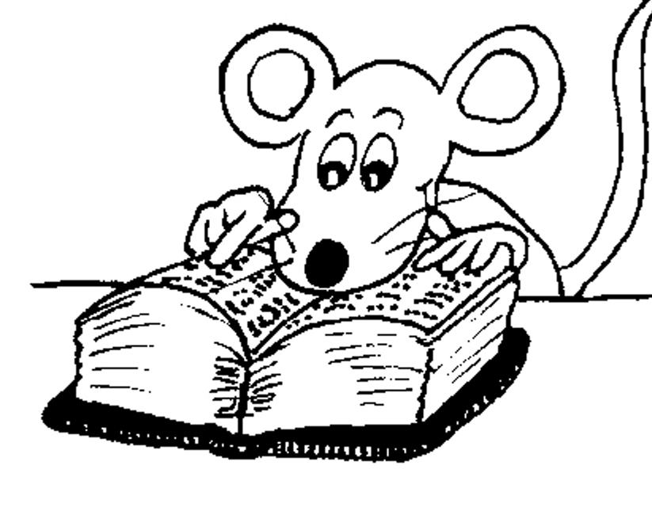
Spelling List

Slide 9
・Where were the hundred gold coins found?
・Prices were reduced by forty percent in the sale.
・The famous actress will never wear the same
dress twice.
・My family moved to the country, where
we lived for over a decade.
・Her brother wants to wear a centurion’s
costume to the party.
・We all tried to guess where the millionaire
would be staying this summer.
・All the decathletes were training hard.
・You were celebrating your granny’s birthday on
the twelfth of December.

Slide 10
decagon decade twice
forty hundred December

Slide 11
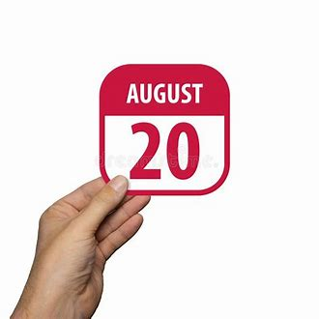
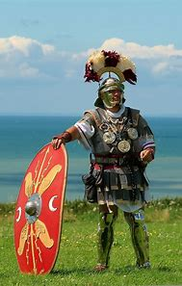
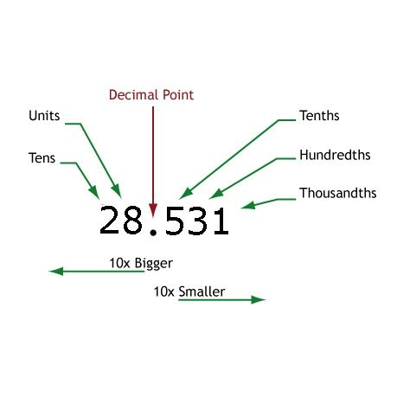
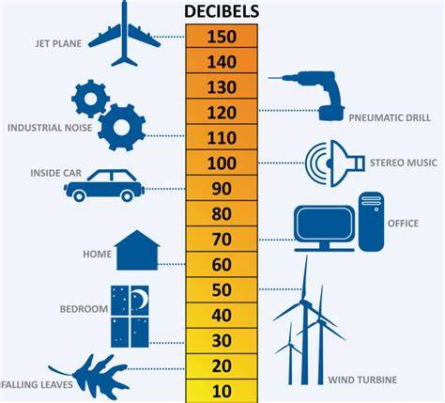
twelfth twentieth percent
centurion decibel decimal

Slide 12
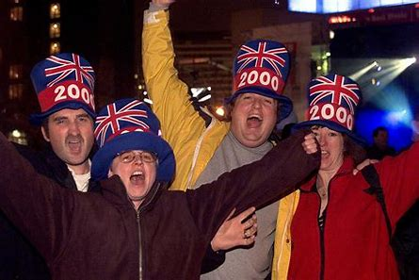
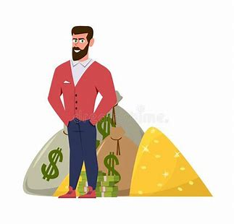
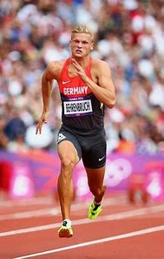
percentage millennium decathlon
millionaire billionaire decathlete

Slide 14
Activity Page
Spelling:
Numerical Prefixes for 10 <dec->.

Slide 15
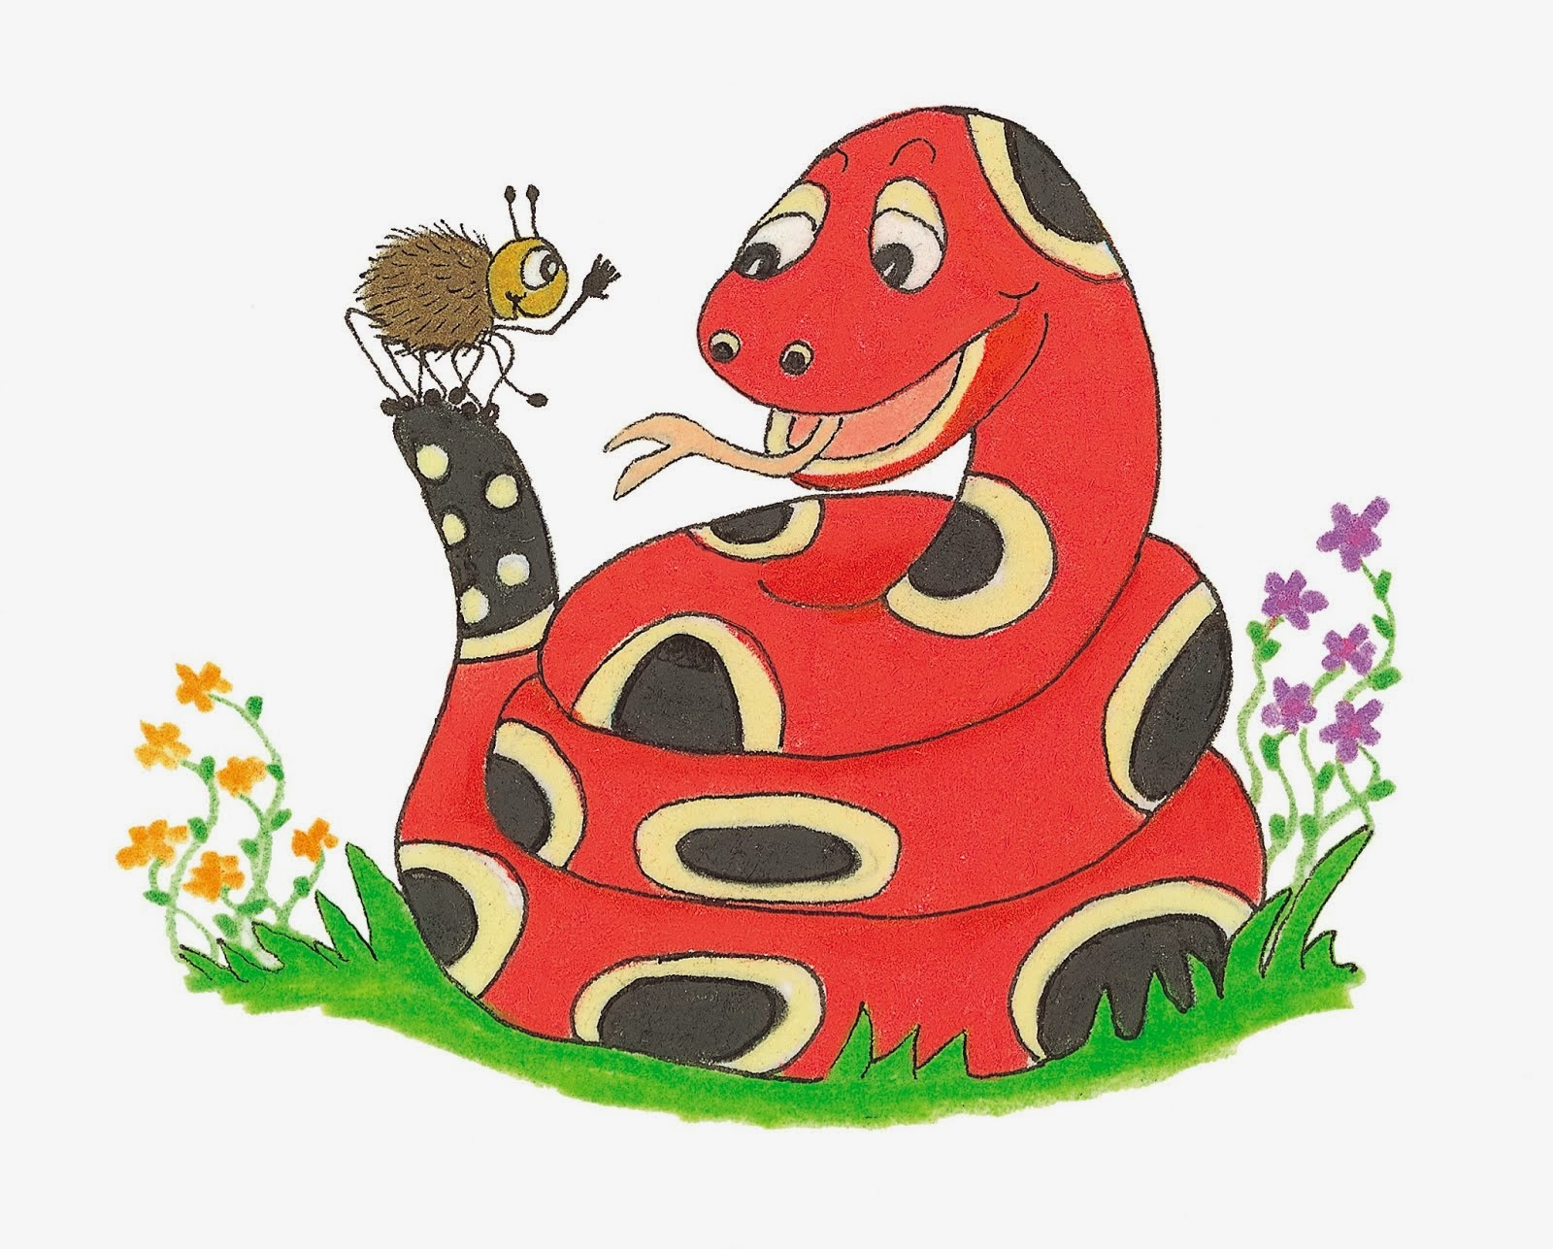
Dictation

Slide 16
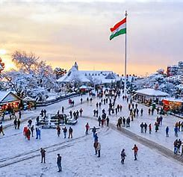

Slide 17
A high percentage of tourists visit in December.

Slide 18
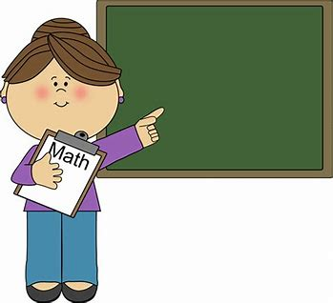
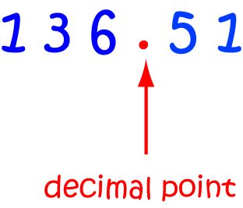

Slide 19
“Remember where to put the decimal point,” said Miss Beech .

Slide 20
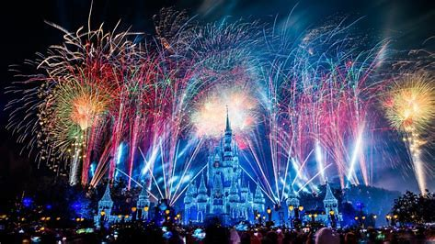

Slide 21
They celebrated the new millennium with hundreds of fireworks.

Slide 22
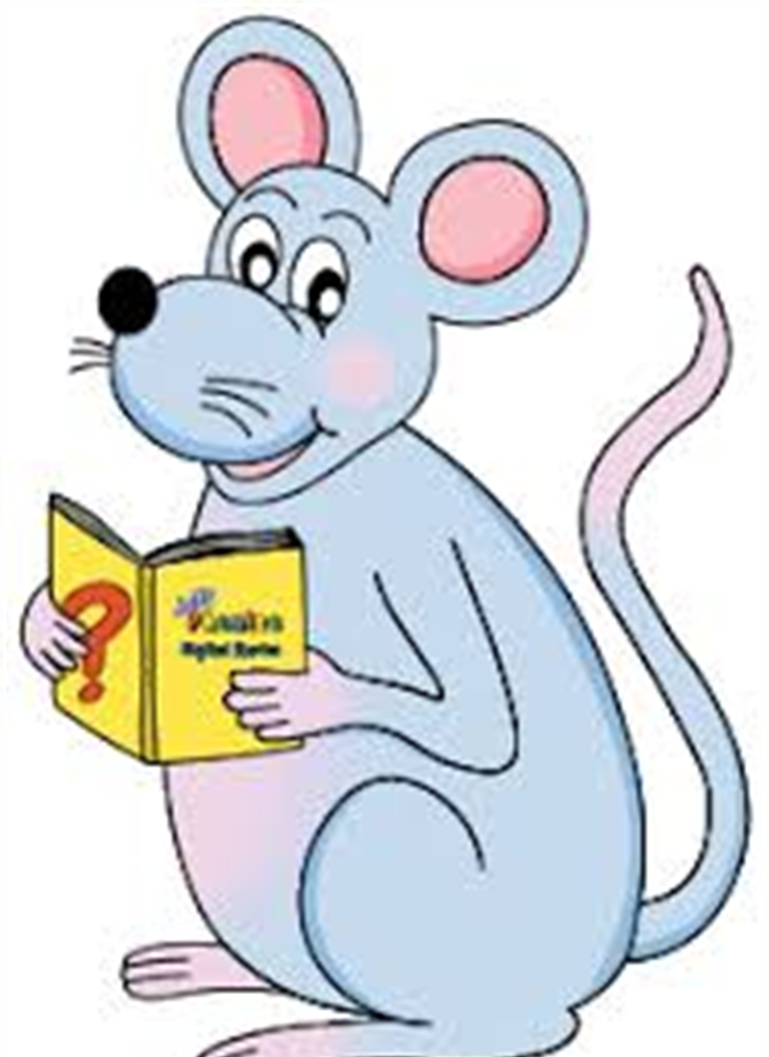
Assignment
Learn Words in the List
Complete Sentence Wall

Slide 23
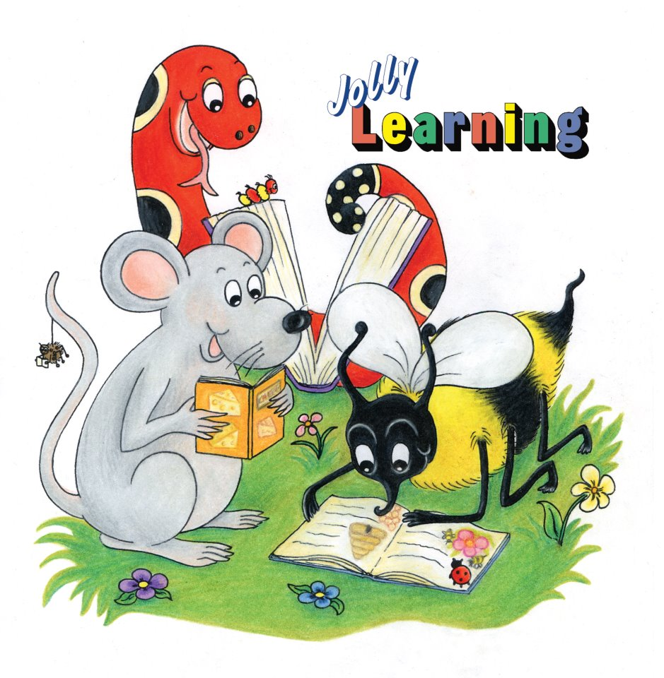
See you
next time!

