Slide 1
Jolly Grammar
6a-10

Slide 2
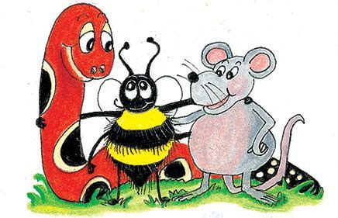
Spelling Test 5

Slide 3
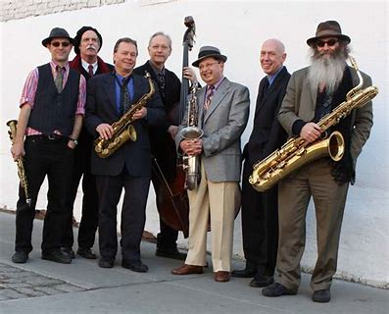
septet

Slide 4
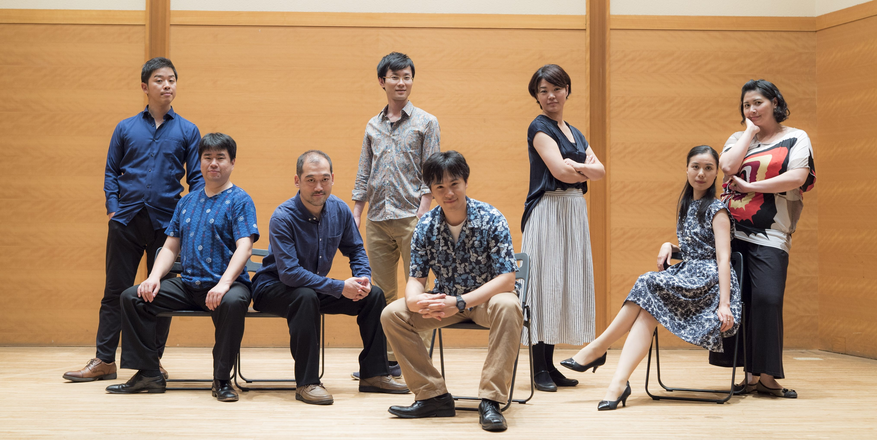
septet
octet

Slide 5
septet
octet
heptagon

Slide 6
septet
octet
heptagon
octagon

Slide 7
septet
octet
heptagon
octagon
nonagon

Slide 8
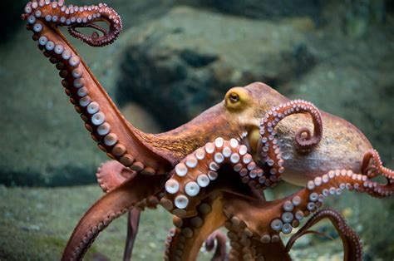
septet
octet
heptagon
octagon
nonagon
octopus

Slide 9
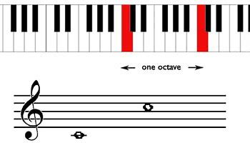
septet
octet
heptagon
octagon
nonagon
octopus
octave

Slide 10
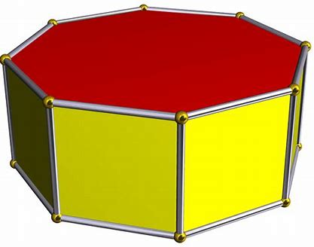
septet
octet
heptagon
octagon
nonagon
octopus
octave
octagonal

Slide 11
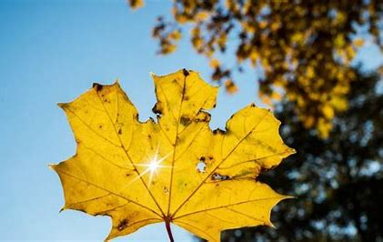
septet
octet
heptagon
octagon
nonagon
octopus
octave
octagonal
September

Slide 12
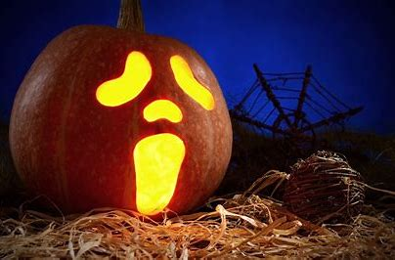
septet
octet
heptagon
octagon
nonagon
octopus
octave
octagonal
September
10. October

Slide 13
septet
octet
heptagon
octagon
nonagon
octopus
octave
octagonal
September
10. October
11. November

Slide 14
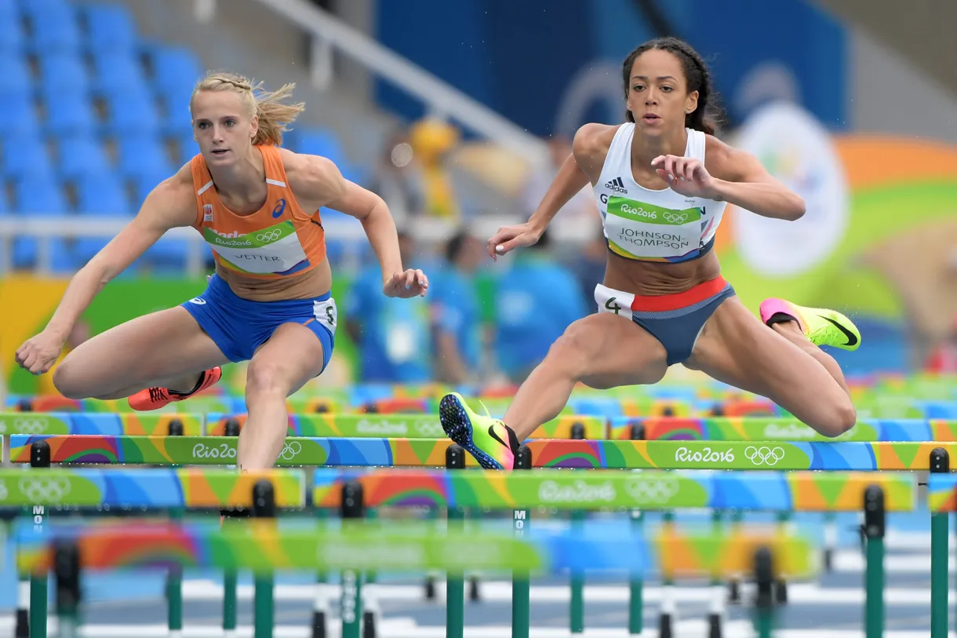
septet
octet
heptagon
octagon
nonagon
octopus
octave
octagonal
September
10. October
11. November
12. heptathlon

Slide 15
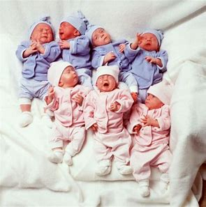
septet
octet
heptagon
octagon
nonagon
octopus
octave
octagonal
September
10. October
11. November
12. heptathlon
13. septuplet

Slide 16
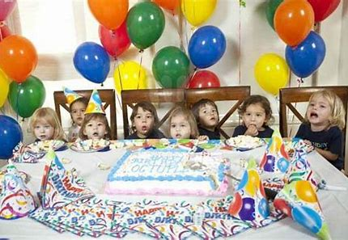
septet
octet
heptagon
octagon
nonagon
octopus
octave
octagonal
September
10. October
11. November
12. heptathlon
13. septuplet
14. octuplet

Slide 17
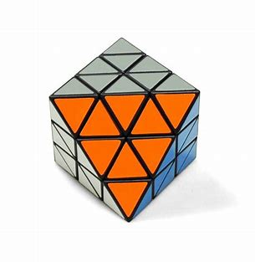
septet
octet
heptagon
octagon
nonagon
octopus
octave
octagonal
September
10. October
11. November
12. heptathlon
13. septuplet
14. octuplet
15. octahedron

Slide 18
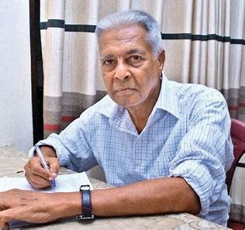
septet
octet
heptagon
octagon
nonagon
octopus
octave
octagonal
September
10. October
11. November
12. heptathlon
13. septuplet
14. octuplet
15. octahedron
16. septuagenarian

Slide 19
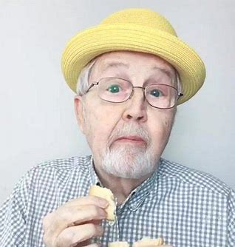
septet
octet
heptagon
octagon
nonagon
octopus
octave
octagonal
September
10. October
11. November
12. heptathlon
13. septuplet
14. octuplet
15. octahedron
16. septuagenarian
17. octogenarian

Slide 20
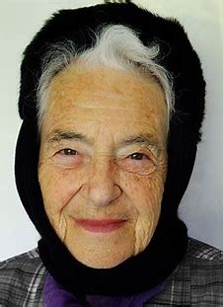
septet
octet
heptagon
octagon
nonagon
octopus
octave
octagonal
September
10. October
11. November
12. heptathlon
13. septuplet
14. octuplet
15. octahedron
16. septuagenarian
17. octogenarian
18. nonagenarian

Slide 21
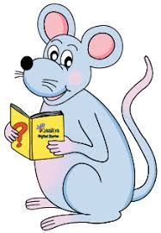
Let’s revise
Parts of Speech.

Slide 22
Parts of Speech

Slide 23
See you
next time!

