Slide 1
Jolly Grammar
6a-9

Slide 2
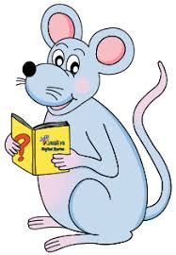
Let’s revise
Homophones.

Slide 3
they’re their there

Slide 4
・In music there are eight notes in an octave.
・The couple have announced their engagement.
They’re getting married next year.
・I congratulated my sisters on their success
in the heptathlon.
・There are seven brothers in my class
at school. They’re septuplets.
・During November there will be no concerts
in the local park.
・Did you know that octopuses have eight arms and three
hearts? They’re really fascinating!
・There are several septuagenarians among
my grandfather’s friends.
・Their old castle has four octagonal towers.

Slide 5
The two small octopuses slept peacefully
in their aquarium.
Subject
octopuses
The two small
Verb
slept
peacefully/
in their
aquarium
Object
(intransitive)

Slide 6
Spelling Point

Slide 7
heptagon
octagon
nonagon
sept-
hepta-
oct-
novem-
nona-

Slide 8
heptagon
octagon
nonagon
sept-
hepta-
7
oct-
8
novem-
nona-
9

Slide 9
Spelling List

Slide 10
・In music there are eight notes in an octave.
・The couple have announced their engagement.
They’re getting married next September.
・I congratulated my sisters on their success
in the heptathlon.
・There are seven brothers in my class
at school. They’re septuplets.
・During November there will be no concerts
in the local park.
・Did you know that octopuses have eight arms and three
hearts? They’re really fascinating!
・There are several septuagenarians among
my grandfather’s grands.
・Their old castle has four octagonal towers.

Slide 11
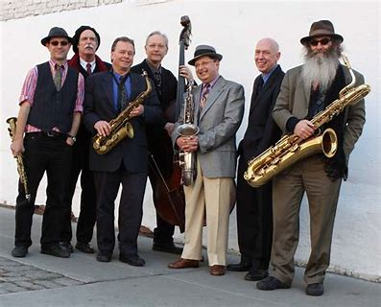
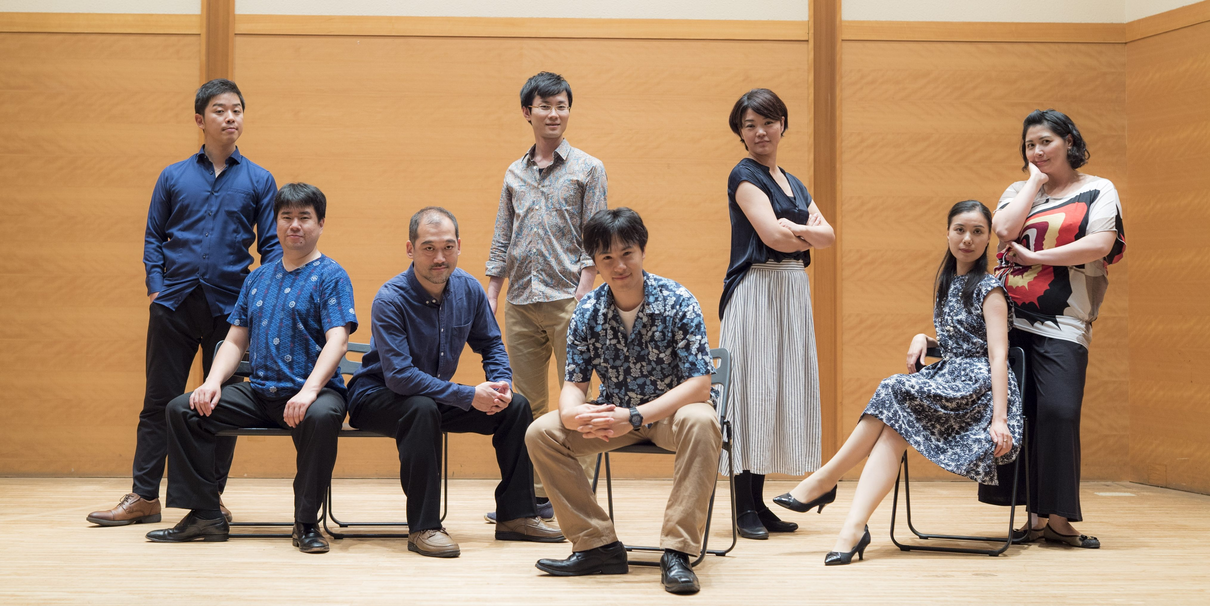
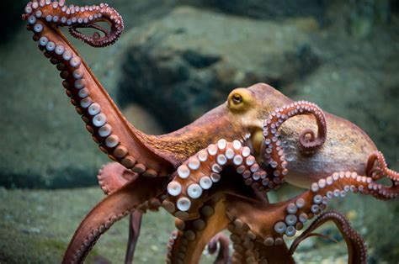
septet octet heptagon
octagon nonagon octopus

Slide 12
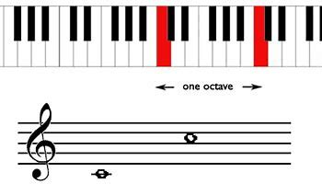
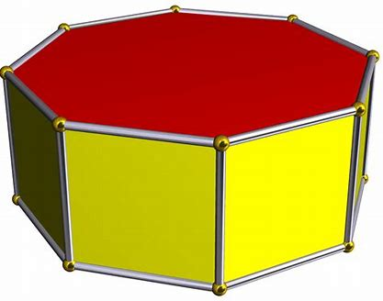
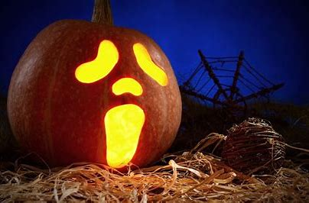
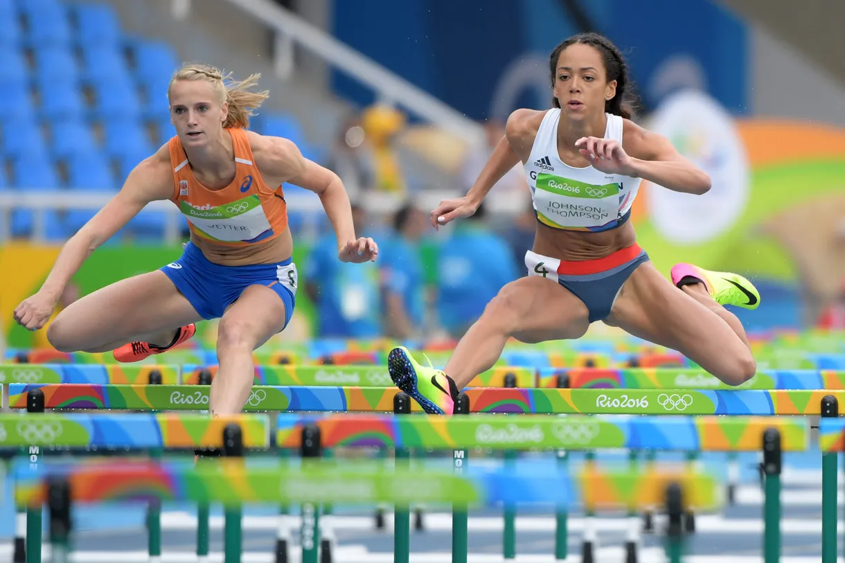
octave octagonal September
October November heptathlon

Slide 13
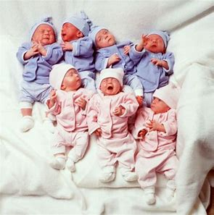
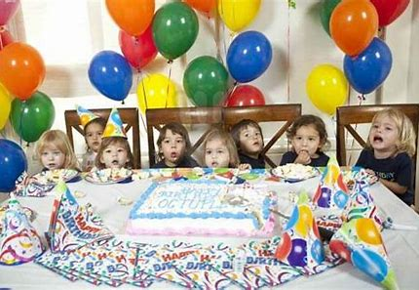
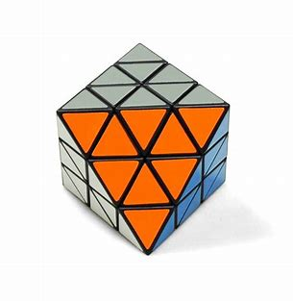
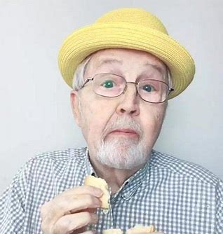
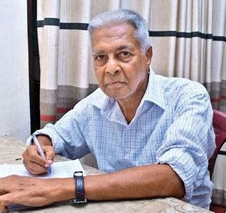
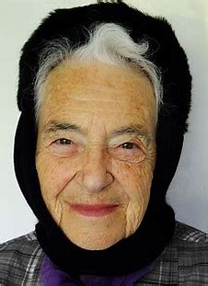
septuplet octuplet octahedron
septuagenarian octogenarian nonagenarian

Slide 14
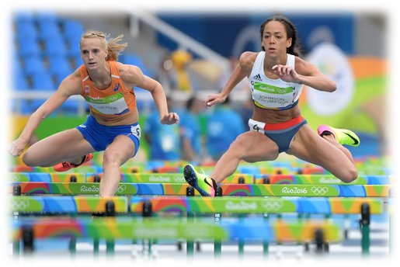
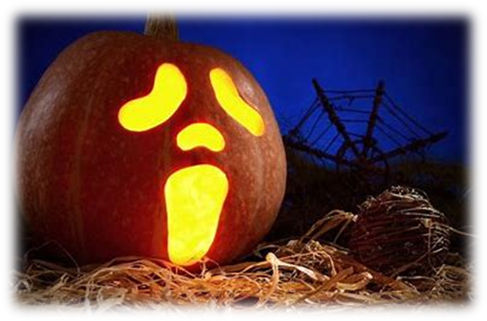
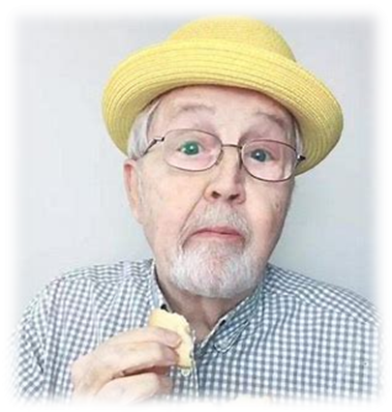
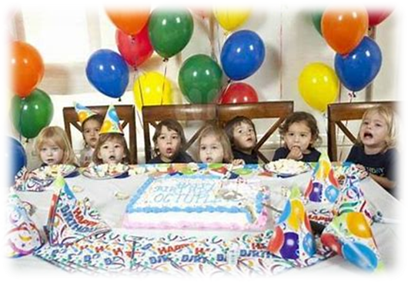
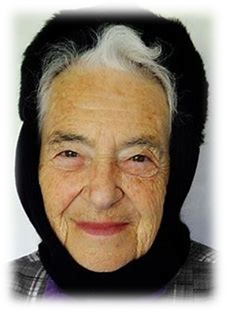
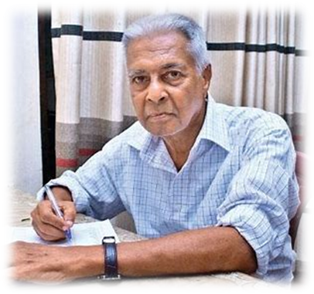
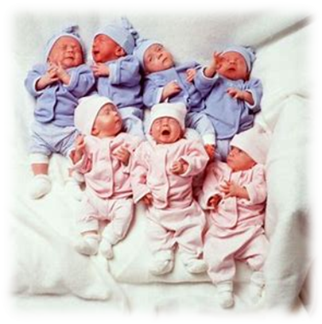

Slide 15
Activity Page
Spelling:
Numerical Prefixes for 7, 8 and 9.

Slide 16
Dictation

Slide 17
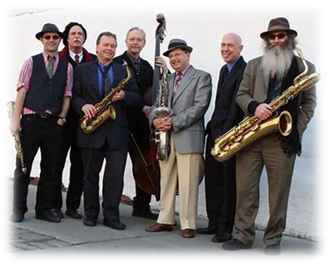
How many people sing in a septet?

Slide 18
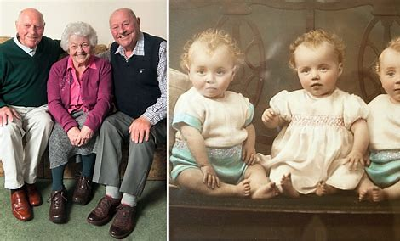
The triplets became octogenarians last month.

Slide 19
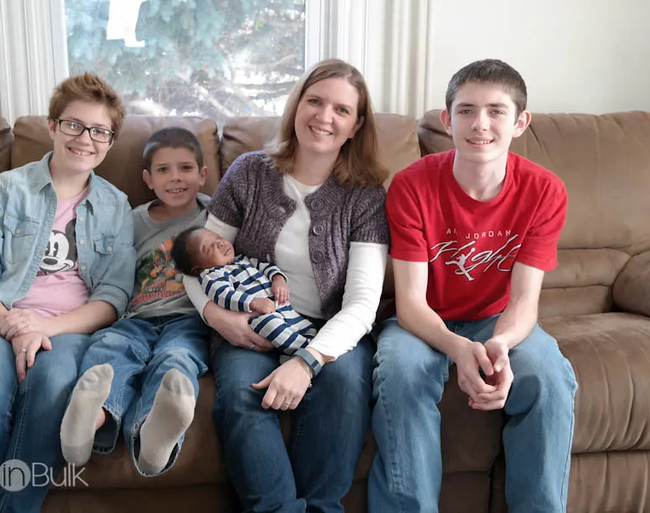
“We will see your cousins in October,” said Dad.

Slide 20
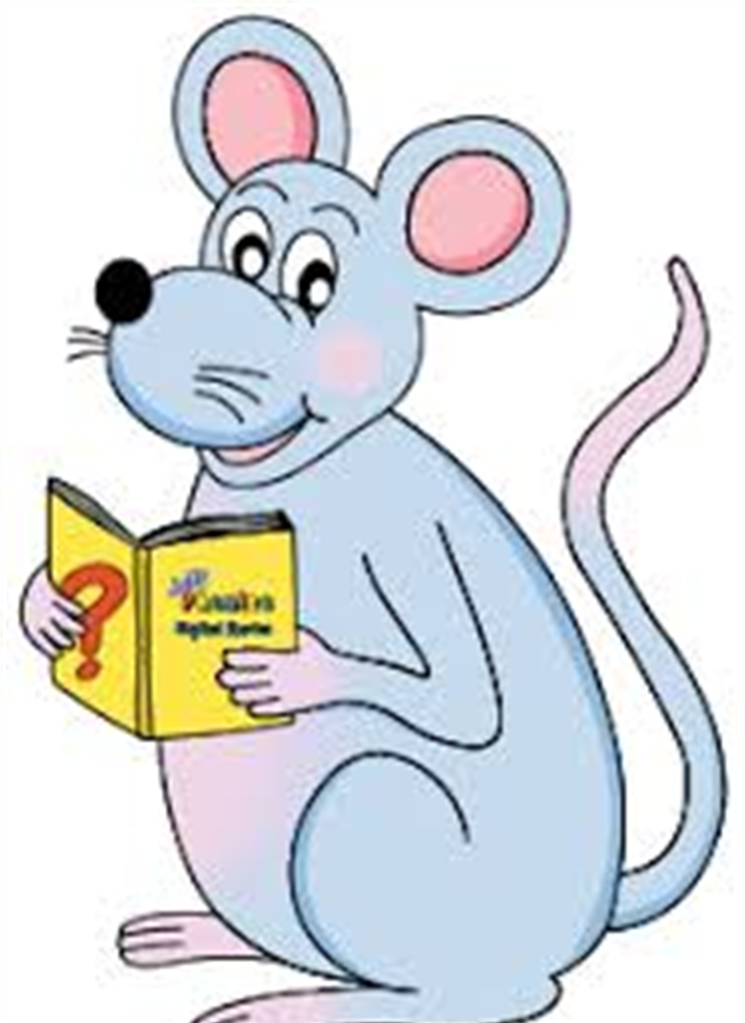
Assignment
Learn Words in the List
Complete Sentence Wall

Slide 21
See you
next time!

