Slide 1
Jolly Grammar
6a-8

Slide 2
Spelling Test 4

Slide 3
quad

Slide 4
quad
quintet

Slide 5
quad
quintet
quadrant

Slide 6
quad
quintet
quadrant
quartet

Slide 7
quad
quintet
quadrant
quartet
sextet

Slide 8
quad
quintet
quadrant
quartet
sextet
hexagon

Slide 9
quad
quintet
quadrant
quartet
sextet
hexagon
pentagon

Slide 10
quad
quintet
quadrant
quartet
sextet
hexagon
pentagon
quarter

Slide 11
quad
quintet
quadrant
quartet
sextet
hexagon
pentagon
quarter
quadruple

Slide 12
quad
quintet
quadrant
quartet
sextet
hexagon
pentagon
quarter
quadruple
10. hexagonal

Slide 13
quad
quintet
quadrant
quartet
sextet
hexagon
pentagon
quarter
quadruple
10. hexagonal
11. pentathlon

Slide 14
quad
quintet
quadrant
quartet
sextet
hexagon
pentagon
quarter
quadruple
10. hexagonal
11. pentathlon
12. sextant

Slide 15
quad
quintet
quadrant
quartet
sextet
hexagon
pentagon
quarter
quadruple
10. hexagonal
11. pentathlon
12. sextant
13. quadrangle

Slide 16
quad
quintet
quadrant
quartet
sextet
hexagon
pentagon
quarter
quadruple
10. hexagonal
11. pentathlon
12. sextant
13. quadrangle
14. pentagram

Slide 17
quad
quintet
quadrant
quartet
sextet
hexagon
pentagon
quarter
quadruple
10. hexagonal
11. pentathlon
12. sextant
13. quadrangle
14. pentagram

Slide 18
quad
quintet
quadrant
quartet
sextet
hexagon
pentagon
quarter
quadruple
10. hexagonal
11. pentathlon
12. sextant
13. quadrangle
14. pentagram
15. quadruped

Slide 19
quad
quintet
quadrant
quartet
sextet
hexagon
pentagon
quarter
quadruple
10. hexagonal
11. pentathlon
12. sextant
13. quadrangle
14. pentagram
15. quadruped
16. pentameter

Slide 20
quad
quintet
quadrant
quartet
sextet
hexagon
pentagon
quarter
quadruple
10. hexagonal
11. pentathlon
12. sextant
13. quadrangle
14. pentagram
15. quadruped
16. pentameter
17. sextuplet

Slide 21
quad
quintet
quadrant
quartet
sextet
hexagon
pentagon
quarter
quadruple
10. hexagonal
11. pentathlon
12. sextant
13. quadrangle
14. pentagram
15. quadruped
16. pentameter
17. sextuplet
18. quadrilateral

Slide 22
Let’s revise
Nouns.

Slide 23
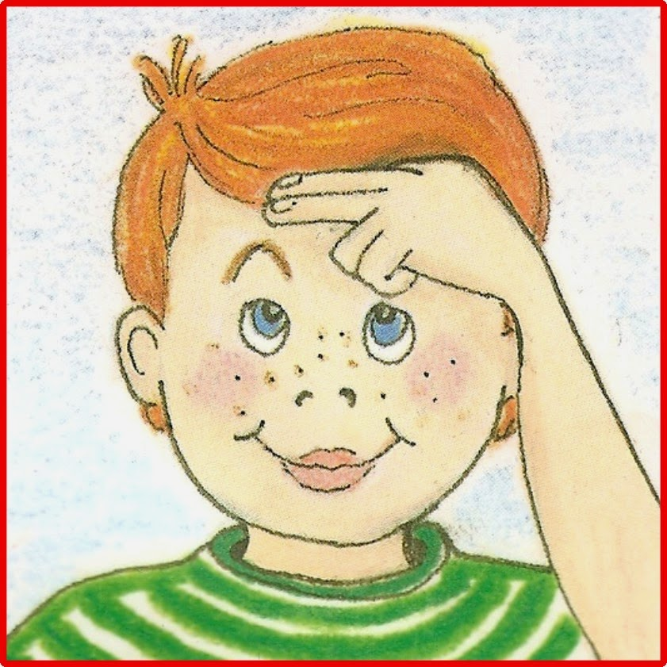
Nouns
Proper Nouns
Common Nouns

Slide 24
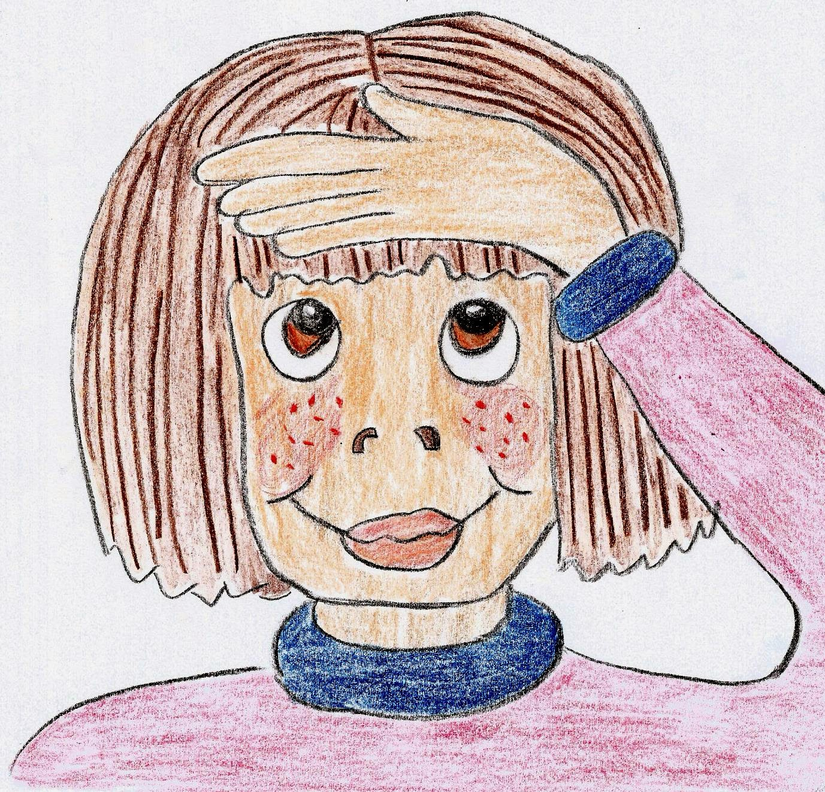
Nouns
Proper Nouns
Common Nouns
Monday
Jane
Tokyo
egg
classes
rain

Slide 25
Proper Noun? or Common Noun?
On Monday, Jane and Zack saw
a bird sitting on an egg in the nest.

Slide 26
Common Nouns
①concrete: photo, drum, flowers, ice
②collective: a class of children
a herd of cows
③abstract: love, trouble, friendship

Slide 27
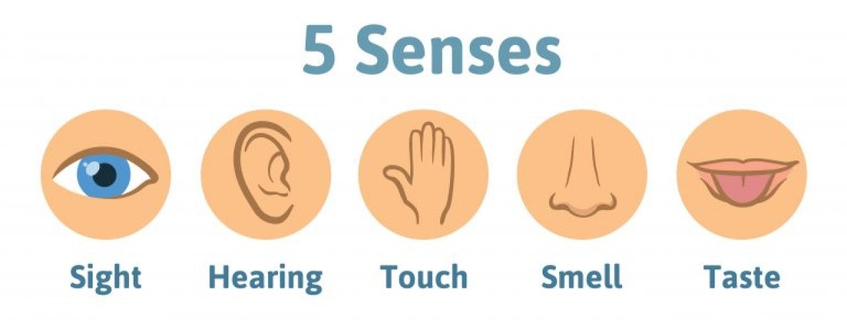
Concrete Nouns
tree
floor
chair
shoe
bed
bell
telephone
radio
bird
frog
silk
water
wool
ice
sand
smoke
perfume
rose
coffee
paint
sugar
vinegar
milk
mint
salt

Slide 28
Concrete Nouns

Slide 29
Common Nouns
①concrete: photo, drum, flowers, ice
②collective: a class of children
a herd of cows
③abstract: love, trouble, friendship

Slide 30
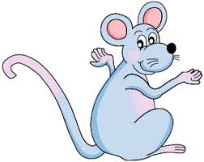
abstract nouns
Example:
happiness sadness anger
amazement anxiety delight
envy excitement fear
hope surprise worry
beauty kindness bravery
confidence fairness intelligence
weakness peace war
freedom taste knowledge
romance hate government
ideas time adventure
weather

Slide 31
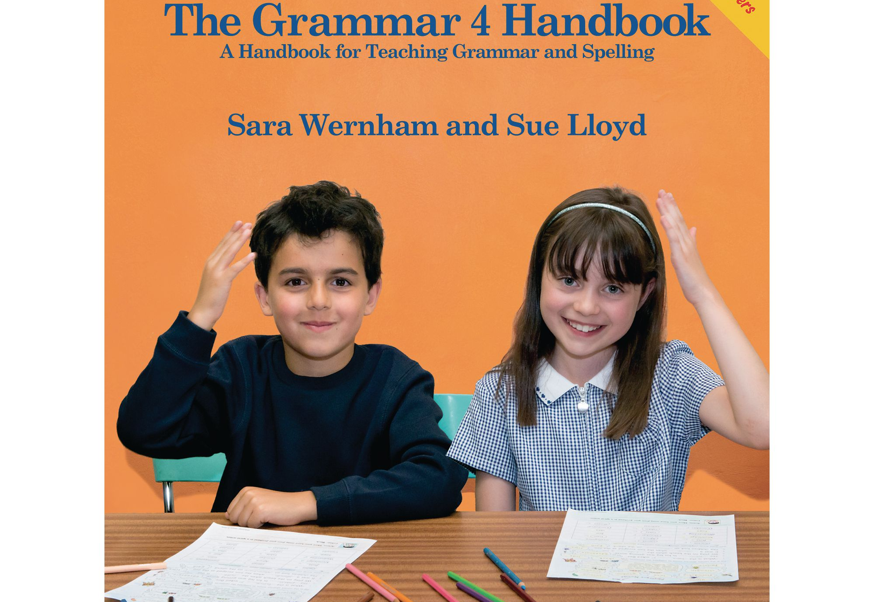

Slide 32
Singular and Plural

Slide 33
girls
foxes
dogs
dishes
potatoes
pianos
boys
berries

Slide 34
girls
foxes
dogs
dishes
potatoes
pianos
boys
berries
men
women
children
mice
sheep
wolves
wives
cactus

Slide 35
Countable nouns
girls
foxes
dogs
dishes
potatoes
pianos
boys
berries
men
women
children
mice
sheep
wolves
wives
cactus

Slide 36
Countable nouns
girls
foxes
dogs
dishes
potatoes
pianos
boys
berries
men
women
children
mice
sheep
wolves
wives
cactus
bread
butter
honey
jam
cheese

Slide 37
Countable nouns
girls
foxes
dogs
dishes
potatoes
pianos
boys
berries
men
women
children
mice
sheep
wolves
wives
cactus
bread
butter
honey
jam
cheese
sugar
pasta
flour

Slide 38
Countable nouns
Uncountable nouns
girls
foxes
dogs
dishes
potatoes
pianos
boys
berries
men
women
children
mice
sheep
wolves
wives
cactus
bread
butter
honey
jam
cheese
sugar
pasta
flour

Slide 39
Noun phrases for uncountable nouns

Slide 40
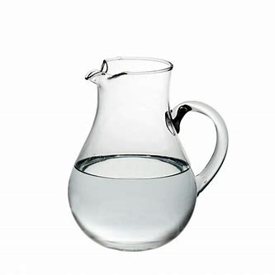
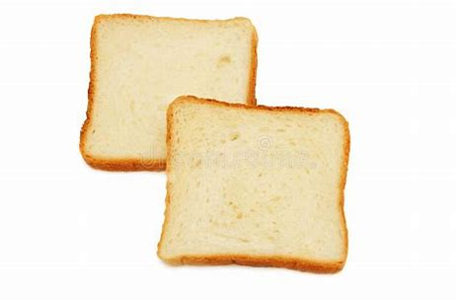
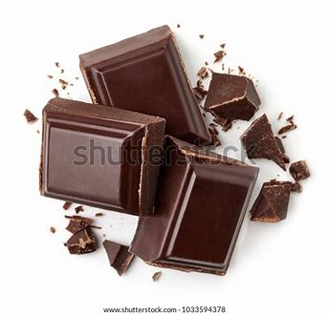
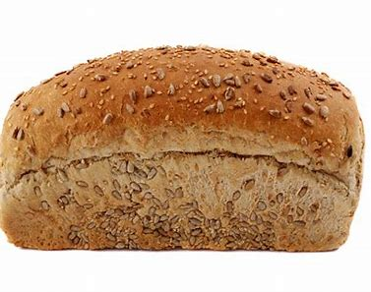
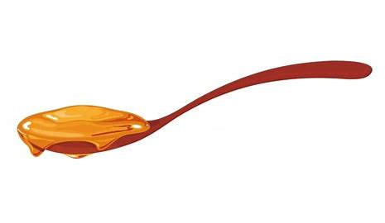
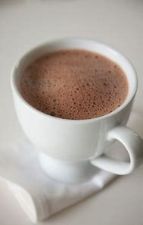
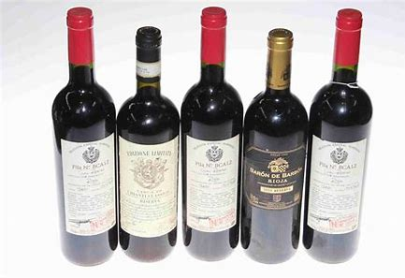
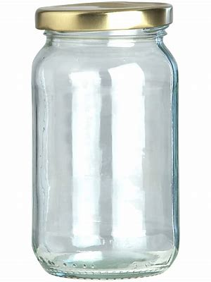
a jug of
two slices of
a loaf of
a spoonful of
five bottles of
a cup of
three pieces of
a jar of

Slide 41
Countable
And
Uncountable
Nouns

Slide 42
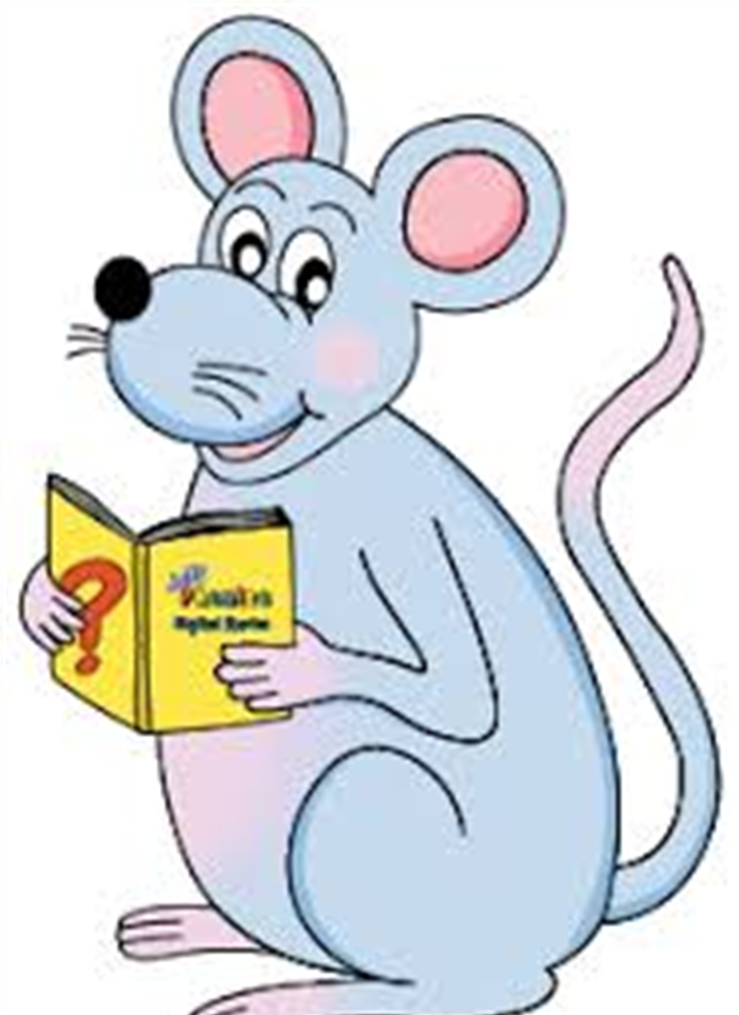
Assignment
Complete the sentences by writing in the correct homophone(s) in page 15.

Slide 43
See you
next time!

