Slide 1
Jolly Grammar
6a-7

Slide 2
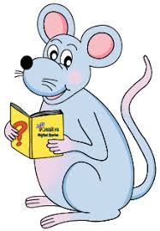
Let’s Revise Articles

Slide 3
an
an
a
ostrich
emu
bicycle
a
a
a
horse
triangle
unicorn
an
a
an
hour
shell
umbrella

Slide 4
Spelling Point

Slide 5
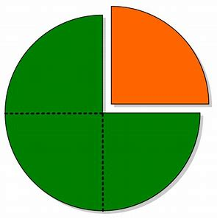
quarter
pentagon
sextet
quar-
quad-
penta
quin-
sex-
hexa-

Slide 6
quarter
pentagon
sextet
quar-
quad-
penta
quin-
sex-
hexa-
4
5
6

Slide 7
Spelling List

Slide 8
Activity Page
Spelling:
Numerical Prefixes for 4, 5 and 6.

Slide 9
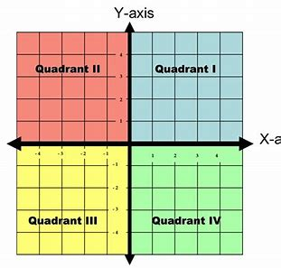
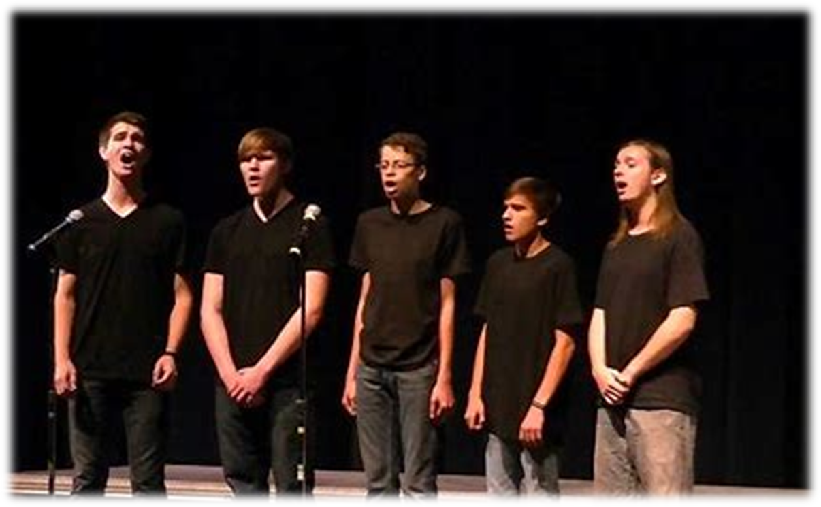
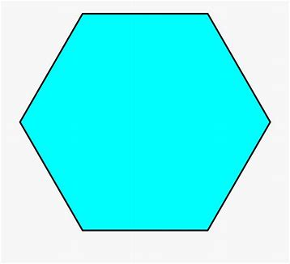
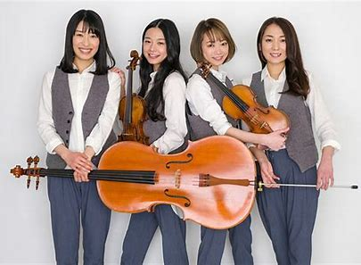
quad quintet quadrant
quartet sextet hexagon

Slide 10
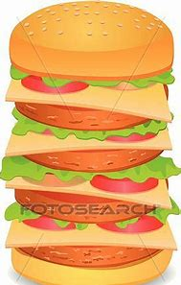
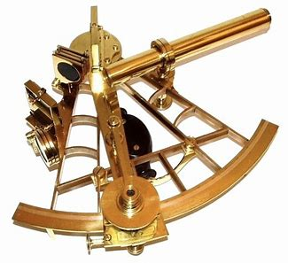
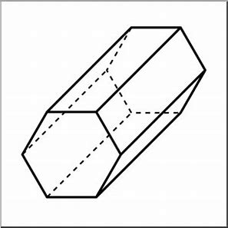
pentagon quarter quadruple
Shooting
Swimming
Fencing
Equestrian
Cross country running
hexagonal pentathlon sextant

Slide 11
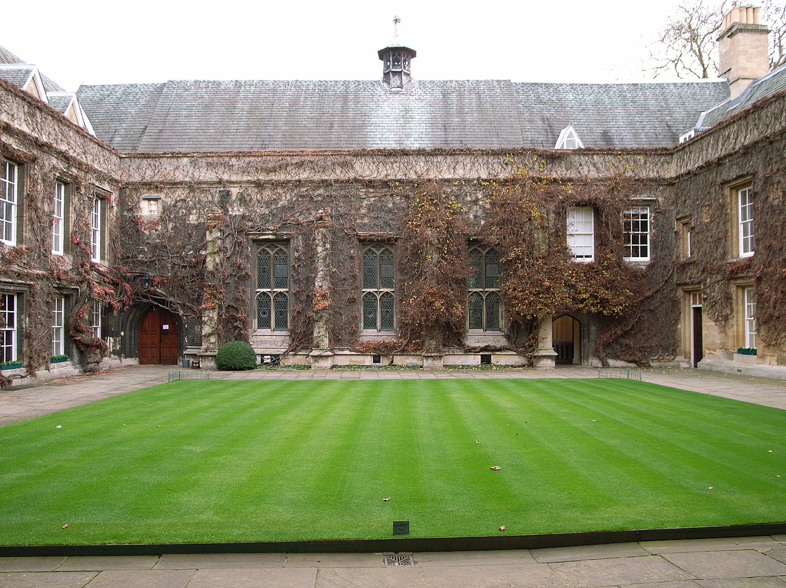
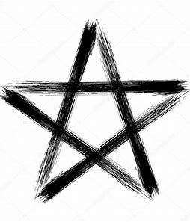
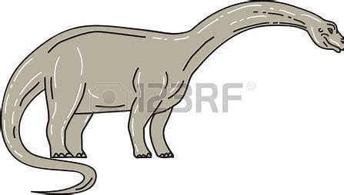
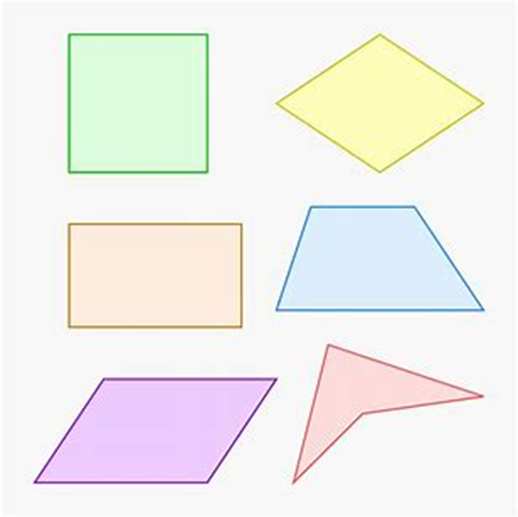
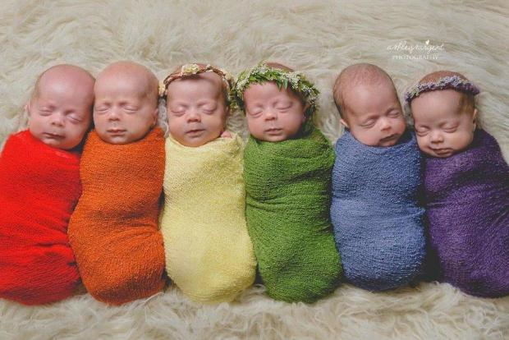
quadrangle pentagram quadruped
pentameter sextuplet quadrilateral

Slide 12
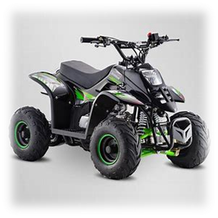
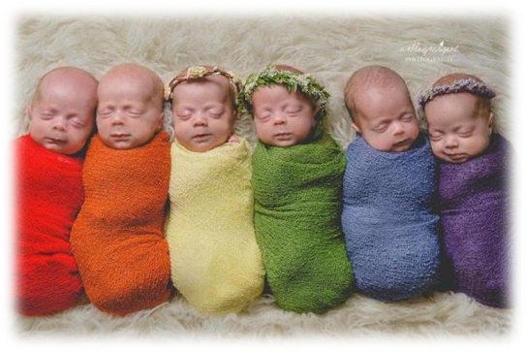
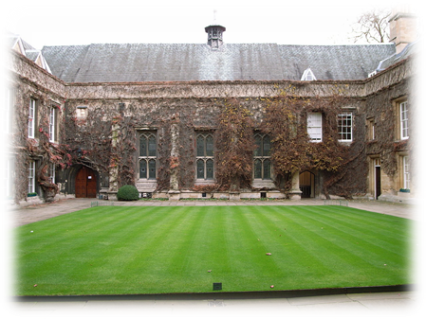

Slide 13
Let’s revise
Homophones.

Slide 14
you’re your

Slide 15
・You’re playing the violin in the quartet next week.
・”You’re going to study quadrants this week,” my
teacher said.
・Have you done your homework on hexagons, yet?
・Is the book you’re reading all about quadrupeds?
・”Your prices have quadrupled this year!” the
angry customer complained.
・Didn’t your cousin do well in the pentathlon?
・Is your room in the building across the quadrangle?
・I’ll peel and quarter the potatoes while you’re chopping
the carrots.

Slide 16
・You’re playing the violin in the quartet next week.
・”You’re going to study quadrants this week,” my
teacher said.
・Have you done your homework on hexagons, yet?
・Is the book you’re reading all about quadrupeds?
・”Your prices have quadrupled this year!” the
angry customer complained.
・Didn’t your cousin do well in the pentathlon?
・Is your room in the building across the quadrangle?
・I’ll peel and quarter the potatoes while you’re chopping
the carrots.

Slide 17
・You’re playing the violin in the quartet next week.
・”You’re going to study quadrants this week,” my
teacher said.
・Have you done your homework on hexagons, yet?
・Is the book you’re reading all about quadrupeds?
・”Your prices have quadrupled this year!” the
angry customer complained.
・Didn’t your cousin do well in the pentathlon?
・Is your room in the building across the quadrangle?
・I’ll peel and quarter the potatoes while you’re chopping
the carrots.

Slide 18
・You’re playing the violin in the quartet next week.
・”You’re going to study quadrants this week,” my
teacher said.
・Have you done your homework on hexagons, yet?
・Is the book you’re reading all about quadrupeds?
・”Your prices have quadrupled this year!” the
angry customer complained.
・Didn’t your cousin do well in the pentathlon?
・Is your room in the building across the quadrangle?
・I’ll peel and quarter the potatoes while you’re chopping
the carrots.

Slide 19
・You’re playing the violin in the quartet next week.
・”You’re going to study quadrants this week,” my
teacher said.
・Have you done your homework on hexagons, yet?
・Is the book you’re reading all about quadrupeds?
・”Your prices have quadrupled this year!” the
angry customer complained.
・Didn’t your cousin do well in the pentathlon?
・Is your room in the building across the quadrangle?
・I’ll peel and quarter the potatoes while you’re chopping
the carrots.

Slide 20
・You’re playing the violin in the quartet next week.
・”You’re going to study quadrants this week,” my
teacher said.
・Have you done your homework on hexagons, yet?
・Is the book you’re reading all about quadrupeds?
・”Your prices have quadrupled this year!” the
angry customer complained.
・Didn’t your cousin do well in the pentathlon?
・Is your room in the building across the quadrangle?
・I’ll peel and quarter the potatoes while you’re chopping
the carrots.

Slide 21
・You’re playing the violin in the quartet next week.
・”You’re going to study quadrants this week,” my
teacher said.
・Have you done your homework on hexagons, yet?
・Is the book you’re reading all about quadrupeds?
・”Your prices have quadrupled this year!” the
angry customer complained.
・Didn’t your cousin do well in the pentathlon?
・Is your room in the building across the quadrangle?
・I’ll peel and quarter the potatoes while you’re chopping
the carrots.

Slide 22
・You’re playing the violin in the quartet next week.
・”You’re going to study quadrants this week,” my
teacher said.
・Have you done your homework on hexagons, yet?
・Is the book you’re reading all about quadrupeds?
・”Your prices have quadrupled this year!” the
angry customer complained.
・Didn’t your cousin do well in the pentathlon?
・Is your room in the building across the quadrangle?
・I’ll peel and quarter the potatoes while you’re chopping
the carrots.

Slide 23
・You’re playing the violin in the quartet next week.
・”You’re going to study quadrants this week,” my
teacher said.
・Have you done your homework on hexagons, yet?
・Is the book you’re reading all about quadrupeds?
・”Your prices have quadrupled this year!” the
angry customer complained.
・Didn’t your cousin do well in the pentathlon?
・Is your room in the building across the quadrangle?
・I’ll peel and quarter the potatoes while you’re chopping
the carrots.

Slide 24
・You’re playing the violin in the quartet next week.
・”You’re going to study quadrants this week,” my
teacher said.
・Have you done your homework on hexagons, yet?
・Is the book you’re reading all about quadrupeds?
・”Your prices have quadrupled this year!” the
angry customer complained.
・Didn’t your cousin do well in the pentathlon?
・Is your room in the building across the quadrangle?
・I’ll peel and quarter the potatoes while you’re chopping
the carrots.

Slide 25
Sentence Wall

Slide 26
I neatly divided the cheese and tomato pizza (into quarters).
Subject
I
Verb
divided
neatly/
into quarters
Object
pizza
the cheese and tomato
(transitive)

Slide 27
Dictation

Slide 28
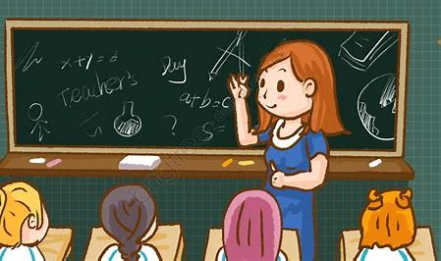

Slide 29
“Please draw a quadrilateral,” said Miss Beech.

Slide 30
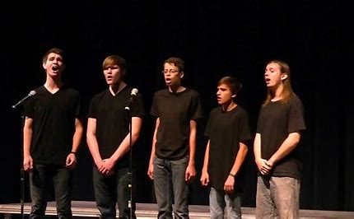

Slide 31
The quintet will be singing in the concert.

Slide 33
Does a pentagon have more sides than a square?

Slide 34
Assignment
Learn Words in the List
Complete Sentence Wall

Slide 35
See you
next time!

