Slide 1
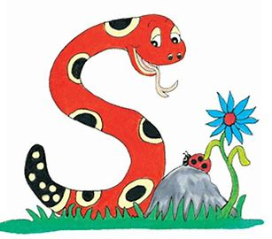
Jolly Grammar
4b-6

Slide 2
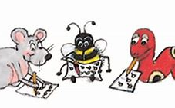
Spelling Test 21

Slide 3
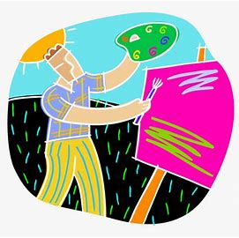
artistically

Slide 4
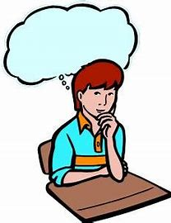
artistically
critically

Slide 5
artistically
critically
logically

Slide 6
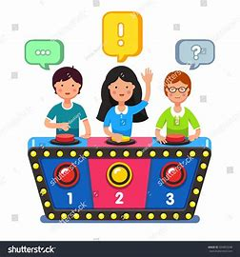
artistically
critically
logically
quizzically

Slide 7
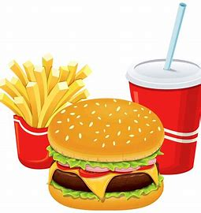
artistically
critically
logically
quizzically
basically

Slide 8
artistically
critically
logically
quizzically
basically
vertically

Slide 9
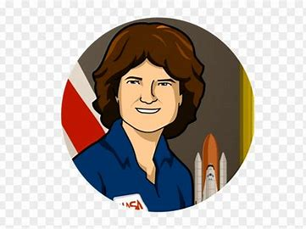
artistically
critically
logically
quizzically
basically
vertically
7.historically

Slide 10
artistically
critically
logically
quizzically
basically
vertically
7.historically
8.politically

Slide 11
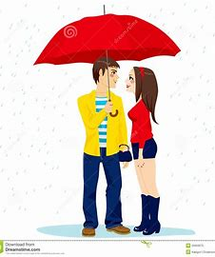
artistically
critically
logically
quizzically
basically
vertically
7.historically
8.politically
9.romantically

Slide 12
artistically
critically
logically
quizzically
basically
vertically
7.historically
8.politically
9.romantically
10.technically

Slide 13
artistically
critically
logically
quizzically
basically
vertically
7.historically
8.politically
9.romantically
10.technically
11.typically

Slide 14
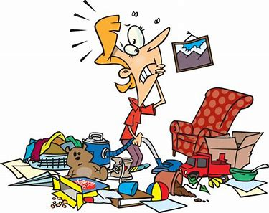
artistically
critically
logically
quizzically
basically
vertically
7.historically
8.politically
9.romantically
10.technically
11.typically
12.chaotically

Slide 15
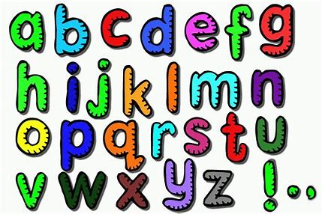
artistically
critically
logically
quizzically
basically
vertically
7.historically
8.politically
9.romantically
10.technically
11.typically
12.chaotically
13.alphabetically

Slide 16
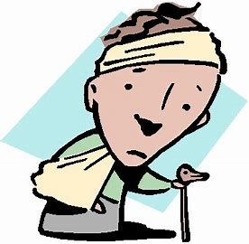
artistically
critically
logically
quizzically
basically
vertically
7.historically
8.politically
9.romantically
10.technically
11.typically
12.chaotically
13.alphabetically
14.traumatically

Slide 17
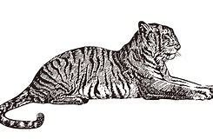
artistically
critically
logically
quizzically
basically
vertically
7.historically
8.politically
9.romantically
10.technically
11.typically
12.chaotically
13.alphabetically
14.traumatically
15.majestically

Slide 18
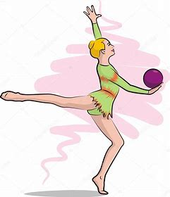
artistically
critically
logically
quizzically
basically
vertically
7.historically
8.politically
9.romantically
10.technically
11.typically
12.chaotically
13.alphabetically
14.traumatically
15.majestically
16.rhythmmically

Slide 19
artistically
critically
logically
quizzically
basically
vertically
7.historically
8.politically
9.romantically
10.technically
11.typically
12.chaotically
13.alphabetically
14.traumatically
15.majestically
16.rhythmmically
17.sarcastically

Slide 20
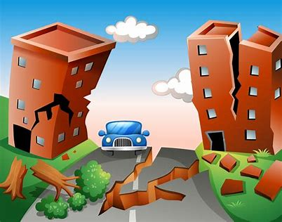
artistically
critically
logically
quizzically
basically
vertically
7.historically
8.politically
9.romantically
10.technically
11.typically
12.chaotically
13.alphabetically
14.traumatically
15.majestically
16.rhythmmically
17.sarcastically
18.catastrophically

Slide 21
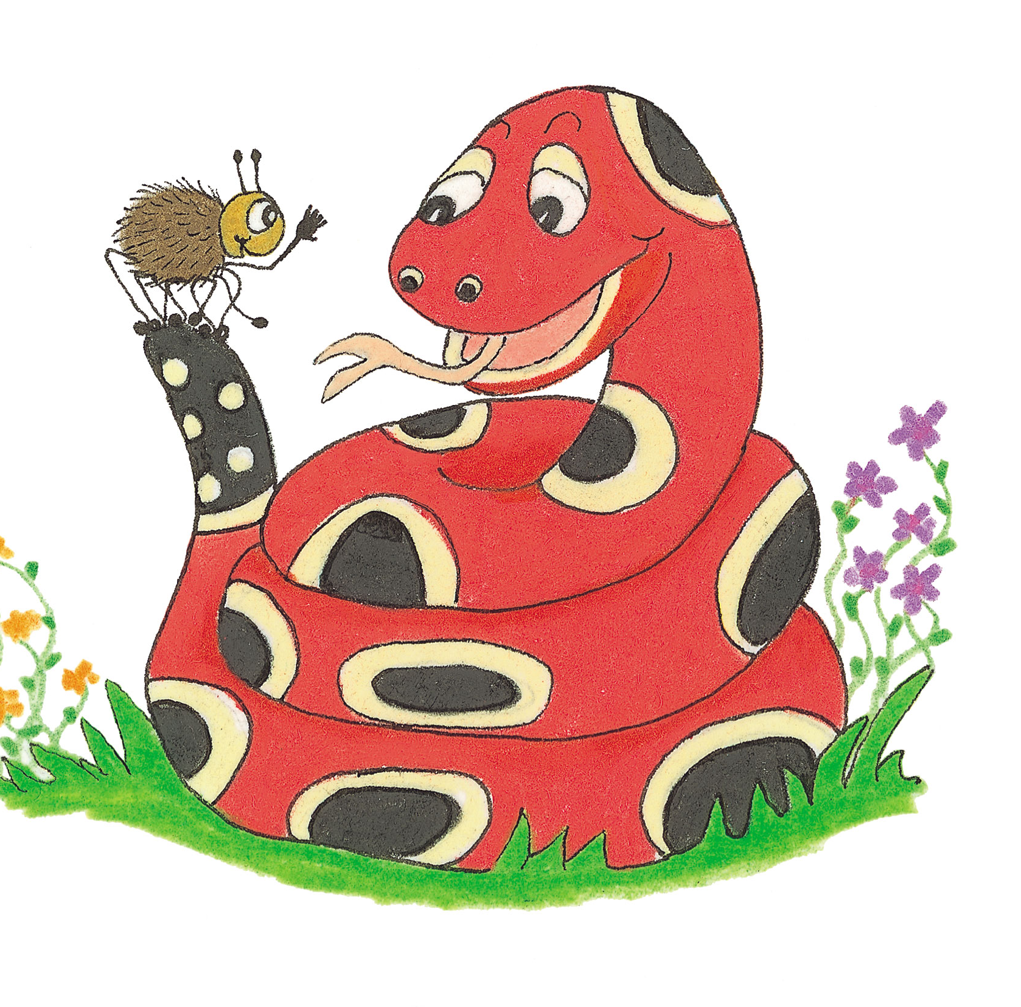
Let’s Revise Suffixes &
Prefixes.

Slide 22
suffixes

Slide 23
suffixes
hens
benches
ladies
brighter
brightest
wished
wishing

Slide 24
suffixes
cloudy
traditional
poetic
typical
loudly
harmful
harmless
breakable
hens
benches
ladies
brighter
brightest
wished
wishing

Slide 25
prefixes
suffixes
impatient
undo
nonstop
decode
disappear
misunderstood
refill
midway
semicircle
cloudy
traditional
poetic
typical
loudly
harmful
harmless
breakable
hens
benches
ladies
brighter
brightest
wished
wishing

Slide 26
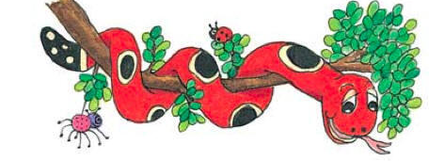
Activity Page :

Slide 27
mid
mis
semi
im
non
night
paint
quick
behave
final
mature
sense
beauty
ing
ly
ful

Slide 28
Thank you.
See you
next time!

