Slide 1
Jolly Grammar 3-19

Slide 2
crazy

Slide 3
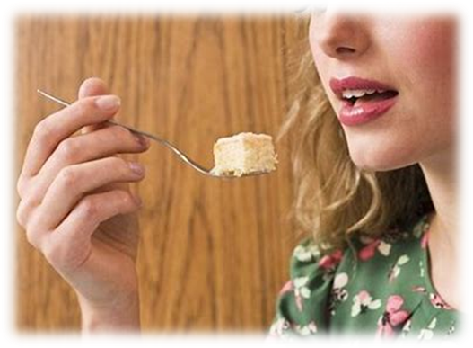
crazy
taste

Slide 4
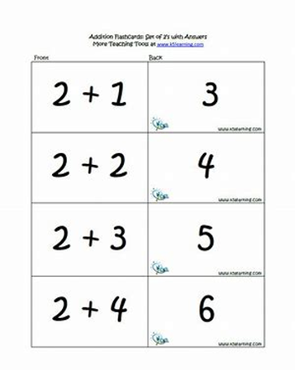
crazy
taste
basic

Slide 5
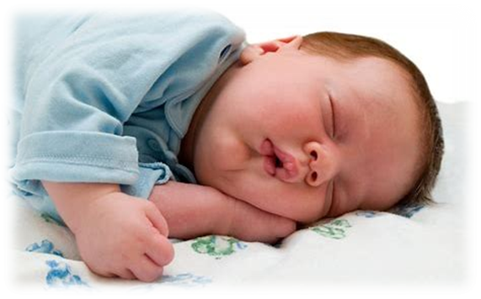
crazy
taste
basic
baby

Slide 6
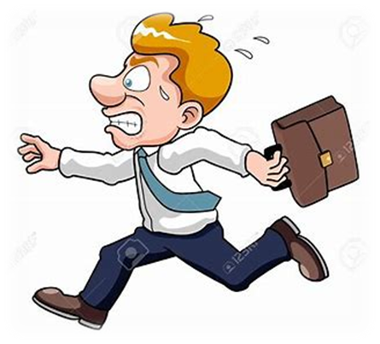
crazy
taste
basic
baby
haste

Slide 7
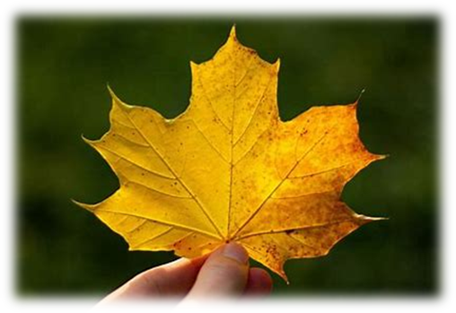
crazy
taste
basic
baby
haste
maple

Slide 8
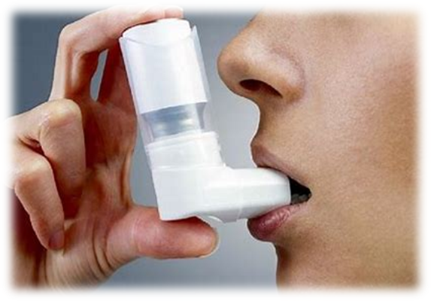
crazy
taste
basic
baby
haste
maple
7. inhaler

Slide 9
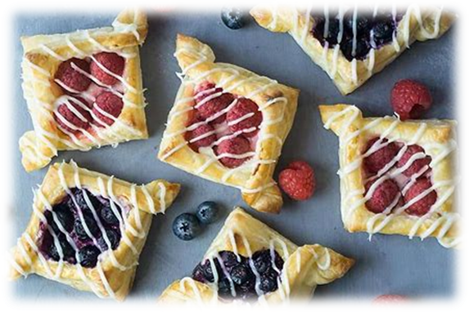
crazy
taste
basic
baby
haste
maple
7. inhaler
8. pastry

Slide 10
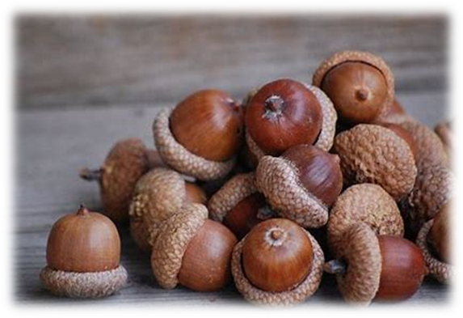
crazy
taste
basic
baby
haste
maple
7. inhaler
8. pastry
9. acorn

Slide 11
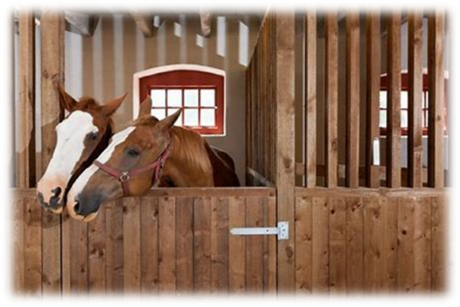
crazy
taste
basic
baby
haste
maple
7. inhaler
8. pastry
9. acorn
10. stable

Slide 12
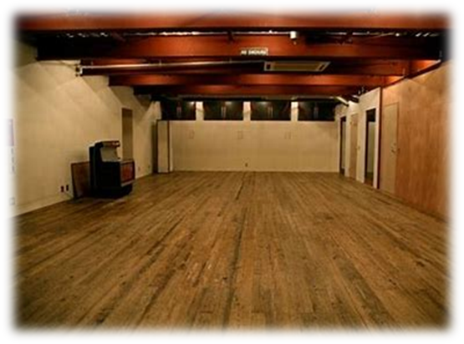
crazy
taste
basic
baby
haste
maple
7. inhaler
8. pastry
9. acorn
10. stable
11. vacant

Slide 13
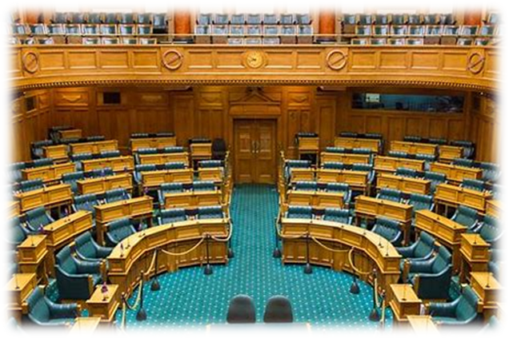
crazy
taste
basic
baby
haste
maple
7. inhaler
8. pastry
9. acorn
10. stable
11. vacant
12. chamber

Slide 14
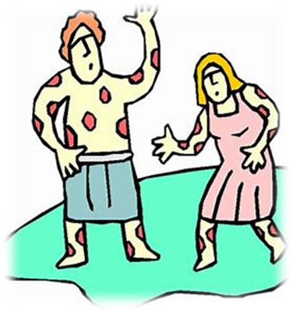
crazy
taste
basic
baby
haste
maple
7. inhaler
8. pastry
9. acorn
10. stable
11. vacant
12. chamber
13. plague

Slide 15
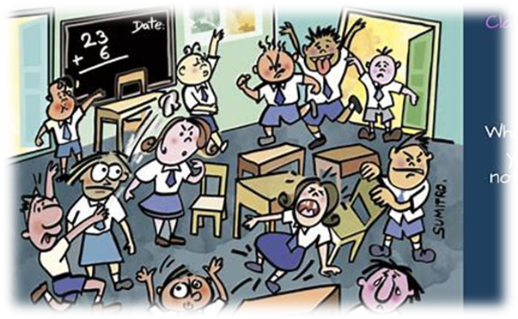
crazy
taste
basic
baby
haste
maple
7. inhaler
8. pastry
9. acorn
10. stable
11. vacant
12. chamber
13. plague
14. chaotic

Slide 16
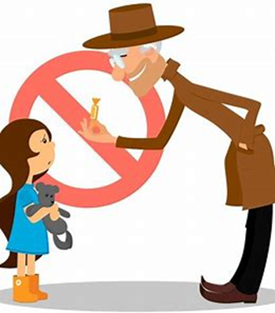
crazy
taste
basic
baby
haste
maple
7. inhaler
8. pastry
9. acorn
10. stable
11. vacant
12. chamber
13. plague
14. chaotic
15. stranger

Slide 17
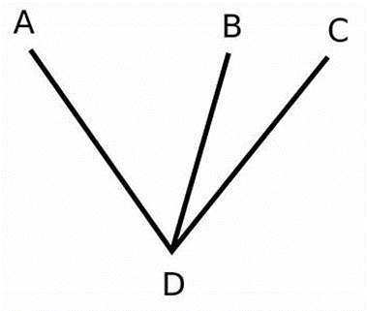
crazy
taste
basic
baby
haste
maple
7. inhaler
8. pastry
9. acorn
10. stable
11. vacant
12. chamber
13. plague
14. chaotic
15. stranger
16. adjacent

Slide 18
crazy
taste
basic
baby
haste
maple
7. inhaler
8. pastry
9. acorn
10. stable
11. vacant
12. chamber
13. plague
14. chaotic
15. stranger
16. adjacent
17. newspaper

Slide 19
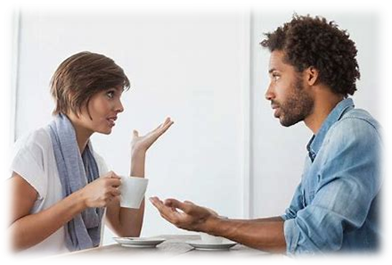
crazy
taste
basic
baby
haste
maple
7. inhaler
8. pastry
9. acorn
10. stable
11. vacant
12. chamber
13. plague
14. chaotic
15. stranger
16. adjacent
17. newspaper
18. conversation

Slide 20
Activity Page:
Contraction

Slide 21
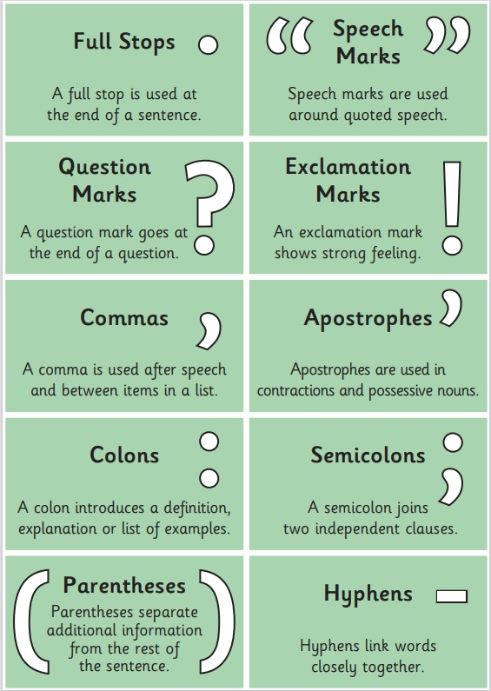

Slide 22
apostrophe

Slide 23
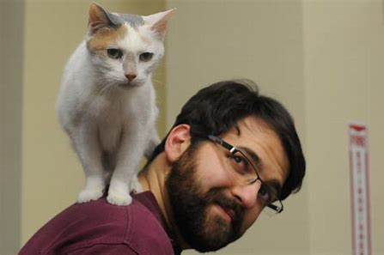
apostrophe
Danny’s cat

Slide 24
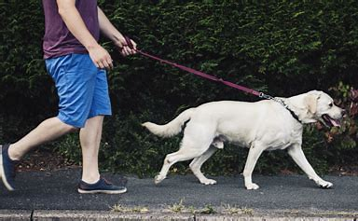
apostrophe
Danny’s cat
You will be walking the dog.

Slide 25
apostrophe
Danny’s cat
You will be walking the dog.
You’ll be walking the dog.

Slide 26
apostrophe
Danny’s cat
You will be walking the dog.
You’ll be walking the dog.
contraction

Slide 27
contractions
I shall
he will
it will
you will
you will
she will
we will
they will

Slide 28
contractions
I shall I’ll
he will
it will
you will
you will
she will
we will
they will

Slide 29
contractions
I shall I’ll
he will
it will
you will
you will you’ll
she will
we will
they will

Slide 30
contractions
I shall I’ll
he will he’ll
it will
you will
you will you’ll
she will
we will
they will

Slide 31
contractions
I shall I’ll
he will he’ll
it will
you will
you will you’ll
she will she’ll
we will
they will

Slide 32
contractions
I shall I’ll
he will he’ll
it will it’ll
you will
you will you’ll
she will she’ll
we will
they will

Slide 33
contractions
I shall I’ll
he will he’ll
it will it’ll
you will
you will you’ll
she will she’ll
we will we’ll
they will

Slide 34
contractions
I shall I’ll
he will he’ll
it will it’ll
you will you’ll
you will you’ll
she will she’ll
we will we’ll
they will

Slide 35
contractions
I shall I’ll
he will he’ll
it will it’ll
you will you’ll
you will you’ll
she will she’ll
we will we’ll
they will they’ll

Slide 36
She’ll be competing in the cross-country race.

Slide 37
She’ll be competing in the cross-country race.
She will be competing in the cross-country race.

Slide 38
They’ll be trying to climb the mountain this year.

Slide 39
They’ll be trying to climb the mountain this year.
They will be trying to climb the mountain this year.

Slide 40
You’ll be playing in the football team next week.

Slide 41
You’ll be playing in the football team next week.
You will be playing in the football team next week.

Slide 42
We shall be watching the fireworks tonight.

Slide 43
We shall be watching the fireworks tonight.
We’ll be watching the fireworks tonight.

Slide 44
He will be collecting his son from school later.

Slide 45
He will be collecting his son from school later.
He’ll be collecting his son from school later.

Slide 46
See you next time!

