Slide 1
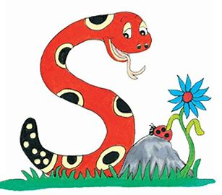
Jolly Grammar
4b-2

Slide 2
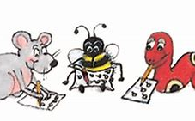
Spelling Test 19

Slide 3
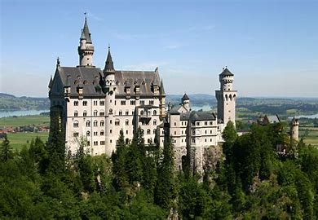
castle

Slide 4
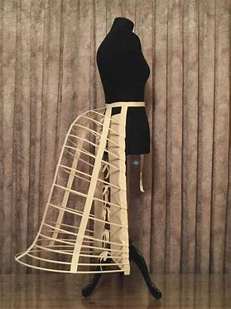
castle
bustle

Slide 5
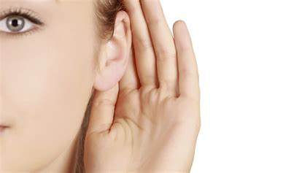
castle
bustle
listen

Slide 6
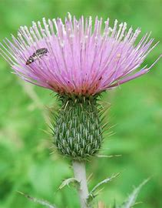
castle
bustle
listen
thistle

Slide 7
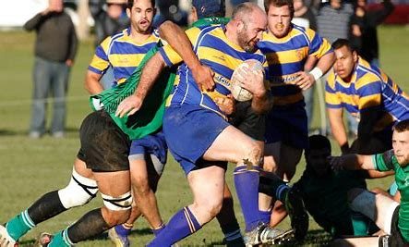
castle
bustle
listen
thistle
jostle

Slide 8
castle
bustle
listen
thistle
jostle
glisten

Slide 9
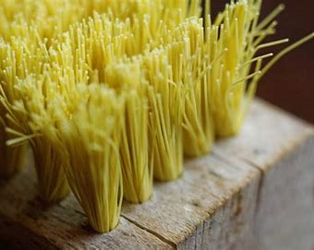
castle
bustle
listen
thistle
jostle
glisten
7.bristle

Slide 10
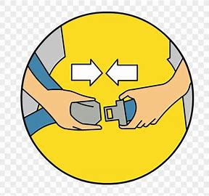
castle
bustle
listen
thistle
jostle
glisten
7.bristle
8.fasten

Slide 11
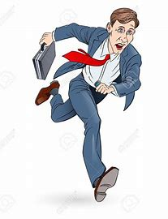
castle
bustle
listen
thistle
jostle
glisten
7.bristle
8.fasten
9.hasten

Slide 12
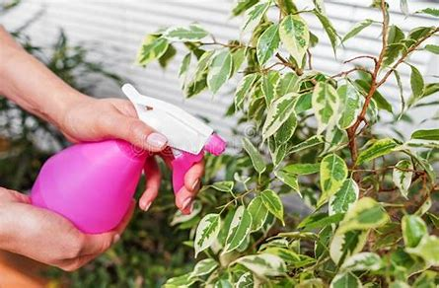
castle
bustle
listen
thistle
jostle
glisten
7.bristle
8.fasten
9.hasten
10.moisten

Slide 13
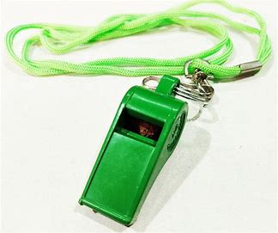
castle
bustle
listen
thistle
jostle
glisten
7.bristle
8.fasten
9.hasten
10.moisten
11.whistle

Slide 14
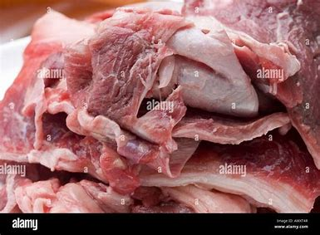
castle
bustle
listen
thistle
jostle
glisten
7.bristle
8.fasten
9.hasten
10.moisten
11.whistle
12.gristle

Slide 15
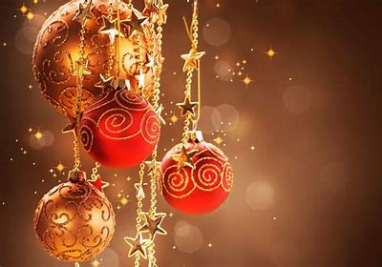
castle
bustle
listen
thistle
jostle
glisten
7.bristle
8.fasten
9.hasten
10.moisten
11.whistle
12.gristle
13.Christmas

Slide 16
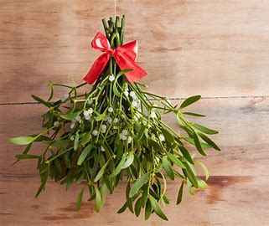
castle
bustle
listen
thistle
jostle
glisten
7.bristle
8.fasten
9.hasten
10.moisten
11.whistle
12.gristle
13.Christmas
14.mistletoe

Slide 17
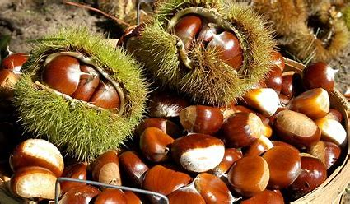
castle
bustle
listen
thistle
jostle
glisten
7.bristle
8.fasten
9.hasten
10.moisten
11.whistle
12.gristle
13.Christmas
14.mistletoe
15.chestnut

Slide 18
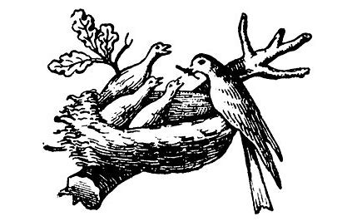
castle
bustle
listen
thistle
jostle
glisten
7.bristle
8.fasten
9.hasten
10.moisten
11.whistle
12.gristle
13.Christmas
14.mistletoe
15.chestnut
16.nestle

Slide 19
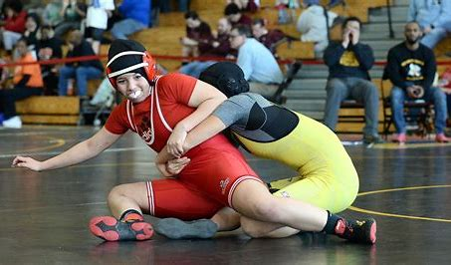
castle
bustle
listen
thistle
jostle
glisten
7.bristle
8.fasten
9.hasten
10.moisten
11.whistle
12.gristle
13.Christmas
14.mistletoe
15.chestnut
16.nestle
17.wrestle

Slide 20
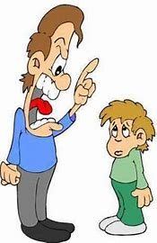
castle
bustle
listen
thistle
jostle
glisten
7.bristle
8.fasten
9.hasten
10.moisten
11.whistle
12.gristle
13.Christmas
14.mistletoe
15.chestnut
16.nestle
17.wrestle
18.chasten

Slide 21
Let’s Revise Suffixes

Slide 22
Plurals
hens benches ladies
Comparatives and Superlatives
brighter brightest
Past tense
I wished
Present participle
wishing

Slide 23
To adjective
cloud → cloudy
loud → loudly
harm → harmful, harmless
break → breakable
Related to …
athlete → athletic
poet → poetic

Slide 24
music

Slide 25
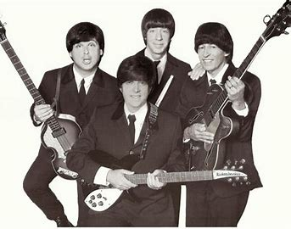
music
musical band

Slide 26
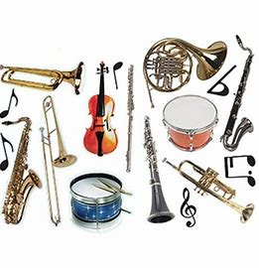
music
musical band
musical instrument

Slide 27
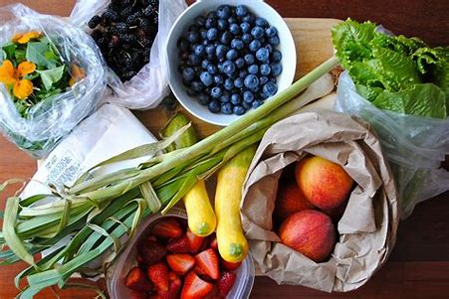
music
musical band
musical instrument
natural food

Slide 28
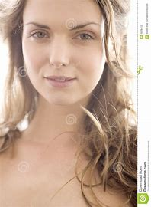
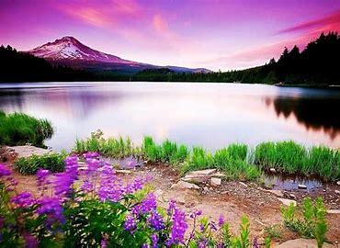
music
musical band
musical instrument
natural food
natural beauty

Slide 29
music
musical band
musical instrument
nature
natural food
natural beauty

Slide 30
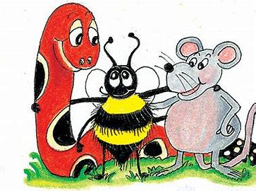
Suffix <-al> Making Noun into Adjectives

Slide 31
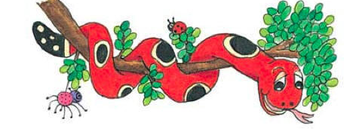
Activity Page:
<-al> for adjectives

Slide 32
Suffix <-al> Making Noun into Adjectives
Adjectives
floral
accidental
logical
intentional
critical
coastal

Slide 33
Suffix <-al> Making Noun into Adjectives
Adjectives
floral
accidental
logical
intentional
critical
coastal
Nouns

Slide 34
Suffix <-al> Making Noun into Adjectives
Adjectives
floral
accidental
logical
intentional
critical
coastal
Nouns
flower

Slide 35
Suffix <-al> Making Noun into Adjectives
Adjectives
floral
accidental
logical
intentional
critical
coastal
Nouns
flower
accident

Slide 36
Suffix <-al> Making Noun into Adjectives
Adjectives
floral
accidental
logical
intentional
critical
coastal
Nouns
flower
accident
logic

Slide 37
Suffix <-al> Making Noun into Adjectives
Adjectives
floral
accidental
logical
intentional
critical
coastal
Nouns
flower
accident
logic
intention

Slide 38
Suffix <-al> Making Noun into Adjectives
Adjectives
floral
accidental
logical
intentional
critical
coastal
Nouns
flower
accident
logic
intention
critic

Slide 39
Suffix <-al> Making Noun into Adjectives
Adjectives
floral
accidental
logical
intentional
critical
coastal
Nouns
flower
accident
logic
intention
critic
coast

Slide 40
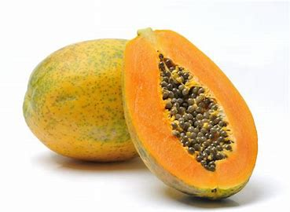
The papaya is a fruit.

Slide 41
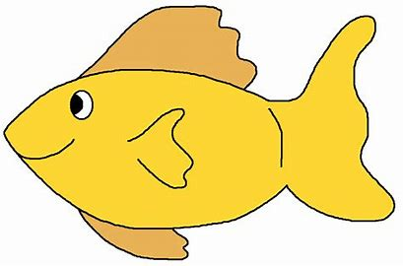
The papaya is a fruit.
tropic

Slide 42
The papaya is a tropical fruit.
tropic

Slide 43
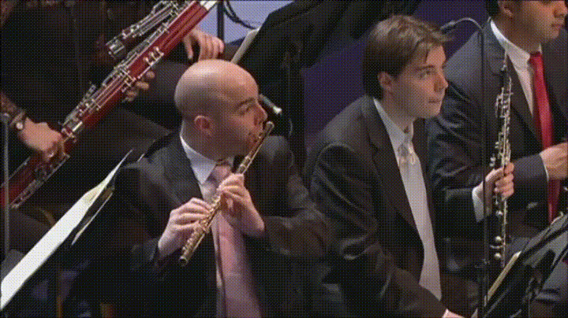
The flute is an orchestral instrument.

Slide 44
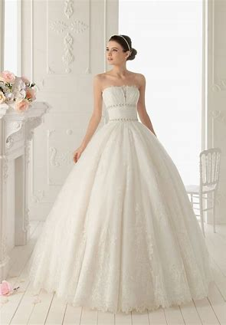
A bridal gown is another name for a wedding dress.

Slide 45
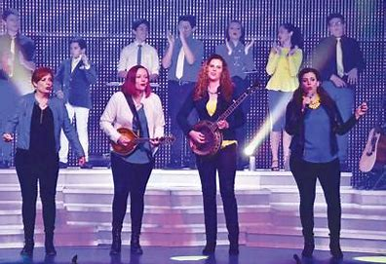
There are several singers in Mary’s musical family.

Slide 46
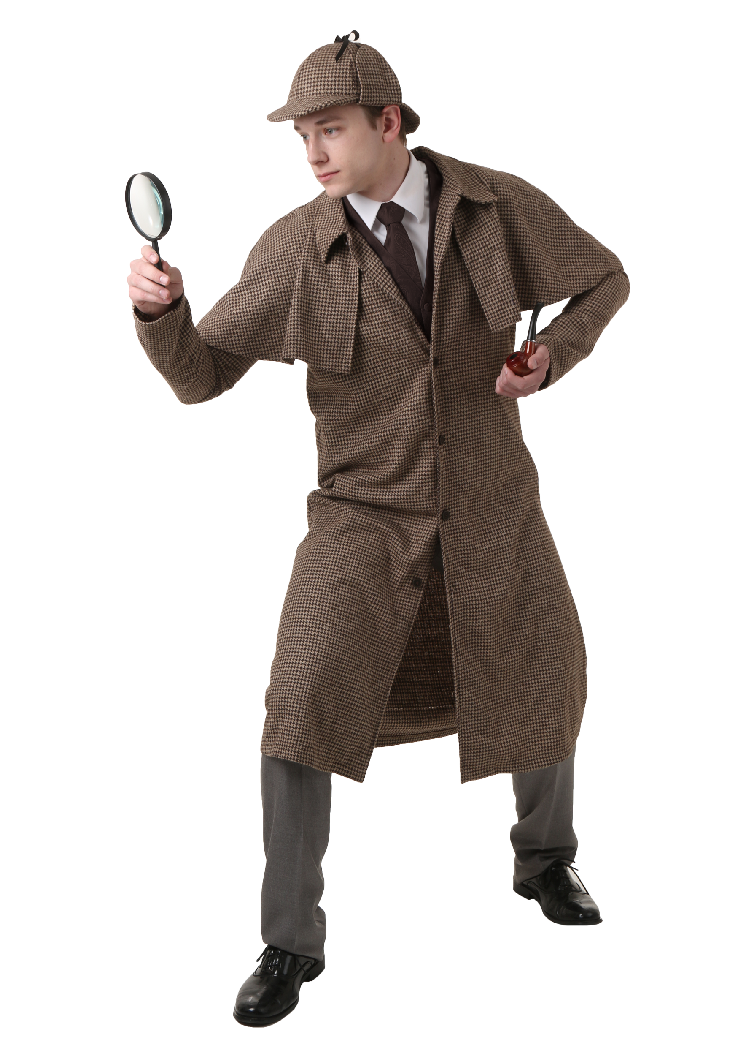
Sherlock Holmes is famous magical detective.

Slide 47
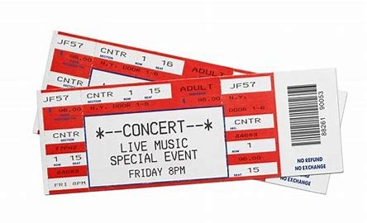
I asked for an additional ticket to the concert.

Slide 48
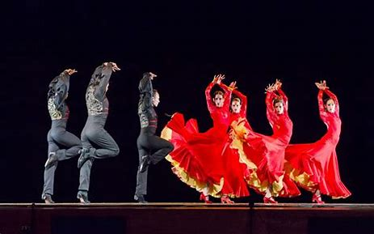
The dancers wore traditional Spanish costume.

Slide 49
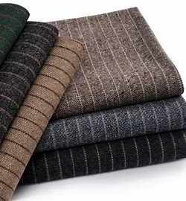
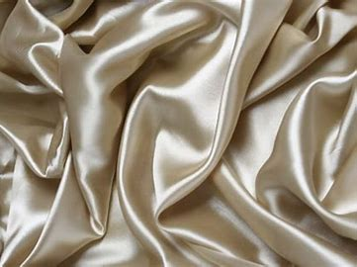
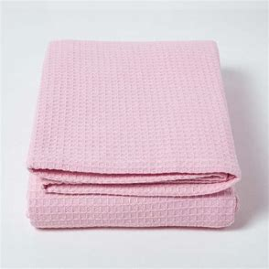
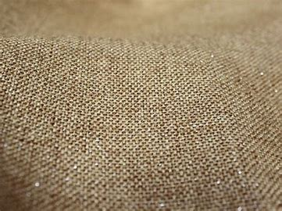
Wool, cotton, silk and linen are all natural materials.

Slide 50
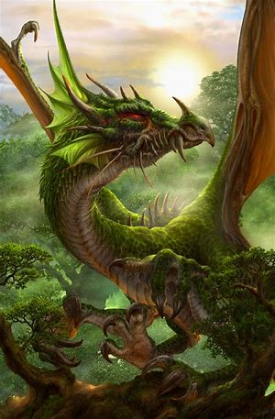
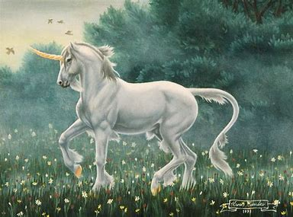
He told a tale of dragons, unicorns and other fictional creatures.

Slide 51
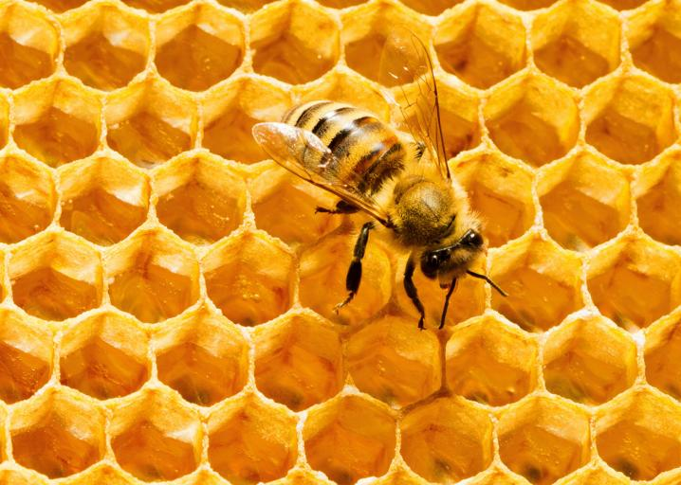
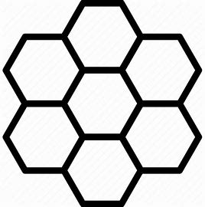
Honeycombs have hexagonal cells where bees store their honey.

Slide 52
Adjectives
alphabetical

Slide 53
Adjectives
alphabetical
Nouns (root words)
alphabet

Slide 54
Adjectives
alphabetical
rhythmical
Nouns (root words)
alphabet

Slide 55
Adjectives
alphabetical
rhythmical
Nouns (root words)
alphabet
rhythm

Slide 56
Adjectives
alphabetical
rhythmical
mythical
Nouns (root words)
alphabet
rhythm

Slide 57
Adjectives
alphabetical
rhythmical
mythical
Nouns (root words)
alphabet
rhythm
myth

Slide 58
Thank you.
See you
next time!

