Slide 1
Jolly Grammar
6a-1

Slide 2
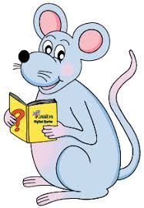
Let’s revise
Homophones.

Slide 3
its
it’s

Slide 4
its
Possessive adjective
that describes nouns by saying who it belongs to
it’s

Slide 5
its
Possessive adjective
that describes nouns by saying who it belongs to
it’s
A contraction of either
it is or it has

Slide 6
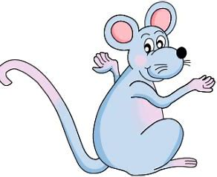
its
Possessive adjective
that describes nouns by saying who it belongs to
it’s
A contraction of either
it is or it has
cold so the dog will need coat.

Slide 7
its
Possessive adjective
that describes nouns by saying who it belongs to
it’s
A contraction of either
it is or it has
It’s cold so the dog will need coat.

Slide 8
its
Possessive adjective
that describes nouns by saying who it belongs to
it’s
A contraction of either
it is or it has
It’s cold so the dog will need its coat.

Slide 9
Homophones

Slide 10
Spelling Point

Slide 11
unicycle
monocle

Slide 12
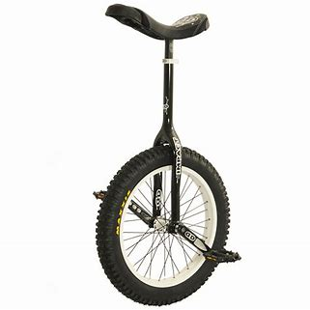
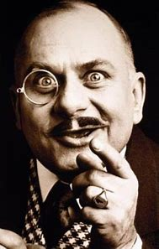
unicycle
monocle

Slide 13
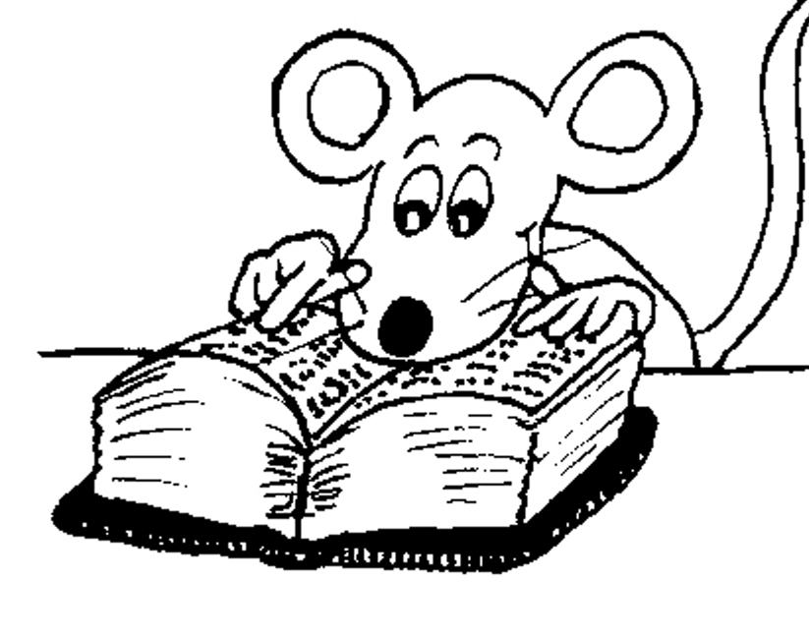
Spelling List
<uni-><mono->

Slide 14
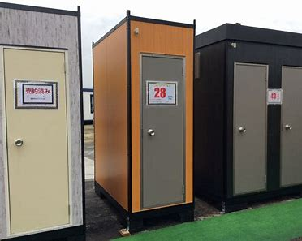
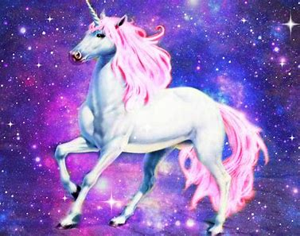
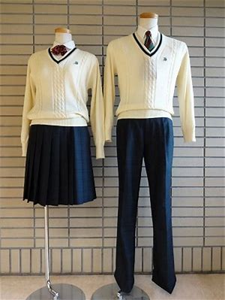
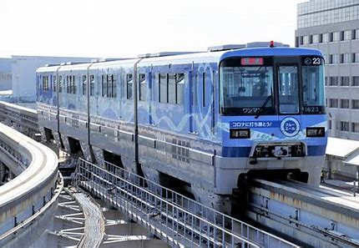
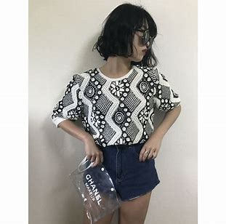
unit unicorn uniform
monogram monorail monotone

Slide 15
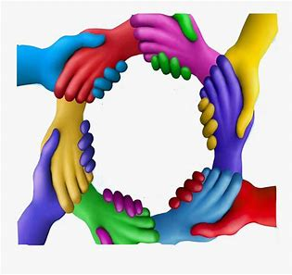
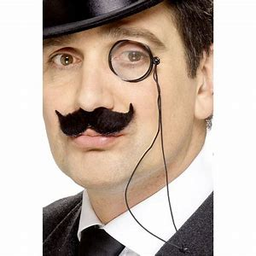
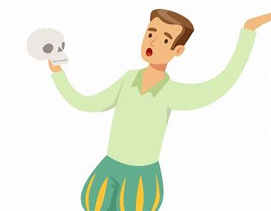
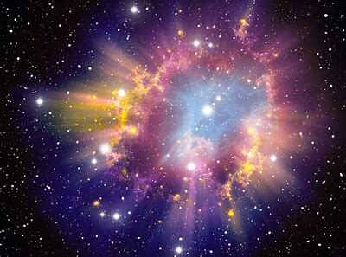
unify unicycle union
universe monocle monologue

Slide 16
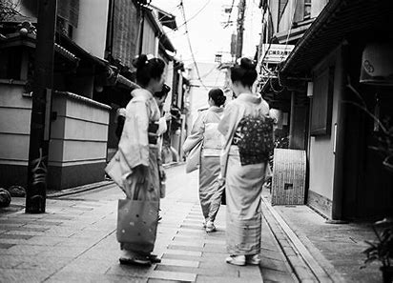
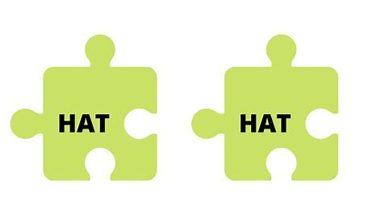
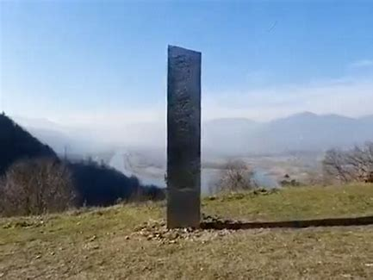
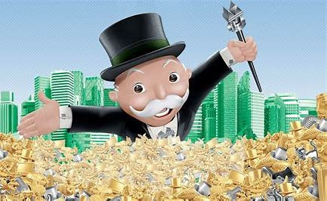
monosyllable universal monochrome
monolith unification monopoly

Slide 17
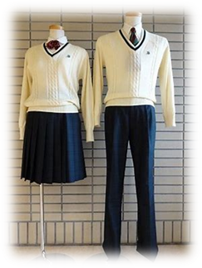
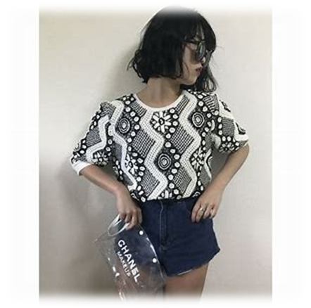
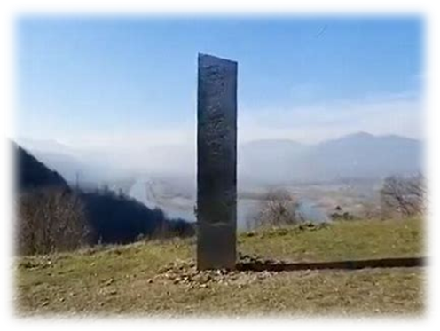
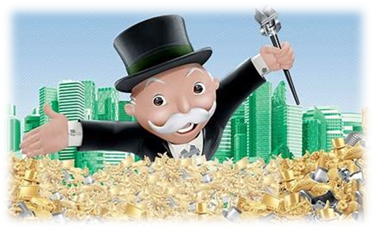
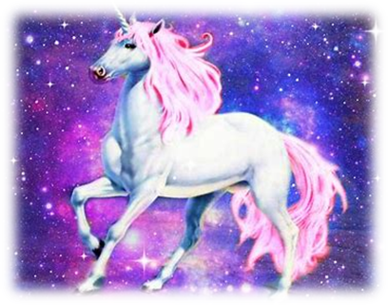
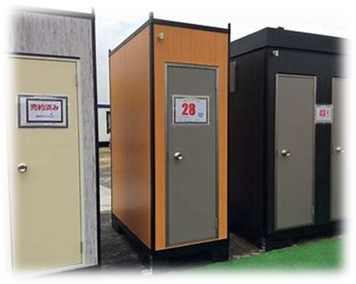
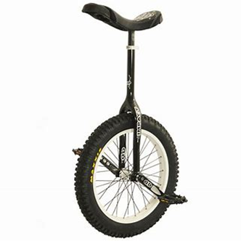
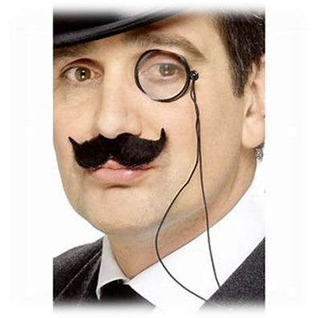
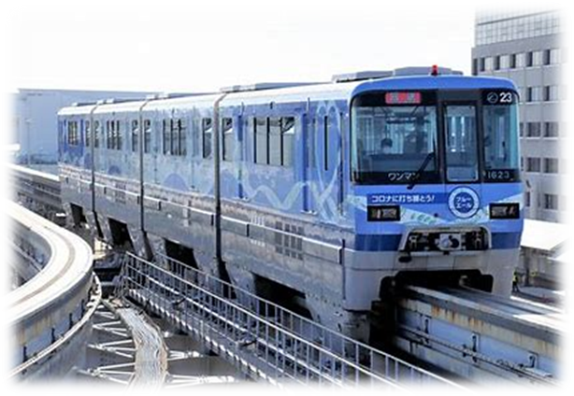
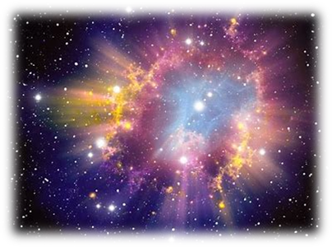
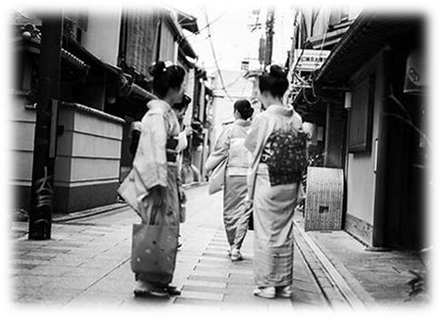

Slide 18
Activity Page
Spelling:
Numerical Prefixes for 1

Slide 19
‘Its’ and ’it’s’ are homophones. They are words that sound the same but have different spellings and meanings. Which one should be used to complete each sentence correctly?
(Page 3)

Slide 20
The museum is proud of its collection of unicycle.
The school has changed its uniform from blue to green.
You should go by monorail. It’s the quickest way to the
airport.
The union has asked its members to go on strike next week.
It’s a gloomy picture because of its monochrome design.
“Yes, it’s a huge monolith,” the teacher told the class.
This is Dad’s handkerchief. It’s got his monogram in
the corner.
“It’s a story about a dragon and a unicorn,” said the boy.

Slide 21
Parsing ＆
Sentence Wall

Slide 22
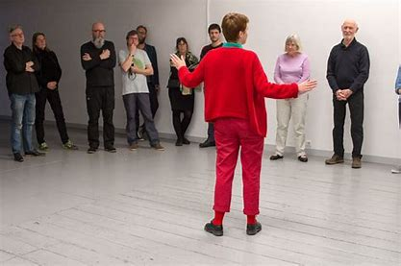
The actor performed the monologue perfectly.

Slide 23
The actor performed the monologue perfectly.

Slide 24
The actor performed the monologue perfectly.

Slide 25
The actor performed the monologue perfectly.

Slide 26
The actor performed the monologue perfectly.

Slide 27
The actor performed the monologue perfectly.
Subject
actor
The
Verb
performed
perfectly
Object
monologue
the
(transitive)

Slide 28
Dictation

Slide 29
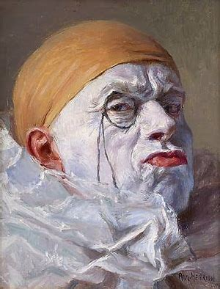

Slide 30
The man in the painting was wearing a monocle.

Slide 32
How many stars are in the universe?

Slide 33
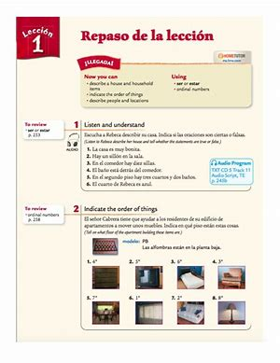
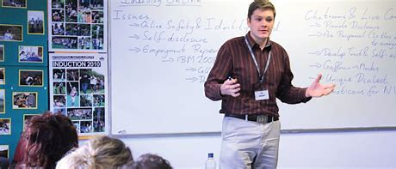

Slide 34
“Turn to the first unit in our textbook,” said the teacher.

Slide 35
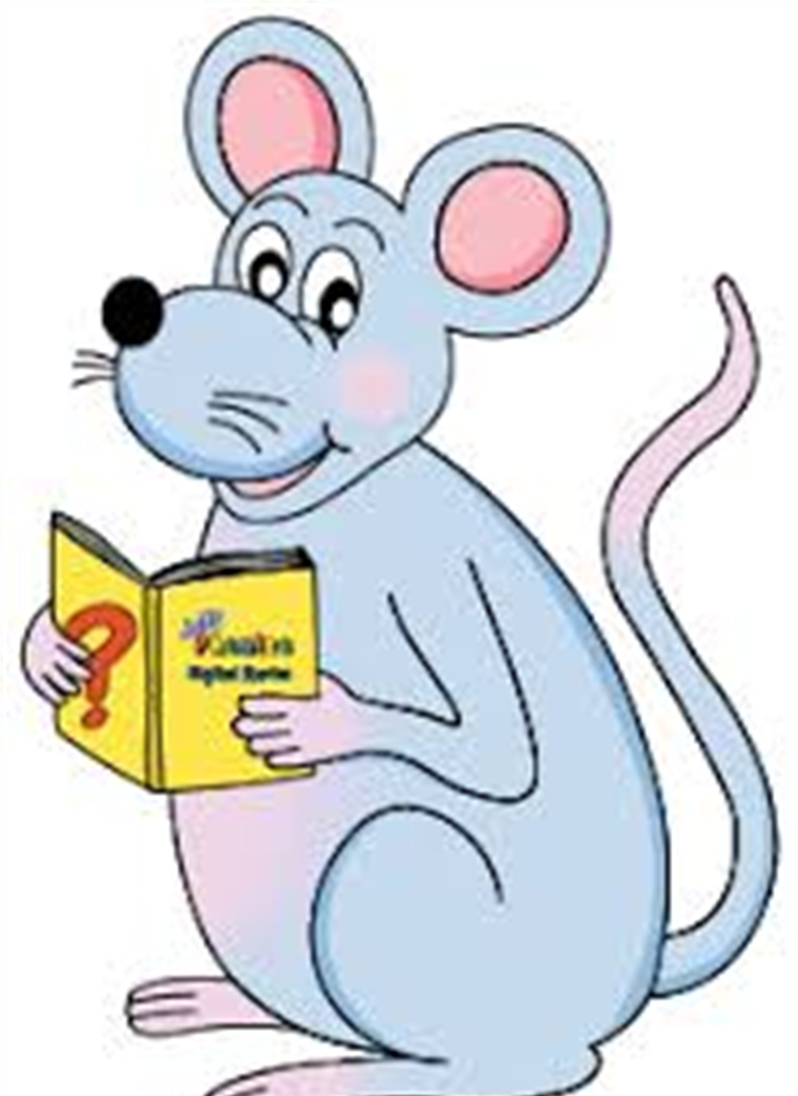
Assignment
Learn Words in the List
Complete Sentence Wall

Slide 36
See you
next time!

