Slide 1
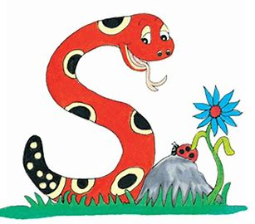
Jolly Grammar
4a-36

Slide 2
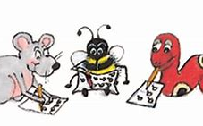
Spelling Test 18

Slide 3
epic

Slide 4
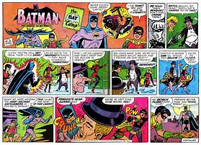
epic
comic

Slide 5
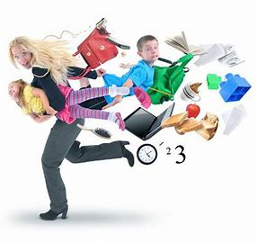
epic
comic
hectic

Slide 6
epic
comic
hectic
toxic

Slide 7
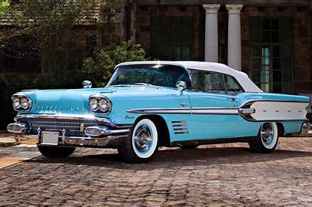
epic
comic
hectic
toxic
classic

Slide 8
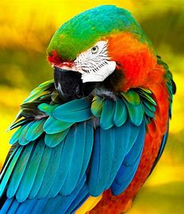
epic
comic
hectic
toxic
classic
exotic

Slide 9
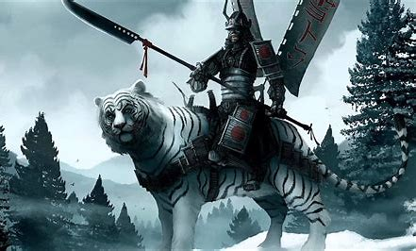
epic
comic
hectic
toxic
classic
exotic
7.heroic

Slide 10
epic
comic
hectic
toxic
classic
exotic
7.heroic
8.poetic

Slide 11
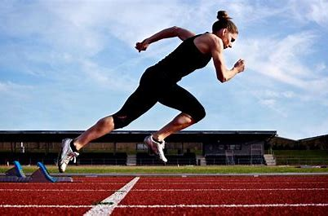
epic
comic
hectic
toxic
classic
exotic
7.heroic
8.poetic
9.athletic

Slide 12
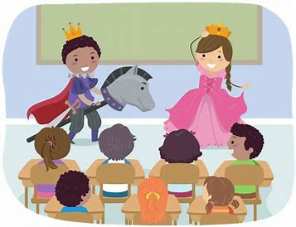
epic
comic
hectic
toxic
classic
exotic
7.heroic
8.poetic
9.athletic
10.dramatic

Slide 13
epic
comic
hectic
toxic
classic
exotic
7.heroic
8.poetic
9.athletic
10.dramatic
11.fantastic

Slide 14
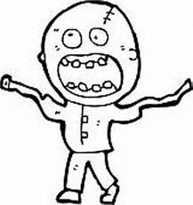
epic
comic
hectic
toxic
classic
exotic
7.heroic
8.poetic
9.athletic
10.dramatic
11.fantastic
12.lunatic

Slide 15
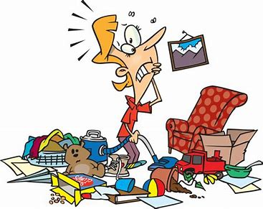
epic
comic
hectic
toxic
classic
exotic
7.heroic
8.poetic
9.athletic
10.dramatic
11.fantastic
12.lunatic
13.chaotic

Slide 16
epic
comic
hectic
toxic
classic
exotic
7.heroic
8.poetic
9.athletic
10.dramatic
11.fantastic
12.lunatic
13.chaotic
14.rhythmic

Slide 17
epic
comic
hectic
toxic
classic
exotic
7.heroic
8.poetic
9.athletic
10.dramatic
11.fantastic
12.lunatic
13.chaotic
14.rhythmic
15.scientific

Slide 18
epic
comic
hectic
toxic
classic
exotic
7.heroic
8.poetic
9.athletic
10.dramatic
11.fantastic
12.lunatic
13.chaotic
14.rhythmic
15.scientific
16.synmpathetic

Slide 19
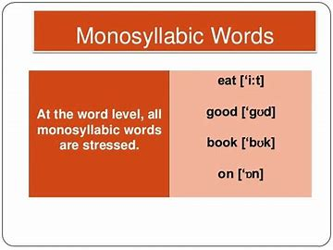
epic
comic
hectic
toxic
classic
exotic
7.heroic
8.poetic
9.athletic
10.dramatic
11.fantastic
12.lunatic
13.chaotic
14.rhythmic
15.scientific
16.synmpathetic
17.monosyllabic

Slide 20
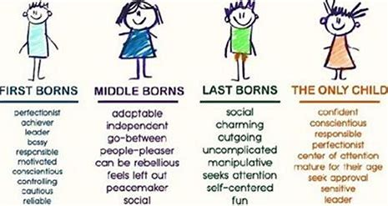
epic
comic
hectic
toxic
classic
exotic
7.heroic
8.poetic
9.athletic
10.dramatic
11.fantastic
12.lunatic
13.chaotic
14.rhythmic
15.scientific
16.synmpathetic
17.monosyllabic
18.characteristic

Slide 21
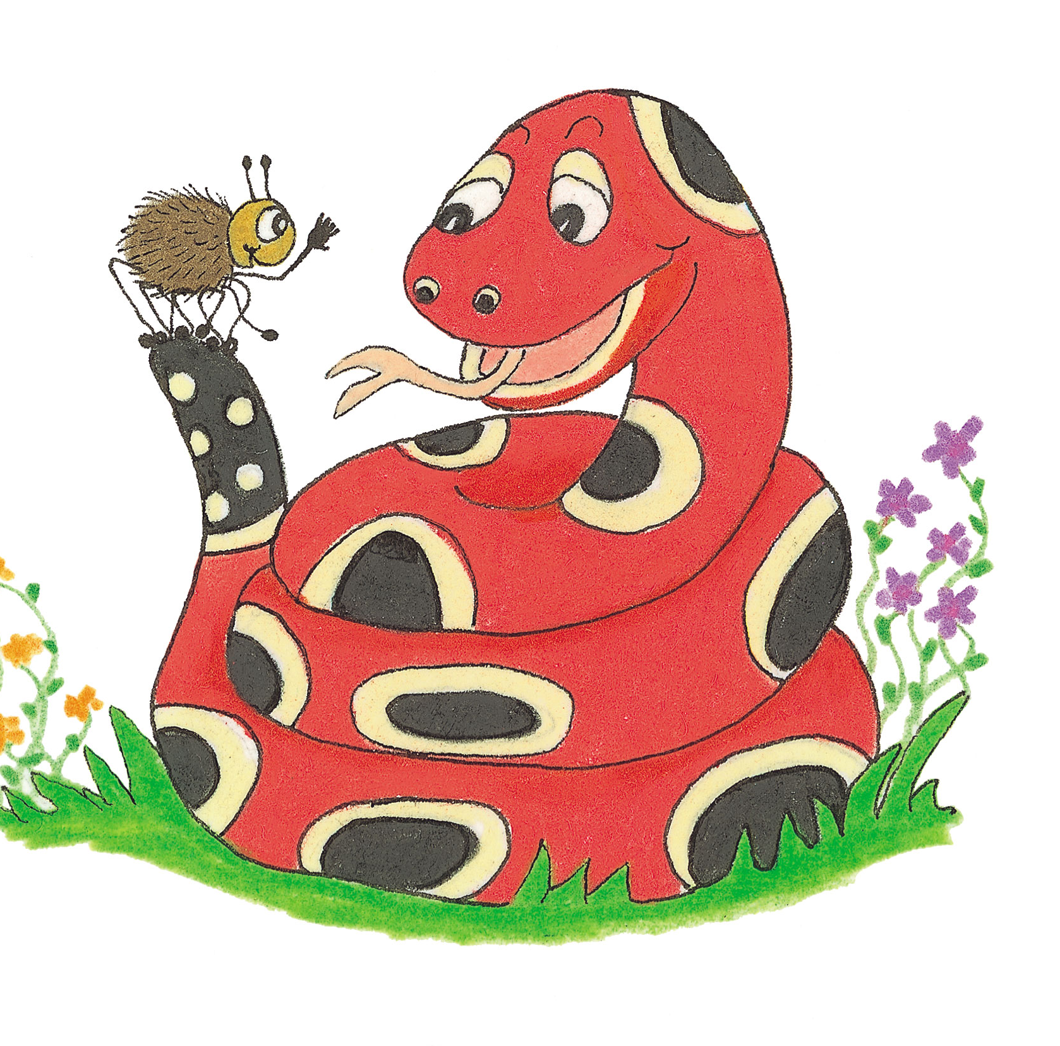
Let’s Revise Homophones

Slide 22
to ＝infinitive, preposition
She is going to sing.
I am going to the park.
two ＝２
He has two cars.
too ＝also
You are tall too.

Slide 23
your＝possessive adjective
I like your bag.
you’re＝ you are
You’re so lucky.

Slide 24
there＝adverb to show position
The house is over there.
their＝possessive adjective
I love their cookies.
they’re＝ they are
They’re my parents.

Slide 25
where＝question word
Where is your brother?
wear＝verb
I wear my favorite shoes everyday.
were＝ past tense of the verb to be
We were good friends in Japan.

Slide 26
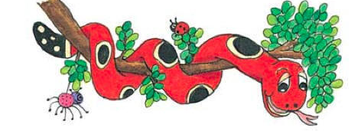
Activity Page:
Homophones(where, wear, were)

Slide 27
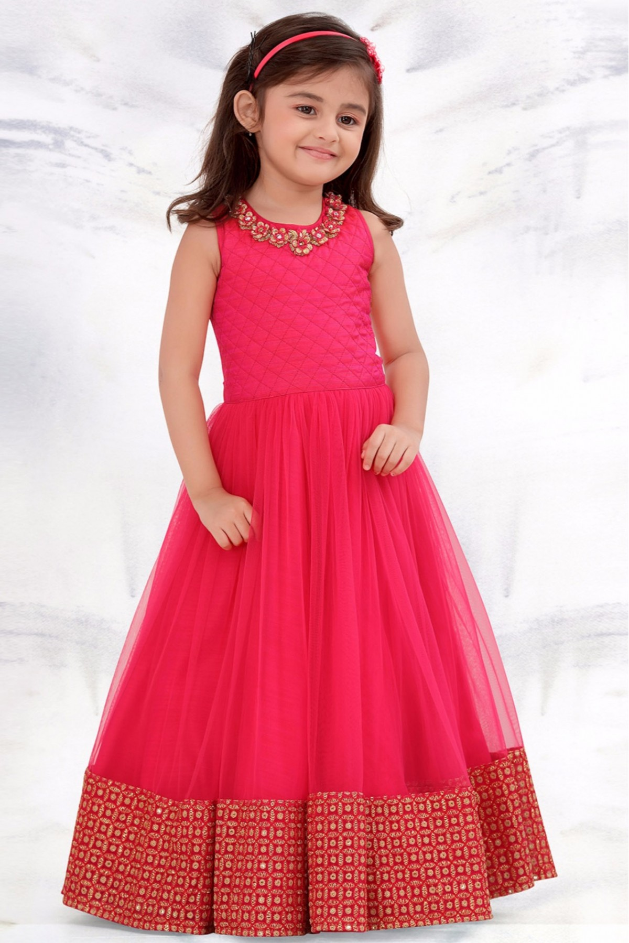
She did not know what to wear to the party.

Slide 28
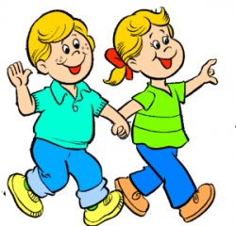
Where shall we go today?

Slide 29
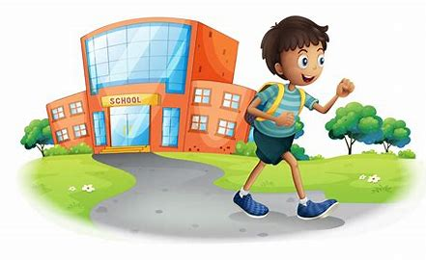
We were ready to go home.

Slide 30
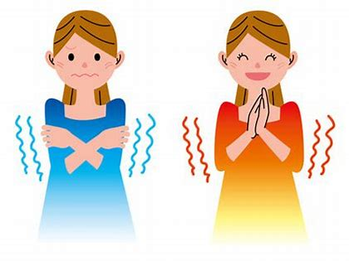
We were cold, but now
we are warm.
Now

Slide 31
The staff had to wear suits at the office.

Slide 32
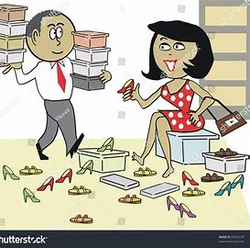
Where did you buy your new shoes?

Slide 33
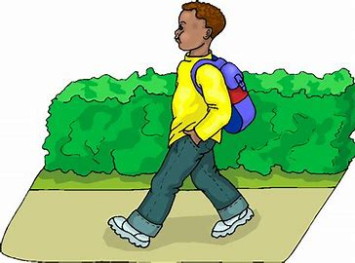
You said you were going out on Tuesday.

Slide 34
They were both fluent
in speaking Spanish.

Slide 35
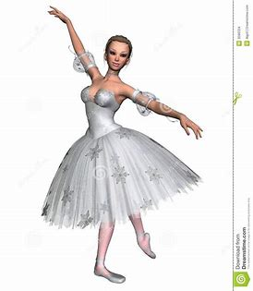
We will wear snowflake costumes in the play.

Slide 36
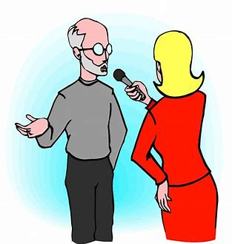
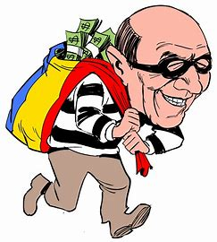
The reporter asked where the robbery happened.

Slide 37
Thank you.
See you
next time!

