Slide 1
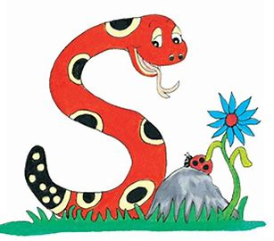
Jolly Grammar
4a-35

Slide 2
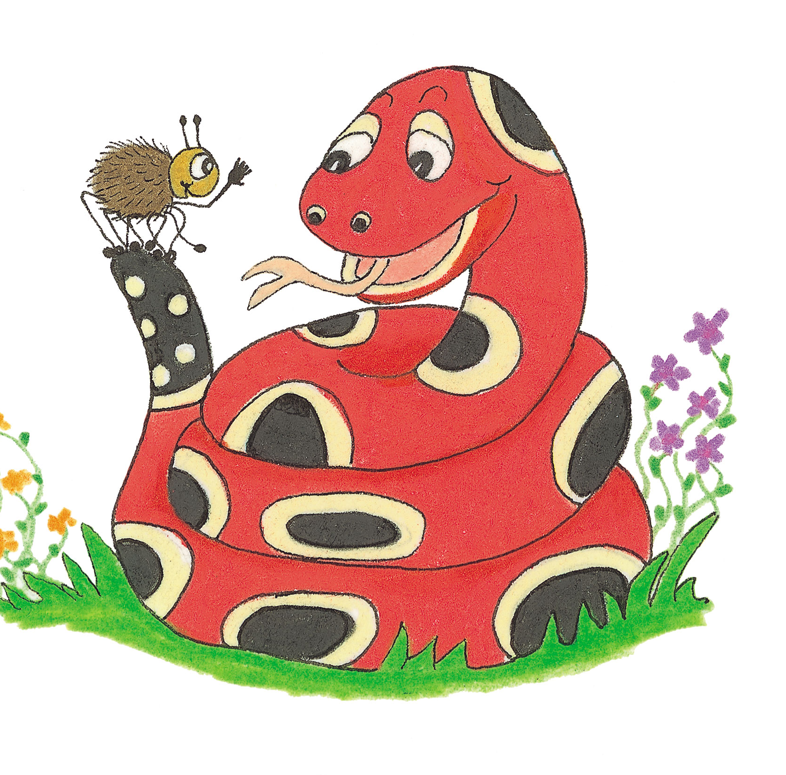
Let’s Revise Homophones

Slide 3
to ＝infinitive, preposition
She is going to sing.
I am going to the park.
two ＝２
He has two cars.
too ＝also
You are tall too.

Slide 4
your＝possessive adjective
I like your bag.
you’re＝ you are
You’re so lucky.

Slide 5
there＝adverb to show position
The house is over there.
their＝possessive adjective
I love their cookies.
they’re＝ they are
They’re my parents.

Slide 6
where＝question word
Where is your brother?
wear＝verb
I wear my favorite shoes everyday.
were＝ past tense of the verb to be
We were good friends in Japan.

Slide 7
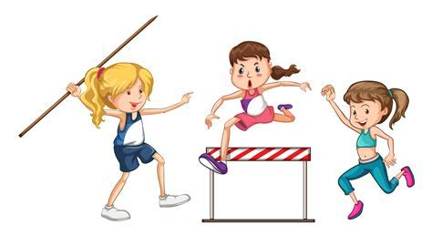
athletic
related to athletes

Slide 8
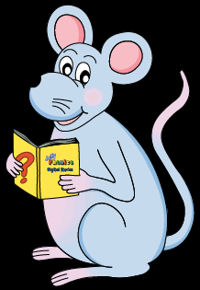
Activity Page
<-ic>

Slide 9
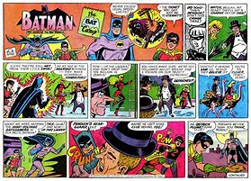
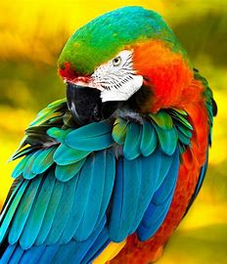
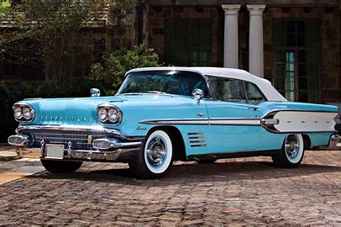
epic comic hectic
toxic classic exotic

Slide 10
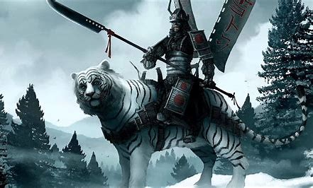
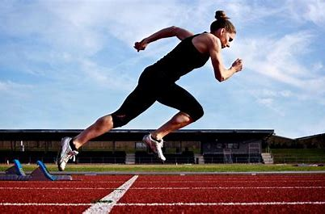
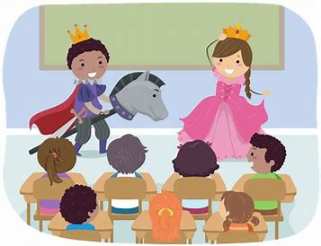
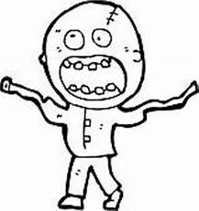
heroic poetic athletic
dramatic fantastic lunatic

Slide 11
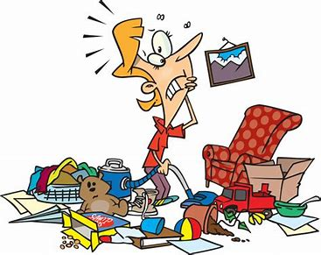
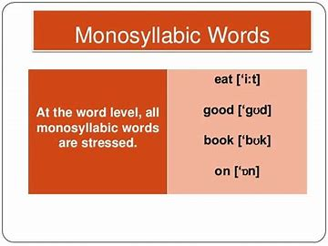
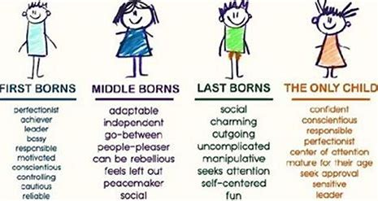
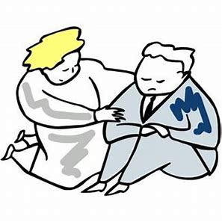
chaotic rhythmic scientific
sympathetic monosyllabic characteristic

Slide 14
parsing

Slide 15
An epic poem is a dramatic story about the heroic deeds.

Slide 16
An epic poem is a dramatic story about the heroic deeds.

Slide 17
An epic poem is a dramatic story about the heroic deeds.

Slide 18
An epic poem is a dramatic story about the heroic deeds.

Slide 19
An epic poem is a dramatic story about the heroic deeds.

Slide 20
An epic poem is a dramatic story about the heroic deeds.

Slide 21
An epic poem is a dramatic story about the heroic deeds.

Slide 22
An epic poem is a dramatic story about the heroic deeds.

Slide 23
An epic poem is a dramatic story about the heroic deeds.

Slide 24
An epic poem is a dramatic story about the heroic deeds.
Simple
Present

Slide 25
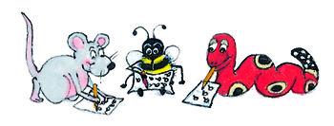
Dictation

Slide 26
Dictation
1.
2.
3.

Slide 27
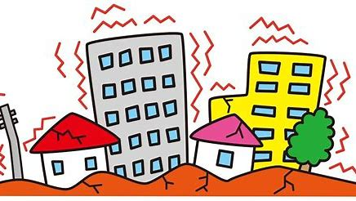

Slide 28
There has been a gigantic earthquake.

Slide 29
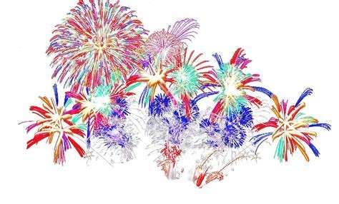

Slide 30
“The fireworks were fantastic!” exclaimed Sam.

Slide 32
Recent world events have been very dramatic.

Slide 33
Thank you.
See you
next time!

