Slide 1
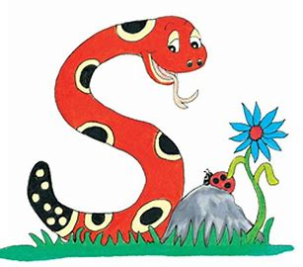
Jolly Grammar
4a-31

Slide 2
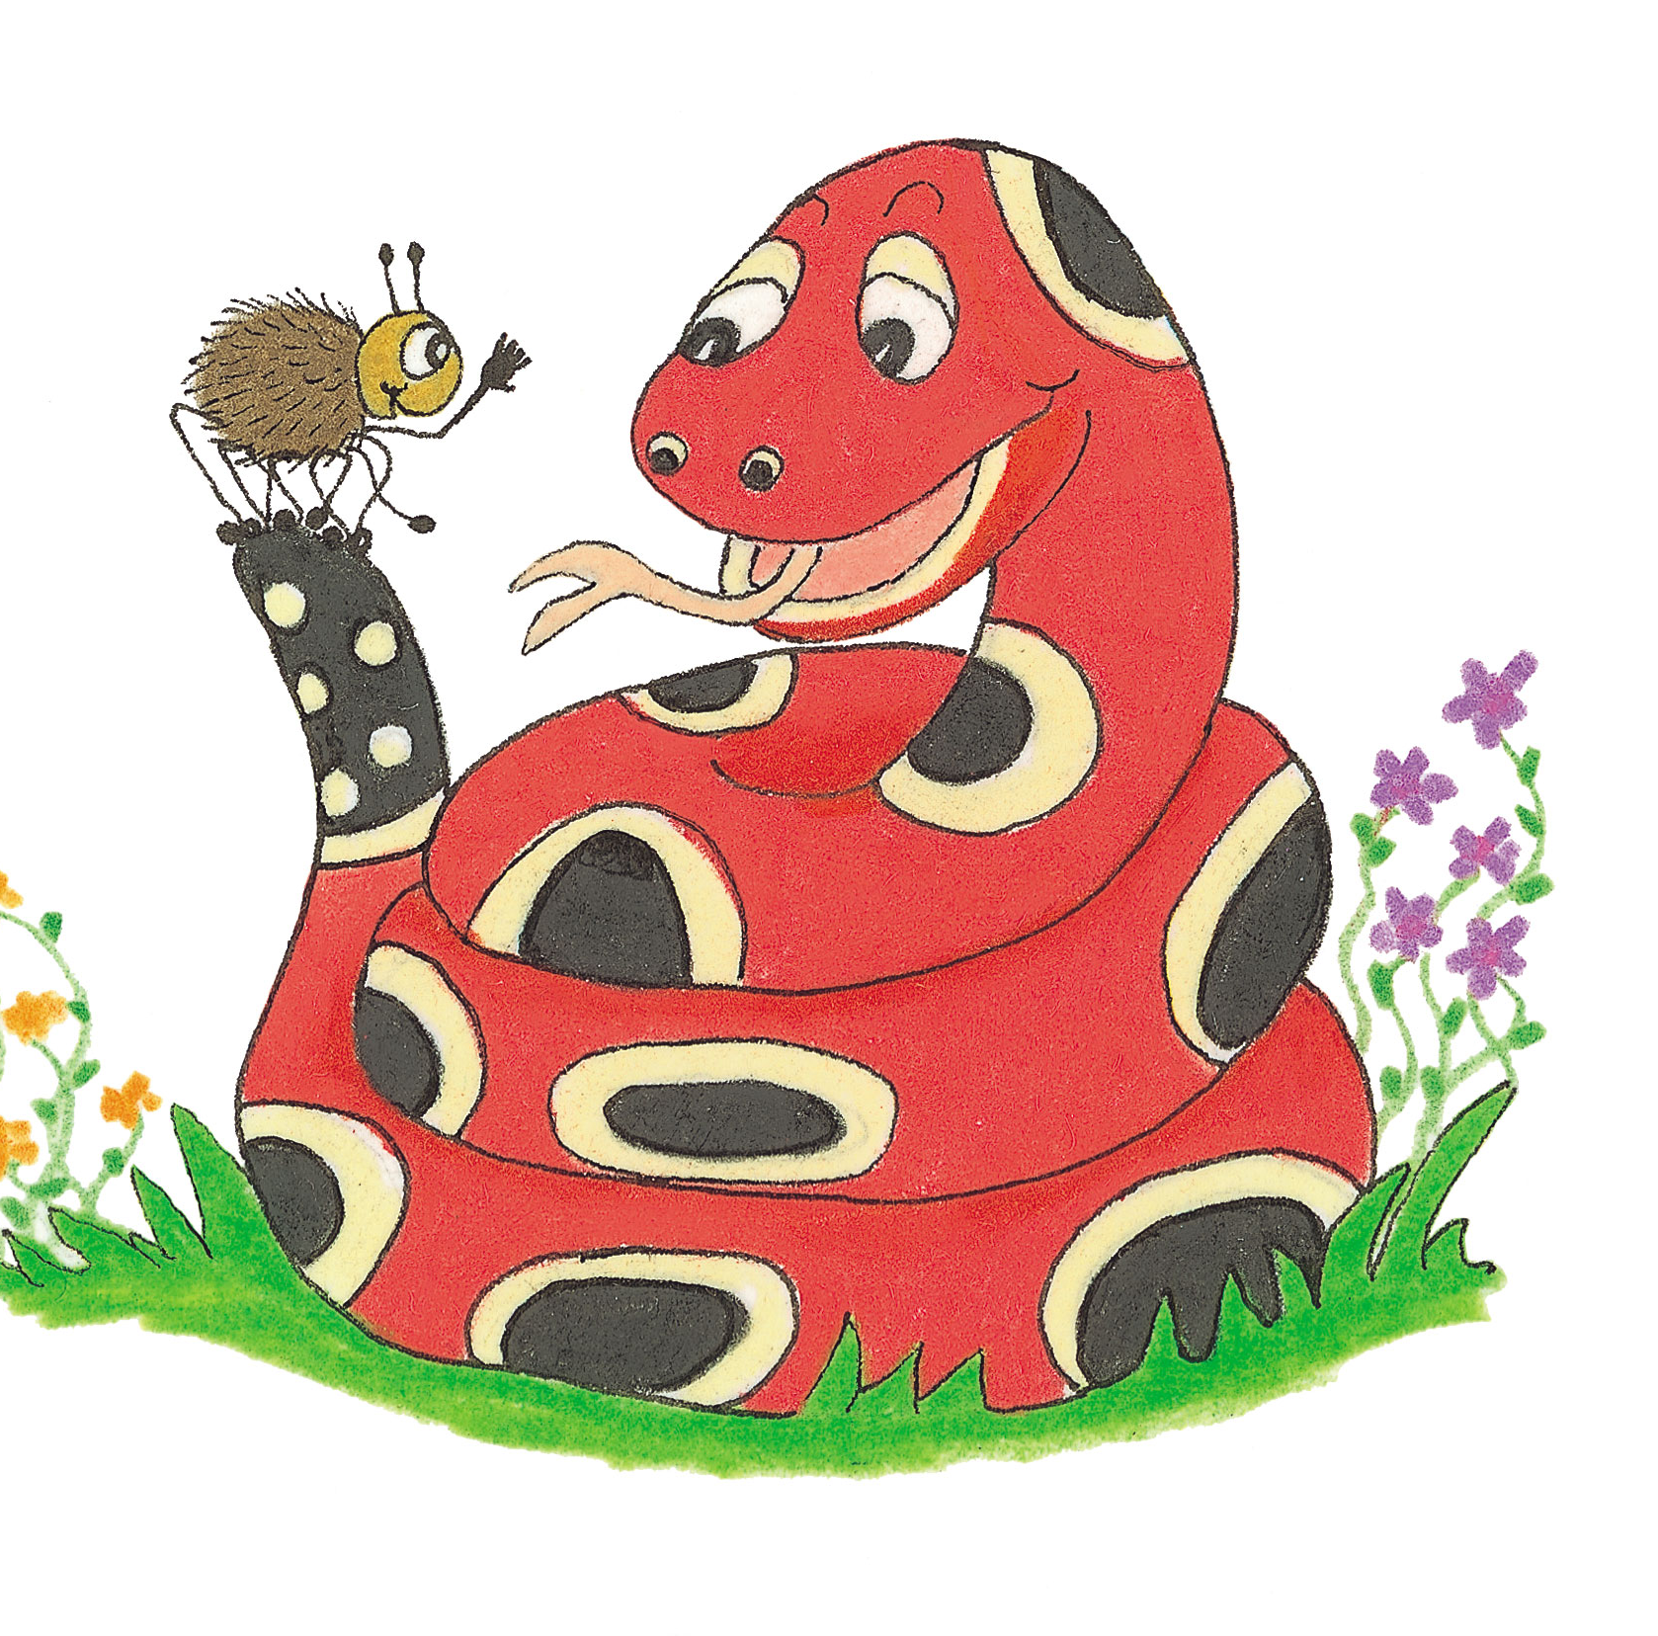
Let’s Revise schwa.

Slide 3
husband
handsome
medium
forward
error
whether

Slide 4
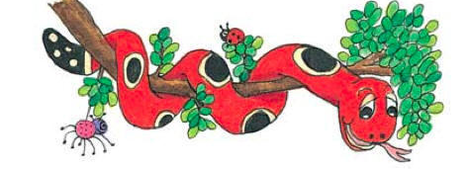
Let’s review <gh>

Slide 5
igh

Slide 6
igh
light
sight
bright

Slide 7
igh
light
sight
bright
gh
rough
tough
enough
cough
laugh

Slide 8
igh
light
sight
bright
/ie/
gh
rough
tough
enough
cough
laugh
/f/

Slide 9
igh
light
sight
bright
gh
rough
tough
enough
cough
laugh
brought (bring)
caught (catch)

Slide 10
igh
light
sight
bright
gh
rough
tough
enough
cough
laugh
bought (bring)
caught (catch)
fought (fight)
thought (think)
taught (teach)

Slide 11
igh
light
sight
bright
gh
rough
tough
enough
cough
laugh
bought (bring)
caught (catch)
fought (fight)
thought (think)
taught (teach)
ghost

Slide 12
thought
/or/
yoghurt
/g/
caught
/or/

Slide 13
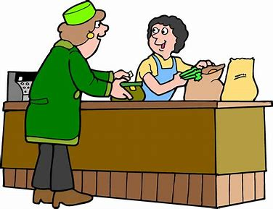
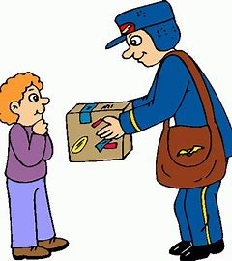
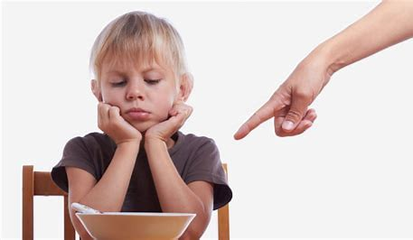
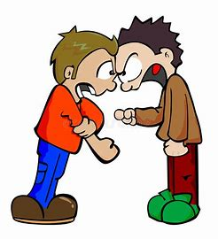
ought bought brought
fought nought thought

Slide 14
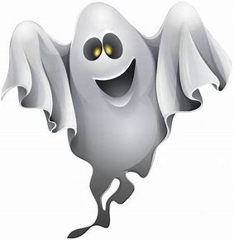
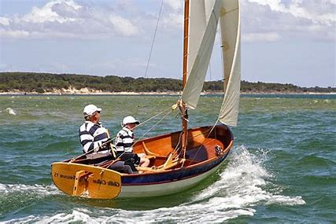
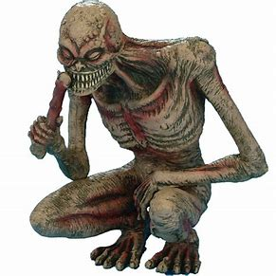
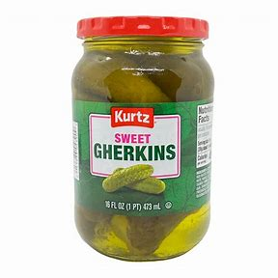
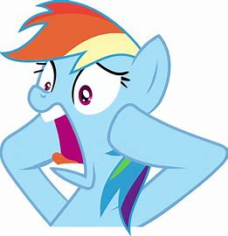
ghostly dinghy ghoul
aghast gherkin yoghurt

Slide 15
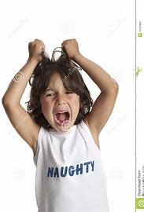
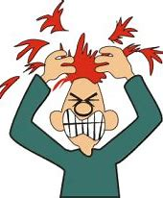
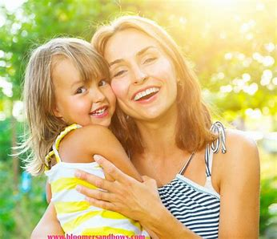
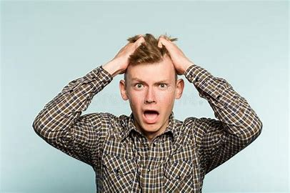
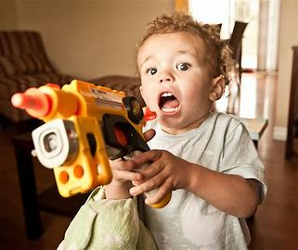
naughty fraught caught
daughter distraught onslaught

Slide 18
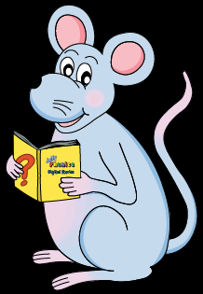
Activity Page
<ough><gh>
<augh>

Slide 19
“Have you brought the salad?” asked Meg.
The umpire exclaimed. “Well caught.”
I bought pickle, ketchup, mustard and
Some gherkins.

Slide 20
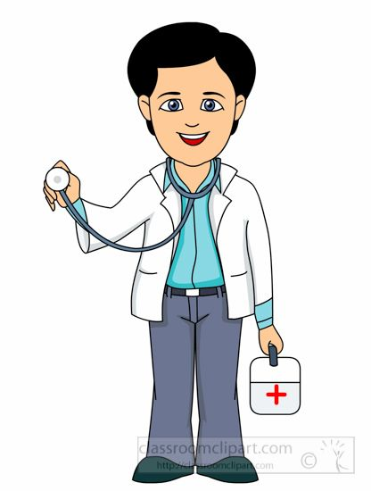
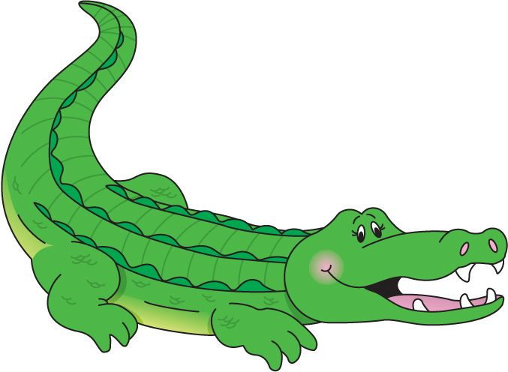
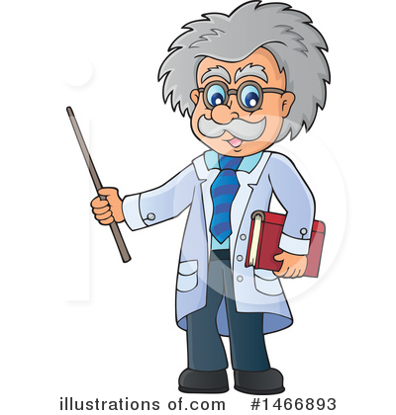
pirate
loaf
doctor
crocodile
researcher

Slide 21
The loaf’s crust was dark and crispy.
He looked aghast at the crocodile’s sharp, pointed teeth.
The doctor’s stethoscope could not be found.
The results of the researcher’s findings were unexpected.
Did they find any of the pirate’s treasure?

Slide 22
parsing

Slide 23
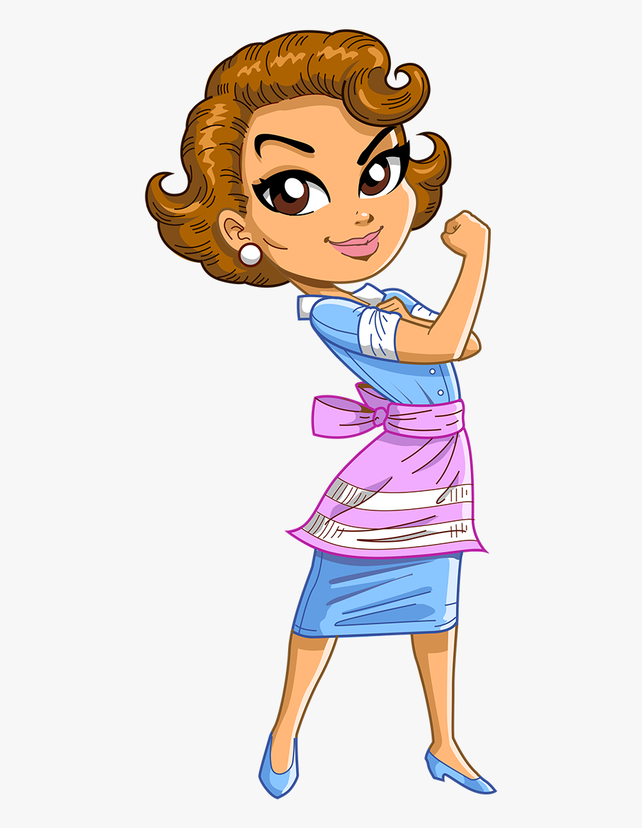
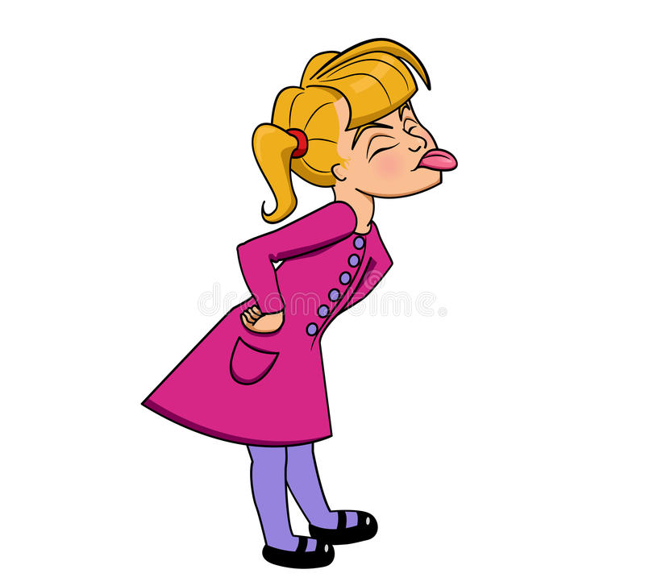
She quickly caught her naughty daughter.

Slide 24
She quickly caught her naughty daughter.

Slide 25
She quickly caught her naughty daughter.

Slide 26
She quickly caught her naughty daughter.

Slide 27
She quickly caught her naughty daughter.

Slide 28
She quickly caught her naughty daughter.

Slide 29
She quickly caught her naughty daughter.

Slide 30
She quickly caught her naughty daughter.
Simple
Past

Slide 31
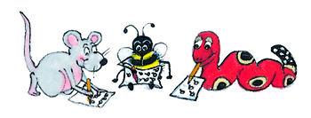
Dictation

Slide 32
Dictation
1.
2.
3.

Slide 33
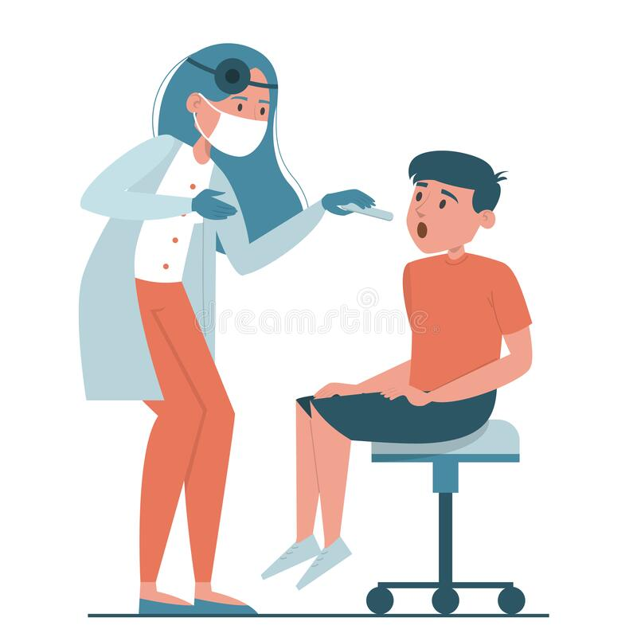

Slide 34
The doctor thought that the boy had flu.

Slide 35
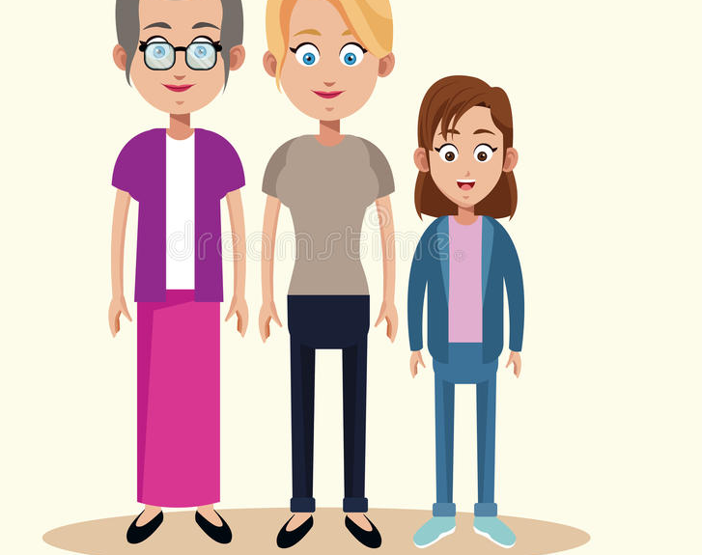

Slide 36
“That would be my daughter,” said Granny.

Slide 38
I think they ought to search in the earth.

Slide 39
Thank you.
See you
next time!

