Slide 1
Jolly Grammar
6b-36

Slide 2
Spelling Test 36

Slide 3
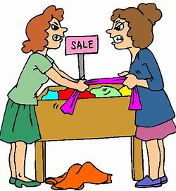
bargain

Slide 4
bargain
certain

Slide 5
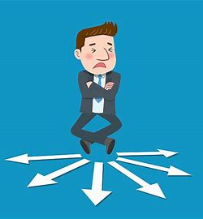
bargain
certain
perhaps

Slide 6
bargain
certain
perhaps
develop

Slide 7
bargain
certain
perhaps
develop
continue

Slide 8
bargain
certain
perhaps
develop
continue
remember

Slide 9
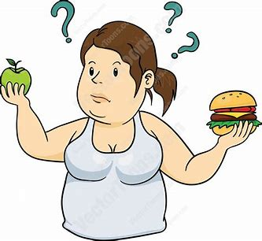
bargain
certain
perhaps
develop
continue
remember
7. decide

Slide 10
bargain
certain
perhaps
develop
continue
remember
7. decide
8. relevant

Slide 11
bargain
certain
perhaps
develop
continue
remember
7. decide
8. relevant
9. amateur

Slide 12
bargain
certain
perhaps
develop
continue
remember
7. decide
8. relevant
9. amateur
10. category

Slide 13
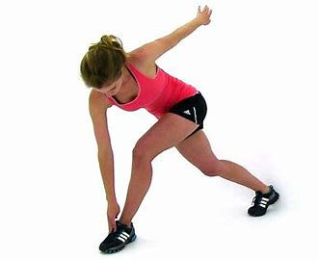
bargain
certain
perhaps
develop
continue
remember
7. decide
8. relevant
9. amateur
10. category
11. strengthen

Slide 14
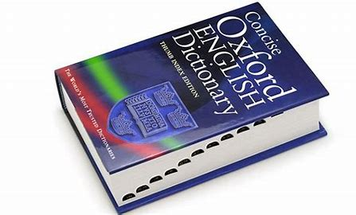
bargain
certain
perhaps
develop
continue
remember
7. decide
8. relevant
9. amateur
10. category
11. strengthen
12. dictionary

Slide 15
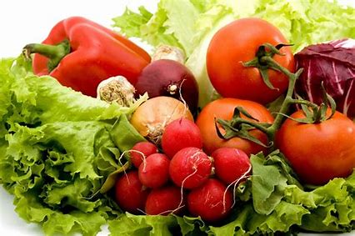
bargain
certain
perhaps
develop
continue
remember
7. decide
8. relevant
9. amateur
10. category
11. strengthen
12. dictionary
13. vegetable

Slide 16
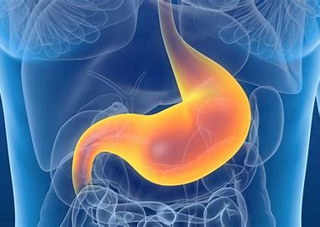
bargain
certain
perhaps
develop
continue
remember
7. decide
8. relevant
9. amateur
10. category
11. strengthen
12. dictionary
13. vegetable
14. stomach

Slide 17
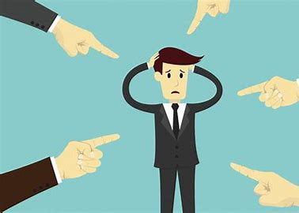
bargain
certain
perhaps
develop
continue
remember
7. decide
8. relevant
9. amateur
10. category
11. strengthen
12. dictionary
13. vegetable
14. stomach
15. criticise

Slide 18
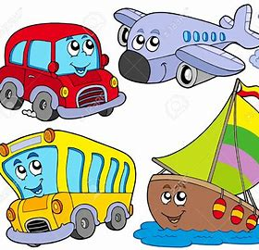
bargain
certain
perhaps
develop
continue
remember
7. decide
8. relevant
9. amateur
10. category
11. strengthen
12. dictionary
13. vegetable
14. stomach
15. criticise
16. vehicle

Slide 19
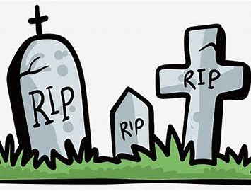
bargain
certain
perhaps
develop
continue
remember
7. decide
8. relevant
9. amateur
10. category
11. strengthen
12. dictionary
13. vegetable
14. stomach
15. criticise
16. vehicle
17. cemetery

Slide 20
bargain
certain
perhaps
develop
continue
remember
7. decide
8. relevant
9. amateur
10. category
11. strengthen
12. dictionary
13. vegetable
14. stomach
15. criticise
16. vehicle
17. cemetery
18. restaurant

Slide 21
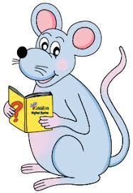
Let’s Review
Parts of Speech.

Slide 22
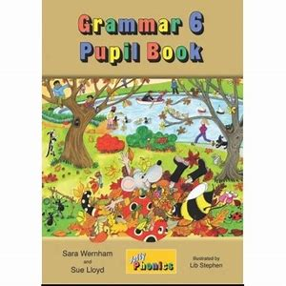
Antonyms and
Synonyms

Slide 23
Let’s Play Grammar Action Sentences!
1. article / adjective / common noun / verb / adverb
2. article / adjective / adjective / common noun / verb
3. pronouns / verb / preposition / article / common
nouns / verb

Slide 24
Let’s Play Grammar Action Sentences!
4. proper nouns / conjunction / proper noun / verb /
adverb
5. article / common noun / verb / adverb / conjunction
/ adverb
6. proper noun / verb / preposition / article / adjective
/ common noun

Slide 25
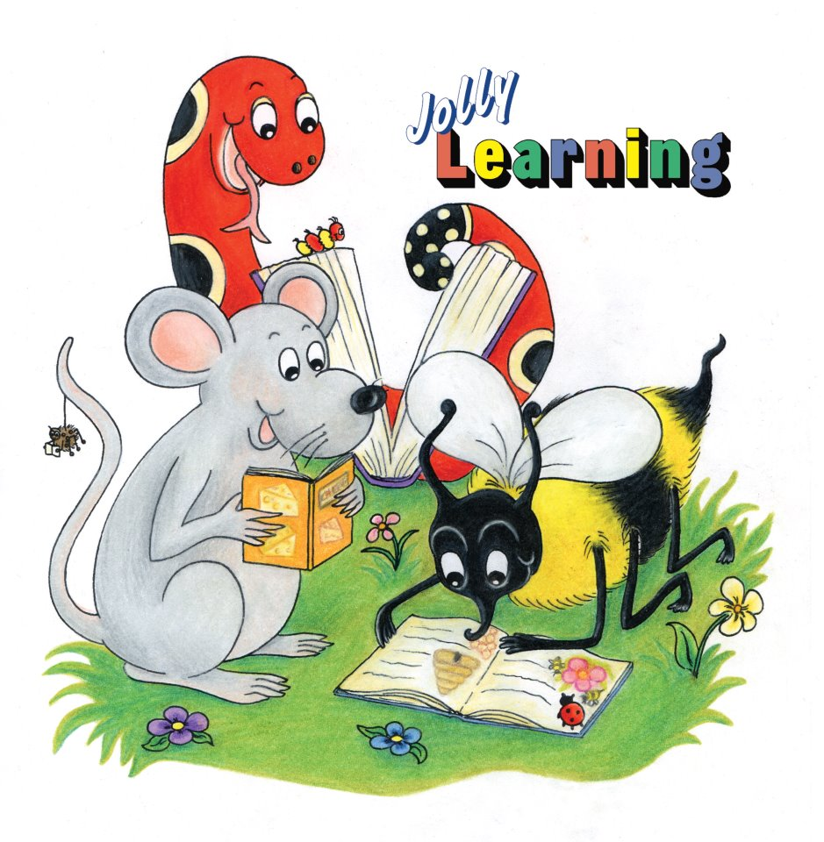
See you
next time!

